Slide 1
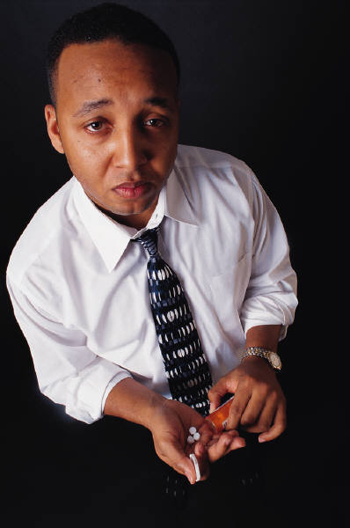
Placebos and Stereotypes:
The amazing power of expectations
Notes:
Perhaps this presentation could be paired with the one on anchoring, as both phenomena represent the influence of seemingly irrelevant factors. Perhaps there is an intersection with peer effects too.
What does the subject matter of this presentation have to do with economics? How can people protect themselves from the weaknesses discussed here? How can or should rational actors and policy makers make use of the ideas discussed here?

Slide 2
Reading
Predictably Irrational by Dan Ariely
  Chapter 9: The Effect of Expectations
  Chapter 10: The Power of Price

Slide 3
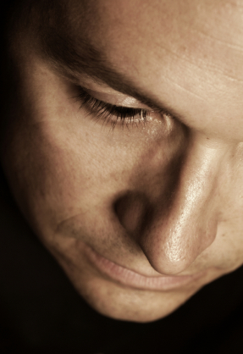
How powerful are our expectations?
“there is nothing either good or bad, but thinking makes it so;”
William Shakespeare
Hamlet, Act II, scene ii
(1600)
“Whatever the mind of man can conceive and believe, it can achieve.”
Napolean Hill
Think and Grow Rich (1937)
“A man is but the product of
his thoughts. What he thinks, he becomes.” Mahatma Gandhi

Slide 4
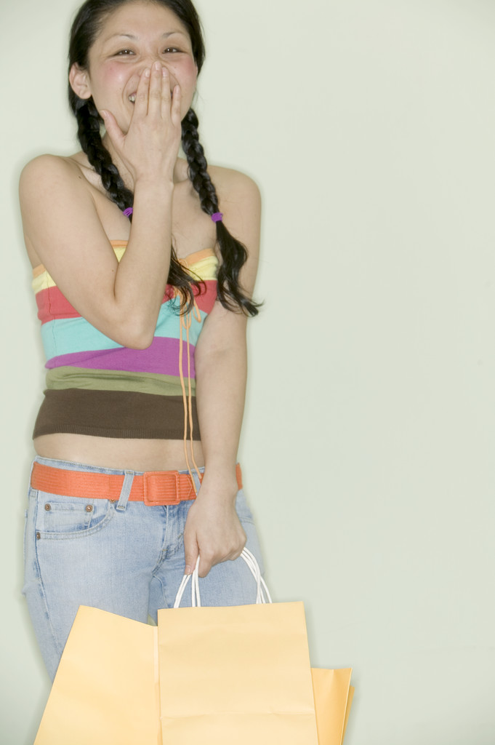
Placebo effect: The joke
Sometimes we think of a placebo effect as something shallow, something that only works for stupid people, or something that is a joke.
Pen and Teller’s placebo examples
http://www.youtube.com/watch?v=MzjoKhBklYg

Slide 5
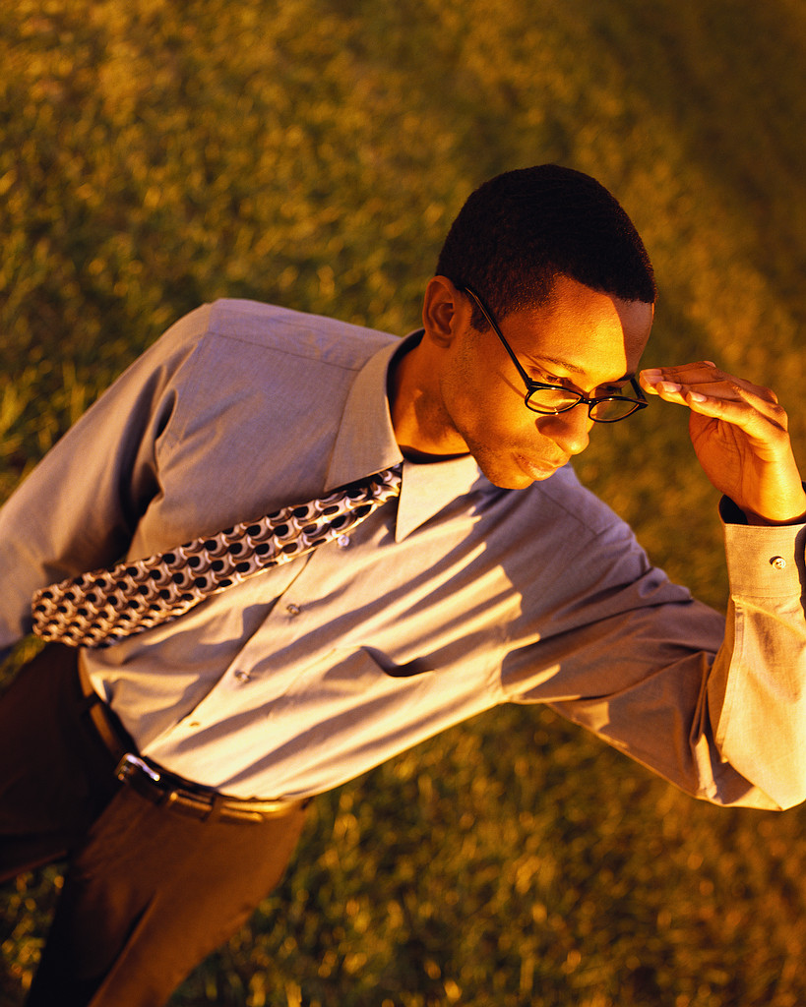
Placebo effect:
The reality
But, our tendency to dismiss the placebo effect may simply reflect our underestimation of the power of expectation to actually change outcomes.
Let’s consider some examples…

Slide 6
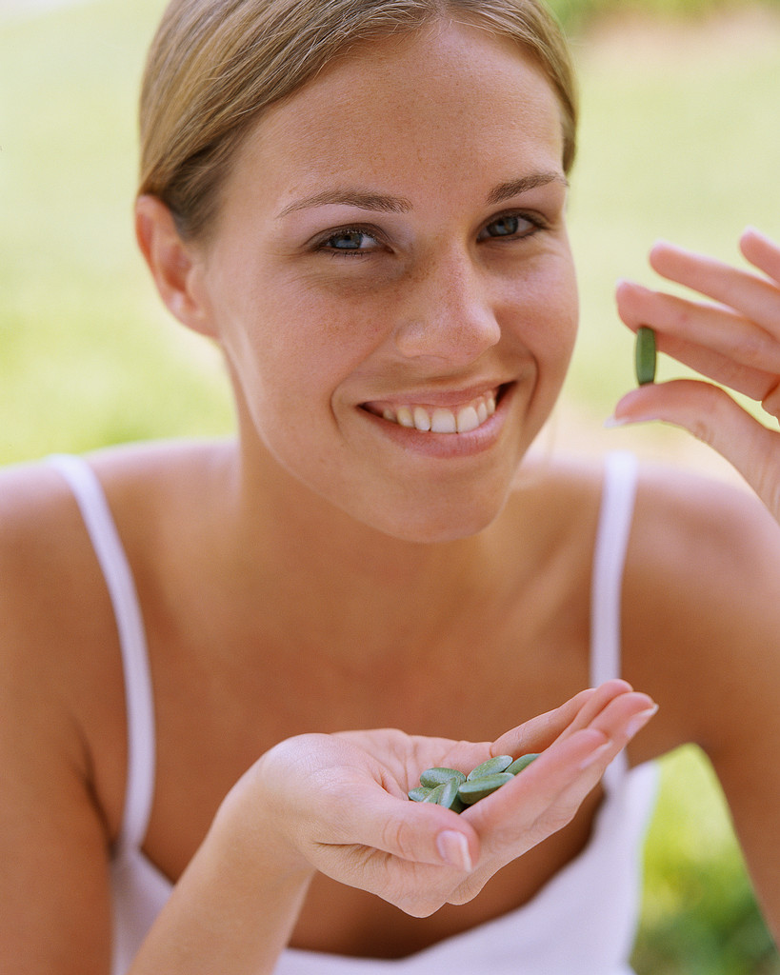
Does price have a placebo effect?
Volunteers received small electrical shocks and recorded pain levels. They were then given a fake pain reliever. Some were told it cost $1.50 per pill, others $0.10 per pill. The shocks were then repeated and pain levels recorded.
Did the expensive pill “work” better?
Waber, R. (MIT), 2006, The role of branding and pricing on health outcomes via the placebo response, Master of Science Thesis – Massachusetts Institute of Technology, Figure on page 25.

Slide 7
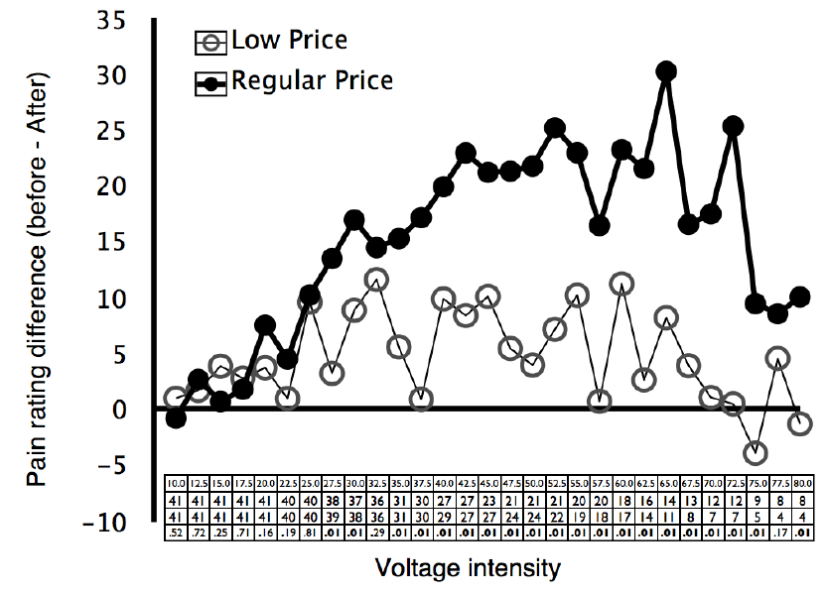
Does price have a placebo effect for pain?
Notes:
“The Role of Branding and Pricing on Health Outcomes via the Placebo Response” by Rebecca L. Waber, Masters Thesis, MIT, June 2008. Figure 2: Mean difference in pain ratings, after vs. before placebo, by voltage intensity. The table depicts the intensity of the shocks (top row), the number of observations in the high price (2nd row) and low price (3rd row) conditions, and the significance level of each difference (bottom row).

Slide 8
Does place have a placebo effect?
In addition to price differences, some participants were told that the pain reliever was from a Chinese drug company, while others were told it was from a U.S. drug company.
Did this have an effect?
Waber, R. (MIT), 2006, The role of branding and pricing on health outcomes via the placebo response, Master of Science Thesis – Massachusetts Institute of Technology, p. 26.

Slide 9
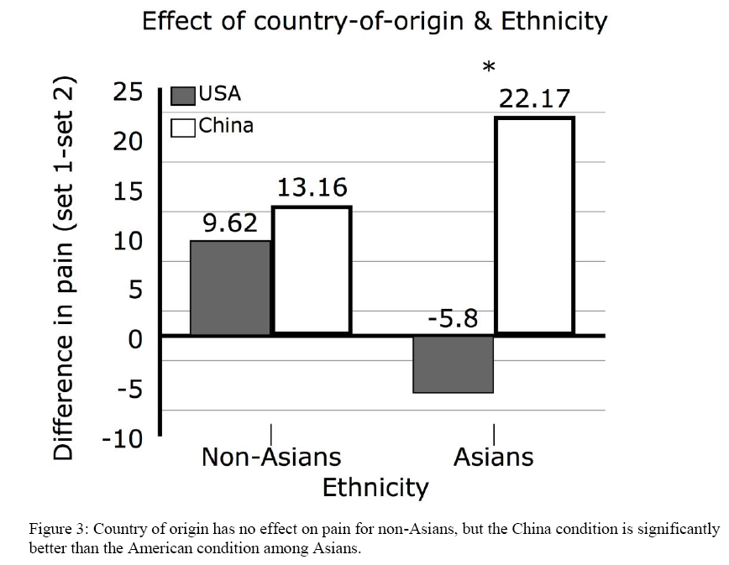
Does place have a placebo effect?
Notes:
“The Role of Branding and Pricing on Health Outcomes via the Placebo Response” by Rebecca L. Waber, Masters Thesis, MIT, June 2008. “The average mean difference score for Asians in the United States condition was -5.8, indicating that their pain ratings were actually higher in the second round after receiving the placebo, whereas in the China condition the average mean difference score was 22.17. … Among Non-Asians, however, there was no difference for the country factor.” The author had hypothesized that the subjects would report greater pain reduction from the “American” placebo. That turned out not to be the case: there was no significant overall difference between the “American” and “Chinese” drugs. However, Asian-American subjects reported greater – and statistically significant -- pain reduction from the “Chinese” drug.

Slide 10
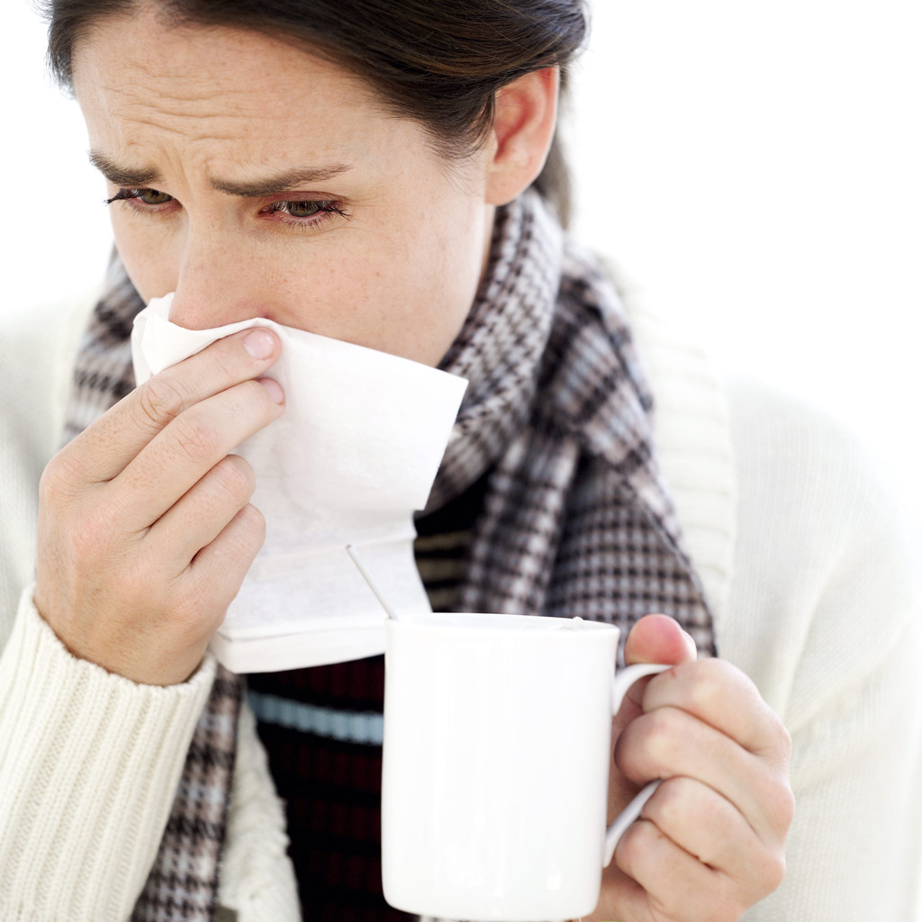
Price and placebo effect in cold medicines
http://www.youtube.com/watch?v=nm5GB7Wu26Q

Slide 11
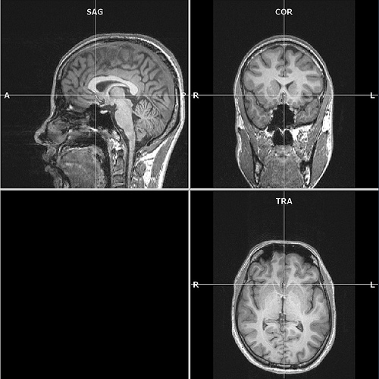
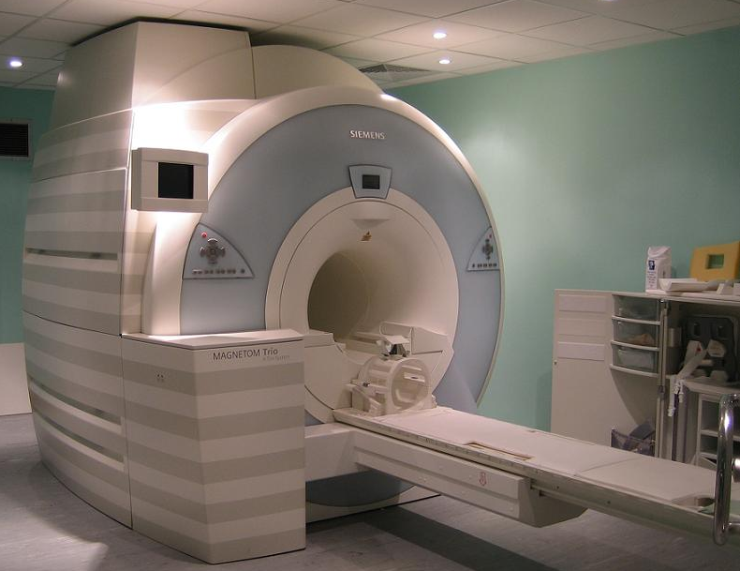
Is the lower self-report of pain real, or is it simply people saying what they think they are supposed to say?
Study gave fake pain medicine to subjects receiving a shock while in an fMRI machine showing brain activation.
Notes:
http://www.flickr.com/photos/11304375@N07/3081315619/
http://www.flickr.com/photos/mohapj/3503554759/

Slide 12
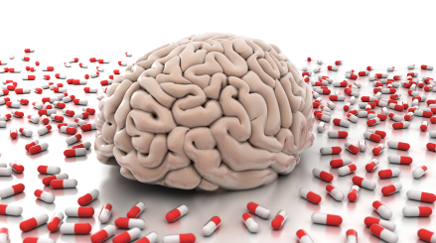
“We found that the magnitude of the reduction between control and placebo trials in reported pain… correlated with the magnitude of reduction in neural activity during the shock period in pain-responsive portions of several brain structures.”
T. Wager (Michigan), et al (Princeton, Harvard, Wisconsin, Michigan, Texas), 2004, Placebo-induced changes in fMRI in the anticipation and experience of pain. Science, 303, p. 1163.

Slide 13
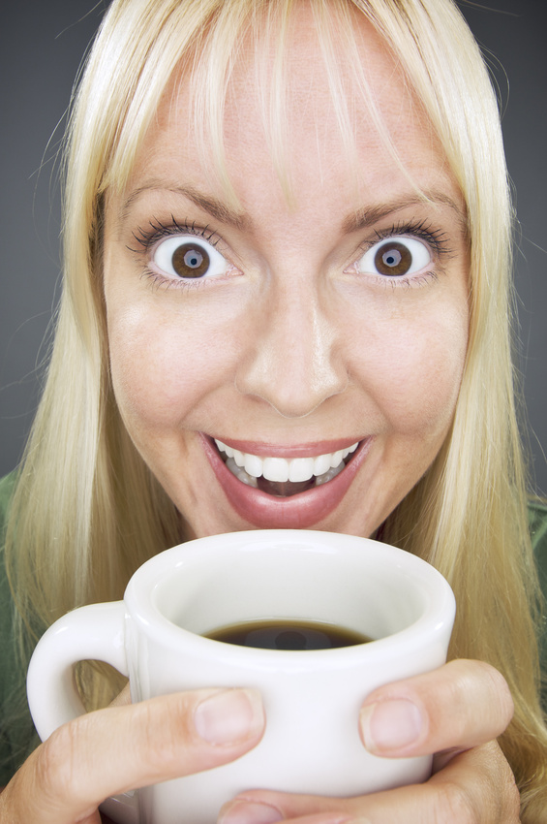
Can expectations also increase positive feelings?
We have seen how expectations – by themselves – can change pain experiences.
Can they do the same thing for pleasurable experiences of consuming goods?

Slide 14
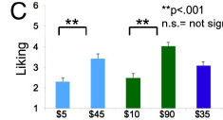

Does higher price actually make things taste better?
Experiment: In random order, tasted wine 1 ($5 or $45), wine 2 ($10 or $90) or wine 3 ($35).
H. Plassmann (Cal. Tech), J. O’Doherty (Cal. Tech), B. Shiv (Stanford), & A. Rangel (Cal. Tech), 2008, Marketing actions can modulate neural representations of experienced pleasantness. Proceedings of the National Academy of Sciences, 105, 1050-1054.

Slide 15
Is the experience really different or are they just saying it is?
This study was conducted while participants were in an fMRI machine revealing activation of different brain areas.
The medial orbitofrontal cortex (mOFC), is an area of the brain that registers actual experienced pleasantness.
Did the activity in the mOFC actually differ?
H. Plassmann (Cal. Tech), J. O’Doherty (Cal. Tech), B. Shiv (Stanford), & A. Rangel (Cal. Tech), 2008, Marketing actions can modulate neural representations of experienced pleasantness. Proceedings of the National Academy of Sciences, 105, 1050-1054.

Slide 16
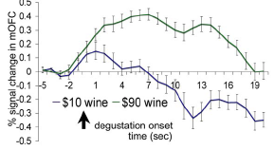
Fundamentally different neurological experience
Degustation = when tasting begins
H. Plassmann (Cal. Tech), J. O’Doherty (Cal. Tech), B. Shiv (Stanford), & A. Rangel (Cal. Tech), 2008, Marketing actions can modulate neural representations of experienced pleasantness. Proceedings of the National Academy of Sciences, 105, 1050-1054.

Slide 17
The Placebo Effect is “Real”
“Our results show that increasing the price of a wine increases subjective reports of flavor pleasantness as well as the neural computations of experienced utility that are made in brain areas such as the medial orbitofrontal cortex (mOFC).”
“Marketing Actions Can Modulate Neural Representations of Experienced
Utility” By Hilke Plassmann, John O'Doherty, Baba Shiv, and Antonio Rangel,. Proceedings of the National Academy of Sciences of the United States of America, January 22, 2008
vol. 105 no. 3 .

Slide 18
Expectations drive outcomes
While the neurological evidence is new, the reality that higher prices and expectations produce higher product experiences is nothing new.
Separate Groups Rating Identical Audio Recorders | $525 price | $110 price
Actual Performance | Average Rating | Average Rating
High | 5.5 | 4.5
Low | 3.7 | 3.1
R. Olshavsky (Indiana) & J. Miller (Drake), 1972, Consumer expectations, product performance and perceived product quality, Journal of Marketing Research, 9(1), 19-21.

Slide 19
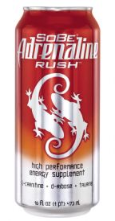
Can expectations make you smarter?
Students given SoBe Adrenaline Rush and then asked to complete word puzzle problems.
Price: Some students charged $1.89 for the drink. Others, told the regular price was $1.89 but that they would be charged $.89 because of an institutional discount.
Expectancy: Some provided information that consuming drinks like SoBe can “significantly improve” mental functioning, others that is can “slightly improve”
B. Shiv (Stanford), Z. Carmon (INSEAD), D. Ariely (MIT), 2005, Placebo effects of marketing actions: Consumers may get what they pay for. Journal of Marketing Research, 42, 383-393.

Slide 20
Can expectations make you smarter?
What do you think?
Did the number of correctly completed work puzzles increase with
Higher price only
Higher expectancy (“significantly improve” v. “slightly improve”) only
Both higher price and higher expectancy
Neither higher price nor higher expectancy

Slide 21
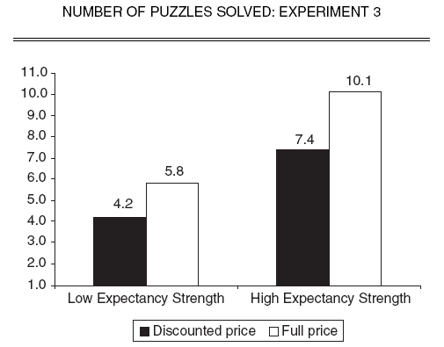
Can expectations make you smarter?
“Slightly improve”
“Significantly improve”
B. Shiv (Stanford), Z. Carmon (INSEAD), D. Ariely (MIT), 2005, Placebo effects of marketing actions: Consumers may get what they pay for. Journal of Marketing Research, 42, 383-393.

Slide 22
Why do we believe baseless ideas?
“On the one hand, there is vast empirical evidence that consumers often perceive lower-priced products and services to be of lower quality, especially if they have no simple alternative way to assess quality.”
“On the other hand, … investigations of the relationship between price and objective indications of quality, such as Consumer Reports ratings, arrive at a different conclusion.”
B. Shiv (Stanford), Z. Carmon (INSEAD), D. Ariely (MIT), 2005, Placebo effects of marketing actions: Consumers may get what they pay for. Journal of Marketing Research, 42, 383-393.

Slide 23
Why do we believe baseless ideas?
“An explanation that is implied by our research for this discrepancy may be a self-fulfilling nature of consumer expectations. Such expectations may lead lower-priced products to perform worse, regardless of whether their objective indications of quality (research of the type that Consumer Reports examines) are actually worse.”
B. Shiv (Stanford), Z. Carmon (INSEAD), D. Ariely (MIT), 2005, Placebo effects of marketing actions: Consumers may get what they pay for. Journal of Marketing Research, 42, 383-393.

Slide 24
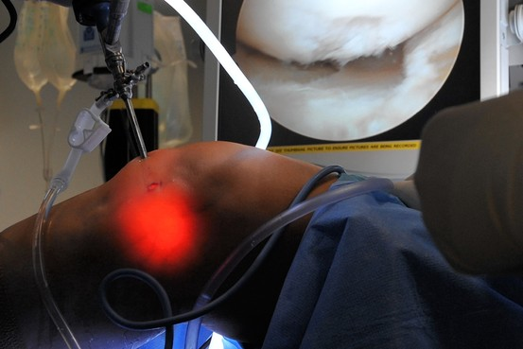
Knee Surgery
Patients led to believe they had knee surgery saw results comparable to those who had the procedure, a study by Finnish researchers found.
Here, an arthroscopic surgery, during which two incisions are made: one for a small camera and the other for the surgical tool.

Slide 25
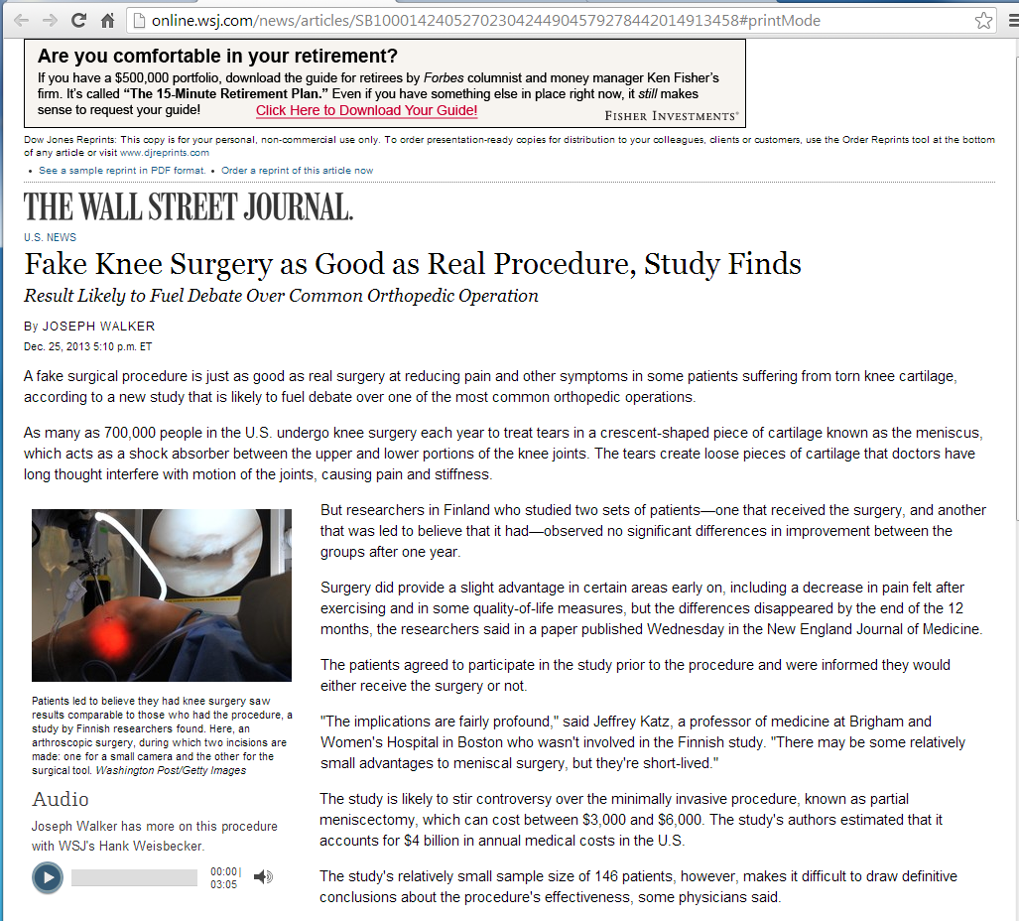

Slide 26
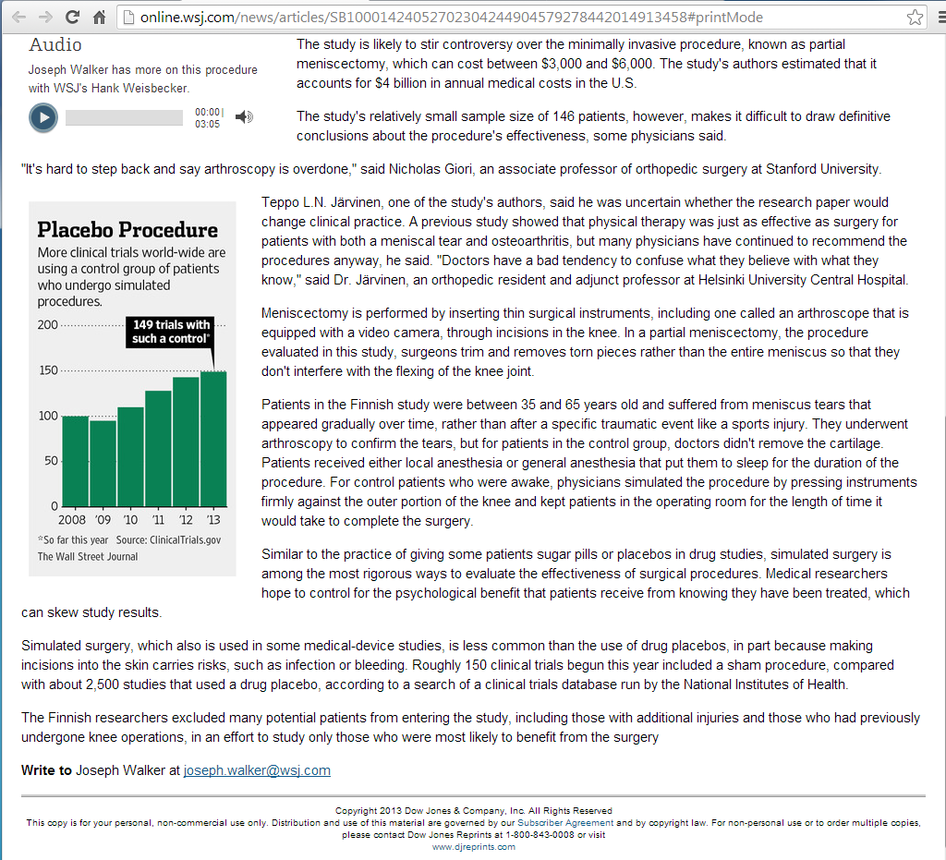

Slide 27
Expectations affect happiness
Would beer taste better with balsamic vinegar in it?
http://www.youtube.com/watch?v=8MS-LvS0aNw

Slide 28
Optimism
Optimism—in moderation—is associated with financially responsible behavior
http://www.youtube.com/watch?v=3qOvmQ4OURg
http://www.youtube.com/watch?v=PY5dclbaeNU

Slide 29
Stereotypes can affect how the stereotyped see themselves

Slide 30

Can stereotype-based expectations affect academic performance?
Female Asian-American college students were given a questionnaire followed by a math test.
Group 1 had a gender-related questionnaire.
  ex: 3 reasons why you might prefer a single-sex dorm
Group 2 had an ethnicity related questionnaire.
  ex: did parents/grandparents speak languages other than English
Group 3 had a neutral questionnaire.
Notes:
In the female-identity-salient condition, participants (n = 14) were asked (a) whether they lived on or off campus, (b) whether they had a roommate, (c) whether their floors were coed or single sex, (d) whether they preferred coed or single-sex floors, (e) to list three reasons why they would prefer a coed floor, and (f) to list three reasons why they would prefer a single-sex floor. In the Asian identity-salient condition, participants (n = 16) were asked (a) whether their parents or grandparents spoke any languages other than English, (b) what languages they knew, (c) what languages they spoke at home, (d) what opportunities they had to speak other languages on campus, (e) what percentage of these opportunities were found in their residence halls, and (f) how many generations of their family had lived in America. In the control condition, participants (n = 16) were asked (a) whether they lived on or off campus, (b) whether they used the university telephone service, (c) to rate on a 7-point scale how satisfied they were with the service, (d) whether they would consider subscribing to cable television, (e) how much they would be willing to pay per month for cable television, and (f) to list one or two reasons why they would or would not subscribe to cable television.

Slide 31
Can stereotype-based expectations affect academic performance?
Did drawing attention issues of race or gender affect subsequent math scores?
No effect for either
Both gender focus and race focus lowered scores
Both gender focus and race focus raised scores
Gender focus raised scores; Race focus lowered scores
Gender focus lowered scores; Race focus raised scores
Notes:
In the female-identity-salient condition, participants
(n = 14) were asked (a) whether they lived on or off campus, (b)
whether they had a roommate, (c) whether their floors were coed or
single sex, (d) whether they preferred coed or single-sex floors, (e)
to list three reasons why they would prefer a coed floor, and (f) to list
three reasons why they would prefer a single-sex floor. In the Asianidentity-
salient condition, participants (n = 16) were asked (a)
whether their parents or grandparents spoke any languages other
than English, (b) what languages they knew, (c) what languages they
spoke at home, (d) what opportunities they had to speak other languages
on campus, (e) what percentage of these opportunities were
found in their residence halls, and (f) how many generations of their
family had lived in America. In the control condition, participants (n
= 16) were asked (a) whether they lived on or off campus, (b)
whether they used the university telephone service, (c) to rate on a 7-
point scale how satisfied they were with the service, (d) whether they
would consider subscribing to cable television, (e) how much they
would be willing to pay per month for cable television, and (f) to list
one or two reasons why they would or would not subscribe to cable
television.

Slide 32
Stereotype expectations and performance
M. Shih (Harvard), T. Pittinsky (Harvard), & N. Ambady (Harvard), 1999, Stereotype susceptibility: Identity salience and shifts in quantitative performance. Psychological Science, 10(1), 80-83.

Slide 33
Stereotype Effect
How others assess people like me affects what I expect of myself (and of people like me)
And what I expect of myself affects how I perform
How I perform affects how others assess people like me
We’re back to square one! The cycle continues on and on and on
But, the effect could be positive or negative

Slide 34
Stereotype expectations and performance
A few years later, the same study was repeated, but this time using a verbal test instead of a math test [reversed stereotypes].
Results?

Slide 35
Stereotype expectations and performance
M. Shih (Harvard), T. Pittinsky (Harvard), & N. Ambady (Harvard), 1999, Stereotype susceptibility: Identity salience and shifts in quantitative performance. Psychological Science, 10(1), 80-83.

Slide 36

Gender expectations in math tests
Study: Two groups given same math test. Group B told that the test wasn’t related to intellectual abilities, but just helped for studying psychological processes.
Does telling the participants that the test isn’t related to intellectual ability change the impact of gender expectations?

Slide 37
Gender expectations in math tests
 | % Correct on math test | % Correct on math test when told questions were unrelated to intellectual ability
Men | 26% | 25%
Women | 12% | 25%
P. Davies (Stanford), S. Spencer (U. Waterloo), D. Quinn (U. Conn), R. Gerhardstein (Florida State), 2002, Consuming images: How television commercials that elicit stereotype threat can restrain women academically and professionally. Personality and Social Psychology Bulletin, 28(12), 615-628.

Slide 38


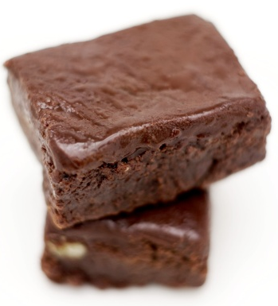

College students from a calculus II class exposed to TV commercials (4 neutral, 2 stereotypical or counter-stereotypical) then given a math test.
Stereotypical
a young woman who was so excited about a new acne product that she bounced on her bed with joy
a woman “drooling” with anticipation to try a new brownie mix
Counter-Stereotypical
a woman speaking intelligently about health care concerns
an attractive woman impressing a man with her knowledge of automotive engineering

Slide 39
Can television commercials change math performance?
 | % Correct on math test after counter-stereotypical commercials | % Correct on math after stereotypical commercials
Men | 34% | 39%
Women | 31% | 19%
P. Davies (Stanford), S. Spencer (U. Waterloo), D. Quinn (U. Conn), R. Gerhardstein (Florida State), 2002, Consuming images: How television commercials that elicit stereotype threat can restrain women academically and professionally. Personality and Social Psychology Bulletin, 28(12), 615-628.

Slide 40
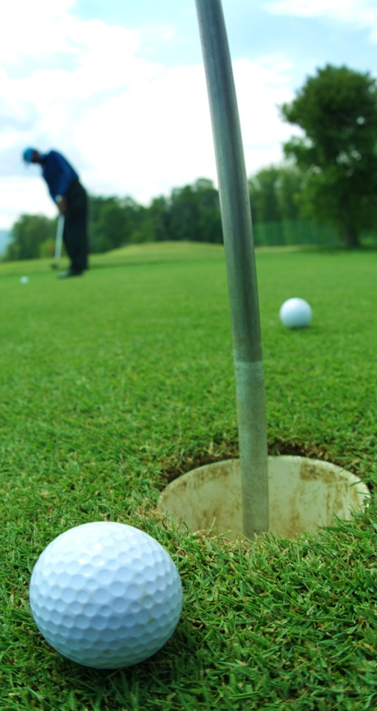
Race Stereotypes
An identical golf challenge for 3 groups of black and white men.
Athletic ability group: Test described as a measuring of factors correlated with one’s natural ability to perform tasks “such as shooting, throwing, or hitting a ball”
Strategic sports intelligence group: Test described as a measure of factors correlated with “ability to think strategically during athletic performance”
Race prime group: Started with question of racial identity.
Control group: No description

Slide 41
 | Strokes in identical golf challenge (smaller is better)
 | Athletic ability | Strategic sports intelligence | Race questions | Control
Black | 23.10 | 27.20 | 27.30 | 22.10
White | 27.80 | 23.30 | 22.90 | 24.60
Note: This test was before Tiger Woods’ dominance in golf
J. Stone (U. Arizona), C. Lynch (Princeton), M. Sjomeling (U. Arizona), & J. Darley (Princeton), 1999, Stereotype threat effects on black and white athletic performance. Journal of Personality and Social Psychology, 77(6), 1213-1227.
Notes:
Note: This test would have been conducted before Tiger Woods dominance in golf

Slide 42

Can expectations make you live longer?
Comparing people of similar age, gender, socioeconomic status, loneliness, and functional health, those with more positive self-perceptions of aging went on to live about 7.5 years longer.
B. Levy (Yale), M. Slade (Yale), S. Kunkel (Miami U.), S. Kasl (Yale), 2002, Longevity increased by positive self-perceptions of aging. Journal of personality and social psychology, 83(2), 261-270

Slide 43
How powerful are our expectations?
“; for there is nothing either good or bad, but thinking makes it so;”
William Shakespeare
Hamlet, Act II, scene ii
(1600)
“Whatever the mind of man can conceive and believe, it can achieve.”
Napolean Hill
Think and Grow Rich (1937)
“A man is but the product of
his thoughts. What he thinks, he becomes.” Mahatma Gandhi

Slide 44

Powerful forces push our actual experiences to match our expected experiences in pain, pleasure, academics, sports, even life span
If you change your expectations, what can you change about your future?
Notes:
Very good discussion of the placebo effect. What are its wider implications?

Slide 45
Is there a way out?
If we suffer from the price placebo effect, we will instinctively devalue anything we buy at a discount
But we can avoid this by simply pausing to ask ourselves, Can price really determine quality?
“[I]n a series of experiments, [we] found that consumers who stop to reflect between the relationship between price and quality are far less likely to assume that a discounted drink is less effective (and, consequently, they don’t perform as poorly on word puzzles as they would if they did assume it).”
  Dan Ariely, Predictably Irrational, chapter 10.

Slide 46
Is the placebo effect necessarily bad for us?
Q: If something actually makes your life better, why should you care whether it works through the placebo effect?
A: The placebo is actually irrelevant and it costs money. We should be able to get the desired effect without the placebo. That way, we would get the job done and save some cash

Slide 47
Placebos in health care
Doctors prescribe placebos all the time
  Even when doctors know that a patient’s sore throat is a viral ailment they prescribe antibiotics
  They know that antibiotics are useless against a viral ailment. But they also know that viral sore throat has no other treatment and patients need to be sent home with some degree of relief
The problem is that this raises health care costs

Slide 48
Placebos in health care
The price placebo effect can lead patients to seek expensive brand name medicines rather than equally effective generics
This could raise health care costs too, unless doctors and health insurance companies say no to such patient demands

Slide 49
Placebos in marketing
Placebos work
So, can we blame marketing professionals who hype a product?
  After all, it will enhance the consumer’s experience if the right irrelevant or even false information is given
However you cut it, a lie is a lie is a lie, no matter what placebo effect it may have

Slide 50

Tailpiece
This ‘Placebo’ Could Be The Drug For You
  All Things Considered, NPR, December 23, 2010
  a faux commercial for “Placebo” — a drug that does nothing and makes no claims at all
Even Knowingly Taking A Placebo Seems To Help
  by Richard Knox, Morning Edition, NPR, December 23, 2010

