Slide 1
Altruism and Fairness
Non-Standard Preferences
Behavioral Economics
Udayan Roy

Slide 2
Social preferences

Slide 3
Choices Involving Strategy
Some of game theory’s apparent failures may be attributable to faulty assumptions about people’s preferences
and not be due to fundamental problems with the theory itself
Many applications of game theory assume that people are motivated only by self-interest
But players sometimes make decisions that seem contrary to their own interests

Slide 4
Pure self-interest
A large number of laboratory experiments calls into question the assumption of pure self-interest.
Voluntary contribution games
Dictator games
Gift-exchange games

Slide 5
Voluntary Contribution Games
In a voluntary contribution game:
Each member of a group makes a contribution to a common pool
As the common pool is shared equally, each player’s contribution benefits everyone
This creates a conflict between individual interests and collective interests
Game theory predicts zero or minimal contributions

Slide 6
Voluntary Contribution Games
The zero or minimal contributions predicted by game theory matches the behavior of experienced players reasonably well
But for the two-stage voluntary contribution game, predictions based on standard game theory are far off: people do contribute significant amounts
This suggests that standard assumptions about players’ preferences may be incorrect

Slide 7
Importance of Social Motives: The Dictator Game
In the dictator game:
The ‘dictator’ divides a fixed prize between himself and the ‘recipient’
The recipient has a passive role
Usually there’s no direct contact or communication between players during the game
A self-interested dictator would take everything

Slide 8
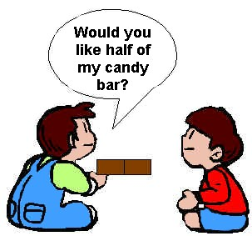
Importance of Social Motives: The Dictator Game
However, most studies find significant generosity.
A sizable fraction of subjects divides the prize equally
This illustrates the importance of social motives: altruism, fairness, status

Slide 9
Dictator Game
In this experiment, a subject (the dictator) has an endowment of $10 and chooses how much of the $10 to transfer to an anonymous partner.
While the standard theory of self-interested consumers predicts that the dictator would keep the whole endowment, Forsythe et al. (1994) find that sixty percent of subjects transfer a positive amount.
Notes:
Forsythe, Robert, Joel L. Horowitz, N. E. Savin, and Martin Sefton. 1994. “Fairness in Simple Bargaining Experiments.” Games and Economic Behavior, 6(3): 347–69.

Slide 10
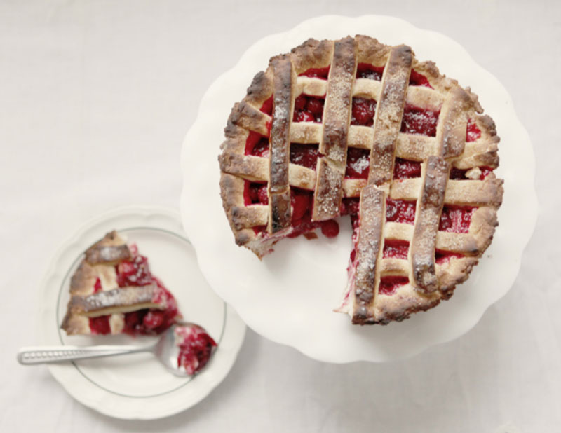
Importance of Social Motives: The Ultimatum Game
In the ultimatum game:
The ‘divider’ offers to give the ‘responder’ some share of a fixed prize
The responder then decides whether to accept or reject the proposal
If she accepts, the pie is divided as specified; if she rejects, both players receive nothing
Theory says the divider will offer a tiny fraction of the prize, and the responder will accept
Notes:
Bernheim and Whinston have an application on “admitting new states to the Union”.

Slide 11
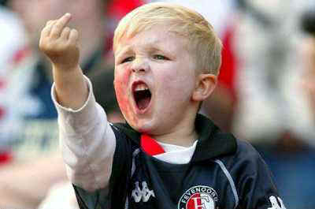
Importance of Social Motives: The Ultimatum Game
Studies show that many subjects reject very low offers; the threat of rejection produces larger offers
This suggests that, in social situations, emotions such as anger and indignation influence economic decisions

Slide 12
Importance of Social Motives: The Ultimatum Game
Most researchers find that offers that give the responder less than 30 percent of the prize are rejected more than 50 percent of the time
As a result, the average division tends to be 45 percent to the responder and 55 percent to the divider, with about 16 percent of the offers being rejected

Slide 13
Importance of Social Motives: The Ultimatum Game
Researchers have found that gender matters:
Men tend to receive more favorable divisions, when the divisions are made by women
Culture matters too:
Some cultures value fairness more than others
The offers made by the divider don’t vary, but the minimum acceptable offer does
When responders are asked to state their minimum acceptable offer first, the division tends to be more equal

Slide 14
Fairness: Punishment Game
The ultimatum game experiments show that we will not tolerate unfairness
The punishment game is the same as the ultimatum game except that there is a third party who observes the outcome and can reduce the divider’s gains, at some cost to himself
Experiments have shown that about 60 percent of these third party observers will punish the divider for unfair offers even though it costs them money to do so!
Notes:
I need to draw better distinctions between the terms such as fairness, reciprocity, altruism, ethics, etc.

Slide 15
The Fairness Instinct
Capuchin Monkeys, Anger, Brain Games, National Geographic YouTube Channel, September 10, 2014, 4:25 – 6:35
Humans, Compassion, Brain Games, National Geographic, YouTube, August 10, 2014, 2:20 --

Slide 16
Importance of Social Motives: The Trust Game
In the trust game:
The trustor decides how much money to invest
The trustee divides up the principal and earnings
If players have no motives other than monetary gain, theory says that
trustees will be untrustworthy and
trustors will forgo potentially profitable investments

Slide 17
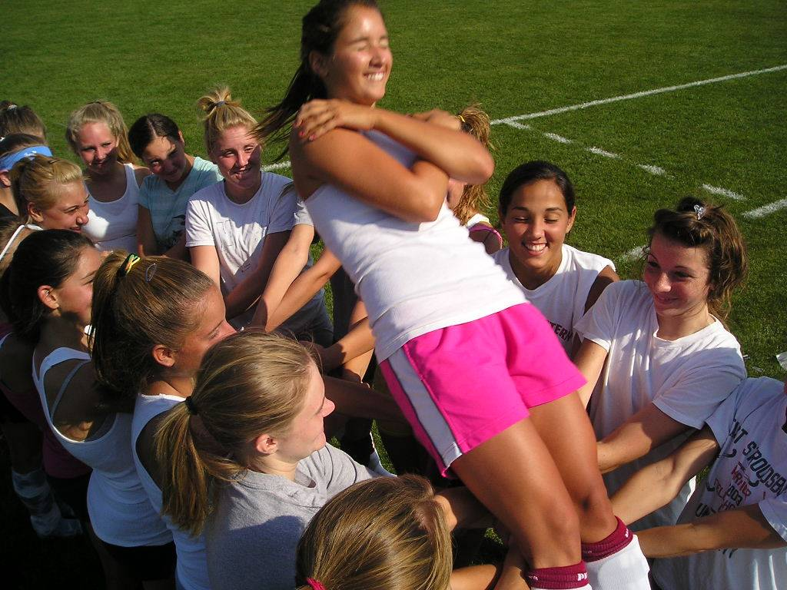
Importance of Social Motives: The Trust Game
Studies show that
Trustors invested about half of their funds
Trustees varied widely in their choices
Overall, trustors received about $0.95 in return for every dollar invested

Slide 18
Importance of Social Motives: The Trust Game
Many (but not all) people do feel obligated to justify the trust shown in them by others, thus many are willing to extend trust
This game helps us understand why business conducted on handshakes and verbal agreements works

Slide 19
Trust: Golden Balls
This is a game show on British TV.
There are two players and a given amount of money.
Each player has to pick “Split” or “Steal”.
If both pick “Split” they share the money equally.
If both pick “Steal” they get nothing.
If one picks “Split” and the other picks “Steal”, all the money goes to the one who chose “Steal.”
http://youtu.be/p3Uos2fzIJ0
http://youtu.be/S0qjK3TWZE8

Slide 20
Gift Exchange Games
This experiment is designed to mirror a labor market.
It tests efficiency wages models according to which the workers reciprocate a generous wage by working harder.
The first subject (the firm) decides a wage.
After observing the firm’s chosen wage, the second subject (the worker) responds by choosing an effort level.
The standard theory predicts that the worker, no matter what the firm chooses, exerts the minimal effort and that, in response, the firm offers the lowest wage that satisfies the participation constraint for the workers.
Notes:
Fehr, Ernst, Georg Kirchsteiger, and Arno Riedl. 1993. “Does Fairness Prevent Market Clearing? An Experimental Investigation.” Quarterly Journal of Economics, 108(2): 437–59.

Slide 21
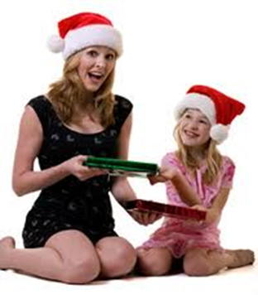
Gift Exchange Games
The standard theory predicts that the worker, no matter what the firm chooses, exerts the minimal effort and that, in response, the firm offers the lowest wage that satisfies the participation constraint for the workers.
Fehr, Kirchsteiger, and Riedl (1993) instead find that the workers respond to a higher wage by providing a higher effort.
The firms, anticipating this, offer a wage above the market-clearing wage (just enough to hire the required number of workers).
Notes:
Fehr, Ernst, Georg Kirchsteiger, and Arno Riedl. 1993. “Does Fairness Prevent Market Clearing? An Experimental Investigation.” Quarterly Journal of Economics, 108(2): 437–59.

Slide 22
Explaining the laboratory findings
Several models have been proposed to explain the behavior seen in these experiments.
In one class of models, people care about the inequality of outcome but not about the intentions of the players.
Another class of models, based on psychological games, instead assumes that people care about the intentions that lead to specific outcomes.
A common concept is reciprocity—subjects are nice to subjects that are helpful to them but not to subjects that take advantage of them.
These models also explain the laboratory findings.

Slide 23
Charitable Giving
The size of charitable giving is suggestive of social preferences in the field.
In the United States, 240.9 billion dollars were donated to charities in 2002, representing an approximate 2 percent share of GDP.
Donations of time in the form of volunteer work were also substantial: 44 percent of respondents to a survey reported giving time to a charitable organization in the prior year, with volunteers averaging about fifteen hours per month.
Altogether, a substantial share of GDP reflects a concern for others, a finding qualitatively consistent with the experimental findings.
Notes:
Andreoni, James. 2006. “Philanthropy.” In Handbook of Giving, Altruism, and Reciprocity, Volume 2, ed. Serge-Christophe Kolm, and Jean Mercier Ythier, 1201–65. Amsterdam; London and New York: Elsevier, North Holland.

Slide 24
Charitable Giving
However, while social preferences are a leading interpretation for giving, charitable donations may also be motivated by other factors, such as
desire for status and
social pressure by the fund-raisers.

Slide 25
Charitable Giving
Potential donors will seek fund-raisers if giving is due to altruism, but will avoid them if giving is due to social pressure.
DellaVigna, List, and Malmendier (2009) test this prediction comparing a standard door-to-door fund-raising campaign (the control group) to a fund-raising campaign where, the day before the fund-raising visits, a flyer on the doorknob notifies the households of the time of the upcoming visit.
Notes:
DellaVigna, Stefano, John A. List, and Ulrike Malmendier. 2010. “Testing for Altruism and Social Pressure in Charitable Giving.” Unpublished.

Slide 26
Charitable Giving
The share of the treatment-group households that opened their doors to the fundraisers was 10 to 25 percent lower (compared to the control group).
This is consistent with the idea that some charity is the result of social pressure from fundraisers.
Notes:
DellaVigna, Stefano, John A. List, and Ulrike Malmendier. 2010. “Testing for Altruism and Social Pressure in Charitable Giving.” Unpublished.

Slide 27
Charitable Giving
The authors then consider the effect on giving.
There is no effect of a simple flyer on the unconditional share of households that give, but a flyer with a “Do Not Disturb” box lowers the share of households giving by 25 percent.
The decrease is entirely due to small donations (up to $10), the ones most likely to be due to social pressure.
The share of larger donations (higher than $10) is unaffected by either flyer.
The results imply a clear role of social pressure in door-to-door charitable giving, but also provides indirect evidence of altruism for a subset of donors.

Slide 28
Perceived unfairness and sabotage
Workplace relations between employees and employer can be upset at the time of contract renewal, and workers may respond by sabotaging production.
Alan B. Krueger and Mas (2004) examine the impact of a three-year period of labor unrest at a unionized Bridgestone–Firestone plant on the quality of the tires produced at the plant.
The workers went on strike in July 1994 and were replaced by replacement workers.
The union workers were gradually reintegrated in the plant in May 1995 after the union, running out of funds, accepted the demands of the company.
An agreement was not reached until December 1996.
Notes:
Krueger, Alan B., and Alexandre Mas. 2004. “Strikes, Scabs, and Tread Separations: Labor Strife and the Production of Defective Bridgestone/Firestone Tires.” Journal of Political Economy, 112(2): 253–89.

Slide 29
Perceived unfairness and sabotage
Krueger and Mas (2004) finds that the tires produced in this plant in the 1994–96 years were ten times more likely to be defective.
The increase in defects does not appear due to lower quality of the replacement workers.
The number of defects is higher in the months preceding the strike (early 1994) and in the period in which the union workers and the replacement workers work side-by-side (end of 1995 and 1996).
This provides some evidence that negative reciprocity in response to what workers perceive as unfair treatment can have a large impact on worker productivity.

Slide 30
Social preferences in the workplace among employees
Oriana Bandiera, Iwan Barankay, and Imran Rasul (2005) use personnel data from a fruit farm in the United Kingdom and measure changes in productivity in response to changes in the compensation scheme.
Notes:
Bandiera, Oriana, Iwan Barankay, and Imran Rasul. 2005. “Social Preferences and the Response to Incentives: Evidence from Personnel Data.” Quarterly Journal of Economics, 120(3): 917–62.

Slide 31
Social preferences in the workplace among employees
In the first eight weeks of the 2002 picking season, the fruit pickers were compensated on a relative performance scheme in which the per-fruit piece rate is decreasing in the average productivity.
In this system, workers that care about others have an incentive to keep the productivity low.
In the next eight weeks, the compensation scheme switched to a flat piece rate per fruit.
Notes:
Bandiera, Oriana, Iwan Barankay, and Imran Rasul. 2005. “Social Preferences and the Response to Incentives: Evidence from Personnel Data.” Quarterly Journal of Economics, 120(3): 917–62.

Slide 32
Social preferences in the workplace among employees
After the change to piece rate, the productivity of each worker increased by 51.5 percent
the estimate is higher for workers with a larger network of friends.
The result is not due to a change in incentives: the flat piece rate is on average lower than the relative-pay piece rate, which would contribute to lowering, rather than increasing, productivity after the switch.
Notes:
Bandiera, Oriana, Iwan Barankay, and Imran Rasul. 2005. “Social Preferences and the Response to Incentives: Evidence from Personnel Data.” Quarterly Journal of Economics, 120(3): 917–62.

Slide 33
Social preferences in the workplace among employees
These results can be seen as evidence of altruism
They can, however, also be evidence of collusion in a repeated game, especially since in the field each worker can monitor the productivity of the other workers.
To test for these explanations, the authors examine the effect of the change in compensation for growers of a different fruit where the height of the plant makes monitoring among workers difficult.

Slide 34
Social preferences in the workplace among employees
For this other fruit, the authors find no impact on productivity of the switch to piece rate.
This implies that the findings are not due to altruism, but rather to collusion or to a different form of social preferences, reciprocity.
According to this latter interpretation, the lack of observability of the behavior of others inhibits not only collusion, but also reciprocal behavior.

Slide 35
Gift Exchange in Charitable Giving
Swiss students mailed 9,846 solicitation letters to raise money for schools in Bangladesh.
One third of the recipients received a postcard designed by the students of the school,
another third received four such postcards, and
the remaining third received no postcards.
The three mailings are otherwise identical, except for the mention of the postcard as a gift in the two treatment conditions.
Notes:
Falk, Armin. 2007. “Gift Exchange in the Field.” Econometrica, 75(5): 1501–11.

Slide 36
Gift Exchange in Charitable Giving
The donations rose with the size of the gifts.
Compared to the 12.2 percent frequency of donation in the control group (no postcards),
the frequency is 14.4 percent in the small gift and
20.6 percent in the large-gift treatment. …
The large treatment effects do not appear to affect the donations at next year’s solicitation letter, when no gift is sent.
A gift, therefore, appears to trigger substantial positive reciprocity, as in the laboratory version of the Gift Exchange.

Slide 37
Gift Exchange in the Workplace
In the first experiment, they hire nineteen workers for a six-hour data entry task at a wage of $12 per hour
In the second experiment, they hire twenty-three workers to do door-to-door fund-raising for one weekend at a wage of $10 per hour.
In both cases, they divide the workers into a control and a treatment group.
The control group is paid as promised
The treatment group is told after recruitment that the pay for the task was increased to $20 per hour.
Notes:
Gneezy, Uri, and John A. List. 2006. “Putting Behavioral Economics to Work: Testing for Gift Exchange in Labor Markets Using Field Experiments.” Econometrica, 74(5): 1365–84.

Slide 38
Gift Exchange in the Workplace
At first, the treatment group exerts substantially more effort, consistent with gift exchange:
treated workers log 20 percent more books in the first hour and raise 80 percent more money in the morning hours.
The difference however is short-lived:
the performances of control and treatment group are indistinguishable after two hours of data entry and after three hours of fund-raising.
The increase in wage does not pay for itself.
These experiments suggest that the gift exchange may have an emotional component that dissipates over time.

Slide 39
Negative reciprocity is stronger than positive reciprocity
People show up for a six-hour library work in Germany.
This group of subjects, upon showing up, is notified that the pay is €10 per hour, compared to the promised pay of “presumably” €15 per hour.
No one decides to quit.
This group logs 25 percent fewer books compared to the control group (which was paid as promised)
This reduction in productivity does not decline over time.
Notes:
Kube, Sebastian, Michel André Maréchal, and Clemens Puppe. 2008. “Do Wage Cuts Damage Work Morale? Evidence from a Natural Field Experiment.” Unpublished.

Slide 40
Negative reciprocity is stronger than positive reciprocity
The group in the positive gift exchange treatment (paid €20 per hour) logs 5 percent more books, an increase which also does not dissipate over time.
Note that, as in the laboratory findings, negative reciprocity is stronger than positive reciprocity.
Notes:
Kube, Sebastian, Michel André Maréchal, and Clemens Puppe. 2008. “Do Wage Cuts Damage Work Morale? Evidence from a Natural Field Experiment.” Unpublished.

Slide 41
Gift Exchange and Social Norms
Workers are hired to catalog books for three hours.
A control group of seventeen workers are hired for the announced hourly wage of €12
Two treatment groups receive an unexpected gift:
the first group of sixteen students receives a €7 (20 percent) wage increase, while
the second group of fifteen students receives a thermos bottle worth €7.
This design is motivated by evidence on gift perceptions: subjects in an online survey presented with the experimental design perceive the employer as kinder when the gift is a thermos compared to money.
Notes:
Kube, Sebastian, Michel André Maréchal, and Clemens Puppe. 2008a. “The Currency of Reciprocity—Gift-Exchange in the Workplace.” University of Zurich Institute for Empirical Research in Economics Working Paper 377.

Slide 42
Gift Exchange and Social Norms
The worker effort is consistent with gift exchange.
Compared to the control group,
productivity is 30 percent higher in the thermos group but
only 6 percent higher in the money group.
Interestingly, in the thermos group the relative increase in productivity is larger than the increase in labor costs, suggesting that gifts can pay for themselves.

Slide 43
Gift Exchange and Social Norms
The gift exchange response does not simply depend on the perceived economic value of the gift:
in a separate experiment, 172 subjects offered the choice of a €7 payment or the thermos overwhelmingly prefer the monetary payment.

Slide 44
Social preferences: summary
Social preferences help explain
giving to charities;
the response of striking workers to wage cuts;
the response of giving to gifts in fund-raisers;
the response of effort to unanticipated changes in pay, at least in the short run; and
the response of effort to nonmonetary gifts.

Slide 45
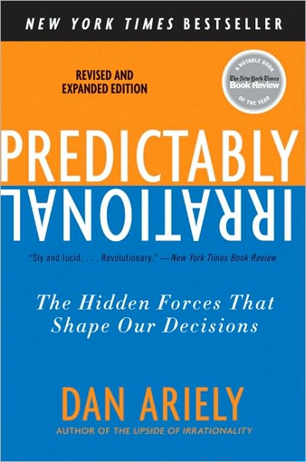
Social Norms and Market Norms
Predictably Irrational, by Dan Ariely
Chapter 4
We are happy to do things for others, but not when we are paid to do so
http://www.youtube.com/watch?v=AIqtbPKjf6Q
Notes:
You are more likely to get someone to complete a survey by giving him $5 and asking afterwards than by promising to pay $50 upon his completion of the survey.

Slide 46
Social Norms and Market Norms
We live in two worlds;
one where social norms prevail, and
another where market norms make the rules.
Social norms such as reciprocity are warm and fuzzy, with no explicit quid pro quo
Market norms are explicit and hard--you get what you pay for
You can’t mix social and market norms

Slide 47
Social Norms and Market Norms
Examples: You can’t mix social and market norms
After Thanksgiving dinner at your mother-in-law’s house, you pulled out your wallet and asked, “How much do I owe you?”
You can’t wine and dine a woman and then say, “You know, this relationship is costing me a lot of money.”
As Woody Allen said, “The most expensive sex is free sex.”

Slide 48
Social Norms and Market Norms: Experiment
Subjects were asked to use a computer to drag circles from one side of the screen into a square.
They were instructed to drag as many circles as they could in 5 minutes
Notes:
James Heyman and Dan Ariely, “Effort for Payment: A Tale of Two Markets,” Psychological Science (2004).

Slide 49
Social Norms and Market Norms: Experiment
The rewards for this very boring task were: $5, $0.50, and zero
Results:
$5: 159 circles
$0.50: 101 circles
Zero: 168 circles
Participants worked harder under non-monetary social norms than for payment!
Notes:
James Heyman and Dan Ariely, “Effort for Payment: A Tale of Two Markets,” Psychological Science (2004).

Slide 50
Social Norms and Market Norms: Experiment
In another version of the experiment, the rewards were a box of Godiva chocolates (worth $5), a Snickers bar (worth $1), and zero
$5 (Godiva): 169 circles
$0.50 (Snickers): 162 circles
Zero: 168 circles
Conclusion: Small gifts don’t constitute a market norm, and keep things in the social realm

Slide 51
Social Norms and Market Norms: Experiment
One more variation: The experimenters described the gifts as a $5 box of chocolates and a $0.50 candy bar.
The results were the same as with the cash rewards.
People reacted to explicitly priced gifts in exactly the same way they reacted to cash.
“People are willing to work free, and they are willing to work for a reasonable wage, but offer them just a small payment and they will walk away.”

Slide 52
From Market Norms to Social Norms: Productivity
The productivity of experimental subjects at a mundane task was measured
The results show how social norms affect work
Payment for participation | Work Done
$5.00 | 159
$0.50 | 101
$0.00 (“Would you do us a favor?”) | 168
Payment for participation | Work Done
$5.00 gift, value not mentioned | 169
$0.50 gift, value not mentioned | 162
$0.00 (“Would you do us a favor?”) | 168
Payment for participation | Work Done
$0.50 gift, value mentioned | 101

Slide 53
Market norms drive out social norms
The AARP asked lawyers whether they would offer their services to needy retirees for a discounted price of $30/hour.
No dice.
When the program manager instead asked if they'd offer their services for free, the lawyers overwhelmingly said they would participate.
A sensei taught a free class. The students felt bad, and asked the master if they could pay him. He replied that if he charged them, they couldn't afford him.

Slide 54
Market norms drive out social norms
Gneezy and Rustichini studied the effect of fining parents who picked up their children from daycare late
Imposing a fine had long-term negative effects.
Without a fine, parents felt guilty about being late
Imposing a fine inadvertently replaced social norms with market norms.
Parents decided that, since they were being fined, they could decide whether or not to be late, and frequently chose to be late.
Notes:
Uri Gneezy and Aldo Rustichini, “A Fine Is a Price,” Journal of Legal Studies (2000).

Slide 55
Market norms drive out social norms
A few weeks later, the day care center removed the fine, but the situation worsened.
Rather than reverting to social norms, parents now concluded that there was no penalty for tardiness.
Conclusion: “When a social norm collides with a market norm, the social norm goes away for a long time. In other words, social relationships are not easy to reestablish. Once a social norm is trumped by a market norm, it will rarely return.”

Slide 56
In a Day Care Center in Israel
The administration—annoyed that parents were showing up late to pick up their kids—decided to make late parents pay fines
Lateness increased!
The late fee induced market norms: “As long as I am paying for being late, I am entitled to keep the teachers waiting.”
The late fee was abandoned
But it was too late. Market norms are sticky!

Slide 57
Social Norms in Business
“It’s remarkable how much work companies (particularly start-ups) can get out of people when social norms (such as the excitement of building something together) are stronger than market norms (such as salaries stepping up with each promotion).
If corporations started thinking in terms of social norms, they would realize that these norms build loyalty and--more important--make people want to extend themselves to the degree that corporations need today: to be flexible, concerned, and willing to pitch in.
That’s what a social relationship delivers.”

Slide 58
Social Norms in Business
“A salary alone will not motivate people to risk their lives.
Police officers, firefighters, soldiers--they don't die for their weekly pay.
It’s the social norms--pride in their profession and a sense of duty--that will motivate them to give up their lives and health.
Money, as it turns out, is very often the most expensive way to motivate people.
Social norms are not only cheaper, but often more effective as well.”
Notes:
Some other stuff:
What does the subject matter of this presentation have to do with economics? How can people protect themselves from the weaknesses discussed here? How can or should rational actors and policy makers make use of the ideas discussed here?
As in the famous Trolley Problem, we sometimes have trouble thinking clearly about moral issues.
Our ethical judgments are also affected by framing and reference point issues.
Our ethics are often damaged by our instinctual obedience to authority (as in the Asch, Milgram, Zimbardo examples).
We tend to grab too much credit for good things for ourselves and we tend to place too much of the responsibility for bad things on others.
We tend to favor strivers who come up from humble beginnings. This can lead us to favor brands that have an underdog image.
This presentation can be combined with the presentation on cheating.

Slide 59
From Market Norms to Social Norms
When something is free, a major change occurs: market norms get replaced by social norms, and we treat each other in ways that are very different from the way buyers and sellers treat each other

Slide 60
From Market Norms to Social Norms
People will help you change a tire, if you ask them to do you a favor, but not if you offer to pay them, say, $5.00
The reason is that when you offer $5.00, you are implicitly sending the message that that’s how much you think the other guy’s time and effort is worth
Standard economics can’t explain this behavior

Slide 61
From Market Norms to Social Norms
When the AARP asked lawyers to do legal work for their members for $30 an hour (market norms), they refused
When asked to volunteer their services (social norms) for needy retirees, they overwhelmingly said yes
The law of supply—a fundamental idea in standard economics—can fail under social norms

Slide 62
From Market Norms to Social Norms: Productivity
Businesses can cultivate social norms-based relationships with their employees and suppliers in order to gain an advantage
But then they cannot say “Business is business!” and treat their employees and suppliers harshly when business conditions turn bad
Social norms require two-way shared sacrifice—reciprocity
People will be generous towards businesses that are routinely seen as acting in generous ways

Slide 63
From Market Norms to Social Norms
Norms can also be simulated by priming
Experimental subjects were divided into two random groups
Group 1 Asked to unscramble neutral sentences (e.g., “It is cold outside.”) prior to experiment
Group 2 Asked to unscramble sentences related to money (e.g., “High-paying salary.”)
Then, each subject had to solve a tough puzzle, but could ask for help

Slide 64
From Market Norms to Social Norms
The “neutral” group asked for help earlier than the “money” group:
Market norms make people more self-reliant
The “money” group was also less willing to help a stooge who wanted help with the puzzle and another stooge who accidentally spilled a box of pencils
Market norms made people less willing to ask for help and less willing to help

Slide 65
From Market Norms to Social Norms—Law of Demand
If somebody brings cookies to the office and offers them for free to those in the office, people will just take one or two
But if cookies are offered for sale by a cookie seller people may buy more cookies
In other words, the law of demand—which says that people buy more when the price falls—breaks down at zero!

Slide 66
From Market Norms to Social Norms—Law of Demand
When a limited number of things are offered for free, people become more conscious of their social obligation not to be greedy and exploit the good people who are offering something for free
When prices are not part of the picture, market norms are replaced by social norms; we start caring more about others

Slide 67
Cap and Trade
Putting a price on pollution makes perfect sense in standard economics
Behavioral economics, however, raises doubts
Once people can excuse their pollution to themselves on the ground that they are paying for the pollution they create, they may pollute more, not less

Slide 68
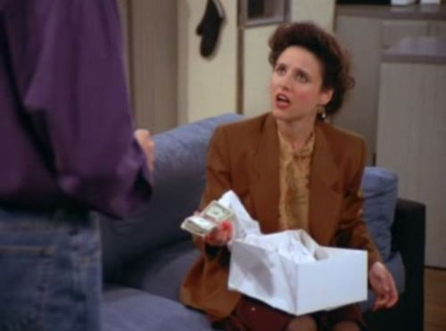
Cash as a birthday gift?
Seinfeld episode: Jerry gives Elaine $182 as a gift on her birthday!
It seems rational …
… but it really is inappropriate
Cash replaces social norms by market norms and ruins the feelings usually evoked by a typical non-cash birthday gift

Slide 69
Video: Scroogenomics
Heard the one about the economist who gave cash as a Valentines Day gift?
Scrooge alert: Your holiday spending may result in an economic loss by Paul Solman, PBS Newshour, December 23, 2013.
Notes:
Video: http://www.pbs.org/newshour/bb/business/july-dec13/giving_12-23.html .

