Slide 1
Endowment Effect
Behavioral Economics
Udayan Roy

Slide 2
Reading
Predictably Irrational by Dan Ariely
Chapter 8: The High Price of Ownership
Thinking, Fast and Slow by Daniel Kahneman
Chapter 27: The Endowment Effect
Misbehaving by Richard Thaler
Chapter 2: The Endowment Effect
Chapter 16: Mugs

Slide 3
The Endowment Effect
Kahneman and Tversky’s “Prospect Theory” describes how people evaluate gains and losses in different ways
Their concept of loss aversion implies related phenomena such as the endowment effect

Slide 4
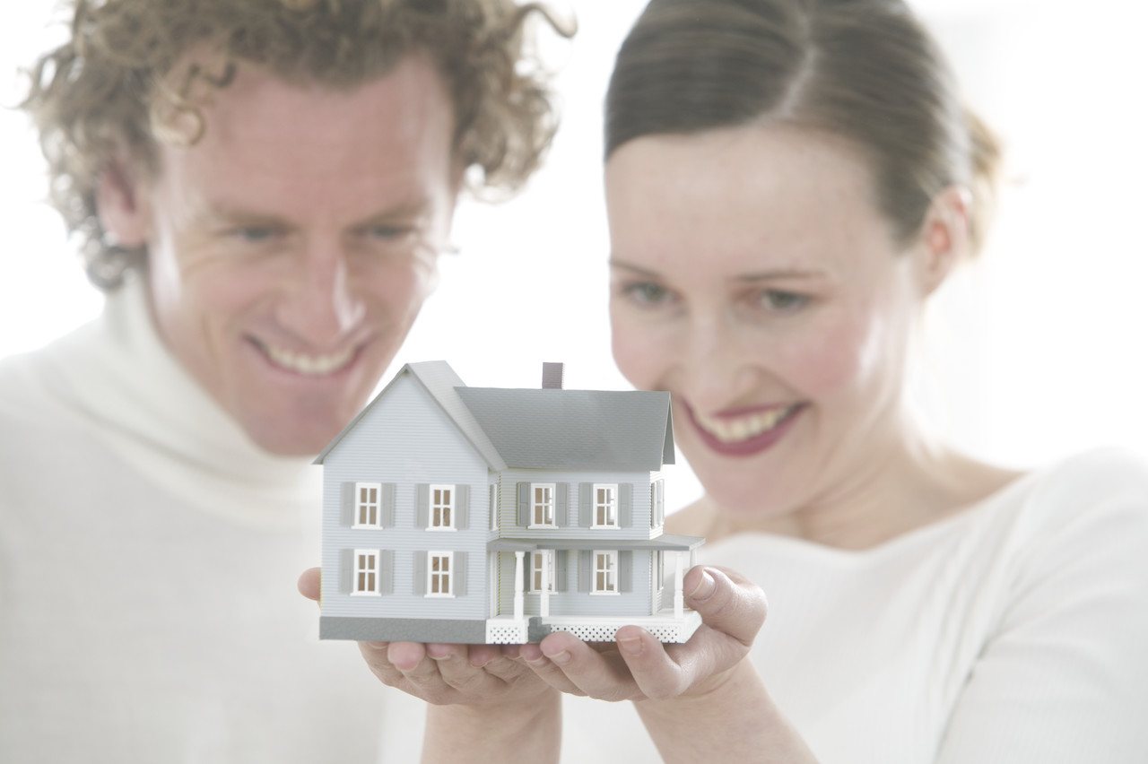
The endowment effect
People value a thing more once it becomes theirs
Ownership increases utility
Term originated by Richard Thaler (U. of Chicago)
Thaler, R. (University of Chicago), 1980, Toward a positive theory of consumer choice. Journal of Economic Behavior and Organization, March, 39-60.

Slide 5
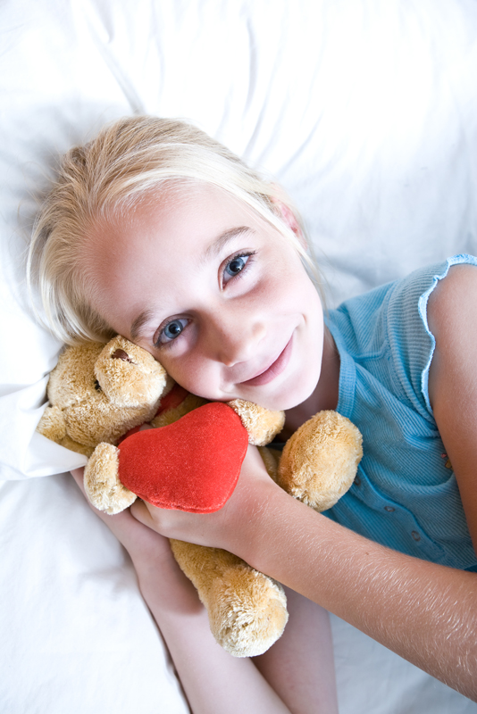
Loss aversion and endowment effect
Once I own something, not having it becomes more painful, because it is a loss.
If I don’t yet own it, then acquiring it is less important, because it is a gain.

Slide 6
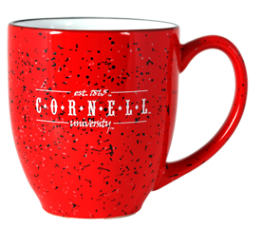
Students in every other seat were given university mugs. Then reported how much they would be willing to sell the mug for.
Students who did not get a mug reported the price they would be willing to pay to get one.
What happened?
The students with mugs priced them higher.
The students with no mugs priced them higher.
Both sets of students priced them about the same

Slide 7
Students with the mugs were willing to sell them, on average, for
$4.50
Students with no mugs were willing to buy them, on average, for
$2.25
Kahneman, D. (UC Berkley), Knetsch, J. (Simon Fraser U), Thaler, R. (Cornell), 1990, Experimental tests of the endowment effect and the Coase theorem. Journal of Political Economy, 98(6), 1325-1348.

Slide 8
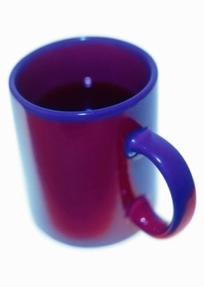
Class A
At the beginning, students given a coffee mug. At the end, given option to trade for a bar of Swiss chocolate.
Class B
Students given a chocolate bar. At the end, given option to trade for a coffee mug.
Class C
At the beginning, offered a choice between a chocolate bar or coffee mug.
?
?
?

Slide 9
Class A
At the beginning, students given a coffee mug. At the end, given option to trade for a bar of Swiss chocolate.
Class B
Students given a chocolate bar. At the end, given option to trade for a coffee mug.
Class C
At the beginning, offered a choice between a chocolate bar or coffee mug.
?
?
?
Which class was most likely to choose the coffee mug?

Slide 10
Class A
89%
chose coffee mug
Class B
10%
chose coffee mug
Class C
59%
chose coffee mug
?
?
?
J. Knetsch (Simon Fraser U.), 1989, The endowment effect and evidence of nonreversible indifference curves. American Economic Review, 79, 1277-1284.

Slide 11
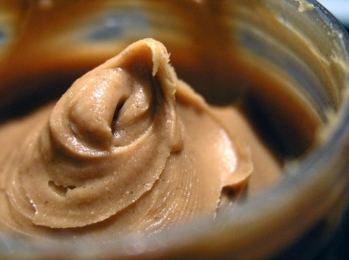
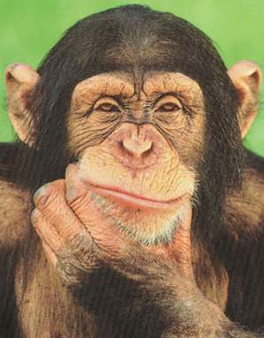
33 chimpanzees given frozen-juice popsicle or tube of peanut butter (both familiar items) and then an opportunity to trade.
?
?
When initially given peanut butter
89%
Chose peanut butter
When initially given popsicle
42%
Chose peanut butter
Brosnan, S. (Emory), et al (Texas, Vanderbilt), 2007, Endowment effects in chimpanzees. Current Biology, 17, 1704-1707.

Slide 12
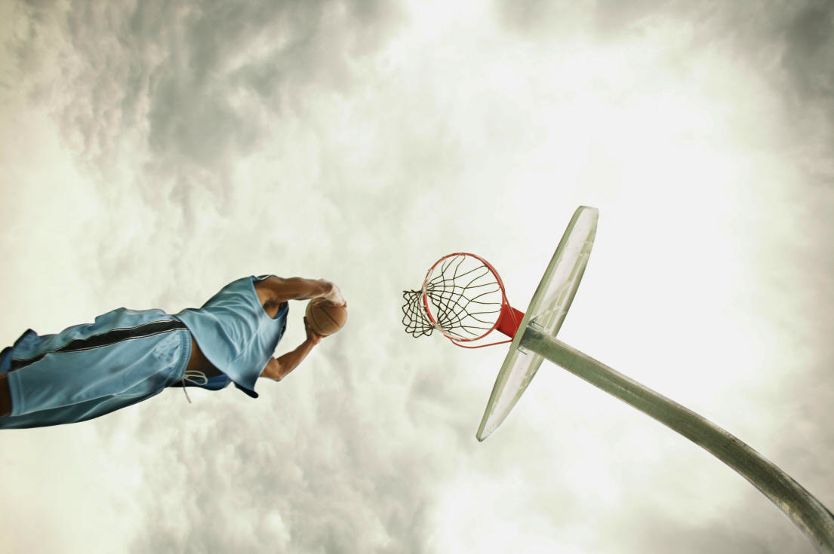
Endowment effect in basketball tickets?
Dr. Dan Ariely, Duke University
http://www.youtube.com/watch?v=drEVExtrUgQ
Carmon, Ziv and Dan Ariely (2000), “Focusing on the Forgone: How Value Can Appear So Different to Buyers and Sellers,” Journal of Consumer Research, 27 (December), 360–70.

Slide 13
Duke basketball tickets experiment
At Duke, home-game basketball tickets are distributed by lottery
Ariely gets a list of the winners and losers
Calls the losers and asks how much they’d pay for a ticket ($170 on average)
Calls the winners and asks at what price they’d sell ($1,400)
This is evidence of the endowment effect

Slide 14
Duke basketball tickets experiment
The lottery losers were willing to pay $170 on average for a ticket
This means the lottery losers valued a ticket at approximately $170.01
The lottery winners were willing to sell their tickets for $1400 on average
This means the lottery winners valued a ticket at approximately $1399.99
Why would two randomly chosen groups value the same thing at such different levels?

Slide 15
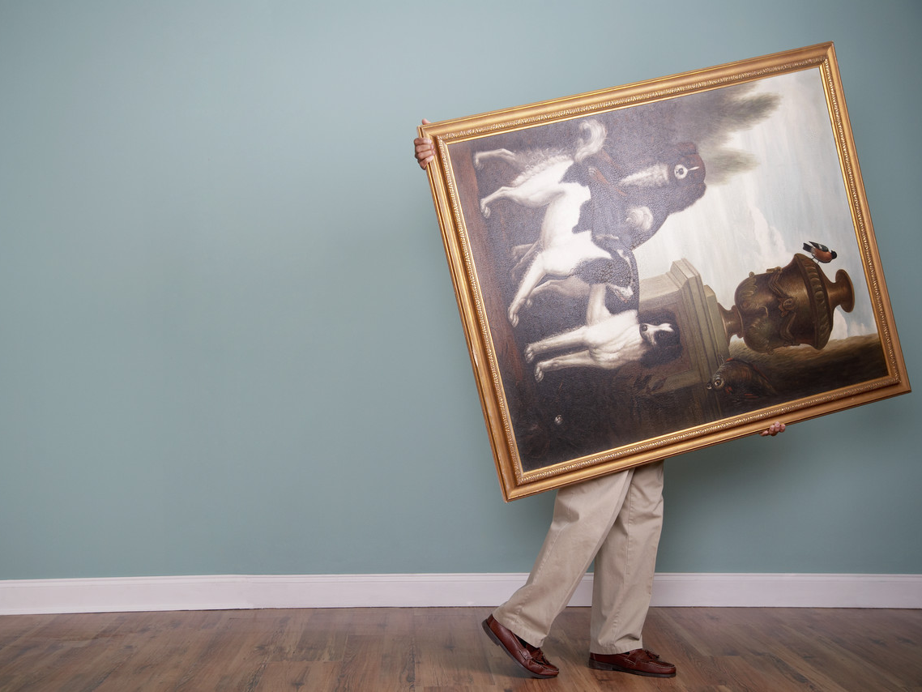
The endowment effect in art
Dr. Dan Gilbert, Harvard University
http://www.youtube.com/watch?v=LTO_dZUvbJA 8:25-13:57

Slide 16
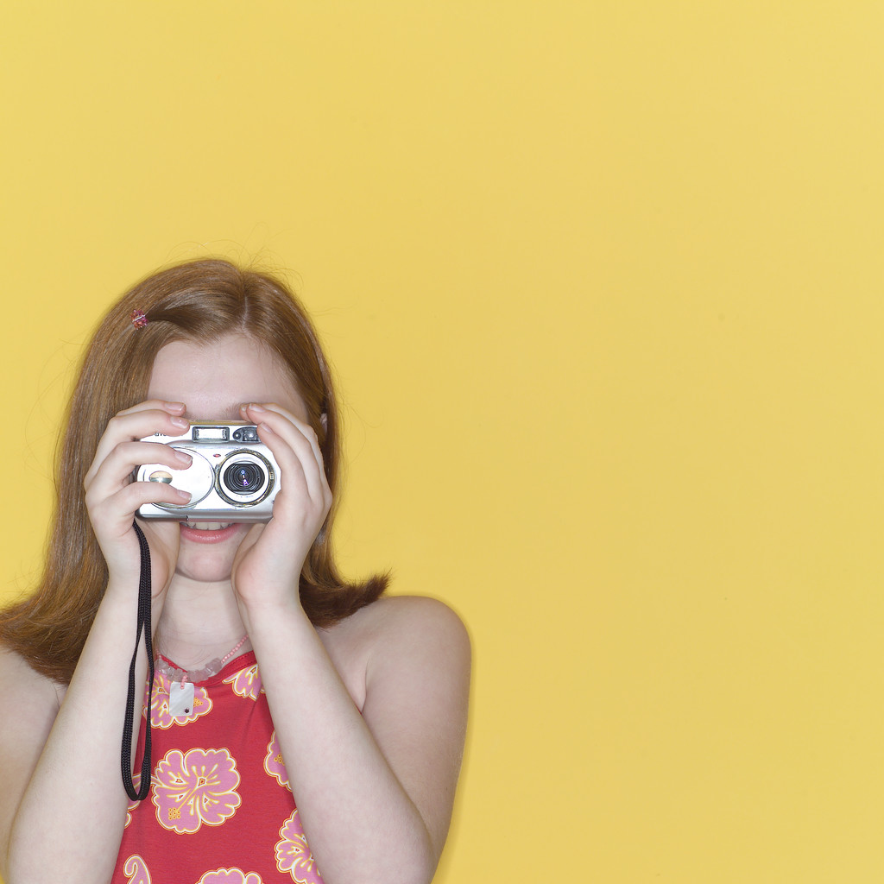
Students in a non-credit photography class at Harvard picked two photos to develop then chose one to keep.
Group 1
“pick your favorite, … you won’t be able to change your mind.”
Group 2
If you change your mind within four days, you can swap it. I’ll call at the end to double-check.
Gilbert, D. (Harvard) & Ebert, J. (MIT), 2002, Decisions and revisions: The affective forecasting of changeable outcomes. Journal of Personality and Social Psychology, 82, 503-514

Slide 17
Both before and two days after their choice, participants were asked how much they liked their photograph from 1 (not at all) to 9 (very much)
Group 1
Change in satisfaction with picture
+1.3
Group 2
Change in satisfaction with picture
-1.8
Gilbert, D. (Harvard) & Ebert, J. (MIT), 2002, Decisions and revisions: The affective forecasting of changeable outcomes. Journal of Personality and Social Psychology, 82, 503-514

Slide 18
“The ratio of fructose to cellulose is an objective and unchanging property of apples, of course, but the experience of sweetness is a subjective property that increases when an apple becomes my apple”
Gilbert, D. (Harvard) & Ebert, J. (MIT), 2002, Decisions and revisions: The affective forecasting of changeable outcomes. Journal of Personality and Social Psychology, 82, 503-514

Slide 19
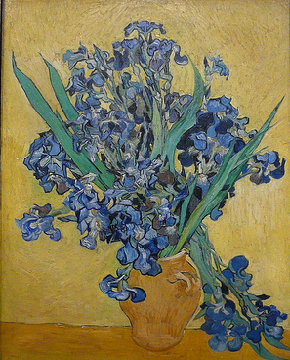
Students ranked 6 art posters. Next, allowed to take home either 3rd or 4th ranked poster. 15 minutes later, they rated their chosen poster again.
Group A: “if … any time in the next month, you can just let me know and we will exchange it for you.”
Group B: Final choice, no exchanges.
Gilbert, D. (Harvard) & Ebert, J. (MIT), 2002, Decisions and revisions: The affective forecasting of changeable outcomes. Journal of Personality and Social Psychology, 82, 503-514
Notes:
Creative commons licensed
http://www.flickr.com/photos/wallyg/1392910765/
http://www.flickr.com/photos/jajankie/3691060595/

Slide 20
Change in ranking of the art poster before and after they chose to take it home.
-.07
+.71
Group A: “if … any time in the next month, you can just let me know and we will exchange it for you.”
Group B: Final choice, no exchanges.
Gilbert, D. (Harvard) & Ebert, J. (MIT), 2002, Decisions and revisions: The affective forecasting of changeable outcomes. Journal of Personality and Social Psychology, 82, 503-514

Slide 21
When allowed to pick their type of choice (changeable or unchangeable), people preferred:
66.3%
33.7%
Group A: “if … any time in the next month, you can just let me know and we will exchange it for you.”
Group B: Final choice, no exchanges.
Gilbert, D. (Harvard) & Ebert, J. (MIT), 2002, Decisions and revisions: The affective forecasting of changeable outcomes. Journal of Personality and Social Psychology, 82, 503-514

Slide 22
When asked which type of choice the typical student would prefer, they believed:
84.3%
15.7%
Group A: “if … any time in the next month, you can just let me know and we will exchange it for you.”
Group B: Final choice, no exchanges.
Gilbert, D. (Harvard) & Ebert, J. (MIT), 2002, Decisions and revisions: The affective forecasting of changeable outcomes. Journal of Personality and Social Psychology, 82, 503-514

Slide 23
Diversification Bias
v.
Endowment Effect
“Our studies show that people prefer to have the opportunity to change their outcomes, …”
“but that, in fact, these opportunities inhibit the psychological processes that would otherwise have helped them manufacture satisfaction.”
Gilbert, D. (Harvard) & Ebert, J. (MIT), 2002, Decisions and revisions: The affective forecasting of changeable outcomes. Journal of Personality and Social Psychology, 82, 503-514

Slide 24
Dr. Dan Gilbert, Harvard University
Summary
http://www.youtube.com/watch?v=LTO_dZUvbJA 14:19-19:05

Slide 25
Endowment effect and marketing
Money-back guarantees are offered by businesses because it reduces people’s resistance to trying a product
Once someone tries the product, the endowment effect may seal the deal

Slide 26
The IKEA effect
One’s sense of ownership of something increases when one invests more of one’s resources in it

Slide 27
Virtual Ownership
We may feel as though we already own something if we can vividly imagine taking possession of it and living with it
This virtual ownership leads to a purchase and to actual ownership
Successful advertisements are good at enabling us to vividly imagine life with a product

Slide 28
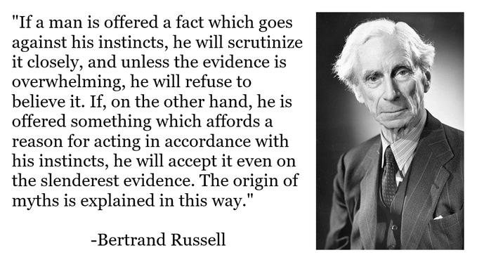
Endowment Effect in Ideas
Once we accept an idea it is very difficult for us to let it go
This is how ideological rigidity sets in
We find it hard to take evidence seriously when it threatens an idea we feel is ours
We only consider evidence when it supports an idea we already believe
This is related to the idea of confirmation bias

