Slide 1
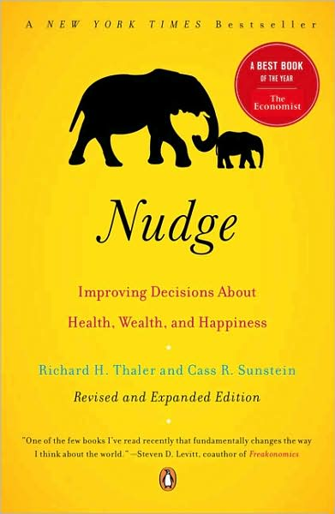
When do we need a nudge?
Nudge, Chapter 4
Behavioral Economics
Udayan Roy

Slide 2
Libertarianism
The standard assumption of rational choice in economics has led to a deep-rooted view that governments should take a hands-off (or libertarian) attitude towards private enterprise and private choice

Slide 3
Paternalism
Behavioral economics, with its emphasis on our predictable irrationalities, has instead begun to make government intervention (or paternalism) seem less unreasonable

Slide 4
Libertarian Paternalism
In this course, we have emphasized the middle-ground (or compromise) notion of …
… libertarian paternalism!
Under libertarian paternalism, the government nudges private citizens towards rational choices without in any way restricting their freedom to do as they wish

Slide 5
Libertarian Paternalism
Under libertarian paternalism, the policy maker (also called the choice architect) tries to influence people’s choices by changing the context in which choices are made but not by changing the menu of available options
The choice architect tries to nudge people towards choices that are obviously rational without making it harder for people to make other choices if they really want to do so

Slide 6
The choice architect needs to be cautious
The Golden Rule of Libertarian Paternalism:
Offer nudges that are most likely to help and least likely to inflict harm
Help the least sophisticated people while imposing minimal harm on everyone else

Slide 7
Nudge guidelines
The choice architect needs some general guidelines to tell when nudges are a good idea
Nudges are a good idea when
The choices are particularly difficult for most people, and
We cannot rely on market competition to make it easier for people to make good choices

Slide 8
Difficult choices

Slide 9
Investment goods and sinful goods
When a choice has costs now and benefits later, we tend to procrastinate, to our peril
Investment goods: exercise, flossing, dieting
When a choice has benefits now and costs later, we tend to be tempted into mistakes
Sinful goods: cigarettes, alcohol, fatty foods
For these choices, we often need nudges

Slide 10
Difficult choices
Some choices are just very difficult
Which house to buy, what kind of mortgage to take, how much of one’s income should one save, which stocks and bonds to buy, what major should one choose in college
For these choices, we often need nudges

Slide 11
Infrequent but crucial choices
Many of our most difficult choices are so difficult because we make them very infrequently
Sometimes difficult tasks become manageable with practice
But in some cases practice is just not possible
You can’t change colleges or majors or spouses or careers or houses or lives too many times
Rare and difficult choices need nudges

Slide 12
Repeatable choices without feedback
You’ll learn nothing from practice if there’s no quick feedback about how well you’re doing
Practicing golf in the dark
Being a stick-in-the-mud and not trying alternative strategies
Having to wait and wait to see the results of a choice (dieting)
Here too, nudges can help

Slide 13
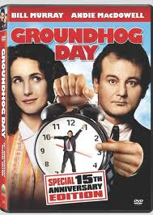
Groundhog Day
A classic film comedy of the redemptive power of repetition and instant feedback
The entire film is available on YouTube in ten 10-minute parts!
Here’s part 5

Slide 14
Choices with unfamiliar outcomes
When we don’t know how the various choices will affect us, we’d need help to make choices
Unfamiliar cuisine
Unfamiliar courses in a curriculum

Slide 15
Market competition

Slide 16
Markets: a mixed verdict
When choices are difficult, will those who offer us those choices help us make the right choices?
Will market competition give businesses the incentives to help us make the right choices?
Answer: yes and no!

Slide 17
Markets: a mixed verdict
In some cases, market competition helps people make the right choices
At other times, market competition further exploits the irrationalities of people

Slide 18
Where the market does not help
First, helping the deluded often requires educating them, giving them more information
But information is a public good; private firms will have no incentive to provide a public good

Slide 19
Where the market does not help
Second, if someone can make a living only by ripping people off, market competition will not get him to do something else; all that competition can do is drive his fees down to the cost of his time
And if it is costly for the charlatan’s honest competitors to dissuade the gullible consumer, they will have no incentive to try

Slide 20
Where the market does not help
Finally, in some cases competition may simply be absent
That is, it might be difficult for new people to enter a business and compete with the charlatans

Slide 21
In some cases, the market helps
There are cigarette companies and there are companies selling nicotine patches
There’s Burger King and there’s NutriSystem
But even here, the government may have a role; it can make it easier for the good guys to compete with the bad guys

