Slide 1

Peer Effects
…of the people around you
The powerful impact
Notes:
This could be related to self-control problems; you have difficulty in sticking to your plans because of peer pressure. This presentation needs to be totally re-written, based closely on Chapter 3 “Following the Herd” of “Nudges”. This presentation has significant intersections with the presentations in the altruism group and with the second presentation on pre-commitment. What does the subject matter of this presentation have to do with economics? How can people protect themselves from the weaknesses discussed here? How can or should rational actors and policy makers make use of the ideas discussed here?

Slide 2

Comparisons with those physically or socially near to you drive your choices.
This influence is called “peer effects”.

Slide 3
Peer Effects: We will look at results of studies examining peer effects in
Weight gain/loss
Drug use
Tobacco use
GPA
Athletic fitness
Academic cheating
Retirement saving
Mutual fund selection
College selection
Income satisfaction
Competitive excellence

Slide 4

Peer effects in body weight

Slide 5
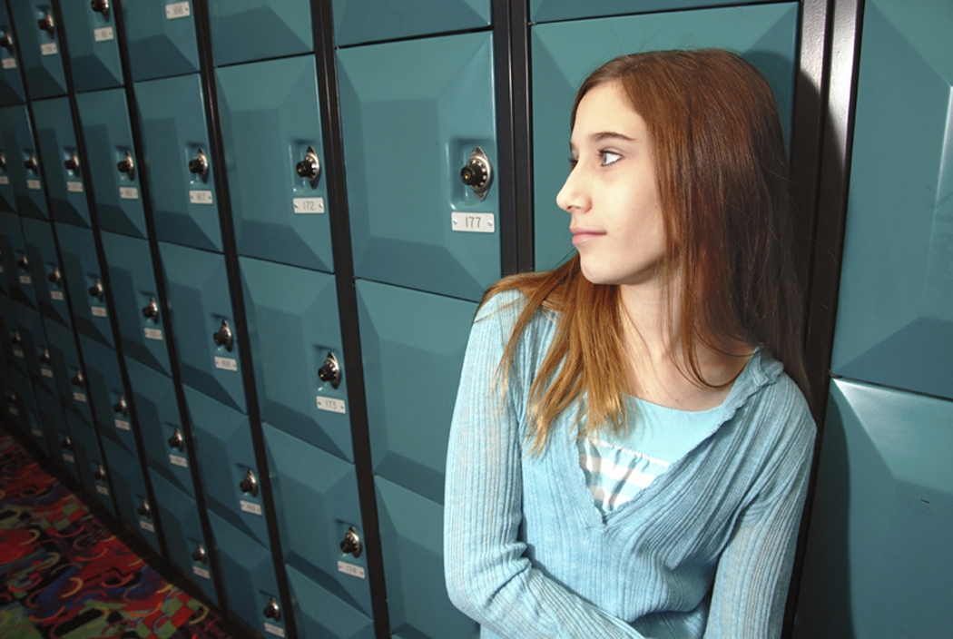
Study examined 90,118 middle and high school students.
Does going to a school with fatter [skinnier] students make you more likely to be fat [skinny]?
Trogdon, J., Nonnemaker, J., & Pais, J., (2008). Peer effects in adolescent overweight. Journal of Health Economics, 27, 1388-1399.

Slide 6
“When mean BMI [Body Mass Index] in the same grade within the same school is one unit higher, an adolescent’s BMI is higher by 0.23 units.”
Other students in same grade BMI is 1 unit higher
New student’s BMI will go up by .23 units
+
+
Trogdon, J., Nonnemaker, J., & Pais, J., (2008). Peer effects in adolescent overweight. Journal of Health Economics, 27, 1388-1399.

Slide 7
Other students in same grade BMI is 1 unit higher
New student’s BMI will go up by .23 units
+
+
What do you think could explain this?
Work with others and write down your answers.
Trogdon, J., Nonnemaker, J., & Pais, J., (2008). Peer effects in adolescent overweight. Journal of Health Economics, 27, 1388-1399.

Slide 8

Peer effects in teenage consumption of
alcohol, marijuana, and tobacco

Slide 9
In a study of 6,356 students, when a teenager’s perception of the share of classmates who use a substance [marijuana, alcohol, or tobacco] increases by 10 percentage points, the probability that he or she will use the substance increases by
  0.0 to 0.4 percentage points
  0.4 to 0.6 percentage points
  1.4 to 2.6 percentage points
  3.4 to 4.6 percentage points
  About 10 percentage points
Kawaguchi, D. 2004, Peer effects on substance use among American teenagers. Journal of Population Economics, 17, 351-367.

Slide 10
In a study of 6,356 students, when a teenager’s perception of the share of classmates who use a substance [marijuana, alcohol, or tobacco] increases by 10 percentage points, the probability that he or she will use the substance increases by
  0.0 to 0.4 percentage points
  0.4 to 0.6 percentage points
  1.4 to 2.6 percentage points
  3.4 to 4.6 percentage points
  About 10 percentage points
Kawaguchi, D. 2004, Peer effects on substance use among American teenagers. Journal of Population Economics, 17, 351-367.

Slide 11

In a study of 11,000+ tenth graders, if a student with a 7% chance of using drugs was moved from an otherwise identical school where none of his classmates used drugs to one where half of his classmates used drugs, what would be the new probability of his using drugs?
7%
8%
10%
15%
20%
Gaviria, A. (IDB) & Raphael, S. (UC-Berkeley), 2001, School-based peer effects and juvenile behavior. The Review of Economics and Statistics, 83(2), 257-268.

Slide 12
In a study of 11,000+ tenth graders, if a student with a 7% chance of using drugs was moved from an otherwise identical school where none of his classmates used drugs to one where half of his classmates used drugs, what would be the new probability of his using drugs?
7%
8%
10%
15%
20%
Gaviria, A. (IDB) & Raphael, S. (UC-Berkeley), 2001, School-based peer effects and juvenile behavior. The Review of Economics and Statistics, 83(2), 257-268.

Slide 13

If a 10th grader with a 7% chance of daily smoking was moved from an otherwise identical school where none of her classmates smoked to one where half of her classmates smoked, what would be her new probability of his smoking?
7%
8%
10%
15%
20%
Gaviria, A. (IDB) & Raphael, S. (UC-Berkeley), 2001, School-based peer effects and juvenile behavior. The Review of Economics and Statistics, 83(2), 257-268.

Slide 14
If a 10th grader with a 7% chance of daily smoking was moved from an otherwise identical school where none of her classmates smoked to one where half of her classmates smoked, what would be her new probability of his smoking?
7%
8%
10%
15%
20%
Gaviria, A. (IDB) & Raphael, S. (UC-Berkeley), 2001, School-based peer effects and juvenile behavior. The Review of Economics and Statistics, 83(2), 257-268.

Slide 15
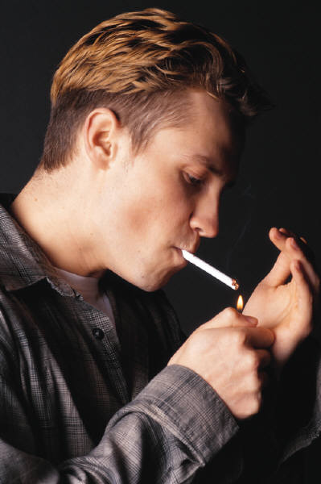
A study of 14,000+ students from 119 universities
“moving a student from a university where no students smoke to an institution where 25 percent of the population smokes increases that student’s probability of smoking by 10.7%.”
Wilson, J. (Akron), 2007, Peer effects and cigarette use among college students. Atlantic Economic Journal, 34, 233-247.

Slide 16

Peer effects and academic performance in college

Slide 17

A study of 2,000+ randomly matched Dartmouth freshman roommates
Did a high GPA roommate improve a student’s GPA?
Did a low GPA roommate lower a student’s GPA?
Sacerdote, B. (Dartmouth), 2001, Peer effects with random assignment: Results for Dartmouth roommates. Quarterly Journal of Economics, 116(2), 681-704, p. 696.

Slide 18

For every 1 point increase (decrease) in the roommate’s GPA, a student’s GPA increased (decreased) about .12 points.
If you would have been a 3.0 student with a 3.0 roommate, but you were assigned to a 2.0 roommate, your GPA would be 2.88.
Sacerdote, B. (Dartmouth), 2001, Peer effects with random assignment: Results for Dartmouth roommates. Quarterly Journal of Economics, 116(2), 681-704, p. 696.

Slide 19

  Perhaps roommates were both influenced by external factors (noisy hall, etc.)?
  Solution: See if the entering academic scores of the roommate influenced a student’s GPA
Sacerdote, B. (Dartmouth), 2001, Peer effects with random assignment: Results for Dartmouth roommates. Quarterly Journal of Economics, 116(2), 681-704, p. 696.

Slide 20
Comparing entering academic scores of roommates:
“These numbers imply that the peer effect is 27% as large as the own effect.”
Sacerdote, B. (Dartmouth), 2001, Peer effects with random assignment: Results for Dartmouth roommates. Quarterly Journal of Economics, 116(2), 681-704, p. 696.

Slide 21

Can we capture a more complete peer group than just the roommate?
S. Carrell (Dartmouth), R. Gilchrist (Adams State), R. Fullerton (Air Force Academy), J. West (Air Force Academy), 2007, Peer and leadership effects in academic and athletic performance. Available at SSRN: http://ssrn.com/abstract=924516

Slide 22
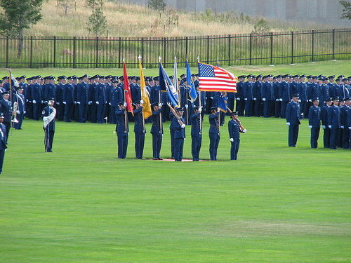
The Air Force Academy – A natural experiment.
Students are randomly assigned to a “squadron” of 120 students who live, eat, and train together and who compete as a squadron in athletic competition.
S. Carrell (Dartmouth), R. Gilchrist (Adams State), R. Fullerton (Air Force Academy), J. West (Air Force Academy), 2007, Peer and leadership effects in academic and athletic performance. Available at SSRN: http://ssrn.com/abstract=924516
Notes:
http://www.flickr.com/photos/lockergnome/40248354/
Creative commons licensed
Air Force Academy – Color Guard

Slide 23
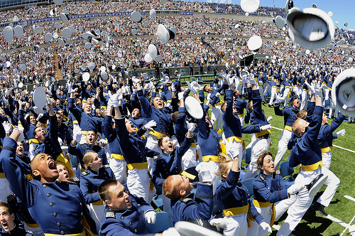
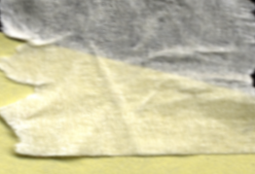

“A 1 point increase in peer group GPA increases individual GPA by .65 grade points.”
S. Carrell (Dartmouth), R. Gilchrist (Adams State), R. Fullerton (Air Force Academy), J. West (Air Force Academy), 2007, Peer and leadership effects in academic and athletic performance. Available at SSRN: http://ssrn.com/abstract=924516
Notes:
http://www.flickr.com/photos/walkadog/3574375600/
Class of 2009, USAF Academy Graduation, Colorado Springs, Co, Hat Hurray Toss
Creative commons license

Slide 24

Being randomly assigned to a squadron with higher athletic ability increased the student’s athletic test scores (timed pull-ups, sit-ups, push-ups, and 600-yard shuttle run). Even the previous year’s assignment continued to have a highly significant effect.
S. Carrell (Dartmouth), R. Gilchrist (Adams State), R. Fullerton (Air Force Academy), J. West (Air Force Academy), 2007, Peer and leadership effects in academic and athletic performance. Available at SSRN: http://ssrn.com/abstract=924516

Slide 25

Does pulling the top students out of a high school negatively affect the remaining students?
A Washington, D.C. suburb opened a new magnet high school admitting only the top 2% (GPA & test scores) from the county.
A. Dills (Clemson), 2005, Does cream-skimming curdle the milk? A study of peer effects. Economics of Education Review, 24, 19-28

Slide 26

Finding: “the departure of an additional 1% of high-scoring students increases the percentage of remaining students scoring in the bottom national quartile by about 9%.”
A. Dills (Clemson), 2005, Does cream-skimming curdle the milk? A study of peer effects. Economics of Education Review, 24, 19-28

Slide 27

Peer effects in academic cheating

Slide 28
Study: A study of cheating at the three military academies from 1959-2002.
Question: Did the introduction of a “cheating” student create more cheaters among other students?
Carrell, S. (Dartmouth), Malmstrom, F. (Air Force Academy), & West, J. (Air Force Academy), 2008, Peer effects in academic cheating. Journal of Human Resources, 43(1),173-207.

Slide 29
One additional college cheater directly created 0.55 to 0.80 new college cheaters. But, “the social multiplier exists as newly created cheaters exert peer influence, which create additional cheaters…Hence, the addition of one college cheater creates
2.21 to 4.90 new college cheaters.”
Carrell, S. (Dartmouth), Malmstrom, F. (Air Force Academy), & West, J. (Air Force Academy), 2008, Peer effects in academic cheating. Journal of Human Resources, 43(1),173-207.

Slide 30

Does having a top public university in your home county make you more likely to attend a higher quality college even if you do not attend college locally?
Yes
Yes, but only for families with high wealth and education
Yes, but only for families with moderate or lower wealth and education
No.
Do, C. (UC-Santa Barbara), 2004, The effects of local colleges on the quality of college attended. Economics of Education Review, 23, 249-257.
Notes:
Discussion of the effect of example, comparison groups, outreach programs, etc.

Slide 31
Does having a top public university in your home county make you more likely to attend a higher quality college even if you do not attend college locally?
Yes, but only for families with moderate or lower wealth and education
Why?
Neighborhood peer effects?
Anchoring?
Do, C. (UC-Santa Barbara), 2004, The effects of local colleges on the quality of college attended. Economics of Education Review, 23, 249-257.
Notes:
Discussion of the effect of example, comparison groups, outreach programs, etc.

Slide 32

Peer effects beyond high school and college age

Slide 33
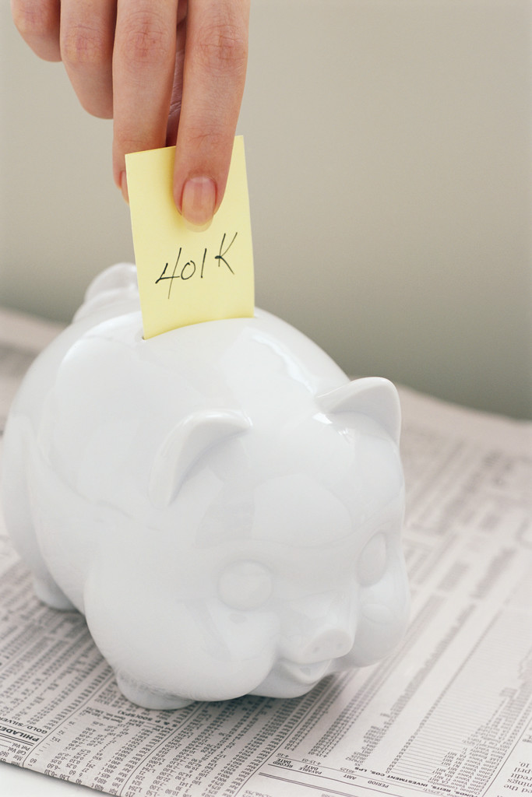
Are professors’ retirement savings affected by their peers’ savings?
Duflo, E. (MIT) & Saez, E. (Harvard), 2002, Participation and investment decisions in a retirement plan: the influence of colleagues’ choices. Journal of Public Economics, 85, 121-148.
Notes:
Environment never stops influencing decisions

Slide 34
“When participation [in a retirement savings program] increases by 1 percent in the department, one’s participation increases by 0.2 percent.”
Duflo, E. (MIT) & Saez, E. (Harvard), 2002, Participation and investment decisions in a retirement plan: the influence of colleagues’ choices. Journal of Public Economics, 85, 121-148.
Notes:
Environment never stops influencing decisions

Slide 35

Are professors’ choice of mutual fund company affected by their peers’ choice?
Duflo, E. (MIT) & Saez, E. (Harvard), 2002, Participation and investment decisions in a retirement plan: the influence of colleagues’ choices. Journal of Public Economics, 85, 121-148.
Notes:
Environment never stops influencing decisions

Slide 36
“When the average share of the contribution invested in one vendor increases by 1 percent, one’s share in this vendor increases by 0.5 percent on average.”
Duflo, E. (MIT) & Saez, E. (Harvard), 2002, Participation and investment decisions in a retirement plan: the influence of colleagues’ choices. Journal of Public Economics, 85, 121-148.
Notes:
Environment never stops influencing decisions

Slide 37

How do great scientists
become
great scientists?

Slide 38

More than half of American Nobel prize winners were taught by Nobel prize winners.
Zuckerman, H. (1998) The scientific elite: Nobel laureates’ mutual influences. In R.S. Albert (Ed.), Genius and Eminence, Routledge p. 167

Slide 39

“a Nobel laureate in physics remarked on his association with two older Nobelists, ‘I’m quite sure that I would have been greatly handicapped if I had not developed the kind of confidence which one gets by being able to talk to and measure oneself against the leaders of the field’”
Zuckerman, H. (1998) The scientific elite: Nobel laureates’ mutual influences. In R.S. Albert (Ed.), Genius and Eminence, Routledge p. 158; p. 167

Slide 40

“[Nobel] laureates, in their comparative youth, sometimes went to great lengths to make sure that they would be working with those they considered the best in their field.”
Zuckerman, H. (1998) The scientific elite: Nobel laureates’ mutual influences. In R.S. Albert (Ed.), Genius and Eminence, Routledge p. 158; p. 167

Slide 41
Are YOU willing to go to great lengths to
make sure that you will be working with those you consider the best
in your field?
Zuckerman, H. (1998) The scientific elite: Nobel laureates’ mutual influences. In R.S. Albert (Ed.), Genius and Eminence, Routledge p. 158; p. 167

Slide 42
What can you do to put the best into your environment?
With whom should you practice, study, train, work with or learn from?
Are you already at a place with some of the world’s top students, scientists, researchers, athletes, coaches?
When should you consider joining a professional association?

Slide 43
Writing participation assignment
I want to be a contender in UFC fighting. Mostly now I spar with some friends from high school. (Although lately I have spent more evenings eating fried food while watching the cartoon network.)
What practical suggestions can you think of to help him accomplish his goal by using the power of peer effects?

Slide 44
Writing participation assignment
I would like to get into a career where I can someday develop a treatment for HIV/AIDs. But, right now I spend most of my time playing Halo 3 on the Xbox
What practical suggestions can you think of to help her accomplish her goal by using the power of peer effects?

Slide 45
Conclusion
Environment control trumps self control
The environment you choose influences your success in life, health, success, and happiness.
The biggest part of environmental influence is peer influence.
You can influence your destiny if you alter your environment.

Slide 46
The Need for Empathy
Should you stay away from people who are fat, take drugs, smoke, have low GPAs, don’t exercise, don’t save money, or are not Nobel prize winners?
Being in the ‘right’ peer group can help you
But the search for the perfect peer group may be taken too far

