Slide 1

Pre-commitment Strategies
in behavioral economics
Part II: Changing Decision Points

Slide 2
Many self-inflicted harmful decisions are the result of exchanging instant gratification for risk of future negative consequences.
Long-term
Patient
Planner
Impartial spectator
Deliberative
Cold state
Short-term
Impulsive
Doer
Passions
Affective/Visceral
Hot state

Slide 3
The temptation of instant gratification can thwart our long-term dreams and goals.
Long-term
Patient
Planner
Impartial spectator
Deliberative
Cold state
Short-term
Impulsive
Doer
Passions
Affective/Visceral
Hot state

Slide 4

How am I going to live today in order to create the tomorrow I'm committed to?
-Anthony Robbins

Slide 5

How can we change?

Slide 6
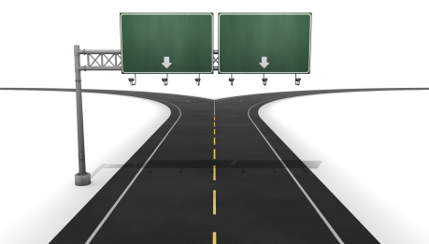
Pre-commitment gives the rider control over the elephant’s future environment.
Many Temptations
Few Temptations

Slide 7
Pre-commitment Strategies
1.
Change the rewards and penalties
2.
Change the number of decision points

Slide 8

Each decision point is an opportunity to change direction
Increase decision points required for negative options
Decrease decision points required for positive options

Slide 9


Increasing decision points
required for negative options
  Partitions
  Waiting periods
  Availability
Decreasing decision points
Required for positive options
  Habit
  Removing distractions
  Lifestyle commitments

Slide 10
Partitions theory
“We propose that encountering a partition during consumption increases the amount of attention consumers pay to the decision, giving them a “decision point” at which to evaluate whether to continue, and thus shifts consumption decision from an automatic mode to a deliberative mode.”
A. Cheema (Washington U.) & D. Soman (U. Toronto), 2008, The effect of partitions on controlling consumption. Journal of Marketing Research, 45, 665-675.

Slide 11
Students completing an unrelated assignment given 20 cookies in a box either separated by paper partitions or not
A. Cheema (Washington U.) & D. Soman (U. Toronto), 2008, The effect of partitions on controlling consumption. Journal of Marketing Research, 45, 665-675.

Slide 12
Participants given box of six chocolates either individually wrapped in box or unwrapped in box and asked to eat within 7 days.
A. Cheema (Washington U.) & D. Soman (U. Toronto), 2008, The effect of partitions on controlling consumption. Journal of Marketing Research, 45, 665-675.

Slide 13
Students given 100 coupons divided into 1, 4, or 10 envelopes. Each coupon could be exchanged for cash or gambled.
A. Cheema (Washington U.) & D. Soman (U. Toronto), 2008, The effect of partitions on controlling consumption. Journal of Marketing Research, 45, 665-675.

Slide 14

What if students were first told about the negative aspects of gambling (stress, poor health, debt, etc.)? Did receiving this information in advance
Reduce the impact of the partitions (multiple envelopes)
Increase the impact of the partitions (multiple envelopes)
Have no effect

Slide 15
Partitions → Rational Deliberation
A. Cheema (Washington U.) & D. Soman (U. Toronto), 2008, The effect of partitions on controlling consumption. Journal of Marketing Research, 45, 665-675.

Slide 16

Mental accounting
The power of imaginary partitions

Slide 17

Mental accounts
(partitions)
In standard economics a dollar is a dollar is a dollar. Money is “fungible”
In behavioral economics, people put money into different mental categories and react differently to fluctuations in different categories

Slide 18
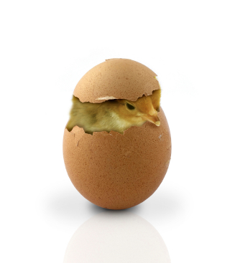
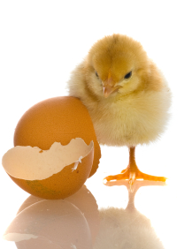

Three broad mental accounts (partitions)
Current income account
Checking account, cash
Routinely Spent
Asset account
Savings account, stocks & bonds
Designated for saving
Future income account
Retirement savings
Rarely spent

Slide 19
“People typically show different propensities to consume from their current income (where marginal propensity to consume is high), current assets (where it is intermediate), and future income (where it is low).”
Current income account
Asset account
Future income account
M. Bertrand (U. Chicago), S. Mullainathan (MIT), & E. Shafir (Princeton), 2004, A Behavioral-Economics View of Poverty. American Economic Review, 94, 419-423, 420

Slide 20

Mental accounting as budget categories
“Also, contrary to standard fungibility assumptions, people compartmentalize wealth and spending into distinct budget categories, such as savings, rent, and entertainment, and into separate mental accounts, such as current income, assets, and future income.
http://www.youtube.com/watch?v=qNIroV6Pas4
M. Bertrand (U. Chicago), S. Mullainathan (MIT), & E. Shafir (Princeton), 2004, A Behavioral-Economics View of Poverty. American Economic Review, 94, 419-423, 420

Slide 21
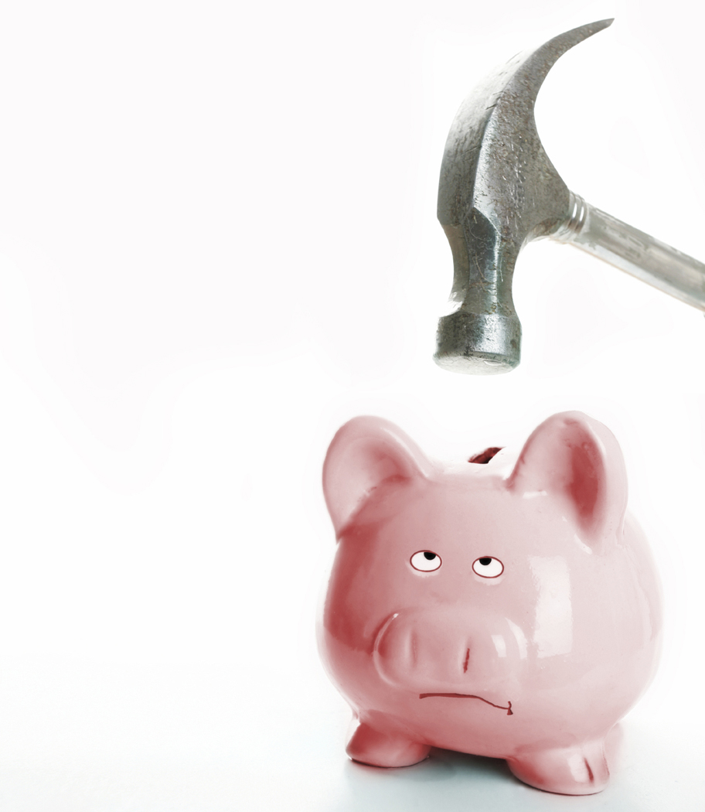
Financial partitioning device

Slide 22
Increasing decision points required to choose a negative option
Partitions
Waiting periods
Availability

Slide 23

Mandatory cooling off periods can reduce problems from hyperbolic discounting and hot state decisions.
If I have to wait to get the result, then it is no longer a “now v. later” decision.
Choices requiring consistency over time reduce the likelihood of “hot state” decisions

Slide 24

Covenant marriage and waiting periods
Louisiana standard marriage: divorce granted if spouses have been living separate and apart continuously for a period of six months
Louisiana covenant marriage: divorce granted if living apart for two years

Slide 25

A credit request freeze allows consumers to freeze their credit files. No credit applications without going through the thaw request process.

Slide 26

Example:
Putting your credit card in a block of ice
Can you implement your own mandatory cooling off periods?
Gold Credit Card
0000 2222 1001 0051
Other ideas?

Slide 27
Increasing decision points required to choose a negative option
Partitions
Waiting periods
Availability

Slide 28

(appealing) Availability
(eventually) Beats
(rational) Cognition
Immediate availability reduces the decision points needed to consume a
tempting
option.

Slide 29
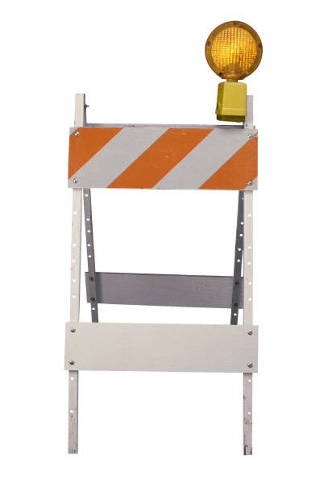
Limiting availability may involve physical separation or intentionally avoiding information about temptations

Slide 30

Avoiding information about temptations
I need to work on an assignment…
if I check the TV
Guide, I may find
something that will tempt me
if I don’t check
I remain intentionally ignorant of the temptations

Slide 31

Avoiding information about temptations
“some years ago voices in the Norwegian government opposed exploratory oil drilling north of 62 degrees latitude. To those who argued that it could do no harm and might be useful to know whether there was oil in the region, these critics replied that if one found oil there would be an irresistible pressure on politicians to begin exploitation immediately. The critics lost, and were proven right.”
J. Elster (Columbia U.), 2000, Ulysses unbound. Cambridge University Press, Cambridge, UK

Slide 32

Reducing availability of temptations
“‘If you have an electric line coming in then you’d want a full line of appliances on it. The Amish are human too, you know.’ Another person noted: ‘It’s not so much the electric that we’re against, it’s all the things that came with it – all the modern conveniences, television, computers.”
D. Kraybill, 1989, The Riddle of Amish Culture, Baltimore: Johns Hopkins U. Press, p. 154-155
Notes:
http://www.flickr.com/photos/deeptrivia/294206235/

Slide 33
Increasing decision points
required for negative options
  Partitions
  Waiting periods
  Availability
Decreasing decision points
Required for positive options
  Habit
  Removing distractions
  Lifestyle commitments

Slide 34

“Creating a good habit requires much conscious effort, but once the groove has been produced the acts which make up a habitual pattern are not consciously willed.”
H. Keane (Australian National U.), 2000, Setting yourself free: Techniques of recovery. Health, 4, 324-346.

Slide 35

“higher consumption of a particular good in the current period makes consumers, all other things equal, more willing to buy that good in the future through the force of habit.”
M. RAVN (European University Institute), S. SCHMITT-GROHÉ (Duke U.) & M. URIBE (Duke U.), 2006, Deep Habits, Review of Economic Studies, 73, 195–218

Slide 36

Consumers’ choices over different brands of goods are affected by past brand choices
“the estimates suggest that there exist large habit effects”
P. Chintagunta (U. Chicago), E. Kyriazidou (UCLA), & J. Perktold, (U. Chicago) 2001,Panel data analysis of household brand choices, Journal of Econometrics, 103, 111-153

Slide 37
Decreasing decision points required to choose a positive option
Habit
Removing distractions
Lifestyle commitments

Slide 38

Removing distractions
Each distraction requires a decision: continue pursuing my long-term goal or pursue the distraction.
As distractions increase, the likelihood of switching from the goal increases

Slide 39
Important
Zone of Competence
Zone of Greatness
Urgent
Not
Urgent
Active Distractions
Passive Distractions
Not Important

Slide 40
Television?
Important
Zone of Competence
Zone of Greatness
Urgent
Not
Urgent
Active Distractions
Passive Distractions
Not Important

Slide 41
Most text messages?
Important
Zone of Competence
Zone of Greatness
Urgent
Not
Urgent
Active Distractions
Passive Distractions
Not Important

Slide 42
Games for a professional athlete?
Important
Zone of Competence
Zone of Greatness
Urgent
Not
Urgent
Active Distractions
Passive Distractions
Not Important

Slide 43
Practice for a professional athlete?
Important
Zone of Competence
Zone of Greatness
Urgent
Not
Urgent
Active Distractions
Passive Distractions
Not Important

Slide 44
Practice for a musician?
Important
Zone of Competence
Zone of Greatness
Urgent
Not
Urgent
Active Distractions
Passive Distractions
Not Important

Slide 45
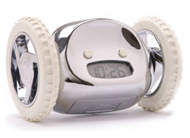
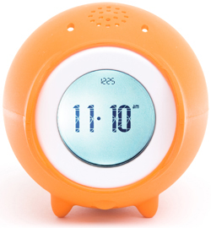
Use technology to fight distractions!
E-mail reminders and alerts
The Clocky: alarm clock rolls off your nightstand and runs away if you try to hit the snooze button, to force you to get out of bed!
The Tocky: like the Clocky, but makes noises that you can record to get you out of bed quicker

Slide 46
Decreasing decision points required to choose a positive option
Habit
Removing distractions
Lifestyle commitments

Slide 47

Some circumstances provide the opportunity to make a lifestyle commitment by adopting a highly developed pre-existing set of behavioral expectations

Slide 48

Adherents are not faced with a variety of decision points on individual items, because the lifestyle package must be taken as a whole or rejected as a whole

Slide 49
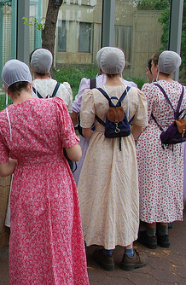
This pre-existing “package” option may come from the history and tradition of a group…

Slide 50

… from a text or set of texts…

Slide 51

Or even by the mutual understanding of only two people.

Slide 52

The lifestyle option reduces future decision points by allowing for a single commitment to accept or reject the entire package, rather than an ongoing struggle of deciding for or against individual elements.

Slide 53
Increasing decision points
required for negative options
  Partitions
  Waiting periods
  Availability
Decreasing decision points
Required for positive options
  Habit
  Removing distractions
  Lifestyle commitments

