Slide 1
Chapter 1: Introduction
ECO41 International Economics
Udayan Roy
Based on International Economics: Theory and Policy, by Paul Krugman, Maurice Obstfeld, and Marc Melitz, Eleventh Edition, 2018

Slide 2
Contents
What Is International Economics About?
International Trade
The Gains from Trade
The Pattern of Trade
How Much Trade?
International Finance
Balance of Payments
Exchange Rate Determination
International Policy Coordination
The International Capital Market
International Economics: Trade and Money

Slide 3
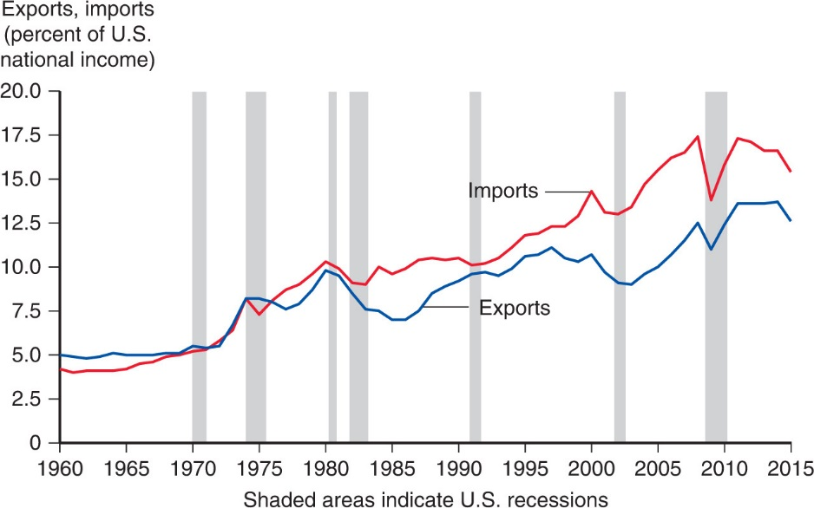
Figure 1-1 Exports and Imports as a Percentage of U.S. National Income
We earn income by producing goods and services
The share of our production that is exported has been increasing
The share of our spending that is spent on imported goods and services has been increasing
As our national income has been rising over time, the actual dollar amounts of exports and imports have been increasing even faster

Slide 4
Figure 1-1 Exports and Imports as a Percentage of U.S. National Income
Exports and imports go up during business cycle recoveries and down during business cycle recessions

Slide 5
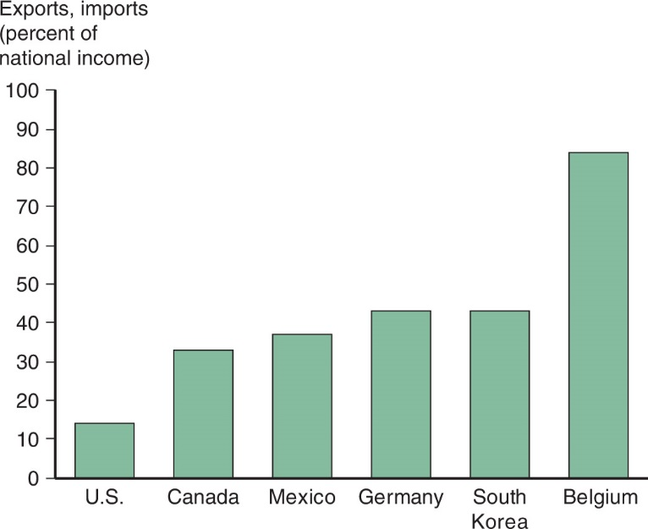
Figure 1.2 Average of Exports and Imports as Percentages of National Income in 2015
Trade is more important in smaller countries
Why?
The average of exports and imports as a percentage of national income, in 2015. Source: OECD

Slide 6
Figure 1.2 Average of Exports and Imports as Percentages of National Income in 2015
Trade is more important in smaller countries
Why?
A small country will usually not be representative of the world as a whole.
So it may have significant advantages in the production of some goods/services and significant disadvantages in the production of other goods/services
Such mismatches with the rest of the world usually lead to a lot of trade
The average of exports and imports as a percentage of national income, in 2015. Source: OECD

Slide 7
Figure 1.2 Average of Exports and Imports as Percentages of National Income in 2015
Trade is more important in smaller countries
Why?
In some cases, production costs can be kept low only if the volume of production is high.
In such cases, producers in small countries may not be competitive unless they export a lot of their output
This is yet another reason why Belgium trades a lot more than the US
The average of exports and imports as a percentage of national income, in 2015. Source: OECD

Slide 8
Figure 1.2 Average of Exports and Imports as Percentages of National Income in 2015
Trade is more important in smaller countries
Question: Rank the following places according to the likely extent of cross-border trade: USA, New York, Long Island, Nassau County
The average of exports and imports as a percentage of national income, in 2015. Source: OECD

Slide 9
What Is International Economics About?
Goods and services flow across international borders. So do people. The effects of trade and migration are part of international economics.
Residents of one country may borrow money from and lend money to residents of other countries. The effects of this is also part of international economics.
Government policies of one country may affect other countries. This too is international economics.

Slide 10
Gains from Trade (1 of 4)
That there are gains from trade is probably the most important insight in international economics.
Countries selling goods and services to each other almost always generates mutual benefits.
When a buyer and a seller engage in a voluntary transaction, they are both usually better off.
Norwegian consumers import oranges that they would have a hard time producing in Norway.

Slide 11
Gains from Trade (2 of 4)
How could a country that is the most (least) efficient producer of everything gain from trade?
Countries use finite resources to produce what they are most productive at (compared to their other production choices), and then trade those products for what they want to consume.
Countries can specialize in production, while consuming a great diversity of goods and services through trade.

Slide 12
Gains from Trade (3 of 4)
Trade benefits countries by allowing them to export goods made with relatively abundant resources and import goods made with relatively scarce resources.
When countries specialize, they may be more efficient due to the larger scale of production.
Countries may also gain by trading current resources for future resources (international borrowing and lending) and from international migration.

Slide 13
Gains from Trade (4 of 4)
Trade is predicted to benefit countries as a whole in several ways, but trade may harm particular groups within a country.
International trade can harm the owners of resources that are used relatively intensively in industries that compete with imports.
Trade may therefore affect the distribution of income within a country.

Slide 14
Patterns of Trade
The pattern of trade describes who sells what to whom.
Differences in climate and resources explain why Brazil exports coffee and Saudi Arabia exports oil.
But why does Japan export automobiles, while the U.S. exports aircraft?
Why some countries export certain products can stem from differences in:
Labor productivity
Relative supplies of capital, labor and land and their use in the production of different goods and services

Slide 15
Effects of Government Policies on Trade (1 of 2)
Policy makers affect the amount of trade through
Tariffs: a tax on imports or exports,
Quotas: a quantity restriction on imports or exports,
Export subsidies: a payment to producers that export, or
Through other regulations (ex., product specifications) that exclude foreign products from the market, but still allow domestic products.
What are the costs and benefits of these policies?

Slide 16
Effects of Government Policies on Trade (2 of 2)
If a government restricts trade, what are the costs if foreign governments respond likewise?
Trade policies are often chosen to cater to special interest groups, rather than to maximize national welfare.
Governments tend to adopt tariffs, then negotiate them down in exchange for reduction in trade barriers of other countries.

Slide 17
International Finance Topics
Exchanging risky assets such as stocks and bonds can benefit all countries by diversification that reduces the variability of income – another source of gains from trade.
Most international trade involves monetary transactions.
Many monetary events have important consequences for international trade.

Slide 18
Balance of Payments
Governments measure the value of exports and imports, as well as the value of financial assets that flow into and out of their countries.
Trade deficits, where countries import more than they export in value, are made possible by net inflows of financial assets (borrowing).
The official settlements balance, or the balance of payments, measures the balance of funds that central banks use for official international payments.
All three values are measured in the government’s national income accounts.

Slide 19
Exchange Rate Determination
Exchange rates are an important financial issue for most governments.
Exchange rates measure how much domestic currency can be exchanged for foreign currency and thus affect how much:
Goods denominated in foreign currency (imports) cost in the domestic country.
Goods denominated in domestic currency (exports) cost in foreign markets.
Some exchange rates change continually (float) while others are fixed for periods of time.

Slide 20
International Policy Coordination
In an integrated economy, one country’s economic policies usually affect other countries as well, leading to the need for some degree of policy coordination.
Depends on type of exchange rate regime.
Capital markets, where money is exchanged (borrowed) for promises to repay in the future, have special concerns in an international setting:
Currency fluctuations can alter the value paid.
Countries, especially developing ones, might default on debt.

Slide 21
The International Capital Market
Capital markets are arrangements by which individuals and firms exchange money now for promises to pay in the future.
International capital markets cope with special regulations that countries impose on foreign investments.
Special risks of currency fluctuations and national default;
Sometimes offer opportunities to evade regulations placed on domestic markets.

Slide 22
International Trade Versus Finance
International trade focuses on transactions involving movement of goods and services across nations.
International trade theory (Econ/Trade Chapters 2–8) and policy (Econ/Trade Chapters 9–12).
International finance focuses on financial or monetary transactions across nations.
International monetary theory (Econ Chapters 13–18/Finance Chapters 2-7) and policy (Econ Chapters 19–22/Finance Chapters 8-11).

