Slide 1
Chapter 5
Resources and Trade: The Heckscher-Ohlin Model

Slide 2
Preview
Production possibilities
Changing the mix of inputs
Relationships among factor prices and goods prices, and resources and output
Trade in the Heckscher-Ohlin model
Factor price equalization
Trade and income distribution
Empirical evidence

Slide 3
Introduction
The Ricardian theory (Ch. 3) showed how trade can arise because of differences in labor productivity
The Heckscher-Ohlin theory argues that, in addition, trade also occurs due to
differences in the availability of labor, labor skills, physical capital, capital, or other factors of production across countries, and
differences in the needs for the various resources across industries

Slide 4
2 × 2 × 2 Heckscher-Ohlin Model
Two countries: home and foreign.
Two goods: cloth and food.
Two factors of production: labor and capital.
Consumer preferences are identical for all individuals
The same technological knowledge is available everywhere
The mix of labor and capital used in production varies across goods.
The supply of labor and capital in each country is constant and varies across countries.
Both labor and capital can move across sectors.

Slide 5
Choosing the Mix of Inputs
To produce a given amount of cloth (or food), a firm may choose different amounts of labor and capital depending on the wage, w, paid to labor and the rental rate, r, paid when renting capital.

Slide 6
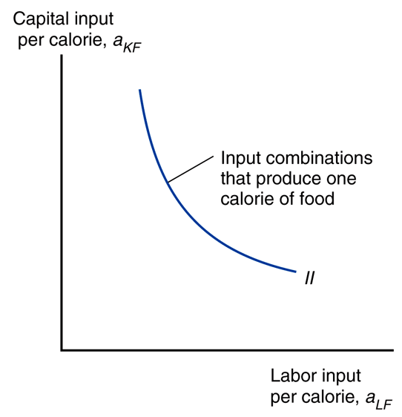
Input Possibilities in Food Production

Slide 7
Choosing the Mix of Inputs
To produce a given amount of cloth (or food), a firm may choose different amounts of labor and capital depending on the wage, w, paid to labor and the rental rate, r, paid when renting capital.
When the wage w increases relative to the rental rate r, we say that the wage-rental ratio w/r increases
When the wage-rental ratio w/r increases, producers use less labor and more capital in the production of both food and cloth.
That is, when w/r increases, the labor-capital ratio L/K decreases in the cloth industry and in the food industry

Slide 8
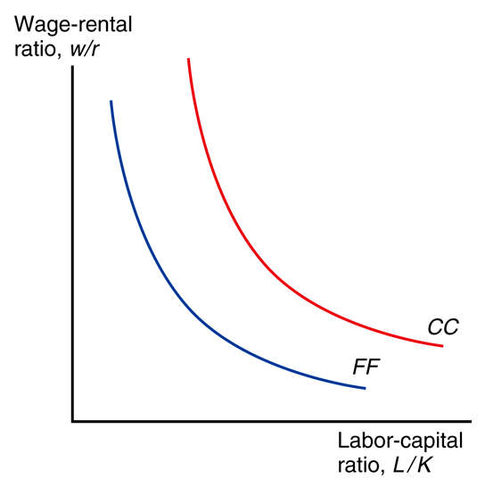
Factor Price Ratios and Input Choice Ratios
This is the Relative Factor Demand Curve
As both countries are assumed to use the same technology, the same relative factor demand curve is true in both countries.
So, if two countries have the same w/r, then they will have the same L/K in food production.

Slide 9
Input Choice Ratios Define Resource Intensity in Production
Assumption: For any given values of w and r, cloth production uses more labor relative to capital than food production uses:
a_{LC} /a_{KC} > a_{LF} /a_{KF} or L_{C} /K_{C} > L_{F} /K_{F}
In this case, we say that,
production of cloth is relatively labor intensive, while
production of food is relatively capital intensive.

Slide 10
Factor Price Ratios and Input Choice Ratios
This is the Relative Factor Demand Curve
Remember our assumption: Cloth is labor intensive; Food is capital intensive

Slide 11
Factor Price Ratios and Input Choice Ratios
This is the Relative Factor Demand Curve
Remember our assumption:
Cloth is labor intensive;
Food is capital intensive

Slide 12
Factor Price Ratios and Goods Price Ratios
In competitive markets, the price of a good should equal its cost of production
And the cost of production depends on the factor prices, w and r.
How the cost of production depends on w and r depends, in turn, on the mix of labor and capital used in production.
An increase in the wage rate of labor should affect the price of cloth more than the price of food since cloth is the labor-intensive industry.
Therefore, an increase in w/r causes an increase in P_{C}/P_{F}.
This idea gives us the Stolper-Samuelson curve.

Slide 13
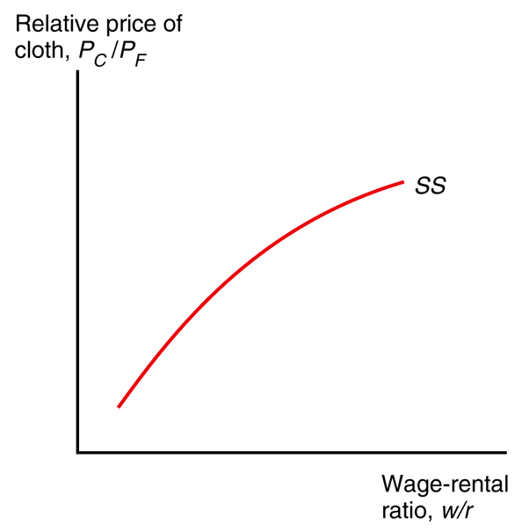
Factor Price Ratios and Goods Price Ratios
The dependence of the relative price of cloth (P_{C}/P_{F}) on the wage-rental ratio (w/r) is called the Stolper-Samuelson (SS) curve.
As both countries are assumed to use the same technology, the same SS curve is true in both countries.

Slide 14
Factor Price Ratios and Goods Price Ratios
Trade equalizes the relative price of goods (such as cloth and food) across the trading countries.
An implication of the Stolper-Samuelson theory is that trade also equalizes the relative price of factors (such as labor and capital).
And if trade increases the relative price of the labor-intensive good (cloth), then it also increases the relative price of labor.
P_{C2}/P_{F2}
P_{C1}/P_{F1}
w₁/r₁
w₂/r₂

Slide 15
Factor Price Ratios and Goods Price Ratios (cont.)
Stolper-Samuelson theorem: If the relative price of a good increases, then the relative price of the factor used intensively in the production of that good increases, while the relative price of the other factor decreases.
As a result, any change in the relative price of goods alters the distribution of income between labor and capital.

Slide 16
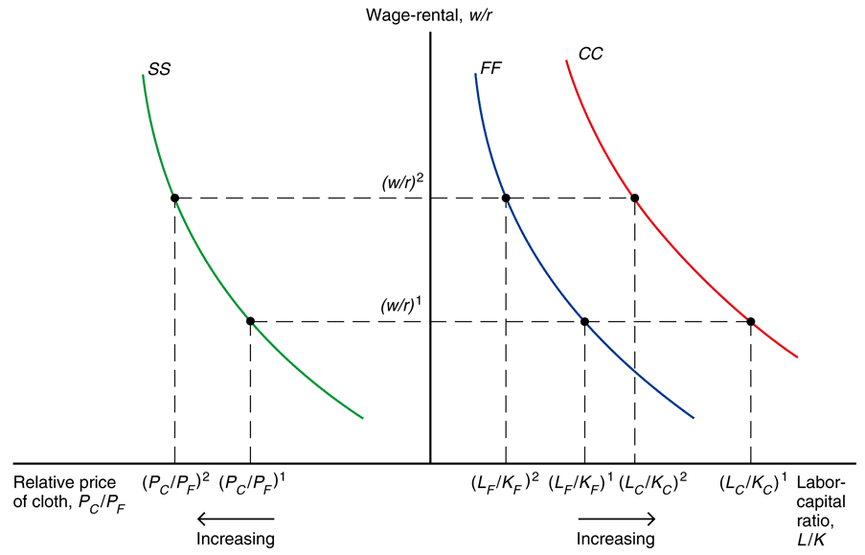
From Goods Price Ratios to Input Choice Ratios
As both countries use the same technology, all three curves apply to both countries.
Notes:
Suppose the price of cloth relative to the price of food is calculated as (P_{C}/P_{F})₁. If we also know the direct relationship between relative goods prices and relative factor prices given (the SS curve), then we can determine relative factor prices--the wage/rental ratio. Once we determine the wage/rental ratio and determine the CC and FF curves, we can determine the capital to labor ratio in both the cloth and food industries (from the relative factor demand curve). In sum, given output prices, we can determine not only factor prices, but factor levels in the Heckscher-Ohlin model.

Slide 17
Fig. 5-7: From Goods Price Ratios to Input Choice Ratios
4. So, productivity of capital decreases in both industries, and productivity of labor increases in both industries
5. So, w/P_{C} and w/P_{F} both increase, whereas r/P_{C} and r/P_{F} both decrease
As both countries use the same technology, all three curves apply to both countries.
2. … w/r increases.
1. When P_{C}/P_{F} increases …
3. So, L/K decreases in both industries
Notes:
Suppose the price of cloth relative to the price of food is calculated as (P_{C}/P_{F})₁. If we also know the direct relationship between relative output prices and relative factor prices given by the SS curve, then we can determine relative factor prices--the wage/rental ratio. Once we determine the wage/rental ratio and determine the CC and FF curves, we can determine the capital to labor ratio in both the cloth and food industries.
In sum, given output prices, we can determine not only factor prices, but factor levels in the Heckscher-Ohlin model.

Slide 18
From Input Choice Ratios to Productivity to Input Prices
When L_{C}/K_{C} increases, capital becomes more productive and labor becomes less productive (in the cloth sector)
Why? Imagine the number of workers per machine goes from 2 to 20.
Wouldn’t a worker be less productive when forced to share a machine with more workers?
Wouldn’t a machine produce more when used by 20 workers rather than 2?
Similarly, when L_{F}/K_{F} increases, capital becomes more productive and labor becomes less productive (in the food sector)

Slide 19
From Input Choice Ratios to Productivity to Input Prices
When L_{C}/K_{C} increases, capital becomes more productive and labor becomes less productive (in the cloth sector)
As a result, the reward to capital (r/P_{C}) increases and the reward to labor (w/P_{C}) decreases
Similarly, when L_{F}/K_{F} increases, capital becomes more productive and labor becomes less productive (in the food sector)
As a result, the reward to capital (r/P_{F}) increases and the reward to labor (w/P_{F}) decreases

Slide 20
Stolper-Samuelson Theorem
When P_{C}/P_{F} ↑, w/r ↑.
So, L/K ↓ in both industries
So, productivity of capital ↓ in both industries, and
productivity of labor ↑ in both industries.
So, w/P_{C} and w/P_{F} both ↑, whereas
r/P_{C} and r/P_{F} both ↓.
When P_{C}/P_{F} ↓, w/r ↓.
So, L/K ↑ in both industries
So, productivity of capital ↑ in both industries, and
productivity of labor ↓ in both industries.
So, w/P_{C} and w/P_{F} both ↓, whereas
r/P_{C} and r/P_{F} both ↑.

Slide 21
Resources and Output
How do levels of output change when the economy’s resources change?
Rybczynski theorem: If you hold output prices constant as the amount of a factor of production increases, then the supply of the good that uses this factor intensively increases and the supply of the other good decreases.

Slide 22
Rybczynski Theorem
Assume that the price of cloth in units of food (P_{C}/P_{F}) is the same in Home and Foreign
This will be the case under free trade, as we will soon see
Then, by the Stolper-Samuelson theorem, the price of labor in units of capital (w/r) will also be the same in Home and Foreign
Then, as both Home and Foreign have the same technology and, therefore, the same relative factor demand, the amount of labor per unit of capital in food production (L_{F}/K_{F}) must be the same in both Home and Foreign
This must also be true for L_{C}/K_{C} in cloth production

Slide 23
Rybczynski Theorem: Twinkies Example
Imagine two goods: Regular Twinkies and Low-Fat Twinkies
Every Regular Twinkie has twice as much sugar as fat
Every Low-Fat Twinkie has five times as much sugar as fat
These ratios do not change
Q: Now, if you hear that Twinkies America uses three times as much sugar as fat and Twinkies Brazil uses four times as much sugar as fat, what would you conclude?

Slide 24
Rybczynski Theorem: Twinkies Example
Imagine two goods: Regular Twinkies and Low-Fat Twinkies
Every Regular Twinkie has twice as much sugar as fat
Every Low-Fat Twinkie has five times as much sugar as fat
These ratios do not change
Q: Now, if you hear that Twinkies America uses three times as much sugar as fat and Twinkies Brazil uses four times as much sugar as fat, what would you conclude?
A: Twinkies Brazil produces more Low-Fat Twinkies (relative to Regular Twinkies) than does Twinkies America

Slide 25
Rybczynski Theorem: Back to Cloth and Food
Imagine two goods: Cloth and Food
Every unit of Food uses twice as much Labor as Capital
Every unit of Cloth uses five times as much Labor as Capital
These ratios do not change
Q: Now, if you hear that America employs three times as much Labor as Capital and Brazil employs four times as much Labor as Capital, what would you conclude?
A: Brazil’s production of Cloth relative to Food is higher than America’s.
As Brazil has higher L/K, it must be that Brazil has higher Q_{C}/Q_{F}.

Slide 26
Resource Availability Ratios and Output Ratios
Assume an economy’s labor force grows, which implies that the ratio of labor to capital, L/K, increases.
Expansion of production possibilities is biased toward cloth.
At a given goods price ratio, the input choice ratio (of labor to capital) remains constant in both the cloth and food sectors.
To employ the additional workers, the economy expands production of the relatively labor-intensive good cloth and contracts production of the relatively capital-intensive good food.

Slide 27
Resource Availability Ratios and Output Ratios
An economy with a high ratio of labor to capital produces a high output of cloth relative to food.
Assumption: Home is labor abundant and Foreign is capital abundant:
L/K > L*/ K*
Likewise, Home is capital scarce and Foreign is labor scarce.
Home, the labor-abundant country, will be relatively efficient at producing cloth because cloth is the labor intensive good.

Slide 28
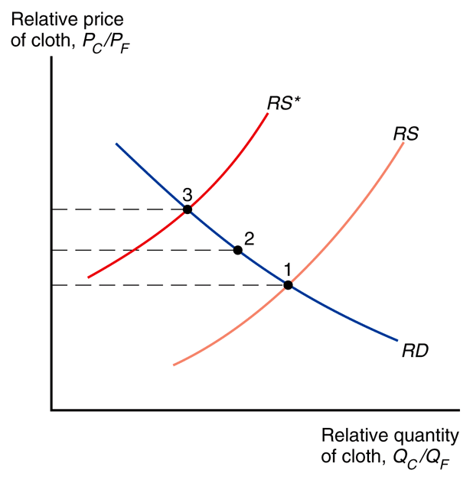
Relative Supply Curves: Goods Price Ratios to Output Ratios
RS*
Assumption: Home is labor abundant and Foreign is capital abundant
RS

Slide 29
Relative Demand Curve: From Goods Price Ratios to Goods Consumption Ratios
Heckscher-Ohlin assumes that people have identical preferences everywhere. So, the same Relative Demand curve is true in both Home and Foreign.
Relative Price of Cloth, P_{C}/P_{F}.
RD
Relative Quantity of Cloth Consumed, Q_{C}/Q_{F}.

Slide 30
Fig. 5-9: Trade Leads to a Convergence of Relative Prices
3: Autarky Foreign
2: Free Trade
1: Autarky: Home

Slide 31
From Autarky to Free Trade
So, under our assumptions,
The autarky relative price of cloth P_{C}/P_{F} will be lower in Home and higher in Foreign.
Equivalently, the autarky relative price of food P_{F}/P_{C} will be higher in Home and lower in Foreign.
Therefore, under free trade, Home will export cloth to Foreign, and
Foreign will export food to Home

Slide 32
From Autarky to Free Trade
Recall that we assumed:
Cloth is labor intensive and food is capital intensive
Home is labor abundant and Foreign is capital abundant
So, we see that the labor abundant country (Home) exports the labor intensive good (Cloth), and
the capital abundant country (Foreign) exports the capital intensive good (Food)

Slide 33
From Autarky to Free Trade
Heckscher-Ohlin Theorem: Each country exports the good that relatively intensively uses the factor of production relatively abundant in that country

Slide 34
Fig. 5-9: Trade Leads to a Convergence of Relative Prices
So, when autarky gives way to free trade, P_{C}/P_{F} ↑ in Home and ↓ in Foreign, till P_{C}/P_{F} becomes the same in the two countries .
3: Autarky Foreign
2: Free Trade
1: Autarky: Home

Slide 35
Stolper-Samuelson Theorem
When P_{C}/P_{F} ↑, w/r ↑.
So, L/K ↓ in both industries
So, productivity of capital ↓ in both industries, and
productivity of labor ↑ in both industries.
So, w/P_{C} and w/P_{F} both ↑, whereas
r/P_{C} and r/P_{F} both ↓.
When P_{C}/P_{F} ↓, w/r ↓.
So, L/K ↑ in both industries
So, productivity of capital ↑ in both industries, and
productivity of labor ↓ in both industries.
So, w/P_{C} and w/P_{F} both ↓, whereas
r/P_{C} and r/P_{F} both ↑.
HOME labor abundant
FOREIGN capital abundant

Slide 36
From Autarky to Free Trade
Therefore, we see that in each country, the relatively abundant factor of production gains – and the relatively scarce resource loses – from globalization

Slide 37
The Factor Price Equalization Theorem
4. So, productivity of capital in any industry – and productivity of labor in any industry – is equalized across the two countries
5. So, w/P_{C} is equalized across the two countries, as are w/P_{F}, r/P_{C} and r/P_{F}
As both countries use the same technology, all three curves apply to both countries.
2. So w/r is equalized.
1. Under free trade, P_{C}/P_{F} is equalized across the two countries.
3. So, L/K in any industry is equalized across the two countries.

Slide 38
Trade in the Heckscher-Ohlin Model
The countries are assumed to have the same technology and the same tastes.
With the same technology, each economy has a comparative advantage in producing the good that relatively intensively uses the factors of production in which the country is relatively well endowed.
With the same tastes, the two countries will consume cloth to food in the same ratio when faced with the same relative price of cloth under free trade.

Slide 39
Trade in the Heckscher-Ohlin Model (cont.)
Since cloth is relatively labor intensive, at each relative price of cloth to food, Home will produce a higher ratio of cloth to food than Foreign.
Home will have a larger relative supply of cloth to food than Foreign.
Home’s relative supply curve lies to the right of Foreign’s.

Slide 40
Trade in the Heckscher-Ohlin Model (cont.)
Like the Ricardian model, the Heckscher-Ohlin model predicts a convergence of relative prices under free trade.
Under free trade, the relative price of cloth rises in the relatively labor abundant (home) country and falls in the relatively labor scarce (foreign) country.

Slide 41
Trade in the Heckscher-Ohlin Model (cont.)
Relative prices and the pattern of trade: In Home, the rise in the relative price of cloth leads to a rise in the relative production of cloth and a fall in relative consumption of cloth.
Home becomes an exporter of cloth and an importer of food.
The decline in the relative price of cloth in Foreign leads it to become an importer of cloth and an exporter of food.

Slide 42
Trade in the Heckscher-Ohlin Model (cont.)
Heckscher-Ohlin theorem: An economy has a comparative advantage in producing, and thus will export, goods that are relatively intensive in using its relatively abundant factors of production,
and will import goods that are relatively intensive in using its relatively scarce factors of production.

Slide 43
Factor Price Equalization
Unlike the Ricardian model, the Heckscher-Ohlin model predicts that factor prices will be equalized among countries that trade.
Free trade equalizes relative output prices.
Due to the connection between output prices and factor prices, factor prices are also equalized.
Trade increases the demand of goods produced by relatively abundant factors, indirectly increasing the demand of these factors, raising the prices of the relatively abundant factors.

Slide 44
Factor Price Equalization (cont.)
In the real world, factor prices are not equal across all trading countries.
The Heckscher-Ohlin model assumes that trading countries produce the same goods, but countries may produce different goods if their factor ratios radically differ.
The model also assumes that trading countries have the same technology, but different technologies could affect the productivities of factors and therefore the wages/rates paid to these factors.

Slide 45
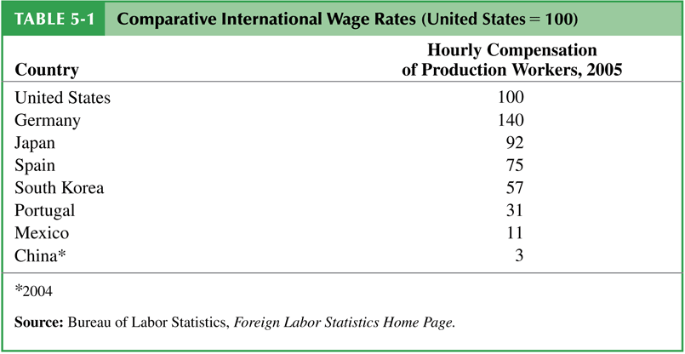
Table 5-1: Comparative International Wage Rates (United States = 100)

Slide 46
Table 5.1 Comparative International Wage Rates
Country | Hourly Compensation of Manufacturing Workers 2015 (United States = 100)
United States | 100
Germany | 112
Japan | 63
Spain | 63
South Korea | 60
Brazil | 31
Mexico | 16
China (2013) | 11.3
India (2012) | 4.5
Source: The Conference Board, International Labor Comparisons.

Slide 47
Factor Price Equalization (cont.)
The model also ignores trade barriers and transportation costs, which may prevent output prices and thus factor prices from equalizing.
The model predicts outcomes for the long run, but after an economy liberalizes trade, factors of production may not quickly move to the industries that intensively use abundant factors.
In the short run, the productivity of factors will be determined by their use in their current industry, so that their wage/rental rate may vary across countries.

Slide 48
Does Trade Increase Income Inequality?
Over the last 40 years, countries like South Korea, Mexico, and China have exported to the U.S. goods intensive in unskilled labor (ex., clothing, shoes, toys, assembled goods).
At the same time, income inequality has increased in the U.S., as wages of unskilled workers have grown slowly compared to those of skilled workers.
Did the former trend cause the latter trend?

Slide 49
Does Trade Increase Income Inequality? (cont.)
The Heckscher-Ohlin model predicts that owners of relatively abundant factors will gain from trade and owners of relatively scarce factors will lose from trade.
Little evidence supporting this prediction exists.
According to the model, a change in the distribution of income occurs through changes in output prices, but there is no evidence of a change in the prices of skill-intensive goods relative to prices of unskilled-intensive goods.

Slide 50
Does Trade Increase Income Inequality? (cont.)
According to the model, wages of unskilled workers should increase in unskilled labor abundant countries relative to wages of skilled labor, but in some cases the reverse has occurred:
Wages of skilled labor have increased more rapidly in Mexico than wages of unskilled labor.
But compared to the U.S. and Canada, Mexico is supposed to be abundant in unskilled workers.
Even if the model were exactly correct, trade is a small fraction of the U.S. economy, so its effects on U.S. prices and wages prices should be small.

Slide 51
Trade and Income Distribution
Changes in income distribution occur with every economic change, not only international trade.
Changes in technology, changes in consumer preferences, exhaustion of resources and discovery of new ones all affect income distribution.
Economists put most of the blame on technological change and the resulting premium paid on education as the major cause of increasing income inequality in the US.
It would be better to compensate the losers from trade (or any economic change) than prohibit trade.
The economy as a whole does benefit from trade.

Slide 52
Trade and Income Distribution (cont.)
There is a political bias in trade politics: potential losers from trade are better politically organized than the winners from trade.
Losses are usually concentrated among a few, but gains are usually dispersed among many.
Each of you pays about $8/year to restrict imports of sugar, and the total cost of this policy is about $2 billion/year.
The benefits of this program total about $1 billion, but this amount goes to relatively few sugar producers.

Slide 53
Empirical Evidence on the Heckscher-Ohlin Model
Tests on US data
Wassily Leontief found that U.S. exports were less capital-intensive than U.S. imports, even though the U.S. is the most capital-abundant country in the world: Leontief paradox.
Tests on global data
Bowen, Leamer, and Sveikauskas tested the Heckscher-Ohlin model on data from 27 countries and confirmed the Leontief paradox on an international level.

Slide 54
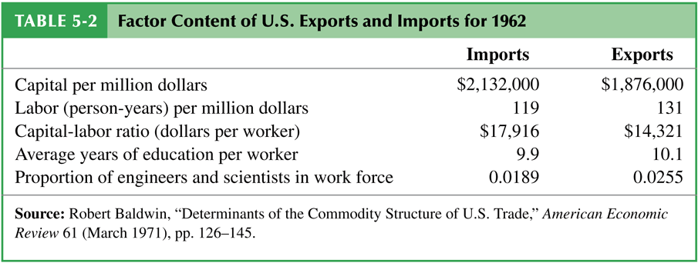
Table 5-2: Factor Content of U.S. Exports and Imports for 1962

Slide 55
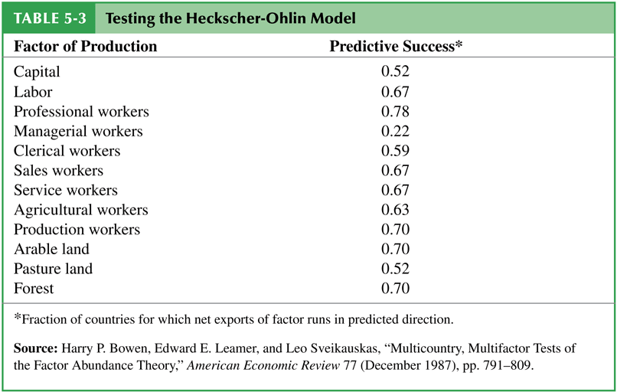
Table 5-3: Testing the Heckscher-Ohlin Model

Slide 56
Empirical Evidence of the Heckscher-Ohlin Model (cont.)
Because the Heckscher-Ohlin model predicts that factor prices will be equalized across trading countries, it also predicts that factors of production will produce and export a certain quantity goods until factor prices are equalized.
In other words, a predicted value of services from factors of production will be embodied in a predicted volume of trade between countries.

Slide 57
Empirical Evidence of the Heckscher-Ohlin Model (cont.)
But because factor prices are not equalized across countries, the predicted volume of trade is much larger than actually occurs.
A result of “missing trade” discovered by Daniel Trefler.
The reason for this “missing trade” appears to be the assumption of identical technology among countries.
Technology affects the productivity of workers and therefore the value of labor services.
A country with high technology and a high value of labor services would not necessarily import a lot from a country with low technology and a low value of labor services.

Slide 58
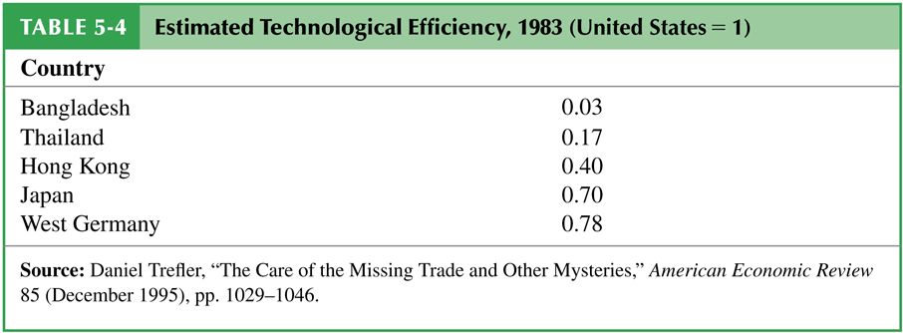
Table 5-4: Estimated Technological Efficiency, 1983 (United States = 1)

Slide 59
Empirical Evidence of the Heckscher-Ohlin Model (cont.)
Looking at changes in patterns of exports between developed (high income) and developing (low/middle income) countries supports the theory.
US imports from Bangladesh are highest in low-skill-intensity industries, while US imports from Germany are highest in high- skill-intensity industries.

Slide 60
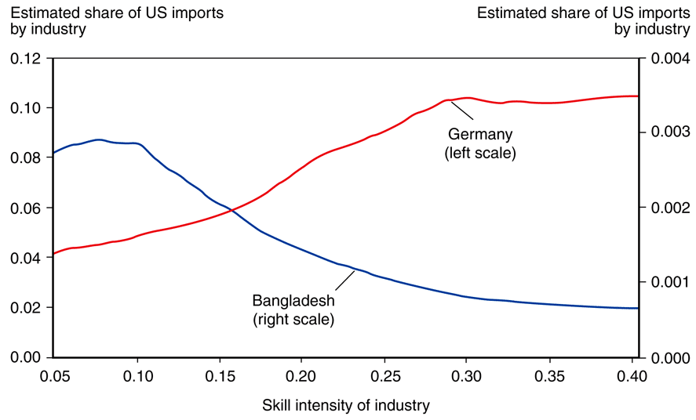
Fig. 5-12: Skill Intensity and the Pattern of U.S. Imports from Two Countries
Source: John Romalis, “Factor Proportions and the Structure of Commodity Trade,” American Economic Review 94 (March 2004), pp. 67–97.

Slide 61
Empirical Evidence of the Heckscher-Ohlin Model (cont.)
As Japan and the four Asian “miracle” countries became more skill-abundant, U.S. imports from these countries shifted from less skill-intensive industries toward more skill-intensive industries.

Slide 62
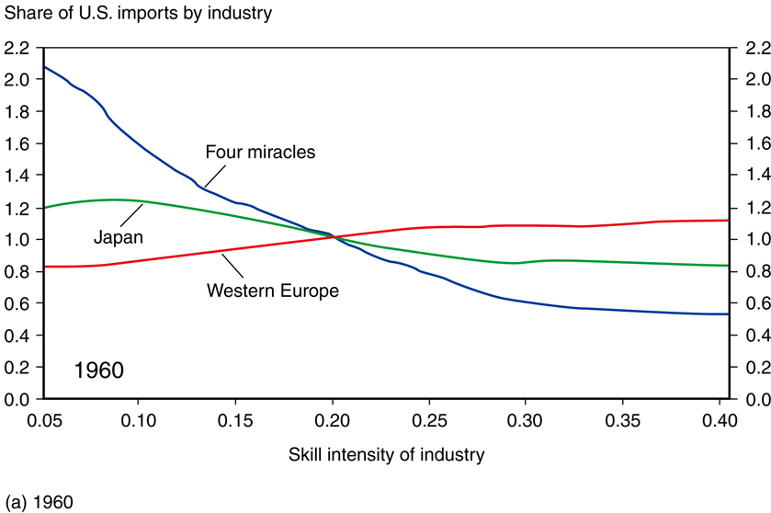
Fig. 5-13: Changing Patterns of Comparative Advantage

Slide 63
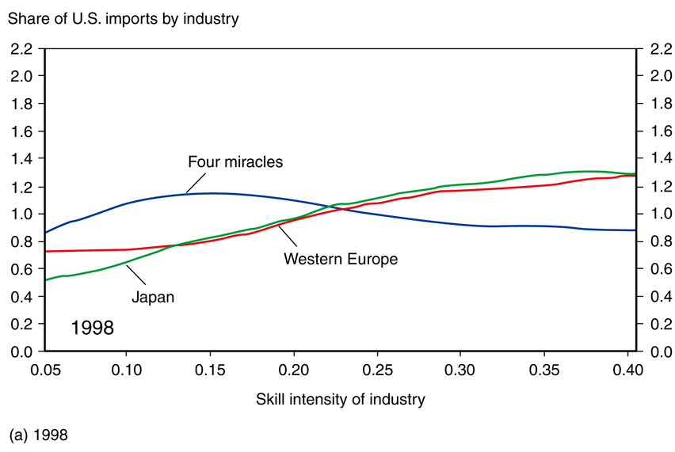
Fig. 5-13: Changing Patterns of Comparative Advantage (cont.)

Slide 64
Summary
Substitution of factors used in the production process generates a curved PPF.
When an economy produces a low quantity of a good, the opportunity cost of producing that good is low.
When an economy produces a high quantity of a good, the opportunity cost of producing that good is high.
When an economy produces the most value it can from its resources, the opportunity cost of producing a good equals the relative price of that good in markets.

Slide 65
Summary (cont.)
An increase in the relative price of a good causes the real wage or real rental rate of the factor used intensively in the production of that good to increase,
while the real wage and real rental rates of other factors of production decrease.
If output prices remain constant as the amount of a factor of production increases, then the supply of the good that uses this factor intensively increases, and the supply of the other good decreases.

Slide 66
Summary (cont.)
An economy exports goods that are relatively intensive in its relatively abundant factors of production and imports goods that are relatively intensive in its relatively scarce factors of production.
Owners of abundant factors gain, while owners of scarce factors lose with trade.
A country as a whole is predicted to be better off with trade, so winners could in theory compensate the losers within each country.

Slide 67
Summary (cont.)
The Heckscher-Ohlin model predicts that relative output prices and factor prices will equalize, neither of which occurs in the real world.
Empirical support of the Heckscher-Ohlin model is weak except for cases involving trade between high-income countries and low/middle- income countries or when technology differences are included.

