Slide 1
Labor Migration
Udayan Roy
http://myweb.liu.edu/~uroy/eco41

Slide 2
International Labor Mobility
This discussion of migration of labor across countries is based on:
Chapter 4 (Specific Factors and Income Distribution) of International Economics: Theory and Policy, Twelfth Edition, by Paul Krugman, Maurice Obstfeld, and Marc Melitz.
See especially the section on “International Labor Mobility”

Slide 3
Why Resources Migrate
Recall that Heckscher-Ohlin theory implies factor-price equalization
However, if the assumptions of Heckscher-Ohlin theory are not satisfied, the relative price of a resource may not be equal everywhere
When the relative price of a resource varies from country to country, there will be a strong economic incentive for the resource to migrate
from the low-price country to the high-price country.

Slide 4
Recap of Welfare Economics: Willingness to Pay and the Demand Curve
Price
A
The area under the demand curve measures the total willingness to pay of the buyers who bought Q₁ units. It also measures the maximum willingness to pay that could be obtained from Q₁ units
P₁
Earlier, we saw this concept applied to consumer goods, such as ice cream. But it is also true for resources, such as labor
B
C
Demand
0
Q₁
Quantity

Slide 5
We can see that A + B represents the total value of labor (or, businesses’ willingness to pay for labor)
The nominal (or, dollar) wage is w.
The nominal (or, dollar) price of a relevant good is p. Therefore, the real wage (in units of the good) is w/p.
But B represents the wages earned by the workers. This is 10 × 50.
Price of Labor, w/p
Therefore, A represents the surplus earned by firms. As capital is the only other resource, the surplus (A) goes to the owners of capital.
In short, A + B is the total output. B goes to labor as wages, and A goes to capital as profits.
A
10
Demand, which is the firms’ willingness to pay for labor
B
50
Quantity of Labor, L

Slide 6
The Relative Wage
The nominal wage (or, dollar wage) is w.
Example: w = $10 per hour
The nominal price (or, dollar price) of a representative good is p.
Example: p = $5 is the price of a quart of ice cream
Then the purchasing power of the (nominal) wage, in units of the representative good, is called the relative wage
It is measured as w/p.
Example: w/p = 2 quarts of ice cream is the relative wage for one hour’s work

Slide 7
Before and After Immigration
(w/p)_{home}
(w/p)_{foreign}
Labor Demand in Home
A
Labor Demand in Foreign
Pre-migration wage in Home
B
D
H
Wage in both countries when migration is complete
E
I
Populations before migration
F
C
Pre-migration wage in Foreign
G
J
Populations after migration
Home
employment
Foreign
employment
O
O*
Total world labor force

Slide 8
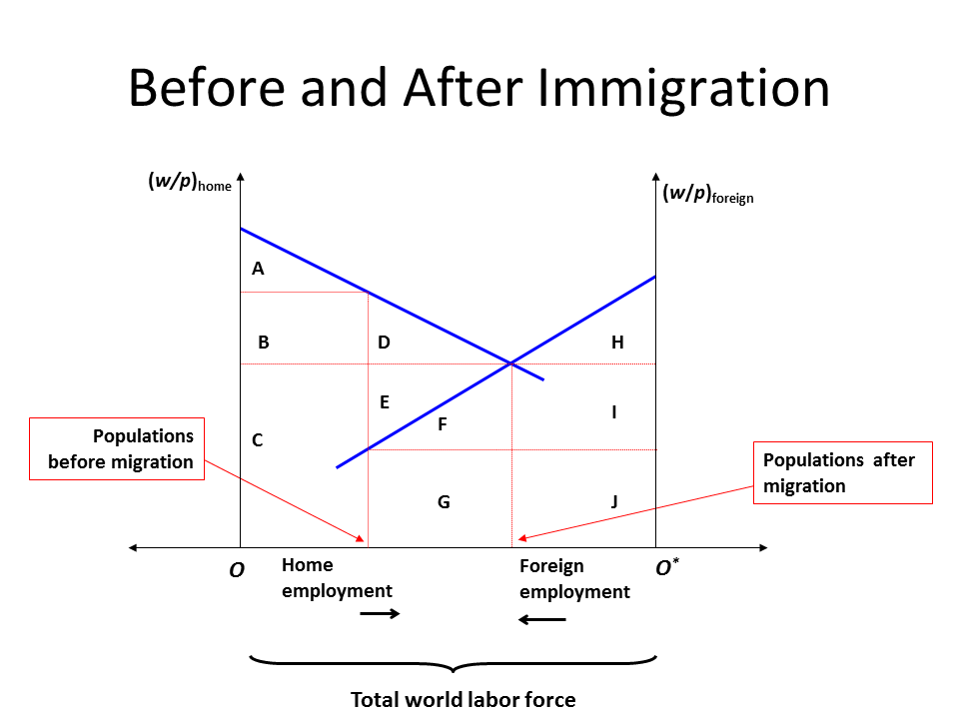
Who Gains? Who Loses?
 | Before |  | After (Residents) |  | After (Citizens)
 | Home | Foreign | Home | Foreign | Home | Foreign
Wages | BC | GJ | CEFG | IJ | C | EFGIJ
Profits | A | FHI | ABD | H | ABD | H
Total | ABC | FGHIJ | ABCDEFG | HIJ | ABCD | EFGHIJ

Slide 9
Effect on Resource Prices
When a resource moves from one country (the guest country) to another (the host country), the relative price of that resource
increases in the guest country, and
decreases in the host country.
For example, if labor migrates from Mexico to the U.S.,
the native (or, pre-migration) workers in the U.S. will lose, and
Mexican workers, both those who left Mexico and those who stayed, will gain

Slide 10
Effect on Complementary Resources
The relative reward to any resource that is a complement to the migrating resource
increases in the host country and
decreases in the guest country.
For example, if labor migrates from Mexico to the U.S.,
U.S. owners of capital will gain and
Mexican owners of capital will lose

Slide 11
Effect of Mexican Immigration on US Wages
Recall that the host country’s complementary resource benefits from immigration
Capital may not be the only complementary resource that benefits from immigration
Landowners may benefit
Complementary labor may benefit
The biggest hit is taken by previous cohorts of immigrants, who are in direct competition with the current cohort of immigrants

Slide 12
Overall Effect
Both the host and the guest countries benefit from the migration of resources in the sense that, in each country, the gains (to the nation’s pre-migration resources) exceed the losses.
For example, if labor migrates from Mexico to the U.S.,
the native (or, pre-migration) U.S. workers will lose,
the U.S. owners of capital will gain, and
capital’s gains will exceed the losses of native US workers. Conversely,
Mexican workers—those that left and those that stayed—will gain,
Mexican owners of capital will lose,
Gains of Mexican labor that stayed will exceed Mexican capital’s losses.

Slide 13
Overall Effect on the World
Since each country experiences a net gain, the world as a whole gains from the migration of resources.
See chapter 4 of the textbook, especially the section on “International Labor Mobility”

Slide 14
Complication: Inequality
Looking only at the total surplus-based analysis we have used so far is not always enough
Inequality is important too
Immigration worsens inequality in the host country when the immigrants are less well-educated than the average native
Restricting immigration to highly-educated foreigners reduces inequality

Slide 15
Complication: Social Safety Net
If immigrants pay less in taxes to the host nation’s government than the host nation’s government spends on them, then citizens of the host nation may be worse off after immigration
If net government spending on immigrants exceeds D—see figure and table—immigration hurts the host nation

Slide 16
Complication: Social Safety Net
Nordic countries—such as Sweden, Norway, and Denmark—and other countries that are small, rich, and have generous social safety nets, may be unable to sustain their way of life without restricting the entry of poor immigrants.
Allowing only the entry of highly-skilled immigrants makes sense on this point

Slide 17
Complication: Culture
Immigrants who do not share the host country’s cultural values may
Find it hard to blend in
Face rejection and joblessness
Turn to violence
Force the host country to accept hitherto unacceptable norms
Again, allowing only the entry of highly-skilled immigrants makes sense on this point

Slide 18
Outsourcing
Outsourcing refers to electronically delivered service work done by workers located elsewhere
This phenomenon can be analyzed exactly as we have analyzed immigration
However, the added pluses are that
These foreign workers will not drain the social safety net
And will not impose costs of cultural conflict
If they do skilled work, they will reduce inequality too

Slide 19
Policy: Immigration by Auction
Most countries restrict immigration
In such cases an economically efficient rationing mechanism is to auction off the limited number of immigration permits

Slide 20
Policy: educational standards
Countries such as Australia and Canada select migrants according to educational and other qualifications

Slide 21
Bonus: Migration and factor price equalization

Slide 22
Movement of Goods and Labor
If the conditions of the factor price equalization theorem are satisfied, there should be no migration among countries that are trade partners
However, there could be migration among countries that are not trade partners

Slide 23
Movement of Goods and Labor
Suppose Country A, a “small” country, allows free trade in goods
Suppose migrants from B move to A
In the long run, this should have no effect on Country A
Why?

Slide 24
Movement of Goods and Labor
The arrival of migrants will not affect relative goods prices in Country A
(because it is a “small” country)
Therefore, as goods and resource prices are tightly linked, resource prices will not be affected either
Let’s see this step by step

Slide 25
Figure 5-6: Factor Prices and Goods Prices
Recap Slide
As labor becomes more expensive relative to capital, cloth, which is labor-intensive in production, finds itself at a disadvantage and becomes relatively more expensive compared to food
Relative price of cloth, P_{C}/P_{F}
SS
17
As both Home and Foreign use the same technologies, the same SS curve is applicable in both countries
5
Wage-rent ratio, w/r
Notes:
The “SS” is a reference to the Stolper-Samuelson theorem.

Slide 26
Movement of Goods and Labor
The effects of immigration we saw earlier are true in the short run
Immigration will, in the short run, lead to a fall in the relative wage (w/P) and a rise in the relative rent (r/P)
Therefore, w/r = (w/P)/ (r/P) will fall in the short run
Therefore, P_{C}/P_{F} will also fall in the short run

Slide 27
Movement of Goods and Labor
When domestic relative price of cloth, the labor-intensive good, falls below the worldwide relative price of cloth, the country faces increased foreign demand for cloth
This pulls domestic P_{C}/P_{F} back to the worldwide P_{C}/P_{F}, in the long run
As a result, w/r also returns to the global level in the long run

Slide 28
Movement of Goods and Labor
As w/r returns to the global level in the long run, the relative wage (w/P) and relative rent (r/P) also return to their global levels
In short, factor price equalization is re-established in the long run
Immigration increases the relative output of the labor-intensive good

Slide 29
Cross-Border Capital Flows
The analysis of cross-border labor movements that we have seen so far can be used to study cross-border labor movements (or foreign direct investment)
Just switch ‘labor’ and ‘capital’ in all previous slides!

