Slide 1
The Ricardian Theory of Trade
ECO 41 International Economics
Udayan Roy
http://myweb.liu.edu/~uroy/eco41/
Notes:
10/23/2023

Slide 2
The Ricardian Model
Source:
Chapter 3 Labor Productivity and Comparative Advantage: The Ricardian Model
International Economics, twelfth edition, by Paul Krugman, Maurice Obstfeld, and Marc Melitz.

Slide 3
The assumptions of the Ricardian theory of trade

Slide 4
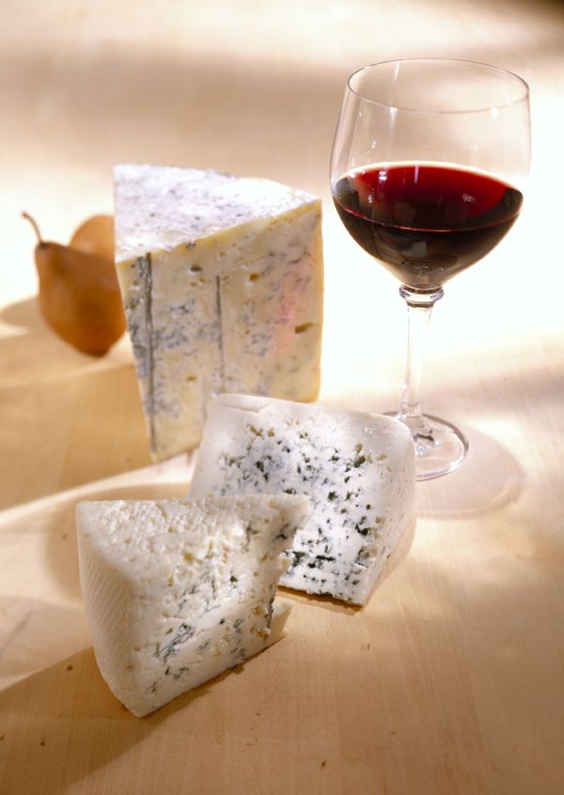
The Ricardian Assumptions—Basics
There are
two countries, Home and Foreign
two goods, Cheese and Wine, and
one resource, Labor
Labor is used to produce cheese and wine

Slide 5
The Ricardian Assumptions—Preferences
The preferences of all consumers in the world are identical.
Q: This is obviously untrue. Why then does David Ricardo assume identical preferences?
A: Ricardo wants to show that technological differences between countries can lead to trade. To accomplish this, he needs to show that two countries that differ only in technology will trade with each other.

Slide 6
The Ricardian Assumptions—Preferences
The preferences of all consumers in the world are identical.
No individual wants to consume only cheese or only wine. Every individual wants to consume some wine and some cheese.

Slide 7
The Ricardian Assumptions—Markets
Cheese and wine are bought and sold in perfectly competitive markets.
The market for a commodity is said to be perfectly competitive if:
There are many sellers
There are many buyers
All sellers sell the exact same product
Under these conditions, no buyer or seller of a commodity has the power to affect the price of that commodity all by himself/herself.
Individuals seek to maximize happiness (within their constraints)
Firms seek to maximize profits (within their constraints)

Slide 8
The Ricardian Assumptions—Governments
Governments do not interfere with the smooth functioning of markets
there are no taxes, subsidies, tariffs, quotas, etc.

Slide 9
The Ricardian Assumptions—Trade, Markets, Prices
I will simplify the standard Ricardian assumptions further
Assume all trade is barter
the price of a gallon of wine is p_{W} pounds of cheese (in every purchase/sale of wine), and
the price of a pound of cheese is p_{C} gallons of wine (in every purchase/sale of cheese).
These barter prices are also called relative prices

Slide 10
The Ricardian Assumptions—Prices
Example:
the price of a gallon of wine is p_{W} = 5 pounds of cheese. Therefore,
the price of a pound of cheese is p_{C} = 1/5 gallons of wine
Conversely, if the price of a pound of cheese is p_{C} = 3 gallons of wine, then
the price of a gallon of wine is p_{W} = 1/3 pounds of cheese.
Note that the prices are reciprocals: p_{W} × p_{C} = 1
So, if you know either p_{W} or p_{C}, you can calculate the other
Also, if one relative price increases, the other necessarily decreases

Slide 11
The Ricardian Assumptions—Wages
A worker’s wage could be measured in cheese or wine:
The cheese-wage (w_{C}) is the amount of cheese that can be obtained (through production or trade) from an hour’s work
The wine-wage (w_{W}) is the amount of wine that can be obtained (through production or trade) from an hour’s work

Slide 12
The Ricardian Assumptions—Technology
Cheese and wine are produced by labor
The amount of labor needed to make a gallon of wine (respectively, cheese) is a_{W} (respectively a_{C}), a constant.
This fixed amount of labor is called the unit labor requirement in wine (respectively, cheese) production

Slide 13
Technology—Our Example
Unit Labor requirements (hours needed to make one unit of ...)
 | Cheese | Wine
Home | 1 hour per pound a_{C,H} = 1 | 2 hours per gallon a_{W,H} = 2
Foreign | 6 hours per pound a_{C,F} = 6 | 3 hours per gallon a_{W,F} = 3
Unit labor requirements are the only difference between Home and Foreign. The two countries are identical in every other way.
We will be using this specific example throughout this lecture

Slide 14
Autarky prices

Slide 15
Autarky: Home
In Home, it takes a worker the same 50 hours of effort to make 1 gallon of wine or 5 pounds of cheese
Therefore, one can guess that, in Home, the price of a gallon of wine will be 5 pounds of cheese
But let’s take a closer look
Unit Labor requirements (hours needed to make one unit of ...)
 | Cheese | Wine
Home | a_{CH} = 10 | a_{WH} = 50
Foreign | a_{CF} = 4 | a_{WF} = 2
Autarky Prices
 | Cheese | Wine
Home |  | p_{WH} = a_{WH}/a_{CH} = 5
Foreign

Slide 16
Autarky: Home
Assume the price of 1 gallon of wine is 6 pounds of cheese in Home (p_{WH} = 6).
If a worker in Home spent 1 hour making cheese, he/she would have 1/10 pounds of cheese
This is the Home worker’s productivity in cheese making
If the worker spent 1 hour making wine, he/she would have 1/50 gallons of wine
This is the Home worker’s productivity in cheese making
But 1/50 gallons of wine could be sold for 1/50 × 6 > 1/10 pounds of cheese
That is, if p_{WH} > 5, then a worker in Home would get more cheese from 1 hour’s work by making wine and selling it for cheese than by making cheese
Unit Labor requirements (hours needed to make one unit of ...)
 | Cheese | Wine
Home | a_{CH} = 10 | a_{WH} = 50
Foreign | a_{CF} = 4 | a_{WF} = 2

Slide 17
Autarky: Home
Therefore, if p_{WH} > 5, then:
Home makes no cheese.
Home makes only wine.
The Home worker’s income in wine from 1 hour of work is equal to the worker’s productivity in wine making
The Home worker’s income in cheese from 1 hour of work is more than the worker’s productivity in cheese making
Unit Labor requirements (hours needed to make one unit of ...)
 | Cheese | Wine
Home | a_{CH} = 10 | a_{WH} = 50
Foreign | a_{CF} = 4 | a_{WF} = 2
Recall that the prices of cheese and wine are reciprocals. Therefore, p_{WH} > 5 and p_{CH} < 1/5 are equivalent.

Slide 18
Autarky: Home
Assume the price of 1 gallon of wine is 4 pounds of cheese in Home (p_{WH} = 4).
Therefore, the price of 1 pound of cheese is ¼ gallons of wine (p_{CH} = ¼).
If the worker spent 1 hour making wine, he/she would have 1/50 gallons of wine
This is the Home worker’s productivity in cheese making
If a worker in Home spent 1 hour making cheese, he/she would have 1/10 pounds of cheese
This is the Home worker’s productivity in cheese making
But 1/10 pounds of cheese could be sold for 1/10 × ¼ = 1/40 > 1/50 gallons of wine
That is, if p_{WH} < 5, then a worker in Home would get more wine from 1 hour’s work by making cheese and selling it for wine than by making wine
Unit Labor requirements (hours needed to make one unit of ...)
 | Cheese | Wine
Home | a_{CH} = 10 | a_{WH} = 50
Foreign | a_{CF} = 4 | a_{WF} = 2

Slide 19
Autarky: Home
Therefore, if p_{WH} < 5, then:
Home makes no wine.
Home makes only cheese.
The Home worker’s income in cheese from 1 hour of work is equal to the worker’s productivity in cheese making
The Home worker’s income in wine from 1 hour of work is more than the worker’s productivity in wine making
Unit Labor requirements (hours needed to make one unit of ...)
 | Cheese | Wine
Home | a_{CH} = 10 | a_{WH} = 50
Foreign | a_{CF} = 4 | a_{WF} = 2
Recall that the prices of cheese and wine are reciprocals. Therefore, p_{WH} < 5 and p_{CH} > 1/5 are equivalent.

Slide 20
Autarky: Home
In autarky, Home must consume some Wine and some Cheese
And the Cheese and Wine consumed in Home must be produced in Home
Therefore, p_{WH} > 5 and p_{WH} < 5 are not possible.
So, in autarky in Home, p_{WH} = 5.
And, as prices are reciprocals, p_{CH} = 1/5.
Unit Labor requirements (hours needed to make one unit of ...)
 | Cheese | Wine
Home | a_{CH} = 10 | a_{WH} = 50
Foreign | a_{CF} = 4 | a_{WF} = 2
Autarky Prices
 | Cheese | Wine
Home | p_{CH} = a_{CH}/a_{WH} = 1/5 | p_{WH} = a_{WH}/a_{CH} = 5
Foreign

Slide 21
Autarky: Home
We just saw that the price of 1 gallon of wine is 5 pounds of cheese in Home in autarky (p_{WH} = 5).
Therefore, the price of 1 pound of cheese is 1/5 gallons of wine (p_{CH} = 1/5).
If the worker spent 1 hour making wine, he/she would have 1/50 gallons of wine
This is the Home worker’s productivity in cheese making
If a worker spent 1 hour making cheese, he/she would have 1/10 pounds of cheese
This is the Home worker’s productivity in cheese making
Unit Labor requirements (hours needed to make one unit of ...)
 | Cheese | Wine
Home | a_{CH} = 10 | a_{WH} = 50
Foreign | a_{CF} = 4 | a_{WF} = 2
Autarky Prices
 | Cheese | Wine
Home | p_{CH} = 1/5 | p_{WH} = 5
Foreign

Slide 22
Autarky: Home
We just saw that the autarky price of 1 gallon of wine is 5 pounds of cheese in Home (p_{WH} = 5).
Therefore, the price of 1 pound of cheese is 1/5 gallons of wine (p_{CH} = 1/5).
If the worker spent 1 hour making wine, he/she would have 1/50 gallons of wine
The 1/50 gallons of wine could be sold for 1/50 × 5 = 1/10 pounds of cheese
If a worker spent 1 hour making cheese, he/she would have 1/10 pounds of cheese
The 1/10 pounds of cheese could be sold for 1/10 × 1/5 = 1/50 gallons of wine
Unit Labor requirements (hours needed to make one unit of ...)
 | Cheese | Wine
Home | a_{CH} = 10 | a_{WH} = 50
Foreign | a_{CF} = 4 | a_{WF} = 2
Note that whether you make cheese for 1 hour or make wine for 1 hour and then sell that wine for cheese, you get the same amount of cheese. And that amount is the worker’s productivity in cheese making.
Similarly, whether you make wine for 1 hour or make cheese for 1 hour and then sell that cheese for wine, you get the same amount of wine. And that amount is the worker’s productivity in wine making.

Slide 23
Autarky: Home
In autarky,
p_{WH} = 5 and p_{CH} = 1/5
Home makes both wine and cheese.
The Home worker’s wage income in cheese from 1 hour of work (w_{CH}) is equal to the worker’s productivity in cheese making
The Home worker’s income in wine from 1 hour of work (w_{WH}) is equal to the worker’s productivity in wine making
Unit Labor requirements (hours needed to make one unit of ...)
 | Cheese | Wine
Home | a_{CH} = 10 | a_{WH} = 50
Foreign | a_{CF} = 4 | a_{WF} = 2
Autarky Prices
 | Cheese | Wine
Home | p_{CH} = 1/5 | p_{WH} = 5
Foreign
Autarky Wages
 | Cheese | Wine
Home | w_{CH} = 1/10 | w_{WH} = 1/50
Foreign

Slide 24
Autarky: Foreign
Let us now repeat the analysis we just did for autarky in Home, but now for Foreign
In Foreign, it takes a worker the same 4 hours of effort to make 1 pound of cheese or 2 gallons of wine
So, what are the conclusions we can draw?
Unit Labor requirements (hours needed to make one unit of ...)
 | Cheese | Wine
Home | a_{CH} = 10 | a_{WH} = 50
Foreign | a_{CF} = 4 | a_{WF} = 2

Slide 25
Autarky: Foreign
If p_{CF} > 2, then:
Foreign makes no wine.
Foreign makes only cheese.
The Foreign worker’s income in cheese from 1 hour of work is equal to the worker’s productivity in cheese making
The Foreign worker’s income in wine from 1 hour of work is more than the worker’s productivity in wine making
Unit Labor requirements (hours needed to make one unit of ...)
 | Cheese | Wine
Home | a_{CH} = 10 | a_{WH} = 50
Foreign | a_{CF} = 4 | a_{WF} = 2
Recall that the prices of cheese and wine are reciprocals. Therefore, p_{CF} > 2 and p_{WF} < ½ are equivalent.

Slide 26
Autarky: Foreign
If p_{CF} < 2, then:
Foreign makes no cheese.
Foreign makes only wine.
The Foreign worker’s income in wine from 1 hour of work is equal to the worker’s productivity in wine making
The Foreign worker’s income in cheese from 1 hour of work is more than the worker’s productivity in cheese making
Unit Labor requirements (hours needed to make one unit of ...)
 | Cheese | Wine
Home | a_{CH} = 10 | a_{WH} = 50
Foreign | a_{CF} = 4 | a_{WF} = 2
Recall that the prices of cheese and wine are reciprocals. Therefore, p_{CF} < 2 and p_{WF} > ½ are equivalent.

Slide 27
Autarky: Foreign
In autarky, Foreign must consume some Wine and some Cheese
And the Cheese and Wine consumed in Foreign must be produced in Foreign
Therefore, p_{CF} > 2 and p_{CF} < 2 are not possible.
So, in autarky in Foreign, p_{CF} = 2.
And, as prices are reciprocals, p_{WF} = ½
Unit Labor requirements (hours needed to make one unit of ...)
 | Cheese | Wine
Home | a_{CH} = 10 | a_{WH} = 50
Foreign | a_{CF} = 4 | a_{WF} = 2
Autarky Prices
 | Cheese | Wine
Home | p_{CH} = a_{CH}/a_{WH} = 1/5 | p_{WH} = a_{WH}/a_{CH} = 5
Foreign | p_{CF} = a_{CF}/a_{WF} = 2 | p_{Wf} = a_{WF}/a_{CF} = ½

Slide 28
Autarky: Foreign
In autarky,
p_{CF} = 2 and p_{WF} = ½
Foreign makes both wine and cheese.
The Foreign worker’s income in cheese from 1 hour of work is equal to the worker’s productivity in cheese making
The Foreign worker’s income in wine from 1 hour of work is equal to the worker’s productivity in wine making
Unit Labor requirements (hours needed to make one unit of ...)
 | Cheese | Wine
Home | a_{CH} = 10 | a_{WH} = 50
Foreign | a_{CF} = 4 | a_{WF} = 2
Autarky Prices
 | Cheese | Wine
Home | p_{CH} = a_{CH}/a_{WH} = 1/5 | p_{WH} = a_{WH}/a_{CH} = 5
Foreign | p_{CF} = a_{CF}/a_{WF} = 2 | p_{WF} = a_{WF}/a_{CF} = ½
Autarky Wages
 | Cheese | Wine
Home | w_{CH} = 1/a_{CH} = 1/10 | w_{WH} = 1/a_{WH} = 1/50
Foreign | w_{CF} = 1/a_{CF} = ¼ | w_{WF} = 1/a_{WF} = ½

Slide 29
Autarky: Summary
Home |  |  |  |  | Foreign
w_{C} | w_{W} | p_{C} | p_{W} | Production | Production | p_{C} | p_{W} | w_{C} | w_{W}
w_{C} > 1/10 | w_{W} = 1/50 | p_{C} < 1/5 | p_{W} > 5 | Only Wine | Only Wine | p_{C} < 2 | p_{W} > ½ | w_{C} > ¼ | w_{W} = ½
w_{C} = 1/10 | w_{W} = 1/50 | p_{C} = 1/5 | p_{W} = 5 | Wine and Cheese (Autarky)
w_{C} = 1/10 | w_{W} > 1/50 | p_{C} > 1/5 | p_{W} < 5 | Only Cheese
 |  |  |  |  | Wine and Cheese (Autarky) | p_{C} = 2 | p_{W} = ½ | w_{C} = ¼ | w_{W} = ½
 |  |  |  |  | Only Cheese | p_{C} > 2 | p_{W} < ½ | w_{C} = ¼ | w_{W} > ½
Unit Labor requirements (hours needed to make one unit of ...)
 | Cheese | Wine
Home | a_{CH} = 10 | a_{WH} = 50
Foreign | a_{CF} = 4 | a_{WF} = 2

Slide 30
Opportunity Cost
a_{W} hours of labor are needed to make 1 gallon of Wine
Therefore, 1 hour of labor makes 1/a_{W} gallons of Wine
This is the productivity of labor in Wine production
a_{C} hours of labor are needed to make 1 pound of Cheese
a_{C} hours of labor make a_{C}/a_{W} gallons of Wine
Therefore, in the time it takes to make 1 pound of Cheese, a_{C}/a_{W} gallons of Wine could have been made instead.
a_{C}/a_{W} is the opportunity cost of Cheese in units of Wine

Slide 31
Opportunity Cost
a_{C} hours of labor are needed to make 1 pound of Cheese
Therefore, 1 hour of labor makes 1/a_{C} pounds of Cheese
This is the productivity of labor in Cheese production
a_{W} hours of labor are needed to make one gallon of Wine
a_{W} hours of labor make a_{W}/a_{C} pounds of Cheese
Therefore, in the time it takes to make 1 gallon of Wine, a_{W}/a_{C} pounds of Cheese could have been made instead.
a_{W}/a_{C} is the opportunity cost of Wine in units of Cheese

Slide 32
Autarky Prices = Opportunity Costs
We have shown that, in autarky, the prices of cheese and wine must be their opportunity costs:
$p_{C}=\frac{a_{C}}{a_{W}}$
$p_{W}=\frac{a_{W}}{a_{C}}$
In autarky, the price of Cheese in units of Wine (p_{C}) is the opportunity cost of Cheese in units of Wine (a_{C}/a_{W})
And the price of Wine (p_{W}) in units of Cheese is the opportunity cost of Wine in units of Cheese (a_{W}/a_{C})

Slide 33
Free trade

Slide 34
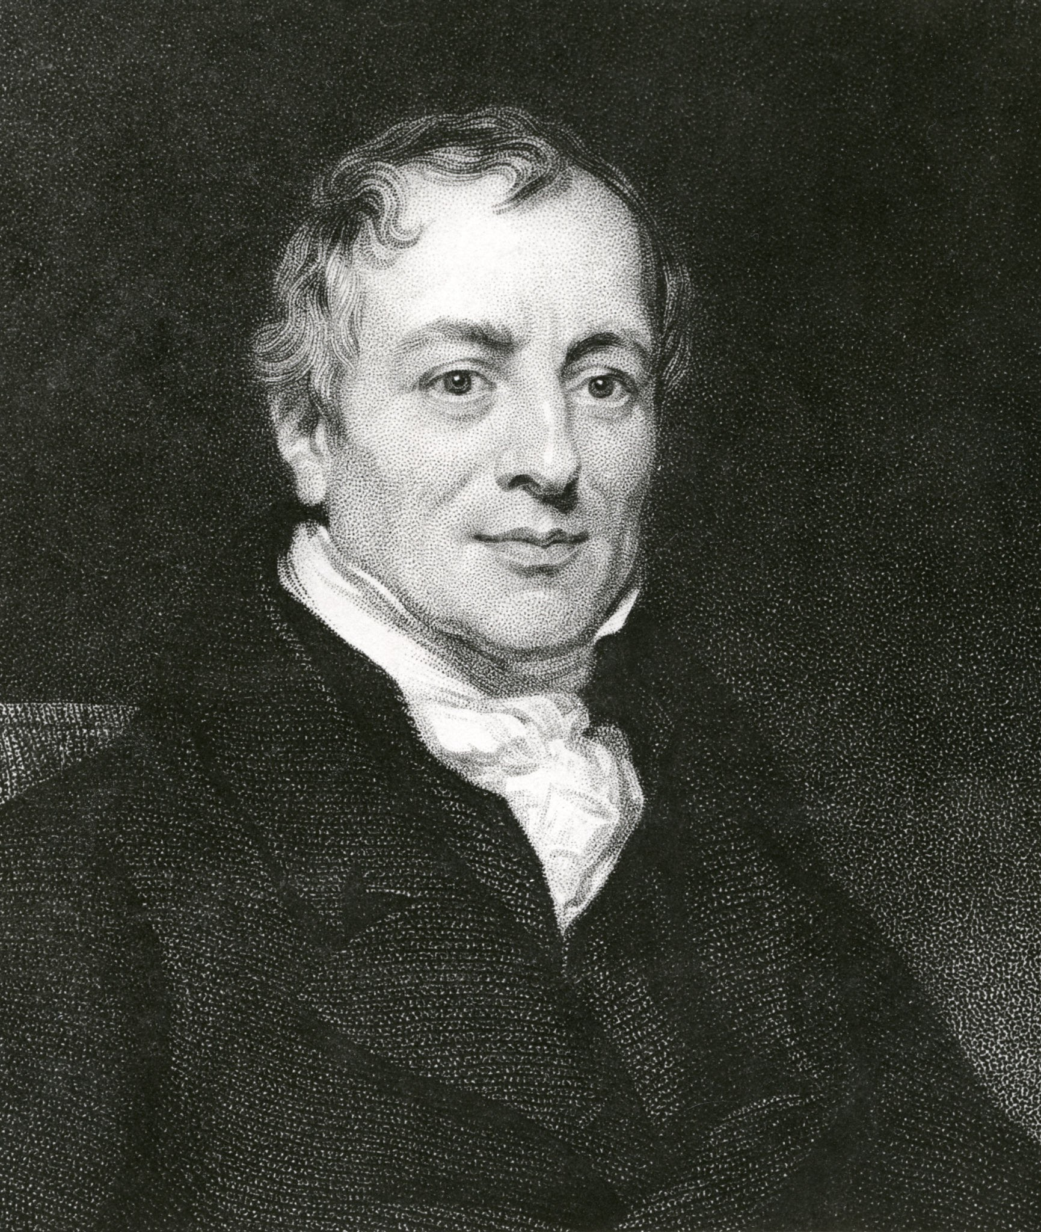
Tech Differences Cause Trade!
Let a_{C}/a_{W}, the opportunity cost of Cheese, be different in the two countries
This is the same as assuming that a_{W}/a_{C}, the opportunity cost of Wine, is different in the two countries
Then, the autarky price of cheese—as well as that of wine—will be different in the two countries.
And this cross-country difference in autarky prices guarantees international trade
In this way, David Ricardo’s Theory of Comparative Advantage explains how technology differences cause trade.
David Ricardo (1772 – 1823)

Slide 35
Free-Trade Equilibrium: Example
p_{C}
p_{W}
Autarky Prices
 | Cheese | Wine
Home | 1/5 | 5
Foreign | 2 | 1/2
Autarky in Foreign p_{CF} = 2
Autarky in Home p_{WH} = 5
Free Trade 1/5 < p_{CFT} < 2
Free Trade ½ < p_{WFT} < 5
1. Home will export Cheese to—and import Wine from—Foreign
Autarky in Home p_{CH} = 1/5
Autarky in Foreign p_{WF} = ½
2. The price of Cheese (p_{C}) will:
rise in Home,
fall in Foreign, and
eventually the same free trade price (p_{CFT}) will prevail everywhere
4. The exact values of the free trade prices (p_{CFT} and p_{WFT}) will depend on consumer demand for Cheese and Wine, which I am ignoring here. Note, however, that p_{CFT} and p_{WFT} are reciprocals of each other.
3. The price of Wine (p_{W}) will:
rise in Foreign,
fall in Home, and
eventually the same free trade price (p_{WFT}) will prevail everywhere

Slide 36
Autarky and Free Trade: Summary
Home |  |  |  |  | Foreign
w_{C} | w_{W} | p_{C} | p_{W} | Production | Production | p_{C} | p_{W} | w_{C} | w_{W}
w_{C} > 1/10 | w_{W} = 1/50 | p_{C} < 1/5 | p_{W} > 5 | Only Wine | Only Wine | p_{C} < 2 | p_{W} > ½ | w_{C} > ¼ | w_{W} = ½
w_{C} = 1/10 | w_{W} = 1/50 | p_{C} = 1/5 | p_{W} = 5 | Wine and Cheese (Autarky)
w_{C} = 1/10 | w_{W} > 1/50 | p_{C} > 1/5 | p_{W} < 5 | Only Cheese
 |  |  |  |  | Wine and Cheese (Autarky) | p_{C} = 2 | p_{W} = ½ | w_{C} = ¼ | w_{W} = ½
 |  |  |  |  | Only Cheese | p_{C} > 2 | p_{W} < ½ | w_{C} = ¼ | w_{W} > ½
Free Trade Free Trade Free Trade Free Trade Free Trade Free Trade Free Trade Free Trade
Unit Labor requirements (hours needed to make one unit of ...)
 | Cheese | Wine
Home | a_{CH} = 10 | a_{WH} = 50
Foreign | a_{CF} = 4 | a_{WF} = 2
The only possible free trade outcome is 2 > p_{C} > 1/5 and 5 > p_{W} > ½. As some of each good must be produced, wine will be produced only in Foreign and Cheese will be produced only in Home.

Slide 37
Autarky and Free Trade: Summary
Home |  |  |  |  | Foreign
w_{C} | w_{W} | p_{C} | p_{W} | Production | Production | p_{C} | p_{W} | w_{C} | w_{W}
w_{C} = 1/10 | w_{W} = 1/50 | p_{C} = 1/5 | p_{W} = 5 | Wine and Cheese (Autarky)
w_{C} = 1/10 | w_{W} > 1/50 | p_{C} > 1/5 | p_{W} < 5 | Only Cheese (Free Trade) | Only Wine (Free Trade) | p_{C} < 2 | p_{W} > ½ | w_{C} > ¼ | w_{W} = ½
 |  |  |  |  | Wine and Cheese (Autarky) | p_{C} = 2 | p_{W} = ½ | w_{C} = ¼ | w_{W} = ½
Unit Labor requirements (hours needed to make one unit of ...)
 | Cheese | Wine
Home | a_{CH} = 10 | a_{WH} = 50
Foreign | a_{CF} = 4 | a_{WF} = 2
The only possible free trade outcome is 2 > p_{C} > 1/5 and 5 > p_{W} > ½. As some of each good must be produced, wine will be produced only in Foreign and Cheese will be produced only in Home.

Slide 38
Free-Trade Equilibrium: Example
p_{C}
p_{C} | p_{W} | Specialization | Comment
p_{C} < 1/5 | p_{W} > 5 | No Cheese produced in either country | Possible neither in autarky nor in free trade
p_{C} > 1/5 | p_{W} < 5 | No Wine produced in Home | Possible under free trade
p_{C} > 2 | p_{W} < ½ | No Wine produced in either country | Possible neither in autarky nor in free trade
p_{C} < 2 | p_{W} > ½ | No Cheese produced in Foreign | Possible under free trade
p_{W}
p_{CF} = 2
p_{WH} = 5
1/5 < p_{CFT} < 2
½ < p_{WFT} < 5
p_{CH} = 1/5
p_{WF} = ½
3. So, in the Ricardian theory of trade, each country produces and exports only the good for which it has the lower opportunity cost of production.
That is, each country produces and exports only the good in which the country has a comparative advantage.
This is why the Ricardian theory is also called the Theory of Comparative Advantage.

Slide 39
wages
Wage income is the only kind of income in the Ricardian model. How is this income affected by globalization?

Slide 40
Autarky and Free Trade: Wages
Home |  |  |  |  | Foreign
w_{C} | w_{W} | p_{C} | p_{W} | Production | Production | p_{C} | p_{W} | w_{C} | w_{W}
w_{C} = 1/10 | w_{W} = 1/50 | p_{C} = 1/5 | p_{W} = 5 | Wine and Cheese (Autarky)
w_{C} = 1/10 | w_{W} > 1/50 | p_{C} > 1/5 | p_{W} < 5 | Only Cheese (Free Trade) | Only Wine (Free Trade) | p_{C} < 2 | p_{W} > ½ | w_{C} > ¼ | w_{W} = ½
 |  |  |  |  | Wine and Cheese (Autarky) | p_{C} = 2 | p_{W} = ½ | w_{C} = ¼ | w_{W} = ½
Unit Labor requirements (hours needed to make one unit of ...)
 | Cheese | Wine
Home | a_{CH} = 10 | a_{WH} = 50
Foreign | a_{CF} = 4 | a_{WF} = 2
Recall that, under free trade, Home produces—and exports—only Cheese, and Foreign produces—and exports—only Wine.
And note that, in each country, the wage in units of its exported good, is the same in autarky and free trade.

Slide 41
Autarky and Free Trade: Wages
Home |  |  |  |  | Foreign
w_{C} | w_{W} | p_{C} | p_{W} | Production | Production | p_{C} | p_{W} | w_{C} | w_{W}
w_{C} = 1/10 | w_{W} = 1/50 | p_{C} = 1/5 | p_{W} = 5 | Wine and Cheese (Autarky)
w_{C} = 1/10 | w_{W} > 1/50 | p_{C} > 1/5 | p_{W} < 5 | Only Cheese (Free Trade) | Only Wine (Free Trade) | p_{C} < 2 | p_{W} > ½ | w_{C} > ¼ | w_{W} = ½
 |  |  |  |  | Wine and Cheese (Autarky) | p_{C} = 2 | p_{W} = ½ | w_{C} = ¼ | w_{W} = ½
Unit Labor requirements (hours needed to make one unit of ...)
 | Cheese | Wine
Home | a_{CH} = 10 | a_{WH} = 50
Foreign | a_{CF} = 4 | a_{WF} = 2
Recall that, under free trade, Home produces—and exports—only Cheese, and Foreign produces—and exports—only Wine.
And note that, in each country, the wage in units of its imported good, is higher under free trade.

Slide 42
The Make-or-Buy Decision Under Free Trade
We have seen that a worker who wants cheese can make cheese or make wine and sell it for cheese
We have also seen that in autarky whether you make cheese or make wine and sell it for cheese you end up with the same amount of cheese
So, if the price of wine is higher under free trade than in autarky, then, under free trade, a worker would be better off making wine and selling it for cheese instead of making cheese
And the price of wine would indeed be higher under free trade for the wine exporting country.
Therefore, the wine exporting country would specialize in wine production under free trade.

Slide 43
The Gain from Trade
We just saw that under free trade a worker in Home will specialize in Cheese production
He/she gets more Cheese from an hour’s work by making Cheese rather than making Wine and selling it for Cheese. So, free trade doesn’t enable a worker to get more Cheese from an hour’s work.
He/she gets more Wine from an hour’s work by making Cheese and selling it for Wine rather than by making Wine.
This is where free trade provides an edge that is not available in autarky.
He/she can get more Wine from an hour’s work by taking advantage of trade.

Slide 44
The Gains from Trade
We just saw that under free trade a worker in Foreign will specialize in Wine production
He/she gets more Wine from an hour’s work by making Wine rather than by making Cheese and selling it for Wine. So, free trade doesn’t enable a worker to get more Wine from an hour’s work.
He/she gets more Cheese from an hour’s work by making Wine and selling it for Cheese rather than by making Cheese.
This is where free trade provides an edge that is not available in autarky.
He/she can get more Cheese from an hour’s work by taking advantage of trade.

Slide 45
Ricardian Model: Main Lessons
Trade occurs because technology varies from country to country
Even backward countries—such as Foreign in our numerical example—can gain from trade with advanced countries—such as Home
Advanced countries can gain from trade even if their workers have to compete with “cheap labor” countries

Slide 46
Bonus: commentary

Slide 47
Misconceptions About Comparative Advantage
Free trade is beneficial only if a country is more productive than foreign countries.
But even an unproductive country benefits from free trade by avoiding the high costs for goods that it would otherwise have to produce domestically.
High costs derive from inefficient use of resources.
The benefits of free trade do not depend on absolute advantage, rather they depend on comparative advantage: specializing in industries that use resources most efficiently.

Slide 48
Misconceptions About Comparative Advantage (cont.)
Free trade with countries that pay low wages hurts high wage countries.
While trade may reduce wages for some workers, thereby affecting the distribution of income within a country, trade benefits consumers and other workers.
Consumers benefit because they can purchase goods more cheaply (more wine in exchange for cheese).
Producers/workers benefit by earning a higher income (by using resources more efficiently and through higher prices/wages).

Slide 49
Misconceptions About Comparative Advantage (cont.)
Free trade exploits less productive countries.
While labor standards in some countries are less than exemplary compared to Western standards, they are so with or without trade.
Are high wages and safe labor practices alternatives to trade? Deeper poverty and exploitation (e.g., involuntary prostitution) may result without export production.
Consumers benefit from free trade by having access to cheaply (efficiently) produced goods.
Producers/workers benefit from having higher profits/wages—higher compared to the alternative.

Slide 50
Transportation Costs and Non-traded Goods
The Ricardian model predicts that countries should completely specialize in production.
But this rarely happens for primarily 3 reasons:
More than one factor of production reduces the tendency of specialization (chapter 4)
Protectionism (chapters 8–11)
Transportation costs reduce or prevent trade, which may cause each country to produce the same good or service

Slide 51
Transportation Costs and Non-traded Goods (cont.)
Non-traded goods and services (e.g., haircuts and auto repairs) exist due to high transportation costs.
Countries tend to spend a large fraction of national income on non-traded goods and services.
This fact has implications for the gravity model and for models that consider how income transfers across countries affect trade.

Slide 52
Empirical Evidence
Do countries export those goods in which their productivity is relatively high?
The ratio of US to British exports in 1951 compared to the ratio of US to British labor productivity in 26 manufacturing industries suggests yes.
At this time the US had an absolute advantage in all 26 industries, yet the ratio of exports was low in the least productive sectors of the US.

Slide 53
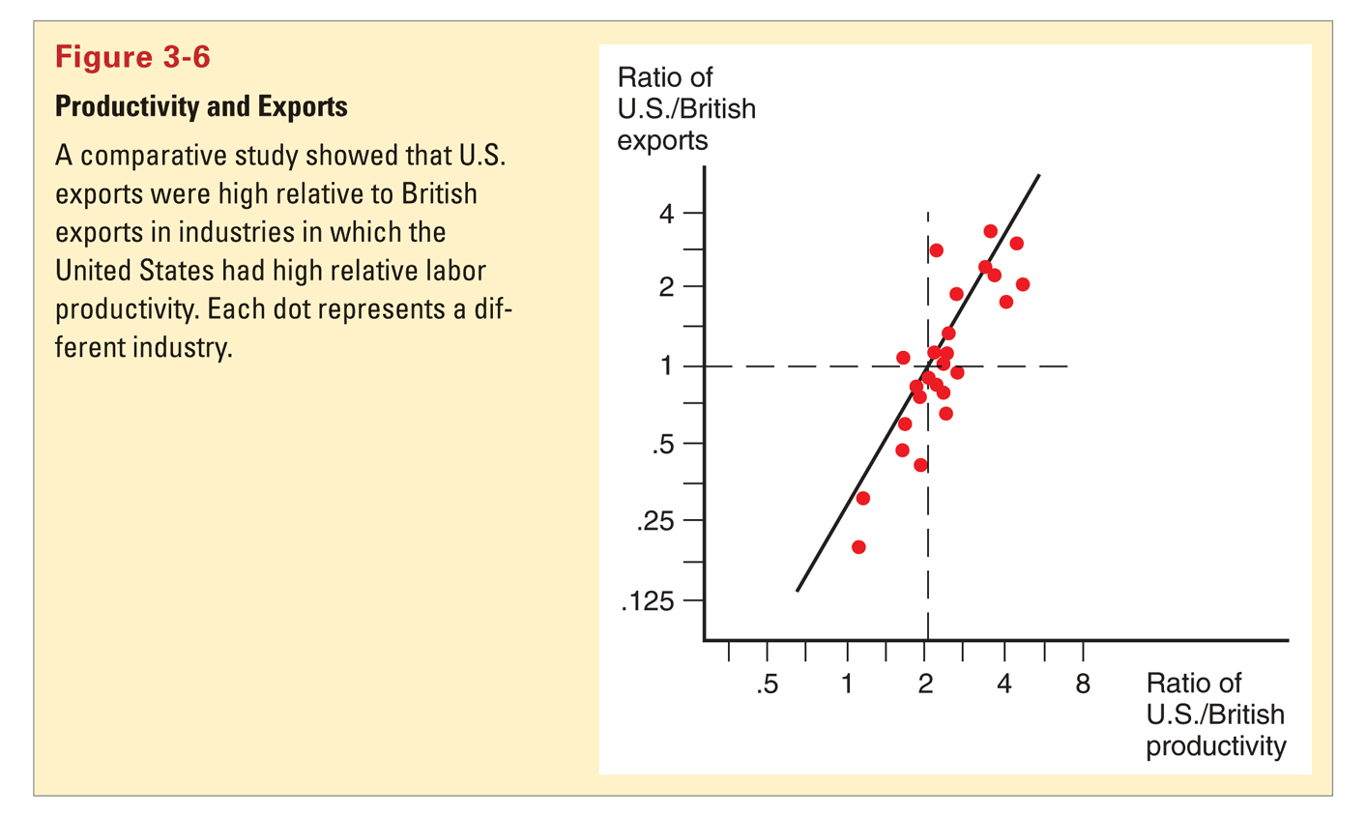
Empirical Evidence (cont.)

Slide 54
Exercise with solution

Slide 55
Exercise: Autarky Relative Prices
Unit Labor requirements
 | Cheese | Wine
Home | 4 hour per pound | 1 hours per gallon
Foreign | 2 hours per pound | 6 hours per gallon
Autarky Prices (In units of the other good)
 | Cheese | Wine
Home
Foreign

Slide 56
Exercise: Autarky Relative Prices
Unit Labor requirements
 | Cheese | Wine
Home | 4 hour per pound | 1 hours per gallon
Foreign | 2 hours per pound | 6 hours per gallon
Autarky Prices (In units of the other good)
 | Cheese | Wine
Home | 4 gallons of Wine
Foreign

Slide 57
Exercise: Autarky Relative Prices
Unit Labor requirements
 | Cheese | Wine
Home | 4 hour per pound | 1 hours per gallon
Foreign | 2 hours per pound | 6 hours per gallon
Autarky Prices (In units of the other good)
 | Cheese | Wine
Home | 4 gallons of Wine | ¼ pounds of Cheese
Foreign

Slide 58
Exercise: Autarky Relative Prices
Unit Labor requirements
 | Cheese | Wine
Home | 4 hour per pound | 1 hours per gallon
Foreign | 2 hours per pound | 6 hours per gallon
Autarky Prices (In units of the other good)
 | Cheese | Wine
Home | 4 gallons of Wine | ¼ pounds of Cheese
Foreign | 1/3 gallons of Wine

Slide 59
Exercise: Autarky Relative Prices
Unit Labor requirements
 | Cheese | Wine
Home | 4 hour per pound | 1 hours per gallon
Foreign | 2 hours per pound | 6 hours per gallon
Autarky Prices (In units of the other good)
 | Cheese | Wine
Home | 4 gallons of Wine | ¼ pounds of Cheese
Foreign | 1/3 gallons of Wine | 3 pounds of Cheese
Q: Which country will export Cheese?
A: Foreign

Slide 60
Exercise: Autarky Relative Prices
Unit Labor requirements
 | Cheese | Wine
Home | 4 hour per pound | 1 hours per gallon
Foreign | 2 hours per pound | 6 hours per gallon
Autarky Prices (In units of the other good)
 | Cheese | Wine
Home | 4 gallons of Wine | ¼ pounds of Cheese
Foreign | 1/3 gallons of Wine | 3 pounds of Cheese
Q: Which country will export Cheese?
A: Foreign
Assume that in free trade 1 pound of cheese trades for 2 gallons of wine, and, equivalently, 1 gallon of wine trades for ½ pounds of cheese

Slide 61
Exercise: Autarky Relative Wages
Unit Labor requirements
 | Cheese | Wine
Home | 4 hour per pound | 1 hours per gallon
Foreign | 2 hours per pound | 6 hours per gallon
Autarky Wages
 | Cheese | Wine
Home
Foreign
Autarky Prices (In units of the other good)
 | Cheese | Wine
Home | 4 gallons of Wine | ¼ pounds of Cheese
Foreign | 1/3 gallons of Wine | 3 pounds of Cheese

Slide 62
Exercise: Autarky Relative Wages
Unit Labor requirements
 | Cheese | Wine
Home | 4 hour per pound | 1 hours per gallon
Foreign | 2 hours per pound | 6 hours per gallon
Autarky Wages
 | Cheese | Wine
Home | ¼ pounds of cheese
Foreign
Relative Price (In units of the other good)
 | Cheese | Wine
Home | 4 gallons of Wine | ¼ pounds of Cheese
Foreign | 1/3 gallons of Wine | 3 pounds of Cheese

Slide 63
Exercise: Autarky Relative Wages
Unit Labor requirements
 | Cheese | Wine
Home | 4 hour per pound | 1 hours per gallon
Foreign | 2 hours per pound | 6 hours per gallon
Autarky Wages
 | Cheese | Wine
Home | ¼ pounds of cheese
Foreign | ½ pounds of cheese
Relative Price (In units of the other good)
 | Cheese | Wine
Home | 4 gallons of Wine | ¼ pounds of Cheese
Foreign | 1/3 gallons of Wine | 3 pounds of Cheese

Slide 64
Exercise: Autarky Relative Wages
Unit Labor requirements
 | Cheese | Wine
Home | 4 hour per pound | 1 hours per gallon
Foreign | 2 hours per pound | 6 hours per gallon
Autarky Wages
 | Cheese | Wine
Home | ¼ pounds of cheese | 1 gallon of wine
Foreign | ½ pounds of cheese | 1/6 gallons of wine
Relative Price (In units of the other good)
 | Cheese | Wine
Home | 4 gallons of Wine | ¼ pounds of Cheese
Foreign | 1/3 gallons of Wine | 3 pounds of Cheese

Slide 65
Exercise: Free Trade Relative Wages
Unit Labor requirements
 | Cheese | Wine
Home | 4 hour per pound | 1 hours per gallon
Foreign | 2 hours per pound | 6 hours per gallon
Autarky Wages
 | Cheese | Wine
Home | ¼ pounds of cheese | 1 gallon of wine
Foreign | ½ pounds of cheese | 1/6 gallons of wine
Assume that in free trade 1 pound of cheese trades for 2 gallons of wine, and, equivalently, 1 gallon of wine trades for ½ pounds of cheese
Relative Price (In units of the other good)
 | Cheese | Wine
Home | 4 gallons of Wine | ¼ pounds of Cheese
Foreign | 1/3 gallons of Wine | 3 pounds of Cheese
Free Trade Wages
 | Cheese | Wine
Home
Foreign

Slide 66
Exercise: Free Trade Relative Wages
Unit Labor requirements
 | Cheese | Wine
Home | 4 hour per pound | 1 hours per gallon
Foreign | 2 hours per pound | 6 hours per gallon
Autarky Wages
 | Cheese | Wine
Home | ¼ pounds of cheese | 1 gallon of wine
Foreign | ½ pounds of cheese | 1/6 gallons of wine
Assume that in free trade 1 pound of cheese trades for 2 gallons of wine, and, equivalently, 1 gallon of wine trades for ½ pounds of cheese
Relative Price (In units of the other good)
 | Cheese | Wine
Home | 4 gallons of Wine | ¼ pounds of Cheese
Foreign | 1/3 gallons of Wine | 3 pounds of Cheese
Free Trade Wages
 | Cheese | Wine
Home |  | 1 gallon of wine
Foreign | ½ pounds of cheese

Slide 67
Exercise: Free Trade Relative Wages
Unit Labor requirements
 | Cheese | Wine
Home | 4 hour per pound | 1 hours per gallon
Foreign | 2 hours per pound | 6 hours per gallon
Autarky Wages
 | Cheese | Wine
Home | ¼ pounds of cheese | 1 gallon of wine
Foreign | ½ pounds of cheese | 1/6 gallons of wine
Assume that in free trade 1 pound of cheese trades for 2 gallons of wine, and, equivalently, 1 gallon of wine trades for ½ pounds of cheese
Relative Price (In units of the other good)
 | Cheese | Wine
Home | 4 gallons of Wine | ¼ pounds of Cheese
Foreign | 1/3 gallons of Wine | 3 pounds of Cheese
Free Trade Wages
 | Cheese | Wine
Home | ½ pounds of cheese | 1 gallon of wine
Foreign | ½ pounds of cheese | 1 gallon of wine

Slide 68
Exercise: What does Free Trade do to Relative Wages
Unit Labor requirements
 | Cheese | Wine
Home | 4 hour per pound | 1 hours per gallon
Foreign | 2 hours per pound | 6 hours per gallon
Autarky Wages
 | Cheese | Wine
Home | ¼ pounds of cheese | 1 gallon of wine
Foreign | ½ pounds of cheese | 1/6 gallons of wine
Assume that in free trade 1 pound of cheese trades for 2 gallons of wine, and, equivalently, 1 gallon of wine trades for ½ pounds of cheese
Relative Price (In units of the other good)
 | Cheese | Wine
Home | 4 gallons of Wine | ¼ pounds of Cheese
Foreign | 1/3 gallons of Wine | 3 pounds of Cheese
Free Trade Wages
 | Cheese | Wine
Home | ½ pounds of cheese | 1 gallon of wine
Foreign | ½ pounds of cheese | 1 gallon of wine

Slide 69
exercises

Slide 70
Exercise 1
Hours needed to make 1 unit of …
 | Meat | Textiles
America | 1/100 | 1/50
Brazil | 1/10 | 1/20
Price of 1 unit of …
 | Meat | Textiles
America Autarky
Free Trade | Average of autarky meat prices | Average of autarky textiles prices
Brazil Autarky
One hour’s output of …
 | Meat | Textiles
America
Brazil
America exports _____.
Brazil exports _____.
Autarky Wage
 | Meat | Textiles
America
Brazil
Assume that the free trade price of meat (respectively, textiles) is the average of the autarky prices of meat (respectively, textiles) in America and Brazil.
Free Trade Wage
 | Meat | Textiles
America
Brazil

Slide 71
Exercise 2
Hours needed to make 1 unit of …
 | Meat | Textiles
America | 10 | 5
Brazil | 1 | 4
Price of 1 unit of …
 | Meat | Textiles
America Autarky
Free Trade | Average of autarky meat prices | Average of autarky textiles prices
Brazil Autarky
One hour’s output of …
 | Meat | Textiles
America
Brazil
America exports _____.
Brazil exports _____.
Autarky Wage
 | Meat | Textiles
America
Brazil
Assume that the free trade price of meat (respectively, textiles) is the average of the autarky prices of meat (respectively, textiles) in America and Brazil.
Free Trade Wage
 | Meat | Textiles
America
Brazil

Slide 72
We’re Done!
Any questions or comments?

