Slide 1
Fixed Exchange Rates and Foreign Exchange Intervention
Chapter 18 Krugman and Obstfeld 9e
ECO41 International Economics
Udayan Roy

Slide 2
Why Study Fixed Exchange Rates?
Four reasons to study fixed exchange rates:
Managed floating
Regional currency arrangements
Developing countries and countries in transition
Lessons of the past for the future

Slide 3
Central Bank Intervention and the Money Supply
Any central bank purchase of assets automatically results in an increase in the domestic money supply (M^{s}↑).
Example: If the US central bank (“The Fed”) buys some financial asset, it must pay for it with newly printed dollars. Therefore, the US money supply must increase.

Slide 4
Central Bank Intervention and the Money Supply
Any central bank sale of assets automatically causes a decrease in the money supply (M^{s}↓).
Example: If the Fed sells some financial asset, the dollars paid by the buyer will no longer be in circulation. Therefore, the US money supply must decrease.
In short, the central bank’s reserves of financial assets moves in the same direction as its money supply.

Slide 5
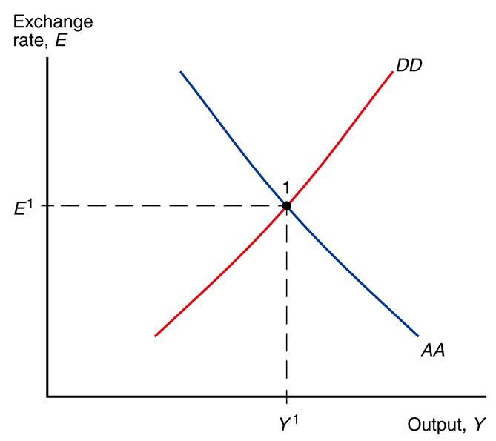
RECAP Fig. 17-8: Short-Run Equilibrium: The Intersection of DD and AA
The short run equilibrium occurs at the intersection of the DD and AA curves
The output market is in equilibrium on the DD curve
The asset markets are in equilibrium on the AA curve

Slide 6
Recap: Shifting the AA and DD Curves
The DD curve shifts right if:
G increases
T decreases
I increases
P decreases
P* increases
C increases for some unknown reason (C₀↑)
CA increases for some unknown reason (CA₀↑)
The AA curve shifts right if:
M^{s} increases
P decreases
E^{e} increases
R* increases
L decreases for some unknown reason (L₀↓)
Knowing how some exogenous change shifts the DD and AA curves helps us predict the consequences of the exogenous change.
Note that a central bank can control only the money supply (M^{s}). Therefore, a central bank can shift only the AA curve.

Slide 7
Short-run macroeconomics under fixed exchange rates

Slide 8
How a Central Bank Fixes the Exchange Rate, When AA Curve Shifts
1. Suppose the central bank wants to fix the value of the exchange rate at E¹. (This is the target exchange rate.)
2. We have seen that M^{s}↓, E^{e}↓, R*↓, and/or L₀↑ shifts the AA curve left. As a result, the short-run equilibrium shifts from point 1 to point 2 and the exchange rate falls. This is not consistent with a fixed exchange rate. To return to the exchange rate to the target value of E¹, the central bank must increase the money supply and shift the AA curve back where it originally was.
E²
2
3. Note that M^{s}↓ gets totally reversed; it is impossible to decrease the money supply.
4. Moreover, E^{e}↓, R*↓, and/or L₀↑ can have no effect on Y and E. The only effect of these three exogenous changes is M^{s}↑.
Y²

Slide 9
How a Central Bank Fixes the Exchange Rate, When AA Curve Shifts
We just saw that E^{e}↓, R*↓, and/or L₀↑ can have no effect on Y and E. The only effect of these three exogenous changes is M^{s}↑.
 | Y | M^{s}
E^{e} | 0 | –
R* | 0 | –
L₀ | 0 | +
E²
2
Y²

Slide 10
How a Central Bank Fixes the Exchange Rate, When AA Curve Shifts
1. Suppose the central bank wants to fix the value of the exchange rate at E¹.
 | Y | M^{s}
E^{e} | 0 | –
R* | 0 | –
L₀ | 0 | +
2. We have seen that M^{s}↑, E^{e}↑, R*↑, and/or L₀↓ shifts the AA curve right. As a result, the short-run equilibrium shifts from point 1 to point 3 and the exchange rate rises. This is not consistent with a fixed exchange rate. To return to the exchange rate to the target value of E¹, the central bank must decrease the money supply and shift the AA curve back where it originally was.
E³
3
3. M^{s}↑ gets totally reversed; it is impossible to increase the money supply. E^{e}↑, R*↑, and/or L₀↓ can have no effect on Y and E. The only effect of these three exogenous changes is M^{s}↓.
4. This would require the central bank to sell its reserve assets. If the central bank has no reserve assets to sell, it will be unable to keep the exchange rate fixed when the AA curve shifts right.
Y³

Slide 11
How a Central Bank Fixes the Exchange Rate, When AA Curve Shifts
Thus, we see that, under fixed exchange rate system, E is exogenous; our theory is silent about the target exchange rate chosen by the central bank. However, our theory can now explain the increases and decreases of the money supply; so, M^{s} is endogenous. (Recall from Ch. 17 that under a flexible exchange rate system, it is the reverse: E is endogenous and M^{s} is exogenous.)
E³
3
As the central bank must continuously adjust the money supply to keep the exchange rate fixed at the target value, M^{s} can no longer be used for other purposes. The usual sort of monetary policy you’ve seen before under flexible exchange rates is no longer possible. But the central bank can control the exogenous target exchange rate. So, it is the target exchange rate that is now the monetary policy tool.
E²
2
Our analysis of the previous two slides shows that the exogenous variables that shift the AA curve but not the DD curve can have no effect on Y. That is, E^{e}, R*, and L₀ have no impact whatsoever on Y.
 | Y | M^{s}
E^{e} | 0 | –
R* | 0 | –
L₀ | 0 | +
Y²
Y³

Slide 12
How a Central Bank Fixes the Exchange Rate
Let us return to the case in which the AA curve shifts right for some reason and moves the equilibrium from point 1 to point 3.
To bring the exchange rate back to E¹, the central bank must reduce the money supply to shift the AA curve back where it was.
But there’s a slight problem. To reduce the money supply the central bank must sell financial assets from its reserves, as we saw earlier. But what if the central bank has exhausted its reserve of assets and has no assets left to sell?
In this case, the central bank will no longer be able to keep the exchange rate fixed. The country will be forced to return to flexible exchange rates.
More on this later!
E³
3
Y³

Slide 13
How a Central Bank Fixes the Exchange Rate
The effect of changes in E^{e} need to be looked at carefully. If people trust the central bank to preserve the fixed exchange rate system for the foreseeable future, then E^{e} = E^{Target}.
In this case, E^{e} cannot change unless E^{Target} also changes in an identical manner, and vice versa. On the other hand, if people do not trust the central bank to preserve the fixed exchange rate system, then E^{e} and E^{Target} need not be equal and may move independently.
E³
3
E²
2
Y²
Y³

Slide 14
Shift of the DD Curve to the Right
Suppose the central bank wants to fix the value of the exchange rate at E¹.
We have seen before that any exogenous change that increases aggregate demand -- C₀↑, T↓, I↑, G↑, CA₀↑, and/or P*↑ -- shifts the DD curve to the right. So, the short-run equilibrium would shift from point 1 to point 2 under flexible exchange rates.
DD²
3
All that the central bank has to do under fixed exchange rates is to increase the money supply (M^{s}↑) and shift the AA curve to the right, thereby taking the short-run equilibrium to point 3.
So, the effect on income (Y↑) now is in the same direction as under flexible exchange rates, but larger in magnitude.
2
AA²
Y³

Slide 15
Shift of the DD Curve to the Right
We have just seen that C₀↑, T↓, I↑, G↑, CA₀↑, and/or P*↑ shifts the DD curve to the right. The central bank has to increase the money supply (M^{s}↑) and shift the AA curve to the right, thereby taking the short-run equilibrium to point 3.
 | Y | M^{s}
E^{e} | 0 | –
R* | 0 | –
L₀ | 0 | +
C₀, I, G | + | +
T | – | –
CA₀ | + | +
P* | + | +
DD²
3
2
AA²
Y³

Slide 16
Shift of the DD Curve to the Left
Suppose the central bank wants to fix the value of the exchange rate at E¹.
We have seen before that any exogenous change that decreases aggregate demand -- C₀↓, T↑, I↓, G↓, CA₀↓, and/or P*↓ -- shifts the DD curve to the left.
So, the short-run equilibrium would shift from point 1 to point 2 under flexible exchange rates.
All that the central bank has to do under fixed exchange rates is to decrease the money supply (M^{s}↓) and shift the AA curve to the left, thereby taking the short-run equilibrium to point 3.
So, the effect on income (Y↓) now is in the same direction as under flexible exchange rates, but larger in magnitude.
DD²
2
3
AA²
Y³

Slide 17
Shift of the DD Curve to the Left
We have just seen that C₀↓, T↑, I↓, G↓, CA₀↓, and/or P*↓ shifts the DD curve to the left. The central bank has to decrease the money supply (M^{s}↓) and shift the AA curve to the left, thereby taking the short-run equilibrium to point 3.
Recall, however, that M^{s}↓ is possible only if the central bank has assets that it can sell. If the central bank has no assets left to sell, it would have to abandon the fixed exchange rate system. The economy would end up at Point 2.
 | Y | M^{s}
E^{e} | 0 | –
R* | 0 | –
L₀ | 0 | +
C₀, I, G | + | +
T | – | –
CA₀ | + | +
P* | + | +
DD²
2
3
AA²
Y³

Slide 18
Devaluation (E^{Target}↑)
Recall that under fixed exchange rates, it is the target value of the exchange rate (E^{Target}) that is the central bank’s monetary policy tool.
Suppose the exchange rate had been fixed at E¹ in the past. Now suppose the central bank wishes to continue to fix the exchange rate but at the higher value of E². This is called devaluation.
E²
2
Recall that a central bank can shift only the AA curve. So, it would have to increase the money supply (M^{s}↑) and shift the AA curve to the right till the equilibrium exchange rate increases to the desired level of E².
Therefore, we see that a devaluation raises output. Conversely, a revaluation—opposite of devaluation—reduces output.
Y²

Slide 19
Devaluation (E^{Target}↑)
We have just seen that a devaluation (E^{Target}↑) raises both output (Y↑) and the money supply (M^{s}↑). Conversely, a revaluation—opposite of devaluation—reduces output and the money supply.
 | Y | M^{s}
E^{e} | 0 | –
R* | 0 | –
L₀ | 0 | +
C₀, I, G | + | +
T | – | –
CA₀ | + | +
P* | + | +
E^{Target} | + | +
E²
2
Y²

Slide 20
Devaluation and Expectations
The effects of a devaluation also depend on whether the new target value of the exchange rate (E^{Target}) is expected to continue for the foreseeable future
If the new higher value of E^{Target} is expected to continue, then, logically, the expected future value of the exchange rate must also increase (E↑ must imply E^{e}↑)
On the other hand, if the new value of E^{Target} is not expected to continue, then E↑ would not imply E^{e}↑.

Slide 21
Devaluation (E↑)
As we just saw in the previous slide, the increase in the central bank’s target exchange rate may raise the expected exchange rate (E^{e}↑). This, we saw before, will shift the AA curve further to the right, taking the equilibrium to point 3.
3
E²
2
The central bank will therefore have to reduce the money supply a bit to shift the AA curve to the left till the economy returns to point 2.
That is, while the central bank will need to increase the money supply to cause a devaluation, a smaller increase in M^{s} will get the job done when people trust the central bank to preserve the fixed exchange rate system at the new value of E^{Target}.
Y²

Slide 22
Change in Domestic Prices (P)
Recall that P↓ causes both AA and DD curves to shift rightward
Therefore, it is clear that Y↑
But E could decrease, stay unchanged, or increase, as in the three diagrams below
 | Y | M^{s}
E^{e} | 0 | –
R* | 0 | –
L₀ | 0 | +
C₀, I, G | + | +
T | – | –
CA₀ | + | +
P* | + | +
E^{Target} | + | +
P | – | Later
E
E
E
DD
DD
DD
AA
AA
AA
Y
Y
Y

Slide 23
Change in Domestic Prices (P)
We just saw that P↓ leads to Y↑, but E could (a) decrease, (b) stay unchanged, or (c) increase.
So, to keep the exchange rate fixed, the central bank would have to increase the money supply and shift AA to the right if E↓, do nothing in case (b), and decrease the money supply and shift AA to the left if E↑.
In other words the effect of P↓ on M^{s} is uncertain.
E
E
E
DD
DD
DD
AA
AA
AA
Y
Y
Y

Slide 24
Summary: The Behavior of Output
Exogenous Change | Effect on Output (Y)
Government Spending (G) | +
Business Investment Spending (I) | +
Net Tax Revenues (T) | –
Foreign Price Level (P*) | +
C-shock (C₀) | +
CA-shocks (CA₀) | +
Domestic Price Level (P) | –
Target Exchange Rate (E^{target}) | +
Expected Future Exchange Rate (E^{e}) | 0
Foreign Interest Rate (R*) | 0
L-shock (L₀) | 0
Only DD shifts
Both DD and AA shift
Only AA shifts

Slide 25
Summary: National Income and Money Supply
Whenever there is an effect on Y, the magnitude of the effect is bigger under fixed exchange rates than under flexible exchange rates.
 | Y | M^{s}
C₀, I, G | + | +
T | – | –
CA₀ | + | +
P* | + | +
P | – | ?
E^{Target} | + | +
E^{e} | 0 | –
R* | 0 | –
L₀ | 0 | +
Only DD shifts
Both DD and AA shift
Only AA shifts

Slide 26
Summary: National Income and Money Supply
This predictions grid assumes that E^{Target} and E^{e} may change independently of each other.
Recall that if people trust the central bank to maintain E^{Target} for the foreseeable future, then E^{Target} = E^{e}.
How would the grid look like in that case?
See next slide.
 | Y | M^{s}
C₀, I, G | + | +
T | – | –
CA₀ | + | +
P* | + | +
P | – | ?
E^{Target} | + | +
E^{e} | 0 | –
R* | 0 | –
L₀ | 0 | +
Only DD shifts
Both DD and AA shift
Only AA shifts

Slide 27
Summary: National Income and Money Supply (Trusted Fixed Exchange Rate System)
If people trust the central bank to maintain E^{Target} for the foreseeable future, then E^{Target} = E^{e}.
 | Y | M^{s}
C₀, I, G | + | +
T | – | –
CA₀ | + | +
P* | + | +
P | – | ?
E^{Target}, E^{e} | + | +
R* | 0 | –
L₀ | 0 | +
Only DD shifts
Both DD and AA shift
Only AA shifts

Slide 28
The interest rate

Slide 29
The Interest Rate
Recall from Ch. 14 that the foreign exchange market is in equilibrium when $R=R^{∗}+\frac{E^{e}}{E^{Target}}−1$
It follows that the domestic nominal interest rate is directly related with the foreign nominal interest rate (R*) and the expected future exchange rate (E^{e}) and inversely related with the target exchange rate (E^{Target}).
 | Y | M^{s} | R
C₀, I, G | + | + | 0
T | – | – | 0
CA₀ | + | + | 0
P* | + | + | 0
P | – | ? | 0
E^{Target} | + | + | –
E^{e} | 0 | – | +
R* | 0 | – | +
L₀ | 0 | + | 0

Slide 30
The Interest Rate (Trusted Fixed Exchange Rate)
When the central bank fixes the exchange rate at E = E^{target}, people may expect E to continue at that level for the foreseeable future.
So, E^{e} = E^{target}.
Then, $R=R^{∗}+\frac{E^{Target}}{E^{Target}}−1=R^{∗}$.
Under trusted fixed exchange rates, the domestic nominal interest rate will always be equal to the foreign nominal interest rate.
Trusted | Y | M^{s} | R
C₀, I, G | + | + | 0
T | – | – | 0
CA₀ | + | + | 0
P* | + | + | 0
P | – | ? | 0
E^{Target}, E^{e} | + | + | 0
R* | 0 | – | +
L₀ | 0 | + | 0

Slide 31
Role of Trust in a Fixed Exchange Rate
Note that our short-run predictions are basically unchanged
No Trust | Y | M^{s} | R
C₀, I, G | + | + | 0
T | – | – | 0
CA₀ | + | + | 0
P* | + | + | 0
P | – | ? | 0
E^{Target} | + | + | –
E^{e} | 0 | – | +
R* | 0 | – | +
L₀ | 0 | + | 0
Trusted | Y | M^{s} | R
C₀, I, G | + | + | 0
T | – | – | 0
CA₀ | + | + | 0
P* | + | + | 0
P | – | ? | 0
E^{Target}, E^{e} | + | + | 0
R* | 0 | – | +
L₀ | 0 | + | 0

Slide 32
The current account

Slide 33
The Current Account
Recall from Ch. 17 that there are two ways of expressing the domestic country’s net exports (or, current account):
Method 1: $CA=CA\left({CA}_{0},\frac{E×P^{∗}}{P},Y−T\right)$
Method 2: $CA=Y−C\left(C_{0},Y−T\right)−I−G$

Slide 34
The Current Account
Method 1: $CA=CA\left({CA}_{0},\frac{E^{Target}×P^{∗}}{P},Y−T\right)$
In this case, the current account is inversely related to after-tax income
Therefore, if there is a change in any exogenous variable other than those in the above equation, its effect on CA will be the opposite of its effect on Y.
Next slide
 | Y | CA | M^{s} | R
C₀, I, G | + | – | + | 0
T | – | Later | – | 0
CA₀ | + | Later | + | 0
P* | + | Later | + | 0
P | – | Later | ? | 0
E^{Target} | + | Later | + | –
E^{e} | 0 | 0 | – | +
R* | 0 | 0 | – | +
L₀ | 0 | 0 | + | 0

Slide 35
The Current Account
 | Y | CA | M^{s} | R
C₀, I, G | + | – | + | 0
T | – | + | – | 0
CA₀ | + | Later | + | 0
P* | + | Later | + | 0
P | – | Later | ? | 0
E^{Target} | + | Later | + | –
E^{e} | 0 | 0 | – | +
R* | 0 | 0 | – | +
L₀ | 0 | 0 | + | 0
Method 1: $CA=CA\left({CA}_{0},\frac{E^{Target}×P^{∗}}{P},Y−T\right)$
Suppose taxes increase (T↑) and all other exogenous variables remain unchanged.
We saw before that Y↓. Therefore, after-tax income must decrease (Y – T↓).
As the current account is inversely related to after-tax income, the current account increases (CA↑) Next slide

Slide 36
The Current Account
Method 2: $CA=Y−C\left(C_{0},Y−T\right)−I−G$
We have assumed that when national income increases, so does consumption spending, but by a smaller amount
So, Y↑ implies Y – C↑ and CA = Y – C – I – G↑.
It follows that all the exogenous factors other than those in this equation must affect CA in the same way they affect Y.
Next slide
 | Y | CA | M^{s} | R
C₀, I, G | + | – | + | 0
T | – | + | – | 0
CA₀ | + | + | + | 0
P* | + | + | + | 0
P | – | – | ? | 0
E^{Target} | + | + | + | –
E^{e} | 0 | 0 | – | +
R* | 0 | 0 | – | +
L₀ | 0 | 0 | + | 0

Slide 37
The Current Account
Note that, contractionary fiscal policies (“fiscal austerity” or “belt tightening”; G↓ or T↑) can raise a country’s net exports (CA↑) in the short run.
But so can protectionist policies such as tariffs and quotas and increases in foreign national income (CA₀↑).
These predictions are also true under flexible exchange rates.
 | Y | CA | M^{s} | R
C₀, I, G | + | – | + | 0
T | – | + | – | 0
CA₀ | + | + | + | 0
P* | + | + | + | 0
P | – | – | ? | 0
E^{Target} | + | + | + | –
E^{e} | 0 | 0 | – | +
R* | 0 | 0 | – | +
L₀ | 0 | 0 | + | 0

Slide 38
Real exchange rate

Slide 39
The Real Exchange Rate
Recall that the real exchange rate is defined as $q=\frac{E×P^{∗}}{P}$.
Therefore, in a fixed exchange rate system, we have $q=\frac{E^{Target}×P^{∗}}{P}$.
Note that this equation is a solution for q because all variables on the right-hand side are exogenous
This gives us the predictions in the table
 | Y | CA | M^{s} | R | q
C₀, I, G | + | – | + | 0 | 0
T | – | + | – | 0 | 0
CA₀ | + | + | + | 0 | 0
P* | + | + | + | 0 | +
P | – | – | ? | 0 | –
E^{Target} | + | + | + | – | +
E^{e} | 0 | 0 | – | + | 0
R* | 0 | 0 | – | + | 0
L₀ | 0 | 0 | + | 0 | 0

Slide 40
Comparing Flexible and Fixed Exchange Rate Regimes

Slide 41
Comparing Exchange Rate Regimes, Short Run
Short-Fix | Y | CA | q | M^{s} | R
C₀, I, G | + | – | 0 | + | 0
T | – | + | 0 | – | 0
CA₀ | + | + | 0 | + | 0
P* | + | + | + | + | 0
P | – | – | – | ? | 0
E^{Target} | + | + | + | + | –
E^{e} | 0 | 0 | 0 | – | +
R* | 0 | 0 | 0 | – | +
L₀ | 0 | 0 | 0 | + | 0
Short-Flex | Y | CA | q | E | R
G, I, C₀ | + | − | − | − | +
T | − | + | + | + | −
CA₀ | + | + | − | − | +
P* | + | + | + | − | +
P | − | − | − | ? | ?
M^{s} | + | + | + | + | −
E^{e} | + | + | + | + | +
R* | + | + | + | + | +
L₀ | − | − | − | − | +

Slide 42
Comparing the Regimes
As output (Y) and the current account (CA) are usually the two main topics, let us look at how the various exogenous variables affect Y and CA in the two exchange rate regimes

Slide 43
It’s Basically the Same!
Fixed Exchange Rates | Y | CA
Government Spending (G) | + | –
Business Investment Spending (I) | + | –
Net Tax Revenues (T) | – | +
Foreign Price Level (P*) | + | +
C-shock (C₀) | + | –
CA-shocks (CA₀) | + | +
Domestic Price Level (P) | – | –
Target Exchange Rate (E^{target}) | + | +
Expected Future Exchange Rate (E^{e}) | 0 | 0
Foreign Interest Rate (R*) | 0 | 0
L-shock (L₀) | 0 | 0
Flexible Exchange Rates (Ch. 17) | Y | CA
Government Spending (G) | + | –
Business Investment Spending (I) | + | –
Net Tax Revenues (T) | – | +
Foreign Price Level (P*) | + | +
C-shock (C₀) | + | –
CA-shocks (CA₀) | + | +
Domestic Price Level (P) | – | –
Money Supply (M^{s}) | + | +
Expected Future Exchange Rate (E^{e}) | + | +
Foreign Interest Rate (R*) | + | +
L-shock (L₀) | – | –

Slide 44
It’s Basically the Same!
Fixed Exchange Rates | Y | CA
Government Spending (G) | + | –
Business Investment Spending (I) | + | –
Net Tax Revenues (T) | – | +
Foreign Price Level (P*) | + | +
C-shock (C₀) | + | –
CA-shocks (CA₀) | + | +
Domestic Price Level (P) | – | –
Target Exchange Rate (E^{target}) | + | +
Expected Future Exchange Rate (E^{e}) | 0 | 0
Foreign Interest Rate (R*) | 0 | 0
L-shock (L₀) | 0 | 0
Flexible Exchange Rates (Ch. 17) | Y | CA
Government Spending (G) | + | –
Business Investment Spending (I) | + | –
Net Tax Revenues (T) | – | +
Foreign Price Level (P*) | + | +
C-shock (C₀) | + | –
CA-shocks (CA₀) | + | +
Domestic Price Level (P) | – | –
Money Supply (M^{s}) | + | +
Expected Future Exchange Rate (E^{e}) | + | +
Foreign Interest Rate (R*) | + | +
L-shock (L₀) | – | –
Recall that expansionary monetary policy is an increase in M^{s} under flexible exchange rates and an increase in E^{target} under fixed exchange rates. Note that their effects are the same: output and the current account both increase.

Slide 45
It’s Basically the Same!
Fixed Exchange Rates | Y | CA
Government Spending (G) | + | –
Business Investment Spending (I) | + | –
Net Tax Revenues (T) | – | +
Foreign Price Level (P*) | + | +
C-shock (C₀) | + | –
CA-shocks (CA₀) | + | +
Domestic Price Level (P) | – | –
Target Exchange Rate (E^{target}) | + | +
Expected Future Exchange Rate (E^{e}) | 0 | 0
Foreign Interest Rate (R*) | 0 | 0
L-shock (L₀) | 0 | 0
Flexible Exchange Rates (Ch. 17) | Y | CA
Government Spending (G) | + | –
Business Investment Spending (I) | + | –
Net Tax Revenues (T) | – | +
Foreign Price Level (P*) | + | +
C-shock (C₀) | + | –
CA-shocks (CA₀) | + | +
Domestic Price Level (P) | – | –
Money Supply (M^{s}) | + | +
Expected Future Exchange Rate (E^{e}) | + | +
Foreign Interest Rate (R*) | + | +
L-shock (L₀) | – | –
As we saw earlier, under fixed exchange rates, any variable that shifts the AA curve is totally reversed by the central bank in order to keep the exchange rate fixed. That explains the zeroes on the left table.

Slide 46
Balance of Payments Crises

Slide 47
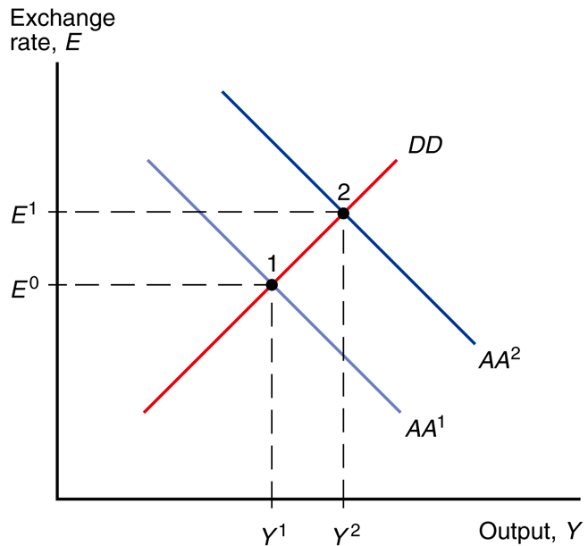
Fig. 18-4: Effect of the Expectation of a Currency Devaluation
If a devaluation (an increase in E) is widely expected, there is an increase in E^{e}. As a result, the AA curve shifts right.
To keep E fixed, the central bank must sell its foreign currency reserves and thereby reduce the domestic money supply and bring the AA curve back to where it was.
So, the mere expectation of a devaluation may cause the central bank to lose a lot of its reserves.
If its reserves are inadequate, the central bank may be forced to devalue or to simply abandon the fixed exchange rate system and switch to flexible exchange rates.

Slide 48
Balance of Payments Crises and Capital Flight
Balance of payments crisis
It is a sharp fall in official foreign reserves sparked by a change in expectations about the future exchange rate.

Slide 49
Balance of Payments Crises and Capital Flight
The mere expectation of a future devaluation causes:
A balance of payments crisis marked by a sharp fall in reserves
A rise in the home interest rate above the world interest rate
An expected revaluation causes the opposite effects of an expected devaluation.

Slide 50
Balance of Payments Crises and Capital Flight
Capital flight
Name given to the reserve loss accompanying a devaluation scare
The associated debit in the balance of payments accounts is a private capital outflow.
Self-fulfilling currency crises
It occurs when an economy is vulnerable to speculation.
The government may be responsible for such crises by creating or tolerating domestic economic weaknesses that invite speculators to attack the currency.

Slide 51
The long run under fixed exchange rates

Slide 52
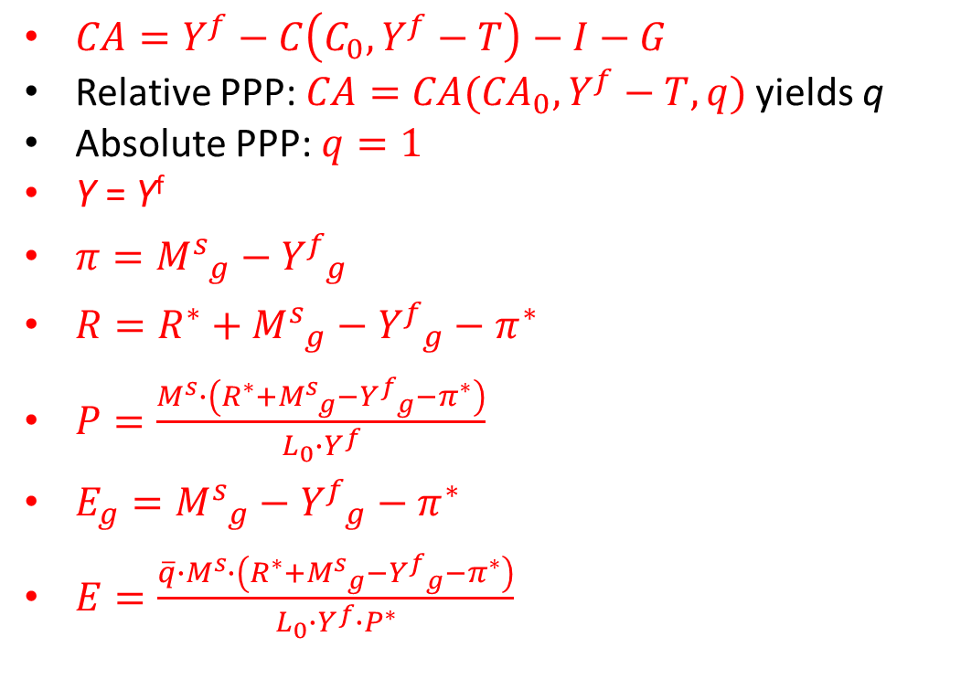
Summary: Long-Run, Flexible Exchange Rates (Chapter 16)
$CA=Y^{f}−C\left(C_{0}, Y^{f}−T\right)−I−G$
Relative PPP: $CA=CA({CA}_{0},Y^{f}−T,q)$ yields q
Absolute PPP: $q=1$
Y = Y^{f}
$π={M^{s}}_{g}−{Y^{f}}_{g}$
$R=R^{∗}+{M^{s}}_{g}−{Y^{f}}_{g}−π^{∗}$
$P=\frac{M^{s}∙\left(R^{∗}+{M^{s}}_{g}−{Y^{f}}_{g}−π^{∗}\right)}{L_{0}∙Y^{f}}$
$E_{g}={M^{s}}_{g}−{Y^{f}}_{g}−π^{∗}$
$E=\frac{{\overline{q}∙M}^{s}∙\left(R^{∗}+{M^{s}}_{g}−{Y^{f}}_{g}−π^{∗}\right)}{L_{0}∙Y^{f}∙P^{∗}}$
How will these results change under fixed exchange rates?
The first three are real variables. Under the principle of monetary neutrality, they will not be affected by a change in the monetary system.
We saw earlier that, under fixed exchange rates, R = R*. Also, it is obvious that E = E^{target} and E_{g} = 0.
Only P and π remain to be determined.

Slide 53
Inflation
As we saw in Chapter 16, under either absolute purchasing power parity or relative purchasing power parity we get $E_{g}=π−π^{∗}$
But under fixed exchange rates, the rate at which the exchange rate appreciates must be zero: $E_{g}=π−π^{∗}=0$
Therefore, $π=π^{∗}$
This is a major weakness of the fixed exchange rate system: the economy loses control over its own inflation rate

Slide 54
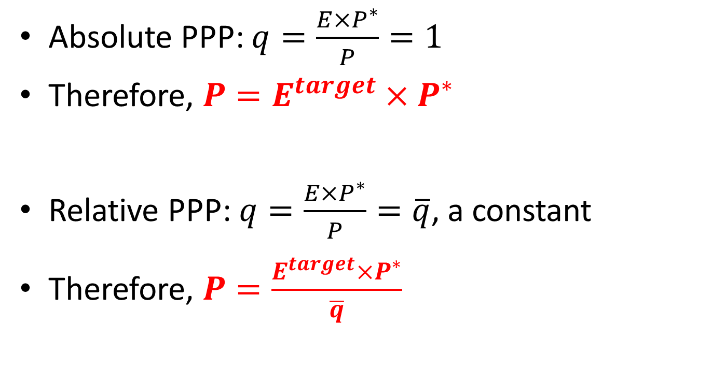
The Price Level
Absolute PPP: $q=\frac{E×P^{∗}}{P}=1$
Therefore, $P=E^{target}×P^{∗}$
Relative PPP: $q=\frac{E×P^{∗}}{P}=\overline{q}$, a constant
Therefore, $P=\frac{E^{target}×P^{∗}}{\overline{q}}$

Slide 55
Summary: Long-Run, Fixed Exchange Rates
$CA=Y^{f}−C\left(C_{0}, Y^{f}−T\right)−I−G$
Relative PPP: $CA=CA({CA}_{0},Y^{f}−T,q)$ yields q
Absolute PPP: $q=1$
Y = Y^{f}
$π=π^{∗}$
$R=R^{∗}$
$P=E^{target}∙P^{∗}$, absolute PPP
$P=\frac{E^{target}∙P^{∗}}{\overline{q}}$, relative PPP
Note that a major weakness of a fixed exchange rate system is that the country adopting such a system loses control of its inflation and interest rates.

Slide 56
Summary: Long-Run, Fixed Exchange Rates
 | Y | CA | q | R | P (Absolute PPP) | P (Relative PPP) | π
E^{Target} |  |  |  |  | + | +
R* |  |  |  | +
P* |  |  |  |  | + | +
π* |  |  |  |  |  |  | +
Y^{f} | + | + | + |  |  | –
C₀, I, G |  | – | – |  |  | +
CA₀ |  |  | – |  |  | +
T |  | + | + |  |  | –
The predictions implied by the solution equations on the previous slide are shown in this predictions table.
The first column lists the exogenous variables. The first row lists the endogenous variables. The content of each cell predicts the effect of the corresponding exogenous variable on the corresponding endogenous variable.
A blank cell indicates no effect. Further, ‘+’ indicates a direct effect, ‘–’ an inverse effect, and ‘?’ indicates an ambiguous effect.

Slide 57
Comparing Exchange Rate Systems, Long Run
Long-Flex | Y | CA | q | R | P | π
Y^{f} | + | + | + |  | –
C₀, I, G |  | – | –
T |  | + | +
CA₀ |  |  | –
M^{s} |  |  |  |  | +
L₀ |  |  |  |  | –
R* |  |  |  | + | +
M^{s}_{g} – Y^{f}_{g} |  |  |  | + | + | +
π* |  |  |  | – | –
P*
Long-Fix | Y | CA | q | R | P | π
Y^{f} | + | + | + |  | –
C₀, I, G |  | – | – |  | +
T |  | + | + |  | –
CA₀ |  |  | – |  | +
E^{Target} |  |  |  |  | +
R* |  |  |  | +
π* |  |  |  |  |  | +
P* |  |  |  |  | +
As the idea of the long-run neutrality of money says, the behavior of real variables (Y, CA, and q) cannot be affected by the monetary policy or by the exchange rate system (which is also monetary policy in a sense).

Slide 58
Comparing Exchange Rate Systems, Long Run and Short Run
Long-Run | Y | CA
Y^{f} | + | +
C₀, I, G |  | –
T |  | +
CA₀
Short-Fix | Y | CA
C₀, I, G | + | –
T | – | +
CA₀ | + | +
P* | + | +
P | – | –
E^{Target} | + | +
E^{e} | 0 | 0
R* | 0 | 0
L₀ | 0 | 0
Short-Flex | Y | CA
G, I, C₀ | + | −
T | − | +
CA₀ | + | +
P* | + | +
P | − | −
M^{s} | + | +
E^{e} | + | +
R* | + | +
L₀ | − | −
The predictions for national income and net exports that hold in both the short and long runs and regardless of the exchange rate system are in red.
The predictions that hold in the short run regardless of the exchange rate system are in blue.

Slide 59
Comparing Exchange Rate Systems, Long Run and Short Run
Long-Run | Y | CA
Y^{f} | + | +
C₀, I, G |  | –
T |  | +
CA₀
Short-Fix | Y | CA
C₀, I, G | + | –
T | – | +
CA₀ | + | +
P* | + | +
P | – | –
E^{Target} | + | +
E^{e} | 0 | 0
R* | 0 | 0
L₀ | 0 | 0
Short-Flex | Y | CA
G, I, C₀ | + | −
T | − | +
CA₀ | + | +
P* | + | +
P | − | −
M^{s} | + | +
E^{e} | + | +
R* | + | +
L₀ | − | −
Contractionary fiscal policy will raise net exports in both the short and long runs and regardless of the exchange rate system.
Contractionary fiscal policy will reduce national income in the short run regardless of the exchange rate system.
Tariffs and expansionary monetary policy raise national income and net exports in the short run regardless of the exchange rate system but have no effect in the long run.

