Slide 1
Optimum Currency Areas and the European Experience
Chapter 21
ECO41 International Economics
Udayan Roy

Slide 2
The theory of optimum currency areas

Slide 3
A few questions
Would it be desirable for the whole world to have one currency?
Would it be desirable for the 50 states of the USA to have currencies of their own?
What are the pros and cons of a country/state having its own currency?

Slide 4
Efficiency gains from shared currency
If several countries/states use the same currency, their people will enjoy certain efficiency gains:
they’ll no longer have to worry about (possible future fluctuations in) exchange rates, and
they’ll no longer face the hassle of currency conversions

Slide 5
Efficiency gains from shared currency
These gains will be greater the more economically interconnected the countries are:
If they trade a lot in goods and services
If they borrow from and lend to each other on a large scale
If there is a great deal of migration among them
In these cases, a common currency can be a blessing

Slide 6
Efficiency gains from shared currency
Some of these efficiency gains can also be obtained under a system of fixed exchange rates, but without a common currency
Under such a system, countries retain the freedom to change the ‘fixed’ exchange rate from time to time
However, when such rate changes happen, people’s uncertainty about the exchange rate increases
Continued, next slide

Slide 7
Efficiency gains from shared currency
Moreover, a country with a fixed exchange rate may suffer from a currency crisis if there is a perception that its central bank would run out of assets, such as foreign currency

Slide 8
Stability losses from shared currency
A country that has its own currency can use monetary policy to stabilize its economy in times of trouble
For example, the US Federal Reserve prints money, floods the economy with loans, makes loans cheaper (reduces interest rates), in order to boost spending, whenever there’s a recession
Without a currency of its own, a country will not be able to do this

Slide 9
Stability losses from shared currency
Moreover, in a country that has its own currency, automatic changes in the exchange value of its currency can act as a cushion in rough times
If there’s a sudden decrease in the demand for ‘Made in USA’ goods, the US dollar automatically becomes cheaper, thereby boosting net exports and cushioning the fall in demand
Without a currency of its own, this flexibility would not be available to a country
Short-Flex | Y | CA | q | E | R
G, I, C₀ | + | − | − | − | +
T | − | + | + | + | −
CA₀ | + | + | − | − | +
P* | + | + | + | − | +
P | − | − | − | ? | ?
M^{s} | + | + | + | + | −
E^{e} | + | + | + | + | +
R* | + | + | + | + | +
L₀ | − | − | − | − | +

Slide 10
Stability losses from shared currency
When countries share a common currency, the stability losses are smaller the more economically interconnected the countries are:
If they trade a lot in goods and services
If they borrow from and lend to each other on a large scale
If there is a great deal of migration among them
If they have a unified government budget

Slide 11
When is a common currency a good idea?
To summarize, countries/states would have large efficiency gains and small stability losses from having a common currency if they are highly integrated:
Lots of trade in goods and services
Lots of borrowing and lending
Lots of migration
A unified government budget
In these cases, a common currency can be a blessing

Slide 12
When is a common currency a good idea?
The 50 states of the USA satisfy most or all the requirements for benefiting from having a common currency
Lots of trade in goods and services (Y)
Lots of borrowing and lending (Y)
Lots of migration (Y)
A unified government budget (Y)

Slide 13
When is a common currency a good idea?
It is not yet clear whether the European countries that have adopted the Euro as their common currency satisfy those requirements
Lots of trade in goods and services (Y)
Lots of borrowing and lending (Y)
Lots of migration (?)
A unified government budget (N)

Slide 14
When is a common currency a good idea?
Many observers believe that the Euro zone countries adopted the Euro for political rather than economic reasons
Currently, there are 19 countries that use the euro

Slide 15
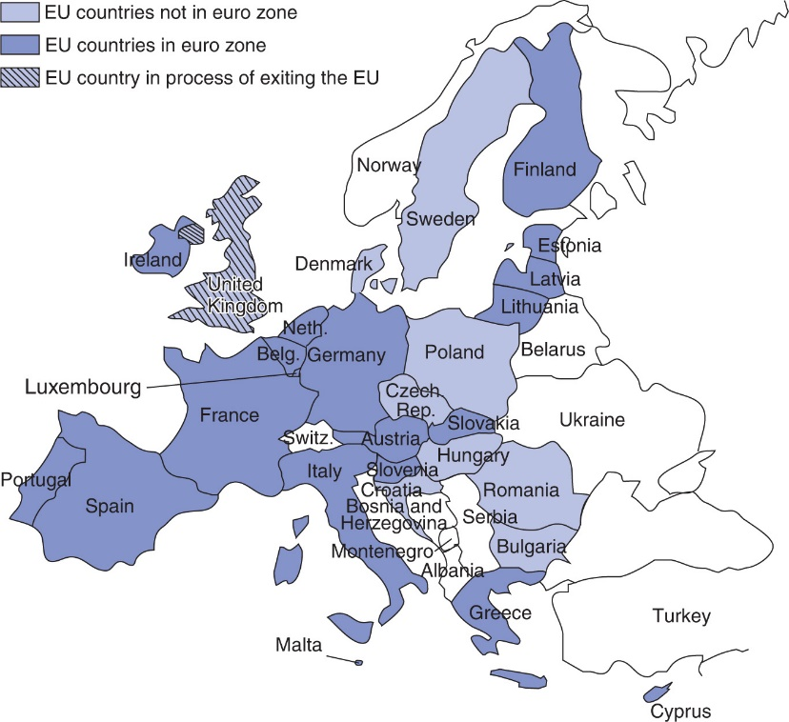
Figure 21.1 Members of the Euro Zone as of January 1, 2017
The heavily shaded countries on the map are the 19 members of EMU: Austria, Belgium, Cyprus, Estonia, Finland, France, Germany, Greece, Ireland, Italy, Latvia, Lithuania, Luxembourg, Malta, the Netherlands, Portugal, the Slovak Republic, Slovenia, and Spain. The United Kingdom does not use the euro, but it remains in the EU for the moment, pending the negotiation of its exit terms following the referendum of June 2016.

Slide 16
The Euro Zone Debt Crisis, 2010-11

Slide 17
The Euro Zone Debt Crisis, 2010-11
Greece wanted to join the Euro zone
But countries had to meet stringent conditions to join the club:
Budget deficits no more than 3% of GDP
Government debt no more than 60% of GDP
The Greek government falsified the budget numbers to qualify
the other countries chose not to check, applying an informal honor system

Slide 18
The Euro Zone Debt Crisis, 2010-11
In October 2009, a new government came to power in Greece
It revealed the true state of Greek government finances:
Budget deficit at 12.7% of GDP
Government debt at 100% of GDP

Slide 19
The Euro Zone Debt Crisis, 2010-11
Lenders feared that the Greek government would default on its debts
Only a few lenders were now willing to lend to the Greek government, and they were charging very high interest rates
Those high rates made default more likely

Slide 20
The Euro Zone Debt Crisis, 2010-11
Potential lenders feared a Greek default partly because Greece could no longer print its own money to pay off its debts
Other countries that had even higher debts but had their own currencies paid lower interest rates

Slide 21
The Euro Zone Debt Crisis, 2010-11
Any default by the Greek government was potentially dangerous because it could lead to a banking crisis throughout Europe, because many European banks had lent money to the Greek government

Slide 22
The Euro Zone Debt Crisis, 2010-11
Greece was forced to reduce its budget deficit
government spending was cut and taxes were raised
But this worsened the recession that had already begun and did not reduce the budget deficit (because tax revenues collapsed)
The government was caught in a policy dilemma

Slide 23
The Euro Zone Debt Crisis, 2010-11
When in a recession, governments use:
Expansionary monetary policy
Greece could not do this because it no longer had its own money
Expansionary fiscal policy
This means an increase in government spending or a cut in taxes or both. This requires borrowing. Greece could not borrow from anybody
Moreover, limited borrowing was a requirement for being in the Euro zone (“Stability and Growth Pact”)

Slide 24
The Euro Zone Debt Crisis, 2010-11
A potential solution for Greece was internal devaluation
which is a steady but sharp reduction in Greek wages
this would reduce the prices of Greek goods, boost exports and cut imports, and thereby enable the Greek government to pay its debts
But wages usually do not fall without long and wrenching economic depressions that are politically unpopular

Slide 25
The Euro Zone Debt Crisis, 2010-11
In the end Greece was not be able to pay its debts
For a while, the problems of Greece threatened to spread to other countries
Lenders worried about loans to the governments of Ireland, Portugal, Spain, and Italy and interest rates rose
This threatened to make further defaults likely, as a self-fulfilling prophecy

Slide 26
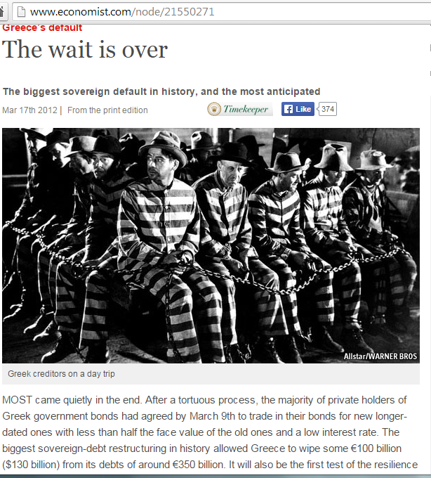

Slide 27
The Euro Zone Debt Crisis, 2010-11
The Eurozone’s debt crisis came to an end in July 2012 when the European Central Bank finally announced that it would do “whatever it takes” to protect the euro
Lenders took this pledge to mean that the ECB would print euros, if necessary, to pay all debts—of governments such as Greece’s—to private lenders

Slide 28
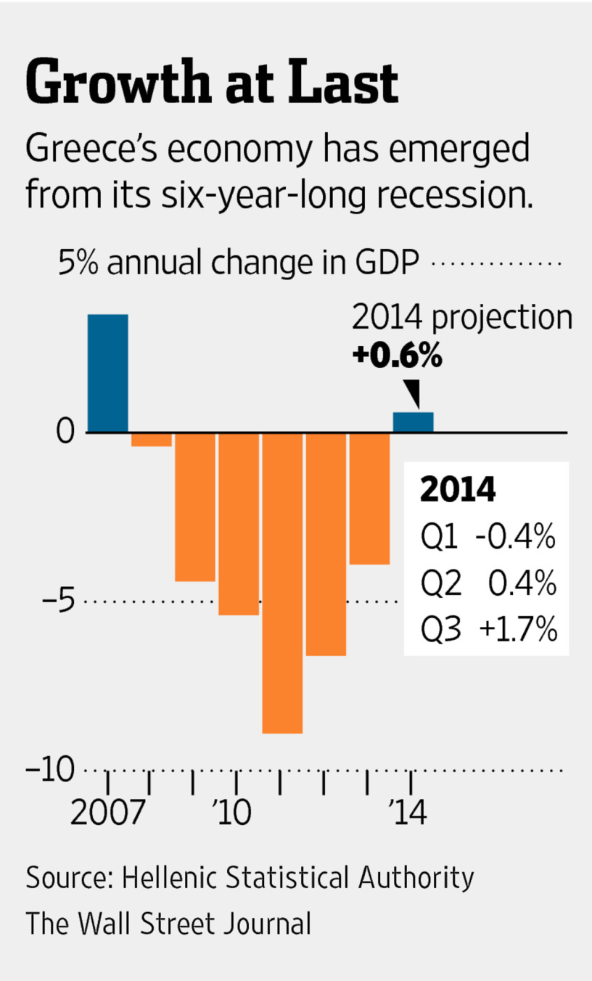
The Euro Zone Debt Crisis, 2010-11
Greek Economy Returns to Growth: Better-Than-Expected Figures End Six Years of Contraction
By STELIOS BOURAS and ALKMAN GRANITSAS, The Wall Street Journal, Nov. 14, 2014

Slide 29
The Euro Zone Debt Crisis, 2010-11
The Greek government’s problem would have been a lot less severe if it had the power to print its own money
If Greece had not abandoned the Drachma, its pre-Euro currency, it could have simply printed Drachmas and paid all its debts
Knowing this, lenders would have happily loaned money to Greece at low interest rates

Slide 30
The Euro Zone Debt Crisis, 2010-11
Greece essentially lied about its budget problems to get into the Euro zone
Now the fact that it got into the Euro zone is the reason for its problems!

Slide 31
The Euro Zone Debt Crisis, 2010-11
Greece-like problems could keep popping up from time to time in the Euro zone, unless
The Euro zone breaks up and its members return to the era when they had their own currencies, or
The European Central Bank decides to print Euros and lend to Greece and other countries with budget deficits
The Euro zone becomes something like the USA
With more internal migration, and
A unified government budget

Slide 32
Further details

Slide 33
Theory of Optimum Currency Areas
The theory of optimum currency areas argues that the optimal area for a system of fixed exchange rates, or a common currency, is one that is highly economically integrated.
economic integration means free flows of
goods and services (trade)
financial capital (assets) and physical capital
workers/labor (immigration and emigration)
The theory was developed by Robert Mundell in 1961.

Slide 34
Theory of Optimum Currency Areas (cont.)
Fixed exchange rates have costs and benefits for countries deciding whether to adhere to them.
Benefits of fixed exchange rates are that they avoid the uncertainty and international transaction costs that floating exchange rates involve.
The gain that would occur if a country joined a fixed exchange rate system is called the monetary efficiency gain.

Slide 35
Theory of Optimum Currency Areas (cont.)
The monetary efficiency gain of joining a fixed exchange rate system depends on the amount of economic integration.
Joining fixed exchange rate system would be beneficial for a country if
trade is extensive between it and member countries, because transaction costs would be greatly reduced.
financial assets flow freely between it and member countries, because the uncertainty about rates of return would be greatly reduced.
people migrate freely between it and member countries, because the uncertainty about the purchasing power of wages would be greatly reduced.

Slide 36
Theory of Optimum Currency Areas (cont.)
In general, as the degree of economic integration increases, the monetary efficiency gain increases.
Draw a graph of the monetary efficiency gain as a function of the degree of economic integration.

Slide 37
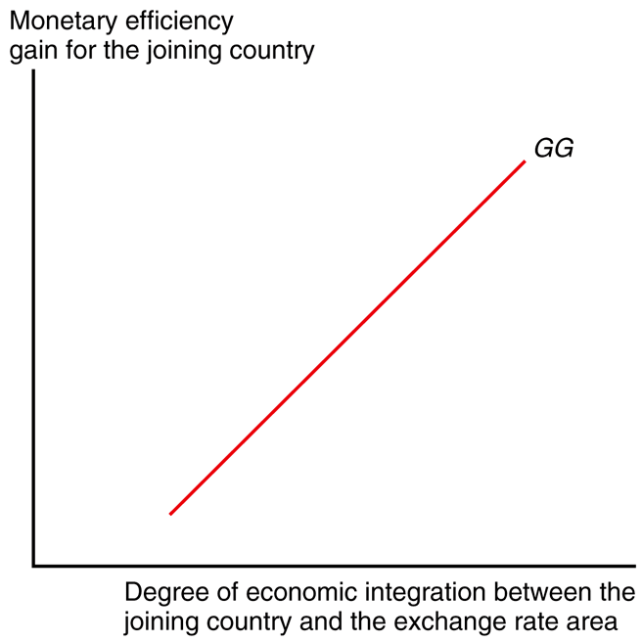
Fig. 20-3: The GG Schedule

Slide 38
Theory of Optimum Currency Areas (cont.)
When considering the monetary efficiency gain,
we have assumed that the members of the fixed exchange rate system would maintain stable prices.
But when variable inflation exists among member countries, then joining the system would not reduce uncertainty (as much).
we have assumed that a new member would be fully committed to a fixed exchange rate system.
But if a new member is likely to leave the fixed exchange rate system, then joining the system would not reduce uncertainty (as much).

Slide 39
Theory of Optimum Currency Areas (cont.)
Economic integration also allows prices to converge between members of a fixed exchange rate system and a potential member.
The law of one price is expected to hold better when markets are integrated.

Slide 40
Theory of Optimum Currency Areas (cont.)
Costs of fixed exchange rates are that they require the loss of monetary policy for stabilizing output and employment, and the loss of automatic adjustment of exchange rates to changes in aggregate demand.
Define this loss that would occur if a country joined a fixed exchange rate system as the economic stability loss.

Slide 41
Theory of Optimum Currency Areas (cont.)
The economic stability loss of joining a fixed exchange rate system also depends on the amount of economic integration.
After joining a fixed exchange rate system, if the new member faces a fall in aggregate demand:
Relative prices will tend to fall, which will lead other members to increase aggregate demand greatly if economic integration is extensive, so that the economic loss is not as great.
Financial assets or labor will migrate to areas with higher returns or wages if economic integration is extensive, so that the economic loss is not as great.

Slide 42
Theory of Optimum Currency Areas (cont.)
The loss of the automatic adjustment of flexible exchange rates is not as great if goods and services markets are integrated. Why?
Consider what would have happened if the country did not join the fixed exchange rate system:
the automatic adjustment would have caused a depreciation of the domestic currency and an appreciation of foreign currencies, which would have caused an increase in many prices for domestic consumers when goods and services markets are integrated.

Slide 43
Theory of Optimum Currency Areas (cont.)
In general, as the degree of economic integration increases, the economic stability loss decreases.
Draw a graph of the economic stability loss as a function of the degree of economic integration.

Slide 44
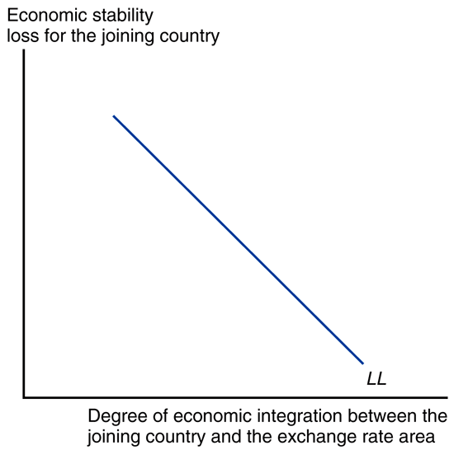
Fig. 20-4: The LL Schedule

Slide 45
Theory of Optimum Currency Areas (cont.)
At some critical point measuring the degree of integration, the monetary efficiency gain will exceed the economic stability loss for a member considering whether to join a fixed exchange rate system.

Slide 46
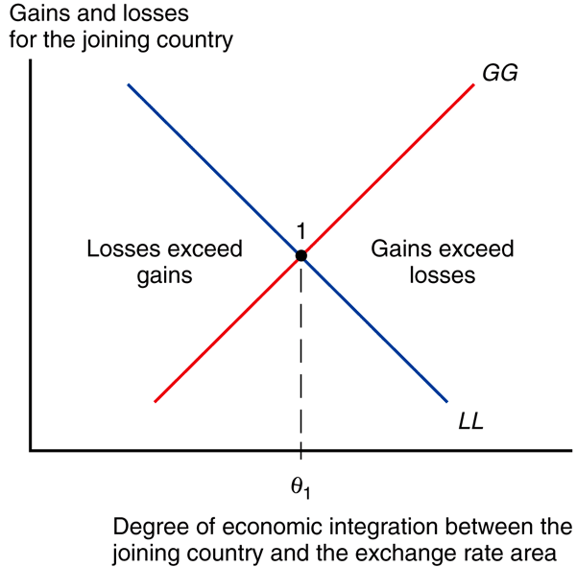
Fig. 20-5: Deciding When to Peg the Exchange Rate

Slide 47
Theory of Optimum Currency Areas (cont.)
There could be an event that causes the frequency or magnitude of changes in aggregate demand to increase for a country.
If so, the economic stability loss would be greater for every measure of economic integration between a new member and members of a fixed exchange rate system.
How would this affect the critical point where the monetary efficiency gain equals economic stability loss?

Slide 48
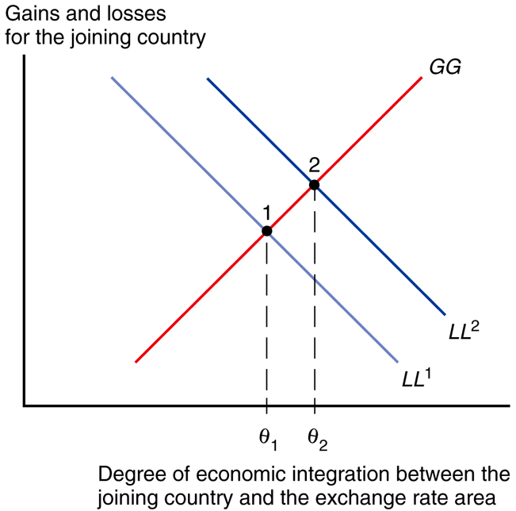
Fig. 20-6: An Increase in Output Market Variability

Slide 49
Is the EU an Optimum Currency Area?
If the EU/EMS/economic and monetary union can be expected to benefit members, we expect that its members have a high degree of economic integration:
large trade volumes as a fraction of GDP
a large amount of foreign financial investment and foreign direct investment relative to total investment
a large amount of migration across borders as a fraction of total labor force

Slide 50
Is the EU an Optimum Currency Area? (cont.)
Most EU members export from 10% to 20% of GDP to other EU members
This compares with exports of less than 2% of EU GDP to the U.S.
But trade between regions in the U.S. is a larger fraction of regional GDP.
Was trade restricted by regulations that were removed under the Single European Act?

Slide 51
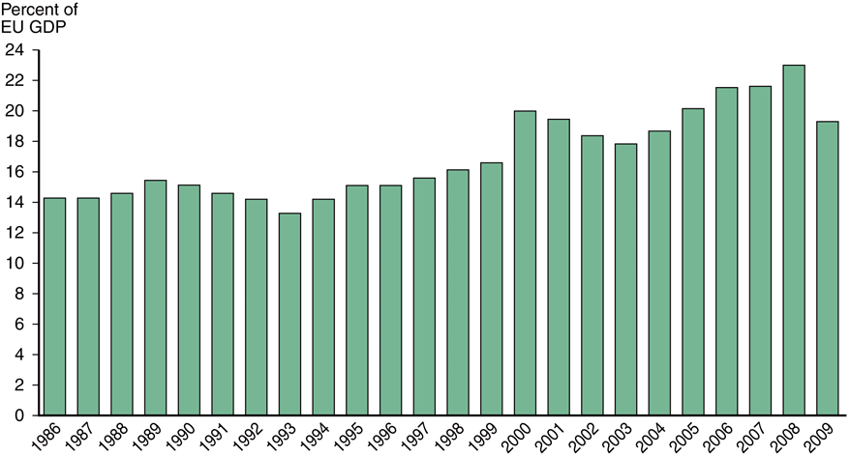
Fig. 20-7: Intra-EU Trade as a Percent of EU GDP

Slide 52
Is the EU an Optimum Currency Area? (cont.)
Deviations from the law of one price also occur in many EU markets.
If EU markets were greatly integrated, then the (currency-adjusted) prices of goods and services should be nearly the same across markets.
The price of the same BMW car varies 29.5% between British and Dutch markets.

Slide 53
Is the EU an Optimum Currency Area? (cont.)
Regional migration is not extensive in the EU.
Europe has many languages and cultures, which hinder migration and labor mobility.
Unions and regulations also impede labor movements between industries and countries.
Differences of U.S. unemployment rates across regions are smaller and less persistent than differences of national unemployment rates in the EU, indicating a lack of EU labor mobility.

Slide 54
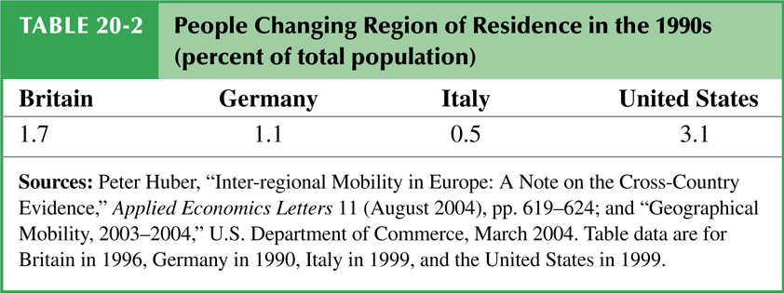
Table 20-2: People Changing Region of Residence in the 1990s (percent of total population)

Slide 55
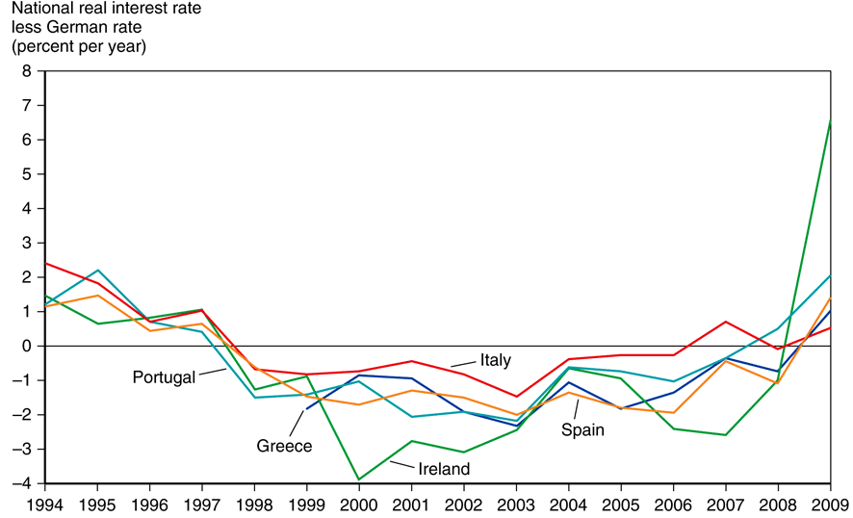
Fig. 20-8: Divergent Real Interest Rates in the Euro Zone
Source: Datastream.

Slide 56
Table 20-3: Current Account Balances of Euro Zone Countries, 2005–2009 (percent of GDP)

Slide 57
Is the EU an Optimum Currency Area? (cont.)
There is evidence that financial assets were able to move more freely within the EU after 1992 and 1999.
But capital mobility without labor mobility can make the economic stability loss greater.
After a reduction of aggregate demand in a particular EU country, financial assets could be easily transferred elsewhere while labor is stuck.
The loss of financial assets could further reduce production and employment.

Slide 58
Other Considerations for an EMU
The structure of the economies in the EU’s economic and monetary union is important for determining how members respond to aggregate demand shocks.
The economies of EU members are similar in the sense that there is a high volume of intra-industry trade relative to the total volume.
They are different in the sense that Northern European countries have high levels of physical capital per worker and more skilled labor, compared with Southern European countries.

Slide 59
Other Considerations for an EMU (cont.)
How an EU member responds to aggregate demand shocks may depend on how the structure of its economy compares to that of fellow EU members.
For example, the effects on an EU member of a reduction in aggregate demand caused by a reduction in demand in the software industry will depend on whether the EU member has a large number of workers skilled in programming relative to fellow EU members.

Slide 60
Other Considerations for an EMU (cont.)
The amount of transfers among the EU members may also affect how EU economies respond to aggregate demand shocks.
Fiscal payments between countries in the EU’s federal system, or fiscal federalism, may help offset the economic stability loss from joining an economic and monetary union.
But relative to interregional transfers in the U.S., little fiscal federalism occurs among EU members.

Slide 61
Summary
The EMS was first a system of fixed exchange rates but later developed into a more extensive coordination of economic and monetary policies: an economic and monetary union.
The Single European Act of 1986 recommended that EU members remove barriers to trade, capital flows, and immigration by the end of 1992.

Slide 62
Summary (cont.)
The Maastricht Treaty outlined 3 requirements for the EMS to become an economic and monetary union.
It also standardized many regulations and gave the EU institutions more control over defense policies.
It also set up penalties for spendthrift EMU members.
A new exchange rate mechanism was defined in 1999 vis-à-vis the euro, when the euro came into existence.

Slide 63
Summary (cont.)
An optimum currency area is a union of countries with a high degree of economic integration among goods and services, financial assets, and labor markets.
It is an area where the monetary efficiency gain of joining a fixed exchange rate system is at least as large as the economic stability loss.
The EU does not have a large degree of labor mobility due to differences in culture and due to unionization and regulation.
The EU is not an optimum currency area.

