Slide 1
Basics of Two-Country Trade: The Standard Trade Model
Udayan Roy
http://myweb.liu.edu/~uroy/eco41

Slide 2
Two-country free trade: part 1

Slide 3
Trade Between Two Countries
 | Japan
Price | D | S
10 | 0 | 11
9 | 0 | 10
8 | 0 | 9
7 | 0 | 8
6 | 0 | 7
5 | 0 | 6
4 | 1 | 5
3 | 2 | 4
2 | 3 | 3
1 | 4 | 2
0 | 5 | 1
Europe
D | S
0 | 9
2 | 8
4 | 7
6 | 6
8 | 5
10 | 4
12 | 3
14 | 2
16 | 1
18 | 0
20 | 0
World
D | S
0 | 20
2 | 18
4 | 16
6 | 14
8 | 12
10 | 10
13 | 8
16 | 6
19 | 4
22 | 2
25 | 1
Trade = S - D
J | E
11 | 9
10 | 6
9 | 3
8 | 0
7 | -3
6 | -6
4 | -9
2 | -12
0 | -15
-2 | -18
-4 | -20
Europe in autarky
Free Trade
Japan in autarky

Slide 4
Trade Between Two Countries
Autarky means no international trade
When two countries begin trading…
The price of any traded good
falls where it is expensive in autarky, and
rises where it is cheap in autarky
Eventually, the price becomes the same in both countries
This global free trade price lies somewhere between the two autarky prices

Slide 5
Trade Between Two Countries
Under free trade between two countries, …
any traded good is exported from where it is cheap in autarky to where it is expensive in autarky, and
is imported to where it is expensive in autarky from where it is cheap in autarky
global quantity demanded = global quantity supplied
exports = imports (in quantity and market value)

Slide 6
Trade Between Two Countries
Balanced Trade Assumption: A country must pay for its imports of some good (Good X) by exporting an amount of equal market value of some other good (Good Y)
In other words, if you import one good you must export another good, and your exports and your imports must be equal in market value

Slide 7
Trade Between Two Countries
The previous slides imply that when a country begins trading …
the price of its imported good falls, and
the price of its exported good rises

Slide 8
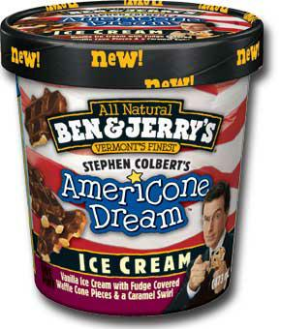
Prices: nominal and relative
So far, I have been not been fully clear about how prices are measured
When the price of a good is measured in currency units, it is called a nominal price
Example: the nominal price of ice cream is $4.00 per quart
Example: the nominal price of coffee is $1.00 per cup

Slide 9
Prices: nominal and relative
When the price of one good is measured in units of another good, it is called a relative price
Example: suppose the nominal price of ice cream is $4.00 per quart and the nominal price of coffee is $1.00 per cup.
Then the relative price of ice cream is 4 cups of coffee per quart.
And the relative price of coffee is ¼ quarts of ice cream per cup
In my lectures on international trade, when I say “price” I mean “relative price”

Slide 10
Two-country free trade: part 2

Slide 11
Graphical analysis of two-country trade
Now, let us review our numerical analysis using graphs!
Economists love graphs!

Slide 12
This is how the worldwide free trade price is determined. Note that the free trade price ( ) must lie between the two countries’ autarky prices ( ).
Europe has the higher autarky price. Europe becomes the importing country. Prices fall. Production falls.
Japan has the lower autarky price. Japan becomes the exporting country. Prices rise. Production rises.
Note that Japan’s exports ↔ equal Europe’s imports ↔.
Price
Europe
+
Japan
=
World
Quantity

Slide 13
Japan: The Exporting Country
Price
of Steel
Price
Domestic
after
supply
trade
World
price
Price
before
trade
Domestic
Exports
demand
0
Domestic
Domestic
Quantity
quantity
quantity
of Steel
demanded
supplied

Slide 14
Europe: The Importing Country
Price
of Steel
Domestic
supply
Price
before
trade
Price
World
after
price
trade
Domestic
Imports
demand
0
Domestic
Domestic
Quantity
quantity
quantity
of Steel
supplied
demanded

Slide 15
Two-country free trade: part 3

Slide 16
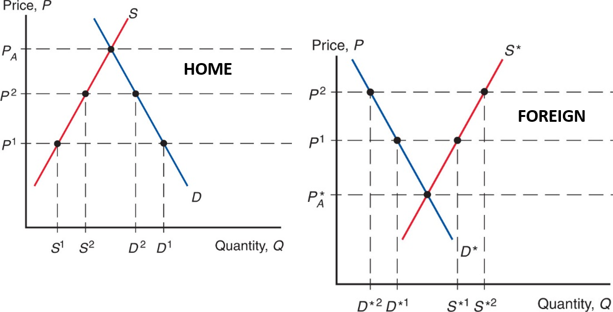
Two-Country Free Trade
There are two countries: Home and Foreign
Autarky price of wheat is P_{A} in Home and P_{A}* in Foreign
So, under free trade, Home will import wheat from Foreign

Slide 17
Supply, Demand, and Trade in a Single Industry
In our example, Home imports wheat and Foreign exports wheat
Because, in autarky, wheat is expensive in Home and cheap in Foreign: P_{A} > P_{A}*
The amount that Home wishes to import will decrease as the price of wheat increases
import demand curve; next slide

Slide 18
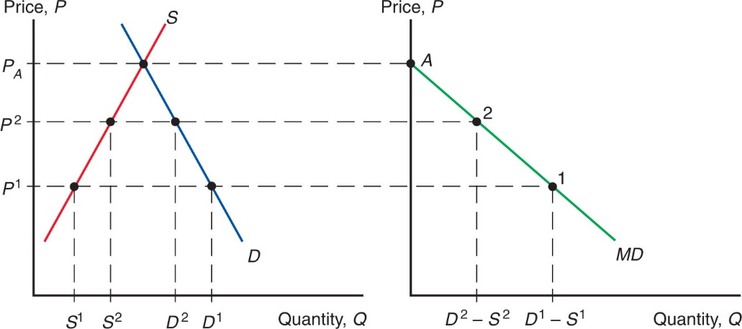
Supply, Demand, and Trade in a Single Industry
Home’s import demand curve (MD) is the quantity that Home consumers demand (D) minus the quantity that Home producers supply (S), at each price: MD = D – S.

Slide 19
Supply, Demand, and Trade in a Single Industry
In our example, Home imports wheat and Foreign exports wheat
Because, in autarky, wheat is expensive in Home and cheap in Foreign: P_{A} > P_{A}*
The amount that Foreign wishes to export will increase as the price of wheat increases
export supply curve; next slide

Slide 20
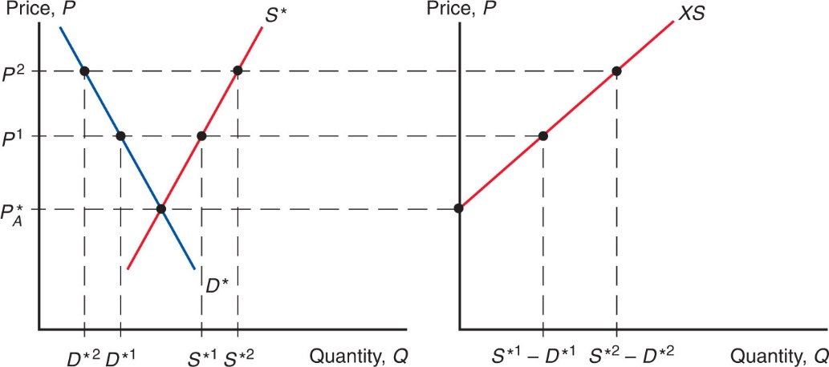
Supply, Demand, and Trade in a Single Industry
Foreign’s export supply curve (XS) is the quantity that Foreign producers supply (S*) minus the quantity that Foreign consumers demand (D*), at each price: XS = S* – D*.
Note: The Foreign country is indicated by an asterisk (*).

Slide 21
Supply, Demand, and Trade in a Single Industry
For equilibrium in free trade between Home and Foreign, we assume:
Home’s import demand (MD) = Foreign’s export supply (XS).
Therefore, the equilibrium outcome under free trade between two countries is at the intersection of the import demand and export supply curves
See next slide

Slide 22
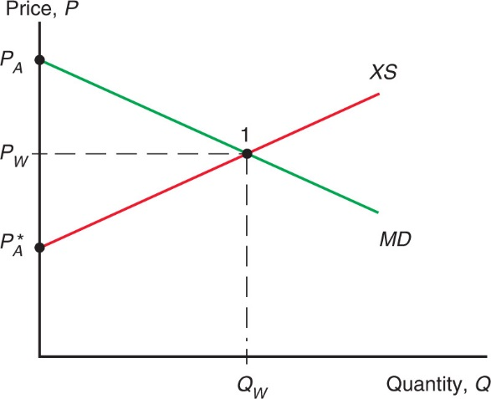
Figure 9.3 World Free-Trade Equilibrium
The equilibrium world price is P_{W}, where Home import demand (MD curve) equals Foreign export supply (XS curve). The amount imported and exported is Q_{W}.

Slide 23
Supply, Demand, and Trade in a Single Industry
In two-country trade, we assume:
Home’s import demand (MD) = Foreign’s export supply (XS). Therefore,
home demand − home supply = foreign supply − foreign demand. Therefore,
home demand + foreign demand = home supply + foreign supply. Therefore,
world demand = world supply.
Therefore, the equilibrium at the intersection of the import demand and export supply curves is equivalent to the equilibrium at the intersection of the world demand and world supply curves that we saw earlier

Slide 24
Effect of Trade on Prices
We have seen that when autarky ends and free trade begins in a country
the price of its imported good falls, and
the price of its exported good rises
How does this affect production and consumption?

Slide 25
Effect of Trade on Production
When autarky ends and free trade begins,
the production of the exported good increases, and
the production of the imported good decreases
See the section “Production Possibilities and Relative Supply” and Figure 5-2 of the course’s textbook.
As the availability of productive resources is always finite, if a country produces more of something, it must produce less of something else

Slide 26
Effect of Trade on Production
When autarky ends and free trade begins,
the production of the exported good increases, and
the production of the imported good decreases
Remember that trade raises the price of the exported good. This gives producers of the exported good an incentive to raise production.
Similarly, trade makes the imported good cheaper. This reduces the incentive for domestic producers of the imported good to produce it.

Slide 27
Effect of Trade on Consumption
Unfortunately, we can’t be sure of the effects of free trade on consumption
All we can be sure of is that the consumption of either the imported good or the exported good will surely increase

Slide 28
Effect of Trade on Consumption
The effect of an increase in the price of beef (relative to steel) on the consumption of beef works through two channels:
Substitution effect: buy less of whatever has become more expensive and more of whatever has become less expensive
Income effect: trade has made you richer. So, act the way people act when they get richer: buy more of normal goods and less of inferior goods
Notes:
Assuming all goods are normal goods.

Slide 29
Effect of Trade on Consumption
Normal goods are goods that people buy more (less) of when they get richer (poorer)
Inferior goods are goods that people buy less (more) of when they get richer (poorer)
Q: Can you think of examples of normal and inferior goods?

Slide 30
Effect of Trade on Consumption
Suppose free trade leads to an increase in the price of beef (relative to steel)
Substitution effect: buy less beef and more steel
Income effect:
Trade has made you richer. So, act like you are richer!
Buy more of whichever good is normal
Buy less of whichever good is inferior
So, the overall effect on beef and steel consumption is uncertain

Slide 31
Effect of Trade on Consumption
Suppose free trade leads to a decrease in the price of beef (relative to steel)
Substitution effect: buy more beef and less steel
Income effect:
Trade has made you richer. So, act like you are richer!
Buy more of whichever good is normal
Buy less of whichever good is inferior
So, the overall effect on beef and steel consumption is again uncertain

Slide 32
If the autarky equilibrium price is the same for both countries, no trade will occur even when trade is allowed. That is, similarity = no trade.
Price
Europe
+
Japan
=
World
Quantity

Slide 33
Similarity = No Trade
If the pre-trade (or autarky) relative prices (of one good in terms of another) are the same for the two countries, no trade will occur.
On relative prices, see the section “Relative Prices and Supply” of the course’s textbook.
Notes:
The page reference is to the 8th edition of Krugman-Obstfeld.

Slide 34
As we saw before, if the autarky equilibrium price is not the same for both countries, trade will occur when trade is allowed. That is, dissimilarity = trade.
Price
Europe
+
Japan
=
World
Quantity

Slide 35
Dissimilarity = Trade
Trade will occur if the pre-trade (or autarky) relative price of one good in terms of the other is not the same for the two countries.
The free trade relative price will be neither higher than the two autarky prices, nor lower.
Therefore, when the autarky relative prices are unequal, the free trade relative price must be different from the autarky relative price for at least one of the two countries.

Slide 36
Reasons For Dissimilarity
Three theories that explain why autarky prices may be high in some countries and low in others:
Ricardian Theory
Specific Factors Theory
Heckscher-Ohlin Theory

Slide 37
Opportunity Cost
The opportunity cost of good X is the amount of good Y that will have to be sacrificed when an additional unit of X is produced
Between two trading countries, one country is said to have a comparative advantage in the production of a good if, in autarky, the opportunity cost of the good is smaller in that country

Slide 38
Opportunity Cost = Autarky Price
In a perfectly competitive economy, the opportunity cost of good X equals the autarky relative price of good X.
Therefore, between two trading countries, one country is said to have a comparative advantage in the production of a good if the autarky relative price of the good is smaller in that country

Slide 39
Trade Follows Comparative Advantage
We have seen that
the country with the cheaper autarky price of a good becomes the exporter of that good, and
the country with the higher autarky price of a good becomes the importer of that good
Therefore, we can say that whichever country has a comparative advantage in the production of a good becomes the exporter of that good

Slide 40
Trade Reflects Comparative Advantage
When autarky ends and free trade begins, each country
increases its production of the good in which it has a comparative advantage and
exports that good.
In other words, free trade follows the principle of comparative advantage.

