Slide 1
Two-Country Trade and Welfare
Udayan Roy
http://myweb.liu.edu/~uroy/eco41
Notes:
This presentation looks at autarky, free trade, and their welfare analysis – using consumer and producer surplus – from the small country point of view.

Slide 2
Questions
Who gains and who loses from free trade among countries?
What are the arguments that people use to support restrictions on free trade?

Slide 3
autarky

Slide 4
Equilibrium and Welfare Without International Trade
Assume:
A country is isolated from rest of the world and produces steel.
The market for steel consists of the buyers and sellers in the country.
No one in the country is allowed to import or export steel.
This situation is called autarky.
We can use our graphical tools of welfare analysis to measure the benefits from consumption and the costs of production

Slide 5
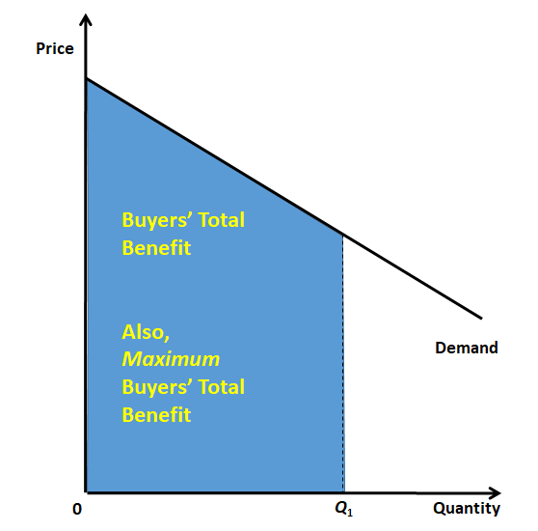
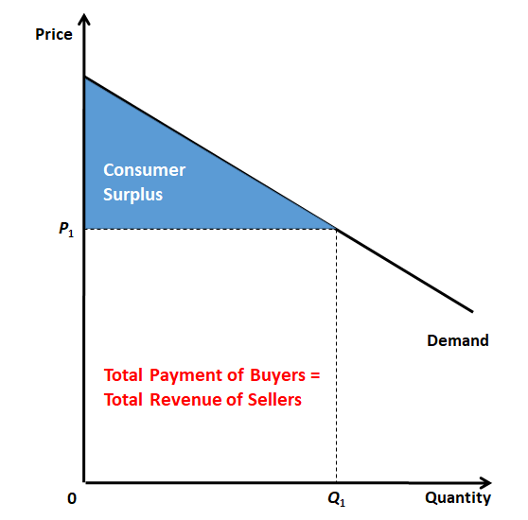
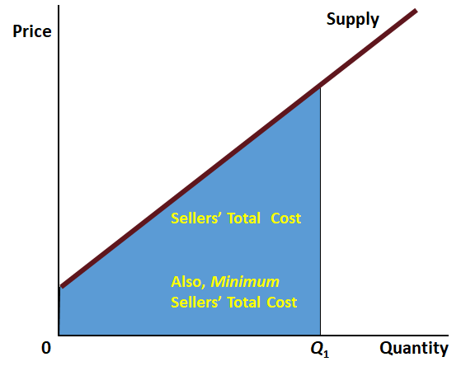
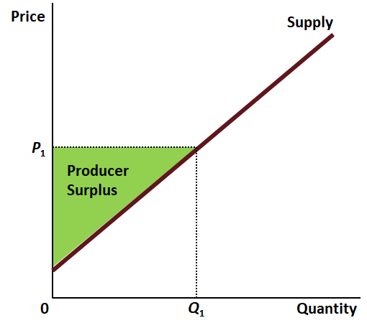
The Graphical Tools of Welfare Analysis

Slide 6
Autarky: Equilibrium without International Trade
Price
of Steel
Domestic
supply
Consumer
surplus
Equilibrium
price
Producer
surplus
Domestic
demand
0
Equilibrium
Quantity
quantity
of Steel

Slide 7
Equilibrium Without International Trade
Domestic price adjusts to balance domestic demand and domestic supply.
The welfare generated by all the buying and selling is called Total Surplus
Total Surplus = Benefit – Cost
Total Surplus = Consumer Surplus + Producer Surplus

Slide 8
Free trade: two countries

Slide 9
Recap: Two-Country Trade
Price
Europe
+
Japan
=
World
Quantity

Slide 10
Recap: Japan, Exporting Country
Price
of Steel
Price
Domestic
after
supply
trade
World
price
Price
before
trade
Domestic
Exports
demand
0
Domestic
Domestic
Quantity
quantity
quantity
of Steel
demanded
supplied

Slide 11
How Free Trade Affects Welfare in an Exporting Country
Price
of Steel
Domestic
Price
supply
after
A
Exports
trade
World
B
D
price
Price
before
C
trade
Domestic
demand
0
Quantity
of Steel

Slide 12
Winners And Losers From Trade: Exporting Country
Domestic producers of the exported good are better off, and
Domestic consumers of the exported good are worse off.
The gain to producers exceeds the loss to consumers.
Therefore, international trade raises the economic well-being of the nation as a whole.

Slide 13
Recap: Europe, Importing Country
Price
of Steel
Domestic
supply
Price
before
trade
Price
World
after
price
trade
Domestic
Imports
demand
0
Domestic
Domestic
Quantity
quantity
quantity
of Steel
supplied
demanded

Slide 14
How Free Trade Affects Welfare in an Importing Country
Price
of Steel
Domestic
supply
A
Price
before trade
B
D
Price
World
after trade
C
price
Imports
Domestic
demand
0
Quantity
of Steel

Slide 15
Winners And Losers From Trade: Importing Country
Domestic producers of the imported good are worse off, and
Domestic consumers of the imported good are better off.
The gains of consumers exceed the losses of producers.
Therefore, international trade raises the economic well-being of the nation as a whole

Slide 16
The Winners And Losers From Trade
Irrespective of whether a country exports a good or imports it, the gains of those who gain exceed the losses of those who lose.
That is, the total surplus always increases.

Slide 17
Had the world price been equal to the autarky price, there would have been no trade and, therefore, no gains from trade.
Price
When the world price is WP₁, the country imports steel and the gain from trade is A.
of Steel
When the world price is WP₂, the gain from trade is A + B. That is, the greater the change in price caused by trade, the greater the gains from trade.
Domestic
supply
Price
before
trade
A
WP₁
B
WP₂
Domestic
demand
0
Quantity
of Steel

Slide 18
More Change = More Fun
The bigger the difference between free trade relative prices and autarky relative prices, the bigger will be the country’s gains from trade

Slide 19
Less Change = Less Fun
If there is an increase in the relative price of a country’s imported good,
its national welfare will decrease, and
the national welfare of the country or countries that the good is being imported from will increase.
See “The Welfare Effects of Changes in the Terms of Trade” in page 116 of KO.

Slide 20
Gains From Trade
The gains from trade can be expressed as the sum of
the gains from exchange, and
the gains from specialization.

Slide 21
Gains From Exchange
Free trade will lead to gains even for a country whose production levels, for whatever reason, remain what they were in autarky.
These gains are called the gains from exchange.

Slide 22
Gains From Specialization
Typically, however, free trade also leads to changes in production levels as a nation becomes more specialized in the production of the good in which it has a comparative advantage.
The gains due to this specialization in production are called the gains from specialization.

Slide 23
Recap: Exporting Country
Price
of Steel
Domestic
Price
supply
after
A
Exports
trade
World
B
D
price
Price
before
D = gains from trade
C
trade
Domestic
demand
0
Quantity
of Steel

Slide 24
Gains From Exchange
Price
of Steel
Domestic Supply
Exports
D = gains from exchange
Price
after
A
Imagine a weird supply curve such that the exporting country’s production is the same in both autarky and free trade. There still will be some gains from trade. These are the gains from exchange.
trade
World
D
B
price
Price
before
C
trade
Domestic
demand
0
Quantity
of Steel

Slide 25
D = gains from exchange E = gains from specialization D + E = total gains from trade
Price
of Steel
Domestic
Price
supply
after
A
Exports
trade
World
D
E
B
price
Price
before
C
trade
Domestic
demand
0
Quantity
of Steel

Slide 26
Opposition to Free Trade
Free trade does not benefit every citizen of a country
Therefore, free trade may be opposed by those who stand to lose from trade
However, the gains of those who gain (which, after all, exceed the losses of those who lose) can be used to compensate those who lose from trade
If this is done, everybody would support free trade

Slide 27
The Lessons for Trade Policy
Other benefits of international trade
Increased variety of goods
Lower costs through economies of scale
Increased competition
Enhanced flow of ideas

Slide 28
Common Arguments For Restricting Trade
Jobs
National Security
Infant Industry
Unfair Competition
Protection-as-a-Bargaining Chip

Slide 29
Bonus material

Slide 30
Terms of Trade
The relative price of the imported good is its price measured in units of the exported good.
If this increases, then the relative price of the exported good, which is its price measured in units of the imported good, necessarily decreases.
The relative price of a nation’s exported good is also called its terms of trade
See page 112 of KO.

Slide 31
Growth Under Trade: Mixed Blessing I
Economic growth in a country can affect (worldwide) relative prices under free trade.
If economic growth in a country leads to an increase in the relative price of its imported good (i.e., to a fall in its terms of trade), the country could be worse off
The other country (i.e., the rest of the world), however, will be better off.
The world will be better off

Slide 32
There is an increase in Europe’s demand for its imported good. This increases (worsens) its terms of trade and decreases (improves) Japan’s terms of trade.
Price
F
A
G
N
O
B
I
C
D
H
J
K
P
Q
E
L
M
R
Europe
+
Japan
=
World
Quantity

Slide 33
Growth and Terms of Trade
 | Europe |  | Japan |  | World
 | Before | After | Before | After | Before | After
Consumer Surplus | ABCD | ABFG | IJ | I | NP | NO
Producer Surplus | E | CE | LM | JKLM | R | PQR
Total Surplus | ABCDE | ABCEFG | IJLM | IJKLM | NPR | NOPQR
Europe’s growth has a positive effect (FG) and a negative effect (the loss of D) from the worsening of the terms of trade. The worsening of Europe’s terms of trade implies an improvement of Japan’s terms of trade (and the gain of K). The World gains OQ from growth in Europe. Note: O + Q = F + G + K - D.

Slide 34
Growth Under Trade: Mixed Blessing II
If economic growth in a country leads to an increase in the (worldwide) relative price of its exported good, this country will be better off
The other country will be worse off
The world will be better off

Slide 35
There is an increase in Japan’s demand for its exported good. This increases (worsens) Europe’s terms of trade and decreases (improves) Japan’s terms of trade.
Price
A
I
F
N
O
B
C
D
J
K
P
Q
G
E
L
M
R
Europe
+
Japan
=
World
Quantity

Slide 36
Growth and Terms of Trade
 | Europe |  | Japan |  | World
 | Before | After | Before | After | Before | After
Consumer Surplus | ABCD | AB | IJ | IF | NP | NO
Producer Surplus | E | CE | LM | GJKLM | R | PQR
Total Surplus | ABCDE | ABCE | IJLM | IFGJKLM | NPR | NOPQR
Japan’s growth has a positive effect (FG) and another positive effect (K) from the improvement of the terms of trade. The worsening of Europe’s terms of trade reduces welfare by D. The World gains OQ from growth in Japan. Note: O + Q = F + G + K - D.

Slide 37
Foreign Aid Can Be a Mixed Blessing I
If the aid-receiving country imports food, and
if it has a higher marginal propensity to spend on food than the donor country,
The fraction of each additional dollar of income that is spent on food is the marginal propensity to spend on food
then foreign aid will increase the relative price of food
thereby worsening the recipient country’s terms of trade and improving the donor country’s terms of trade
Thus, it is a theoretical—but only theoretical—possibility that foreign aid may help the donor country and hurt the recipient country!

Slide 38
Foreign Aid Can Be a Mixed Blessing II
The idea is conveyed by the slide on growth and terms of trade.
Let Japan be the aid donor and Europe be the aid recipient.
The receipt of aid will shift Europe’s demand for its imported good to the right.
The donation by Japan should shift its own demand for food to the left.
But assuming that its marginal propensity to spend on food is low, Japan’s demand shift may be ignored.
Then, the aforementioned slide applies to this slide’s topic—the receipt of foreign aid—as well.

