Slide 1
Roger E. Backhouse: The Ordinary Business of Life Chapter 4 Science, Politics and Trade in Seventeenth-Century England
Udayan Roy
ECO54 History of Economic Thought

Slide 2
Seventeenth-Century England
The Royal Society
Political ferment
Dutch commercial power
Balance-of-trade doctrine
The rate of interest and the case for free trade
Recoinage crisis
Conclusions

Slide 3
Seventeenth-Century England
There was an explosion of writings on economic policy by merchants and businessmen arguing in favor of the policies that would be good for them
However, despite the biases, some writers showed careful and subtle analysis

Slide 4
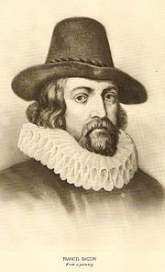
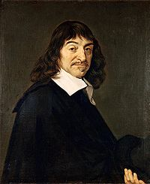
Science
Francis Bacon (1561 – 1626): induction from facts and experiment
Rene Descartes (1596 – 1650): deduction from simple, self-evident truths
Both believed in measurement
Either as a source of ideas (generalizations)
Or as a test of intuition
Both rejected authority as a source of knowledge
These ideas were profoundly influential

Slide 5
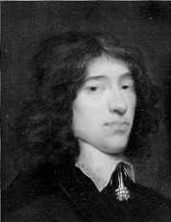
William Petty (1623 – 87)
Political Arithmetic
“instead of using only comparative and superlative words, and intellectual arguments, I have taken the course … to express my self in terms of number, weight or measure; to use only arguments of sense, and to consider only such causes, as have visible foundations in nature.”

Slide 6
William Petty
Prepared estimates of England’s national income
Made major contributions to national income accounting
Estimated the split of income into wages, profits, and rent
National expenditure (or output) = national income
Asset income/asset value should be the same for all assets. Ratio of rent to value of land = ratio of profits to value of capital

Slide 7
William Petty
Mercantilist, on the need for precious metals and tariffs
Argued that increases in the quantity of money led to decreases in interest rates
This is part of the modern view of monetary policy
Petty’s work on measurements was continued by:
John Graunt (1620 – 74) and
Gregory King (1648 – 1712)

Slide 8
William Petty
Video: http://www.mruniversity.com/courses/great-economists-classical-economics-and-its-forerunners/sir-william-petty

Slide 9
Political Arithmetic
Adam Smith and other eighteenth and nineteenth century economists were skeptical about the value of quantitative measurements
It was only in the twentieth century that the ideas pioneered by Petty and his followers were revived and became important

Slide 10
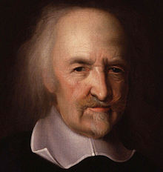
Political Turmoil
Political turmoil in seventeenth century England raised questions about what motivated people and what held societies together
Writers such as Thomas Hobbes began to think that the pursuit of economic gain could be a substitute for the pursuit for political power, which is at the root of political turmoil

Slide 11
Political Turmoil
Hobbes’s discussion had the side effect of solidifying the notion that people are strongly motivated by the pursuit of economic gain

Slide 12
Thomas Hobbes’ Leviathan
In Leviathan (1651), Hobbes, possibly influenced by civil war in England and Germany, argued that the pursuit of self interest was such a strong motivator of people that society could be held together only if the people chose a sovereign who would become both the law giver and the law enforcer

Slide 13
Thomas Hobbes’ Leviathan
Hobbes was not only addressing a fundamental question in social science—how would society be held together—but reached his conclusions by working out the social implications of rational behavior of individuals
In this way, Hobbes went farther than Machiavelli
Hobbes’s methodology became hugely influential in economic thinking
His top-down conception of society would, however, yield in time to a more benign view of the social consequences of self-interested behavior

Slide 14
Balance-of-trade doctrine
From 1620 to 1624, England faced declining sales of cloth to Europe. England was losing precious metals to other countries. It was a crisis.
Gerard Malynes (1586 – 1641) argued that currency traders were artificially keeping the exchange value of English coins below the value suggested by metal content. This made English coins more valuable as metal in foreign lands.
Malynes suggested government regulation to increase the exchange value of English coins. That way, more gold and silver would be received for exports and less would be paid for imports.

Slide 15
Balance-of-trade doctrine
Edward Misselden (1608 – 54) and Thomas Mun (1571 – 1641) argued that the exchange rate should be reduced even further. The cheaper it was to buy English coins, the cheaper it would be to buy English goods. This would boost England’s net exports and reverse the outflow of precious metals.

Slide 16
Balance-of-trade doctrine
Malynes is correct if exports and imports are unresponsive to prices, and Misselden and Mun are correct if exports and imports are responsive to prices.
But both sides agreed that trade deficits were undesirable
Both sides saw monetary factors as an important influence on foreign trade

Slide 17
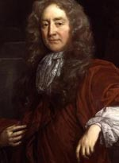
Interest rates
Josiah Child (1630 – 99) argued that the government-set interest rate should be reduced, because lower interest rates lead to greater output

Slide 18
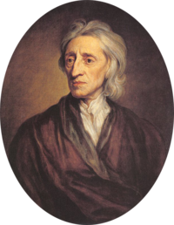
Interest rates
John Locke (1632 – 1704) argued that a lower interest rate would reduce the availability of loanable funds.
Locke also argued that each country had a ‘natural’ interest rate determined by the supply and demand for money.
The latter—that is, the demand for money—would depend on total output and the ‘quickness of circulation’ of money.
Today’s textbooks call this the velocity of money.

Slide 19
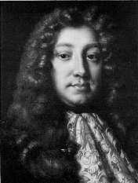
Trade and welfare: dissent
Dudley North (1641 – 91) broke with the prevailing ideas that favored protectionism
Trade is caused by differences between the endowments of people
This idea also explains trade in capital (lending and borrowing) and in land (renting)

Slide 20
Trade and welfare: dissent
Dudley North saw rent and interest as essentially the same thing
Also, availability of land (capital) determines rent (interest), not the other way around
Legislative control of interest rates would be fruitless
North argued that having lots of precious metals was not crucial. If you had land or capital, you could produce things and sell them for precious metals

Slide 21
Conclusions
Seventeenth century economic thinking in England was basically mercantilist, as epitomized by the balance-of-trade doctrine
Irrespective of the actual intent of the writers, doctrines were used to support protectionist interests.

