Slide 1
Economics and Politics
ECO54 History of Economic Thought
Udayan Roy

Slide 2
Economics and Politics
Knut Wicksell (1851 – 1926)
George Stigler (1911 – 1991)
James M. Buchanan (1919 – 2013)
Gordon Tullock (1922 – 2014)
Mancur Olson (1932 – 1998)

Slide 3
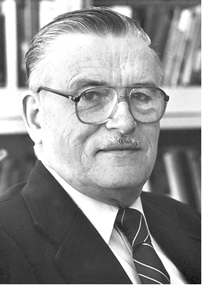
Public Choice Theory
James McGill Buchanan, Jr., founded public choice theory, which seeks to analyze politics with the methods of economics.
The main idea is that governments consist of people who are motivated by their own interests and not by the national interest.

Slide 4
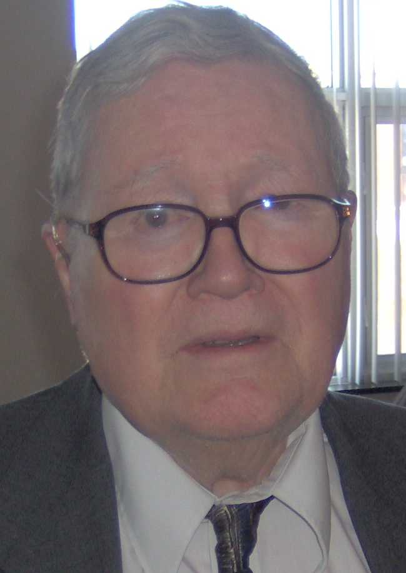
Gordon Tullock
A lot of Buchanan’s work was co-authored with Gordon Tullock, who also made crucial independent contributions to public choice theory

Slide 5
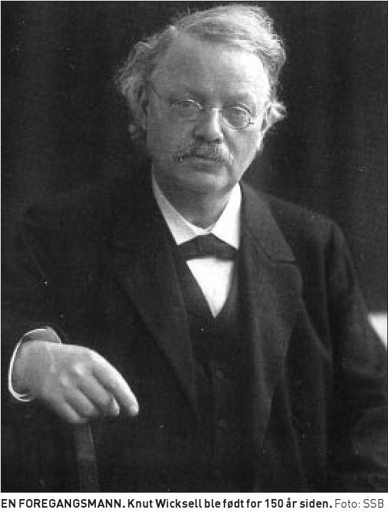
Knut Wicksell
Buchanan has given credit to Knut Wicksell for the general notion that governments consist of people who are motivated by their own interests and not by the national interest

Slide 6
Knut Wicksell
“I was influenced by the Swedish economist Wicksell, who said if you want to improve politics, improve the rules, improve the structure. Don’t expect politicians to behave differently. They behave according to their interests.”
James Buchanan, in an interview in The Region, September 1, 1995

Slide 7
Public Choice Theory
Politicians seek only to be elected and, if elected, re-elected.
This makes them fight on behalf of the special interest groups that contribute to their campaign funds.

Slide 8
Public Choice Theory
Thus government policies—such as those that determine tax and expenditure policies—are the result of the tussle between various special interest groups.
This is one more reason why we should not rely on the government to fix our problems and why we should strip the government of most of its power.

Slide 9
Public Choice Theory: Budget Deficits

Slide 10
Public Choice Theory: Budget Deficits
Why has the US had such a long stretch of budget deficits?
First, the negative future effects of budget deficits are, for most voters, hard to imagine, whereas the positive current effects are very easy to see.
Politicians realize this and press for tax cuts and spending increases.
This explanation echoes the ideas of behavioral economics.

Slide 11
Public Choice Theory: Budget Deficits
Second, budget deficits shift the burden of government spending from current generations to future generations and future generations do not vote in today’s elections.

Slide 12
Buchanan and Constitutional Reform
Buchanan sought to prevent harmful policies by tying politicians’ hands rather than by pleading with politicians to be more public-spirited.
And to tie politicians’ hands Buchanan championed constitutional reform.
He believed that only binding, enforceable constitutional rules can prevent misbehavior by politicians.
Unfortunately, the constitutional reform that Buchanan advocated would require the cooperation of the very politicians who would be weakened by the reform.

Slide 13
Buchanan and Libertarianism
Buchanan got his PhD in economics at the University of Chicago, and his skeptical view of government puts him in the libertarian tradition of the Chicago school of economics.

Slide 14
Public Choice Theory and Keynes
Public choice theory can also be seen as a criticism of Keynesian countercyclical fiscal policy.
Keynesians argue that government should attempt to stabilize an economy that has fallen into a recession by cutting taxes and boosting government spending.
However, as both policies would require increases in the budget deficit and the national debt, Keynesians also argue that taxes should be raised and government spending should be cut when the economy recovers.
Buchanan’s public choice theory argues that it is naïve to believe that politicians would raise taxes and cut government spending when a recession ends and a recovery begins.

Slide 15
Public Choice Theory and Keynes
“A politician who’s seeking office or seeking to remain in office is responsible, as he should be, to constituents. He wants to go back to a constituency and tell them that he’s either lowered their taxes, or he’s brought them program benefits. You plug that into politics and you have a natural proclivity of a politician to create deficits.”
James Buchanan, in an interview in The Region, September 1, 1995

Slide 16
Balanced Budget Amendment
In this way, public choice theory weakens the appeal of Keynesian countercyclical fiscal policy.
Indeed, Buchanan has advocated for a balanced budget amendment, which would require the government to balance every budget
There is very little chance that this proposal will succeed

Slide 17
Buchanan’s Nobel
Buchanan won the Nobel Memorial Prize in Economics in 1986 “for his development of the contractual and constitutional bases for the theory of economic and political decision-making”.

Slide 18
James M. Buchanan: Sources
Chapter XI of New Ideas from Dead Economists by Todd Buchholz
Chapters 12 (page 284) and 14 (page 312) of The Ordinary Business of Life by Roger Backhouse
http://en.wikipedia.org/wiki/James_M._Buchanan
http://www.econlib.org/library/Enc/PublicChoiceTheory.html
http://www.econlib.org/library/Enc/PoliticalBehavior.html
http://www.econlib.org/library/Enc/bios/Buchanan.html
http://www.econlib.org/library/Enc/bios/Stigler.html
http://www.nobelprize.org/nobel_prizes/economics/laureates/1986/
http://www.nobelprize.org/nobel_prizes/economics/laureates/1986/press.html
http://www.nobelprize.org/nobel_prizes/economics/laureates/1986/buchanan-lecture.html
Interview with James Buchanan, The Region, September 1, 1995

Slide 19
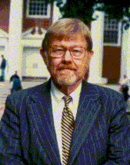
Mancur Olson
Why do governments use price supports, import tariffs, subsidies, etc. for various industries even though such policies can easily be shown to be against the national interest?
To take another example, why do cities such as New York and Boston limit the number of taxi cabs even though those cities would be better off with greater competition among cabbies?

Slide 20
Mancur Olson: Special Interests
Mancur Olson argued that although the total costs of such harmful policies may be large, they tend to affect such large numbers of people that the losses per affected person are typically quite small.
On the other hand, although the total benefits of such harmful policies are small, they tend to be enjoyed by such small numbers of beneficiaries that the benefits per beneficiary can be quite large.

Slide 21
Mancur Olson: Special Interests
As a result, the harmed people have no incentive to put pressure on their elected representatives to repeal harmful policies, whereas the beneficiaries would very probably get together, form a special-interest pressure group, contribute to politicians’ re-election funds, and otherwise force them to support polices that, while good for those belonging to the pressure group, are bad for the country as a whole.

Slide 22
Olson on Economic Development
Olson extended his ideas about the power of special-interest groups into a theory of long-run economic development.
Electorates in stable societies are more complacent than electorates in less stable societies.
As a result, the former are more likely to be sucked dry by special-interest groups.
Revolutions can be good for a country when they reduce the power of entrenched special-interest groups.

Slide 23
George Stigler and Regulatory Capture
An extension of Mancur Olson’s analysis of special interests is the theory of regulatory capture due to George Stigler (1911-1991).
Q: Why do governments regulate certain industries, such as utilities?
A: Because government regulations make it expensive for new competitors to enter the industry, thereby making things easy and profitable for the existing firms who, after all, are funding the re-election campaigns of the incumbent politicians.

Slide 24
Regulatory Capture

Slide 25
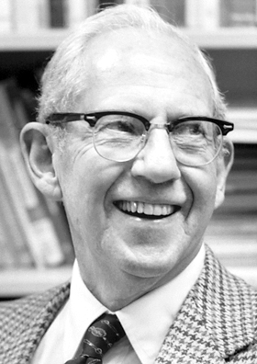
George Stigler Wins Nobel
For his work on regulatory capture and other topics, Stigler received the 1982 Nobel Memorial Prize in Economics
http://www.nobelprize.org/nobel_prizes/economics/laureates/1982/

