Slide 1
Monopolistic Competition
Udayan Roy
ECO 54 History of Economic Thought

Slide 2
Monopolistic and Monopsonistic Competition
Edward Chamberlin (1899 – 1967)
Joan Robinson (1903 – 1983)
Key works:
The Theory of Monopolistic Competition by Edward Chamberlin, 1933
The Economics of Imperfect Competition by Joan Robinson, 1933
For their near-simultaneous contributions, these two economists are regarded as the parents of the modern study of imperfect competition.

Slide 3
Monopolistic Competition
In Augustin Cournot’s analysis of oligopoly, the number of firms is assumed fixed; new firms can’t enter and existing firms can’t leave.
Besides, Cournot assumed that all firms produced the exact same product.
Harold Hotelling had shown what would happen if a fixed number of firms produced goods that were similar but not identical.
Chamberlin then figured out what would happen in an industry in which firms produced similar but not identical goods and were free to enter or leave the industry.

Slide 4
Monopolistic Competition
Chamberlin showed that:
Whether a firm will earn profits or not has nothing to do with the shape of its demand curve.
Profitability depends entirely on the ease with which new firms can enter a profitable industry.
If new firms can freely enter and compete with existing firms, profits will be zero in the long run irrespective of whether each firm has a horizontal demand curve (as in perfect competition) or a negatively sloped demand curve (as in monopoly).

Slide 5
Monopolistic Competition
Chamberlin showed that:
The shape of the demand curve for each firm’s product does, however, affect the efficiency of the overall economy.
If this demand curve is horizontal, the output produced will be equal to the ideal output.
If this demand curve is negatively sloped, the output produced will be less than the ideal output.

Slide 6
Monopolistic Competition in the Short Run
Firm Makes Profit
Price
These profits will not last.
MC
Short-run economic profits encourage new firms to enter the market.
ATC
This reduces the demand faced by firms already in the market (incumbent firms)
Price
Average
total cost
Demand
Incumbent firms’ demand curves shift to the left.
Profit
MR
Their profits fall…
0
Profit-
Quantity
maximizing
quantity

Slide 7
Monopolistic Competition: effect of the entry of new firms on an incumbent
Firm Makes Less Profit
These profits will not last either.
Price
Profits encourage new firms to enter the market.
MC
ATC
This reduces the demand faced by incumbent firms
Incumbent firms’ demand curves shift to the left.
Price
ATC
Their profits fall…
Profit
Demand
MR
0
Profit-
Quantity
maximizing
quantity

Slide 8
Monopolistic Competition in the Long Run
Firm Makes No Profit
Price
Note that Price > Marginal Cost. Indicates suboptimal output in the analysis of perfect competition. In monopolistic competition, this “suboptimality” may be seen as the price of a greater variety of products.
MC
ATC
Price = ATC
Zero profit
Demand
MR
0
Profit-
Quantity
maximizing
quantity

Slide 9
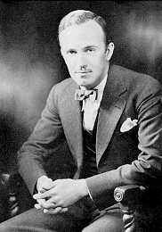
Monopolistic Competition
The chapter on monopolistic competition in any of today’s textbooks discusses Chamberlin’s theory.
Chamberlin’s theory—as formalized by the economists Avinash Dixit and Joseph Stiglitz—has been used in modern theories of international trade and long-run economic growth.

Slide 10
Edward Chamberlin: Other Works
Chamberlin is thought to have conducted “not only the first market experiment, but also the first economic experiment of any kind,” with experiments he used in the classroom to illustrate how prices don't necessarily reach equilibrium.
Chamberlin concluded that most market prices are determined by monopolistic and competitive aspects.
Notes:
Source of quotation from Wikipedia: Ross Miller (2002). Paving Wall Street: Experimental Economics and the Quest for the Perfect Market. New York: John Wiley & Sons. pp. 73–74. ISBN 0-471-12198-3.

Slide 11
Monopsonistic Competition
While Edward Chamberlin discussed an industry that produced a good under monopolistic conditions, Joan Robinson looked at the labor market under monopsonistic conditions
Earlier analyses of the labor market assumed perfect competition.
That is, it was assumed that there were many firms hiring labor
As a result, if one firm paid even slightly less than the prevailing wage that other firms were paying, all its workers would quit
Robinson asked, “What if there was only one firm in a town? What would determine the workers’ wages in such a situation?”

Slide 12
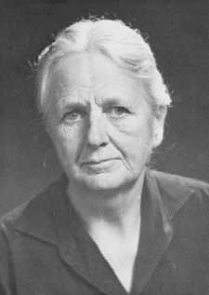
Monopsonistic Competition and the Minimum Wage
In the traditional analysis of perfectly competitive labor markets, a minimum wage reduces hiring and causes unemployment. The higher the minimum wage the higher the job loss.
Robinson’s analysis of a monopsonistic labor market gave a rational justification for the establishment of a minimum wage.
In Robinson’s analysis, a higher minimum wage may increase employment!

Slide 13
Monopsonistic Competition and the Minimum Wage
Under monopsony, firms face a rising labor supply
That is, they must pay higher wages to hire more workers
This is a disincentive for hiring
If a minimum wage is imposed, a firm may be able to hire more workers while paying the same minimum wage.
The usual disincentive to hiring more workers goes away.

Slide 14
Monopsonistic Competition and the Minimum Wage
The monopsonist hires as many workers as are available at the official minimum wage.
And, as more workers wish to work at higher wages, a higher minimum wage may lead to more workers getting hired!
Very unintuitive, but true!
In 1994, the economists David Card and Alan Krueger published a landmark study that showed that hiring did not decrease when New Jersey raised its minimum wage in 1992.
This was seen as support for Robinson’s monopsony analysis of the labor market.
Notes:
Source: “Minimum Wages and Employment: A Case Study of the Fast-Food Industry in New Jersey and Pennsylvania” by David Card and Alan B. Krueger, American Economic Review, Vol. 84, No. 4, September 1994.

Slide 15
Monopolistic Competition
Robinson independently discovered pretty much all of Chamberlin’s results.
Robinson also extended the analysis of monopoly to the case of price discrimination in which the monopolist sells to several separate markets and charges a different price in each case.
Price discrimination allowed high prices in markets where demand was high or less elastic and low prices where demand was low or more elastic.
This increased a monopolist’s overall output, reduced consumer surplus, and increased overall efficiency.

Slide 16
Monopolistic Competition
Joan Robinson also showed that the monopolist’s markup rate—which is equal to (Price – Marginal Cost) / Price—for a particular market is inversely related to the elasticity of demand in that market.
That is, the monopolist will charge a higher price in the market that has the lower elasticity of demand and a lower price in the market that has the higher elasticity of demand.
Recall that Alfred Marshall, Joan Robinson’s teacher, had popularized the concept of price elasticity.
Chamberlin and Robinson extended Marshall’s analysis of competitive markets to include imperfect competition.

Slide 17
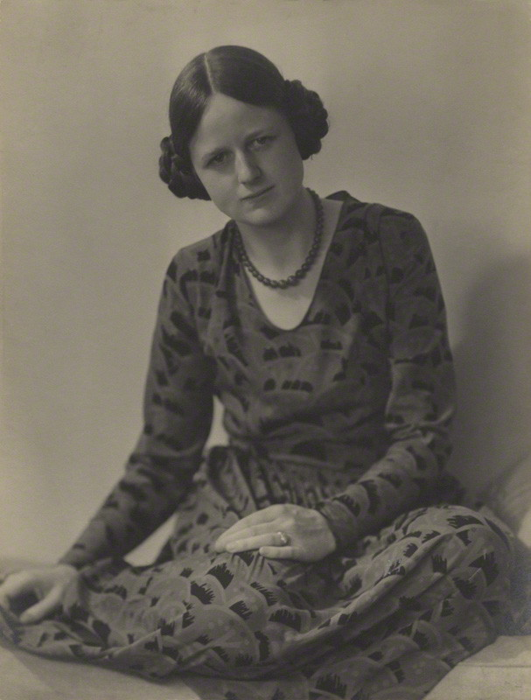
Joan Robinson: Other Work
An Essay on Marxian Economics, 1942
Re-evaluated the legacy of Karl Marx. Robinson was a Marxist.
The Accumulation of Capital, 1956
extended Keynesian economics into the long-run.
Essays in the Theory of Economic Growth, 1962
on long-run growth theory
Notes:
Photo source: https://en.wikipedia.org/wiki/Joan_Robinson#/media/File:Joan_Robinson_Ramsey_Muspratt.jpg. “Joan Robinson in the 1920s”

