Slide 1
National Income: Where It Comes From and Where It Goes
Chapter 3 of Macroeconomics, 9th edition, by N. Gregory Mankiw
ECO62 Udayan Roy

Slide 2
Chapter Outline
In chapter 2, we saw that Y = C + I + G + NX
In this chapter, we will see
a long-run theory of Y, and
a long-run theory of how Y is split between C, I and G
For simplicity, this chapter considers a “closed economy”, which is an economy such that NX = 0
I will skip section 3-2!

Slide 3
The factors that determine total output in the long run

Slide 4
What Determines the Total Production of Goods and Services?
Every theory starts with assumptions and then, step by step, describes the conclusions that follow from the assumptions
It is important to state the assumptions clearly

Slide 5
Two productive resources and one produced good
There are two productive resources, capital and labor, whose quantities are denoted K and L
These two productive resources are used to produce one final good, whose quantity is denoted Y
As there is only one final good, Y can also be considered the economy’s gross domestic product (as in Chapter 2)

Slide 6
The Production Function
The production function is an equation that tells us how much of the final good is produced with specified amounts of capital and labor
Y = F(K, L)
Example: Y = A∙K^{0.3}L^{0.7}
A represents technology
Y = 5K^{0.3}L^{0.7}, when A = 5
 | Y = 5K^{0.3}L^{0.7}
 |  | labor
 |  | 0 | 10 | 20 | 30
capital | 0 | 0 | 0 | 0 | 0
 | 1 | 0 | 25.06 | 40.71 | 54.07
 | 2 | 0 | 30.85 | 50.12 | 66.57
 | 3 | 0 | 34.84 | 56.60 | 75.18
 | 4 | 0 | 37.98 | 61.70 | 81.95

Slide 7
Constant Returns to Scale
 | Y = 5K^{0.3}L^{0.7}
 |  | labor
 |  | 0 | 10 | 20 | 30
capital | 0 | 0 | 0 | 0 | 0
 | 1 | 0 | 25.06 | 40.71 | 54.07
 | 2 | 0 | 30.85 | 50.12 | 66.57
 | 3 | 0 | 34.84 | 56.60 | 75.18
 | 4 | 0 | 37.98 | 61.70 | 81.95
Y = F(K, L) = 5K^{0.3}L^{0.7}
Note:
if you double both K and L, Y doubles
if you triple both K and L, Y triples
… and so on
This feature of the Y = 5K^{0.3}L^{0.7} production function is called constant returns to scale
It is common in economics to assume that production functions obey constant returns to scale

Slide 8
Constant returns to scale
Definition: The production function F(K, L) obeys constant returns to scale if and only if
for any positive number z, F(z∙K, z∙L) = z∙F(K, L)
Example: Suppose F(K, L) = 5K^{0.3}L^{0.7}.
Then, for any z > 0, F(zK, zL) = 5(zK)^{0.3}(zL)^{0.7} = 5z^{0.3}K^{0.3}z^{0.7}L^{0.7} = 5z^{0.3 + 0.7}K^{0.3}L^{0.7} = z5K^{0.3}L^{0.7} = z∙F(K, L)
Therefore, F(K, L) = 5K^{0.3}L^{0.7} obeys constant returns to scale

Slide 9
GDP in the long run: assumptions
$K=\overline{K}$
where $\overline{K}$ is the exogenous stock of physical capital that the economy has inherited as a result of historical investments in physical capital
$L=\overline{L}$
where $\overline{L}$ is the exogenous amount of labor available for work
Let us say that P is the labor force and u is the long-run unemployment rate. Then, $\overline{L}=(1−u)×P$.
Note that full employment of all resources is being assumed
This assumption is unrealistic in short-run macroeconomics

Slide 10
GDP in the long run
Y is endogenous
Therefore, $Y=A∙{\overline{K}}^{0.3}∙{\overline{L}}^{0.7}$ is one equation with one endogenous variable
Therefore, it completes the theory of GDP in the long run
Yes, it really is that simple!
Example: Suppose F(K, L) = 5K^{0.3}L^{0.7}. If K = 2 and L = 10, then Y = 30.85.
Predictions Grid
 | GDP (Y)
Capital (K) | +
Labor (L) | +
Technology (A) | +
K, L, F(K, L)
Y

Slide 11
Making Sense of the Predictions Grid
The first row of the predictions grid lists the endogenous variables (unknowns)
In this case, Y is the only endogenous variable
The first column lists the exogenous variables (knowns)
In this case, K, L, and A are the exogenous variables
Each cell shows the kind of effect that the corresponding exogenous variable has on the corresponding endogenous variable
Predictions Grid
 | GDP (Y)
Capital (K) | +
Labor (L) | +
Technology (A) | +
Indicator | Effect
+ | Endo moves in the same direction as exo
– | Endo moves in the opposite direction as exo
? | Endo could move either way
0 | Exo has no effect on endo

Slide 12
GDP in the long run: Exercise
Recall that in our example long-run GDP is given by the equation $Y=A∙{\overline{K}}^{0.3}∙{\overline{L}}^{0.7}$
Q: Can you look at the solution equation above for long-run output and see why it algebraically implies the predictions in the predictions grid?
Predictions Grid
 | GDP (Y)
Capital (K) | +
Labor (L) | +
Technology (A) | +
Indicator | Effect
+ | Endo moves in the same direction as exo
– | Endo moves in the opposite direction as exo
? | Endo could move either way
0 | Exo has no effect on endo

Slide 13
GDP in the long run
Not only does the predictions grid show how the listed exogenous variables affect some endogenous variable, it lists all the exogenous variables that affect an endogenous variable.
In this case, not only does the grid show that K, L, and A have direct (+) effects on Y, they also imply that
No other variable affects Y, according to our theory
For example, although you may believe that government spending, G, affects Y, our grid says that, according to our theory, G has no effect on Y.
Predictions Grid
 | GDP (Y)
Capital (K) | +
Labor (L) | +
Technology (A) | +

Slide 14
GDP in the long run: assumptions
The assumption that K and L are exogenous is significant
It basically is the assumption that in the long run, all the capital and labor that the economy has is fully utilized in production
The idea is that capital and labor markets function well and ensure the equality of supply and demand
This assumption is not made in short-run theories
In short-run theories it is assumed that some resources may remain unemployed

Slide 15
What is done with total output after it has been produced?

Slide 16
Consumption Expenditure
Now that we know what determines total output (Y), the next question is:
What happens to that output?
In particular, what determines how much of that output is consumed?
That is, what determines C?

Slide 17
Consumption, C
Definition: Net Taxes = Tax Revenue – Transfer Payments
Denoted T and always assumed exogenous
Definition: Disposable income (or, after-tax income) is total income minus net taxes: Y – T.
Assumption: Consumption expenditure is directly related to disposable income
Predictions Grid
 | Y | C
Capital, K | + | +
Labor, L | + | +
Technology, A | + | +
Taxes, T | 0 | −

Slide 18
The Consumption Function
C
C (Y –T )
The slope of the consumption function is the MPC.
MPC
1
Y – T
Marginal propensity to consume (MPC) is the increase in consumption (C) when disposable income (Y – T) increases by one dollar
The MPC is usually a positive fraction: 0 < MPC < 1. I will denote it C_{y}

Slide 19
Consumption, C
Assumption: Consumption expenditure is directly affected by disposable income
Consumption function: C = C (Y – T )
Specifically, C = C_{o} + C_{y} × (Y – T)
C_{o} represents all other exogenous variables that affect consumption, such as asset prices, consumer optimism, interest rates, etc.
C_{y} is the marginal propensity to consume (MPC). It is the fraction of every additional dollar of disposable income that is consumed
Predictions Grid
 | Y | C
Capital, K | + | +
Labor, L | + | +
Technology, A | + | +
Taxes, T | 0 | −
C_{o} | 0 | +

Slide 20
The Consumption Function
C
C = C_{o2} + C_{y}∙(Y – T)
C_{o2} > C_{o1}
C = C_{o1} + C_{y}∙(Y – T)
Predictions Grid
 | Y | C
$\overline{K}$, $\overline{L}$, A | + | +
Taxes, T | 0 | −
C_{o} | 0 | +
Y
Consumption shift factor: greater consumer optimism, higher asset prices (C_{o}↑)

Slide 21
The Consumption Function
C
C = C_{o} + C_{y}∙(Y – T₂)
T₁ > T₂
C = C_{o} + C_{y}∙(Y – T₁)
Predictions Grid
 | Y | C
$\overline{K}$, $\overline{L}$, A | + | +
Taxes (T) | 0 | −
C_{o} | 0 | +
Y
Consumption shift factor: higher taxes reduce consumption spending, assuming all other factors that affect consumption spending are unchanged.

Slide 22
Consumption, C
We have seen that $Y=A∙{\overline{K}}^{0.3}∙{\overline{L}}^{0.7}$
And we just saw that $C=C_{0}+C_{y}∙\left(Y−T\right)$
Therefore, $C=C_{0}+C_{y}∙\left(A∙{\overline{K}}^{0.3}∙{\overline{L}}^{0.7}−T\right)$
This is a solution equation for consumption spending in the long run because all the terms on the right-hand side are exogenous variables (“knowns” or “givens”).
In other words, this equation tells us (a) which exogenous variables affect C, (b) in what way do they affect C, and (c) that any exogenous variable not in the equation has no effect on C.
Predictions Grid
 | Y | C
Capital, K | + | +
Labor, L | + | +
Technology, A | + | +
Taxes, T | 0 | −
C_{o} | 0 | +

Slide 23
Long-Run Consumption: Exercise
We have seen that $Y=A∙{\overline{K}}^{0.3}∙{\overline{L}}^{0.7}$
And we just saw that $C=C_{0}+C_{y}∙\left(Y−T\right)$
Therefore, $C=C_{0}+C_{y}∙\left(A∙{\overline{K}}^{0.3}∙{\overline{L}}^{0.7}−T\right)$
Q: Can you look at the equation above for long-run consumption and see why it algebraically implies the predictions shown on the C-column of the predictions grid?
Predictions Grid
 | Y | C
Capital, K | + | +
Labor, L | + | +
Technology, A | + | +
Taxes, T | 0 | −
C_{o} | 0 | +

Slide 24
Private-Sector Saving
An individual’s saving is his/her after-tax income minus his/her consumption.
Definition: For the economy as a whole, private-sector saving = Y – T – C

Slide 25
Private-Sector Saving
For the economy as a whole, private-sector saving = Y – T – C
As $C=C_{0}+C_{y}∙\left(Y−T\right)$, we get $Y−T−C=Y−T−C_{0}−C_{y}∙\left(Y−T\right)$. Therefore,
$Y−T−C=\left(1−C_{y}\right)∙\left(Y−T\right)−C_{0}=$ $\left(1−C_{y}\right)∙\left(A∙{\overline{K}}^{0.3}∙{\overline{L}}^{0.7}−T\right)−C_{0}$.
Recall that 1 – C_{y} is a positive fraction
Consequently, we get the expanded grid
Predictions Grid
 | Y | C | Y – T – C
K, L, A | + | + | +
Taxes (T) | 0 | − | −
C_{o} | 0 | + | −

Slide 26
Private-Sector Saving
For the economy as a whole, private-sector saving = Y – T – C
$Y−T−C=\left(1−C_{y}\right)∙\left(A∙{\overline{K}}^{0.3}∙{\overline{L}}^{0.7}−T\right)−C_{0}$.
Q: Can you look at the equation above for private-sector saving in the long-run and see why it algebraically implies the predictions shown on the column of the predictions grid for Y – T – C?
Predictions Grid
 | Y | C | Y – T – C
K, L, A | + | + | +
Taxes (T) | 0 | − | −
C_{o} | 0 | + | −

Slide 27
Consumption: example
Suppose F(K, L) = 5K^{0.3}L^{0.7} and K = 2 and L = 10. Then Y = 30.85.
Suppose T = 0.85. Therefore, disposable income is Y – T = 30.
Now, suppose C = 2 + 0.8✕(Y – T).
Then, C = 2 + 0.8 ✕ 30 = 26
Private Saving is defined as disposable income minus consumption, which is Y – T – C = 30 – 26 = 4.
K, L, F(K, L)
Y
C
C(Y – T), T

Slide 28
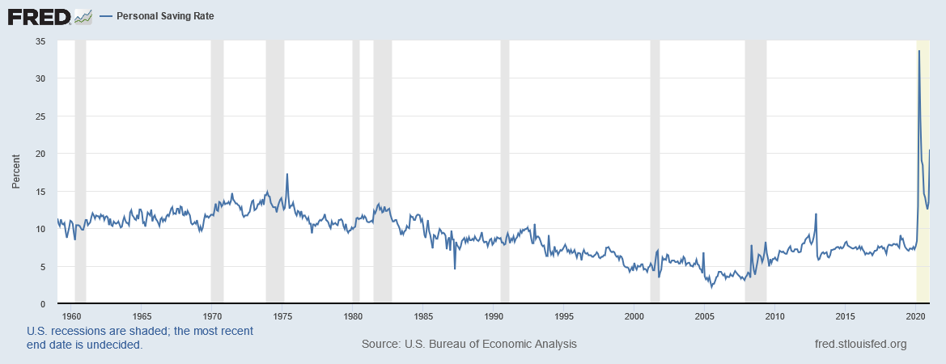
Data: Personal Saving Rate
Recall that private-sector saving is the amount saved out of disposable income (Y – T – C)
This could also be expressed as a percentage of disposable income that is saved: $\frac{Y−T−C}{Y−T}$.
A closely related variable is the personal saving rate
We have data on it for the United States: https://fred.stlouisfed.org/series/PSAVERT
Note he astonishing increase in the personal saving rate in the United States at the onset of the Covid-19 pandemic. People stopped spending out of fear of the virus.

Slide 29
Marginal Propensity to Consume
The marginal propensity to consume is a positive fraction (1 > MPC > 0)
That is, when income (Y) increases, consumption (C) also increases, but by only a fraction of the increase in income.
Therefore, Y↑⇒ C↑ and Y – C↑
Similarly, Y↓⇒ C↓ and Y – C↓
Predictions Grid
 | Y | C | Y – C
K, L, A | + | + | +
T | 0 | − | +
C_{o} | 0 | + | −

Slide 30
Government Spending
Assumption: government spending (G) is exogenous
Definition: Public Saving is the net tax revenue of the government minus government spending, T – G

Slide 31
National Saving
Definition: National saving (S) is the nation’s income minus spending by consumers and the government:
S = Y – C – G

Slide 32
National Saving: Predictions
Predictions Grid
 | Y | C | Y – C
K, L, A | + | + | +
T | 0 | − | +
C_{o} | 0 | + | −
Predictions Grid
 | Y | C | Y – C | Y – C – G
K, L, A | + | + | + | +
T | 0 | − | + | +
C_{o} | 0 | + | − | −
Government spending (G) | 0 | 0 | 0 | −
Predictions Grid
 | Y | C | S
K, L, A | + | + | +
T | 0 | − | +
C_{o} | 0 | + | −
G | 0 | 0 | −

Slide 33
National Saving = Investment
In Chapter 2, we saw that Y = C + I + G + NX
In this chapter, we study a closed economy.
So: NX = 0.
Therefore, Y = C + I + G
Y − C − G = I
Therefore, S = I
Predictions Grid
 | Y | C | S
K, L, A | + | + | +
T | 0 | − | +
C_{o} | 0 | + | −
G | 0 | 0 | −
P0redictions Grid
 | Y | C | S, I
K, L, A | + | + | +
T | 0 | − | +
C_{o} | 0 | + | −
G | 0 | 0 | −
G
K, L, F(K, L)
Y
S = I = Y – C – G
C
C(Y – T), T

Slide 34
Investment: example
Suppose F(K, L) = 5K^{0.3}L^{0.7} and K = 2 and L = 10. Then Y = 30.85.
Suppose T = 0.85. Therefore, disposable income is Y – T = 30.
Now, suppose C = 2 + 0.8✕(Y – T).
Then, C = 2 + 0.8 ✕ 30 = 26
Suppose G = 3
Then, I = S = Y – C – G = 30.85 – 26 – 3 = 1.85
Public Saving = T – G = 0.85 – 3 = –2.15
At this point, you should be able to do problem 8 on page 80 of the textbook.

Slide 35
National Saving = Investment: A Question
We have just seen that, by virtue of the way these terms are defined, national saving (S) must be equal to business investment spending (I).
But saving is done by households and the government and business investment spending is done by a totally different group of decision makers: businesses.
So, how would S = I actually happen?
Think about that.

Slide 36
National Saving = Investment: A Question
People make their choices freely
So, the amount actually saved (S) must be equal to desired saving (S_{desired})
And the actual amount of business investment spending (I) must be equal to desired business investment spending (I_{desired})
Therefore, S = I can happen only if S_{desired} = I_{desired}.
By what mechanism are the desires of savers harmonized with the desires of businesses? (Think about this.)

Slide 37
Saving and Investment
Y
C
C + G
I
C = C_{o} + C_{y}(Y – T)
G
C
T
Y = F(K, L)
Y – T
I = S = Y − C − G = Y − (C + G)

Slide 38
The role of interest rates
We saw earlier that S = I must be true by virtue of the definitions of S and I. We also saw that S = I can happen only if S_{desired} = I_{desired}. Now we will discuss a theory of how S_{desired} = I_{desired} is made possible in an actual economy. Interest rates play the main role in harmonizing saving and investment.

Slide 39
The Real Interest Rate
Imagine that lending and borrowing take place in our economy, but in commodities, not cash
That is, you go to a bank and borrow some amount of the final good—say, wheat. Later you pay back the quantity you borrowed plus a little bit extra as interest
Definition: The real interest rate (r) is the fraction of every unit of the final good borrowed that the borrower will have to pay to the lender as interest

Slide 40
The Real Interest Rate
Example:
Suppose that if you borrow a unit of the final good today, you’ll have to repay 1.05 units of the final good a year from today.
Then, the real interest rate is 0.05 units per unit borrowed.
In percentage terms, the real interest rate is 5 percent.
Data
Worldwide: https://data.worldbank.org/indicator/FR.INR.RINR
USA: https://fred.stlouisfed.org/categories/82

Slide 41
The Real Interest Rate
Source: https://fred.stlouisfed.org/series/DFII10. Downloaded on February 26, 2021. The usual interest rates (called nominal interest rates by economists) are not adjusted for inflation and are almost never negative. But real interest rates are adjusted for inflation and can easily be negative (as they were during the Covid-19 pandemic).

Slide 42
The Nominal Interest Rate
Definition: The interest rate that a bank charges you for a cash loan is called the nominal interest rate (i)
It is the fraction of every dollar borrowed that the lender must pay in interest
The nominal interest rate is not adjusted for inflation
I will discuss the long-run theory of the nominal interest rate in Chapter 5

Slide 43
Equilibrium in the Financial Markets: The Supply and Demand for Loanable Funds
To understand the long-run behavior of the real interest rate, economists imagine a market for loanable funds
The market for loanable funds is shorthand for all financial markets

Slide 44
Equilibrium in the Financial Markets: The Supply and Demand for Loanable Funds
We can apply the basic theory of supply and demand to the market for loanable funds
Borrowers provide the demand for loanable funds
Lenders provide the supply of loanable funds
The price of loanable funds is the real interest rate
This real interest rate is assumed to automatically reach the equilibrium level at which supply and demand are equal

Slide 45
Equilibrium in the Financial Markets: The Supply and Demand for Loanable Funds
Borrowers in the market for loanable funds are assumed to be businesses who need money for their investment spending (I)
Lenders are assumed to be lending their saving (S)
In equilibrium, the real interest rate (r) equalizes supply and demand
That is, r ensures that S = I

Slide 46
Investment and the real interest rate
Assumption: investment spending is inversely related to the real interest rate
I = I(r), such that r↑⇒ I↓
r
I (r )
I

Slide 47
Investment and the real interest rate
Specifically, I = I_{o} − I_{r}r
Here I_{r} is the effect of r on I and
I_{o} represents all other factors that also affect business investment spending
such as business optimism, technological progress, etc.
I_{o2} > I_{o1}
r
I_{o2} − I_{r}r
I_{o1} − I_{r}r
I

Slide 48
The Real Interest Rate
Recall that the amount of investment, I, has already been determined
The investment function, I = I_{o} − I_{r}r, can therefore be used to determine the real interest rate: $r=\frac{I_{o}−I}{I_{r}}$
I(r)
G
r
K, L, F(K, L)
Y
S = I = Y – C – G
C
C(Y – T), T

Slide 49
The Real Interest Rate: example
Suppose F(K, L) = 5K^{0.3}L^{0.7} and K = 2 and L = 10. Then Y = 30.85. Suppose T = 0.85. Therefore, disposable income is Y – T = 30.
Now, suppose C = 2 + 0.8✕(Y – T). Then, C = 2 + 0.8 ✕ 30 = 26
Suppose G = 3. Then, I = S = Y – C – G = 30.85 – 26 – 3 = 1.85
Suppose I = 11.85 – 2r is the investment function
Then, 11.85 – 2r = 1.85. Therefore, r = 5 percent
At this point, you should be able to do problems 9, 10, and 11 on page 80 of the textbook.

Slide 50
The Real Interest Rate: predictions
As investment and the real interest rate are inversely related, any exogenous variable that affects investment one way will affect the real interest rate the other way.
Recall that $r=\frac{I_{o}−I}{I_{r}}$.
Predictions Grid
 | Y | C | S, I | r
K, L, A | + | + | + | −
T | 0 | − | + | −
C_{o} | 0 | + | − | +
G | 0 | 0 | − | +
I_{o} | 0 | 0 | 0 | +

Slide 51
The Real Interest Rate: Exercise
Recall that $r=\frac{I_{o}−I}{I_{r}}$ is the equation for the real interest rate in the long run.
Q: Can you look at the equation above for the real interest rate in the long-run and see why it algebraically implies the predictions shown on the r-column of the predictions grid?
Predictions Grid
 | Y | C | S, I | r
K, L, A | + | + | + | −
T | 0 | − | + | −
C_{o} | 0 | + | − | +
G | 0 | 0 | − | +
I_{o} | 0 | 0 | 0 | +

Slide 52
The Real Interest Rate
S = Y – C – G
r
Predictions Grid
 | Y | C | S, I | r
K, L, A | + | + | + | −
T | 0 | − | + | −
C_{o} | 0 | + | − | +
G | 0 | 0 | − | +
I_{o} | 0 | 0 | 0 | +
S = F(K, L) – C(F(K, L) – T) – G
r₂
r₁
I(r) = I_{o2} − I_{r}r
I(r) = I_{o1} − I_{r}r
I
I(r)
G
r
K, L, F(K, L)
Y
S = I = Y – C – G
C
C(Y – T), T

Slide 53
The Real Interest Rate: predictions
Q: Why is it that business optimism or technological progress shifts the investment curve upwards, but does not affect the amount of investment in the long run?
Saving must equal investment
Business optimism does not affect saving
So, it can’t affect investment either
Any increase in business optimism must be cancelled out by an increase in the real interest rate
Predictions Grid
 | Y | C | S, I | r
K, L, A | + | + | + | −
T | 0 | − | + | −
C_{o} | 0 | + | − | +
G | 0 | 0 | − | +
I_{o} | 0 | 0 | 0 | +
r
S = F(K, L) – C(F(K, L) – T) – G
r₂
I = I_{o2} − I_{r}r
r₁
I = I_{o1} − I_{r}r
I

Slide 54
Looking at all aspects of an economy
The result that an increase in businesses’ desire to invest may not lead to more investment shows the benefit of the macroeconomic approach
The S = I link between saving by the non-business sector and investment spending by the business sector leads to a surprising result

Slide 55
long-run effects of the government’s policies on taxation (T) and spending (G)
Predictions Grid
 | Y | C | S, I | r
K, L, A | + | + | + | −
T | 0 | − | + | −
C_{o} | 0 | + | − | +
G | 0 | 0 | − | +
I_{o} | 0 | 0 | 0 | +

Slide 56
Budget surpluses and deficits
If T > G, budget surplus = (T – G ) = public saving.
If T < G, budget deficit = (G – T ) and public saving is negative.
If T = G , “balanced budget,” public saving = 0.
The U.S. government finances its deficit by issuing Treasury bonds – i.e., borrowing.

Slide 57
US Federal Government Budget
In fiscal year 2020 (October 1, 2019 -- September 30, 2020), the US federal government had $6,551,872 million in net outlays and $3,419,955 million in receipts. The difference was a budget deficit of -$3,131,917 million.
Notes:
Sources: Federal Receipts: https://fred.stlouisfed.org/series/FYFR Federal Net Outlays: https://fred.stlouisfed.org/series/FYONET
Federal Surplus or Deficit: https://fred.stlouisfed.org/series/FYFSD
Downloaded on February 18, 2021.

Slide 58
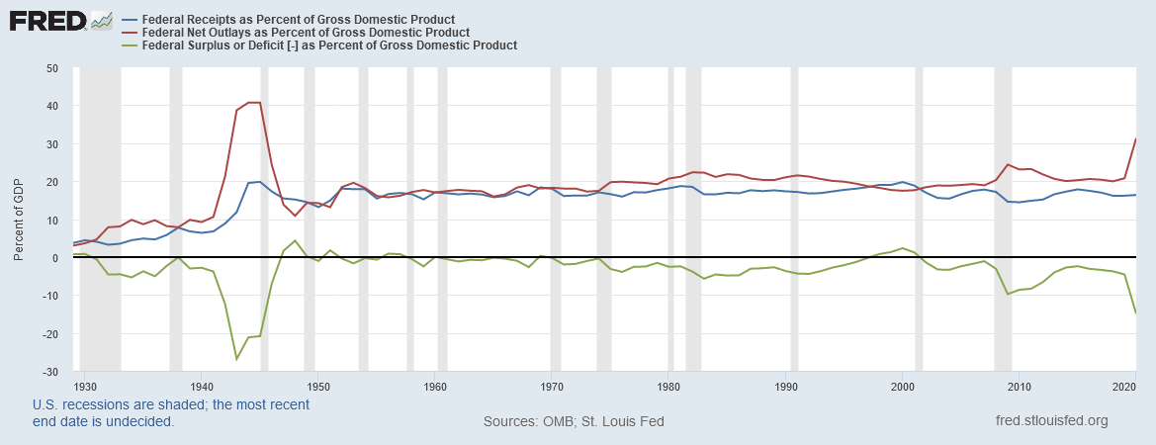
US Federal Government Budget
Notes:
Sources: Receipts: https://fred.stlouisfed.org/series/FYFRGDA188S
Outlays: https://fred.stlouisfed.org/series/FYONGDA188S
Surplus: https://fred.stlouisfed.org/series/FYFSGDA188S
Downloaded on February 18, 2021.

Slide 59
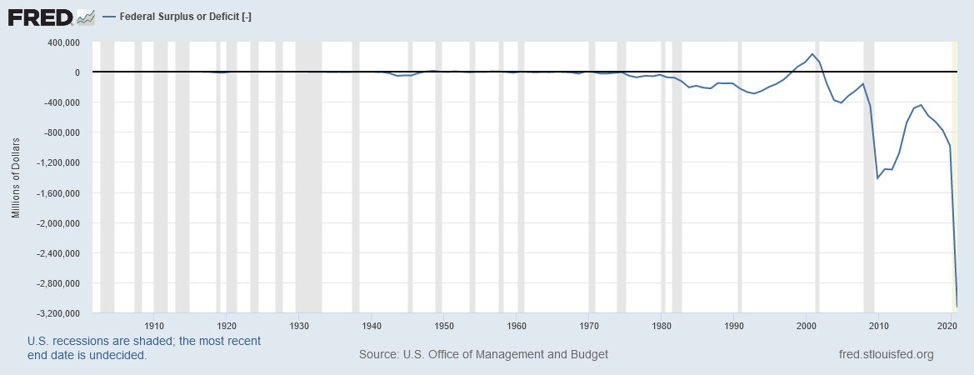
U.S. Federal Government Surplus/Deficit
Source: https://fred.stlouisfed.org/series/FYFSD
Notes:
Downloaded from https://fred.stlouisfed.org/series/FYFSD on February 18, 2021. The years are fiscal years, which begin on October 1 and end on September 30.

Slide 60
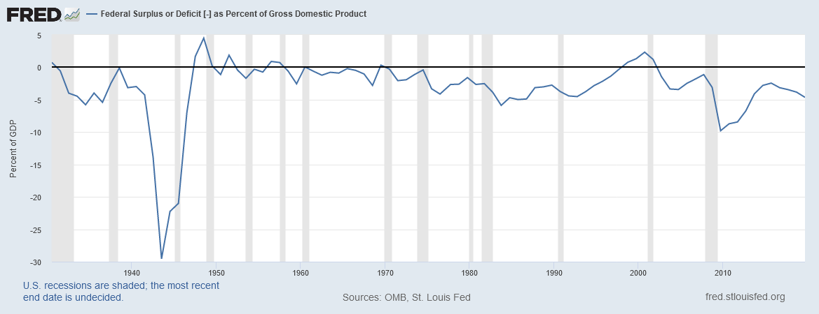
U.S. Federal Government Surplus/Deficit (% of GDP)
Source: https://fred.stlouisfed.org/series/FYFSDFYGDP
Notes:
Downloaded from https://fred.stlouisfed.org/series/FYFSDFYGDP on February 18, 2021. The years are fiscal years, which begin on October 1 and end on September 30.

Slide 61
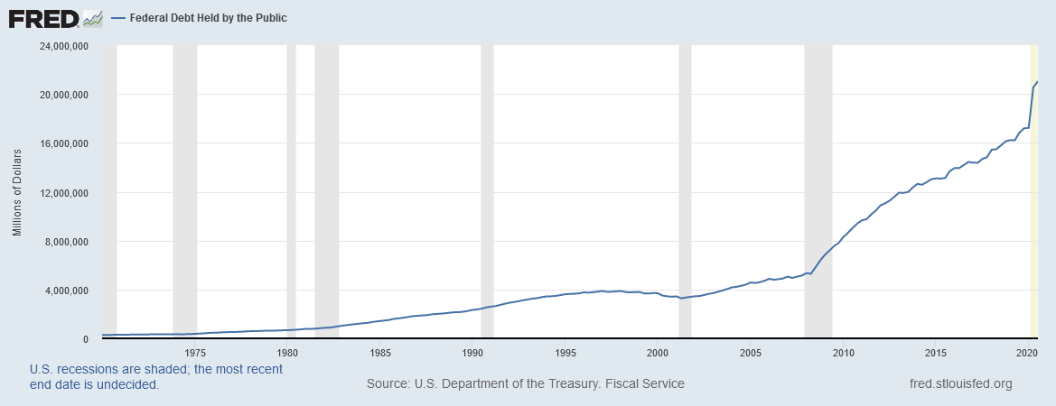
U.S. Federal Government Debt
Notes:
Downloaded from http://research.stlouisfed.org/fred2/series/FYGFDPUN on February 18, 2021.

Slide 62
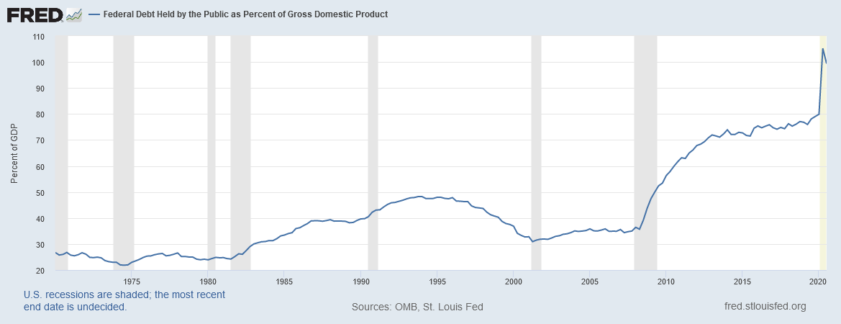
U.S. Federal Government Debt (% of GDP)
Source: https://fred.stlouisfed.org/series/FYGFGDQ188S
Notes:
Source: https://fred.stlouisfed.org/series/FYGFGDQ188S. Downloaded on February 18, 2021.

Slide 63
CASE STUDY: The Reagan deficits
Predictions Grid
 | Y | C | S, I | r
K, L, A | + | + | + | −
T | 0 | − | + | −
C_{o} | 0 | + | − | +
G | 0 | 0 | − | +
I_{o} | 0 | 0 | 0 | +
Reagan policies during early 1980s:
increases in defense spending: ΔG > 0
big tax cuts: ΔT < 0
Both policies reduce national saving:

Slide 64
CASE STUDY: The Reagan deficits
1. The increase in the deficit reduces saving…
r
r₂
2. …which causes the real interest rate to rise…
r₁
3. …which reduces the level of investment.
I (r )
I₂
I₁
S, I

Slide 65
Are the data consistent with these results?
variable 1970s 1980s
T – G –2.2 –3.9
S 19.6 17.4
r 1.1 6.3
I 19.9 19.4
T–G, S, and I are expressed as a percent of GDP
All figures are averages over the decade shown.
Notes:
Display the data line by line, noting that it matches the model’s predictions---UNTIL YOU GET TO Investment.
The model says that investment should have fallen as much as savings. Ask students why they think it didn’t.
Answer: in our closed economy model of chapter 3, the only source of loanable funds is national saving. But the U.S. is actually an open economy. In the face of a fall in national saving (i.e. the domestic supply of loanable funds), firms can finance their investment spending by importing foreign loanable funds. More on this in an upcoming chapter.

Slide 66
Whole chapter in one slide!
Predictions Grid
 | Y | C | S, I | r
K, L, A | + | + | + | −
T | 0 | − | + | −
C_{o} | 0 | + | − | +
G | 0 | 0 | − | +
I_{o} | 0 | 0 | 0 | +
$Y=A∙K^{0.3}L^{0.7}$
$C=C_{0}+C_{y}∙(Y−T)$
$I=S=Y−C−G$
$I=I_{0}−I_{r}∙r$ which gives $r=\frac{I_{0}−I}{I_{r}}$
All exogenous variables (knowns) are in black
All endogenous variables (unknowns) are in red

Slide 67
Whole chapter in one slide!
Predictions Grid
 | Y | C | S, I | r
K, L, A | + | + | + | −
T | 0 | − | + | −
C_{o} | 0 | + | − | +
G | 0 | 0 | − | +
I_{o} | 0 | 0 | 0 | +
$Y=A∙K^{0.3}L^{0.7}$
$C=C_{0}+C_{y}∙(Y−T)$
$C=C_{0}+C_{y}∙(A∙K^{0.3}L^{0.7}−T)$
$I=S=Y−C−G$
$I=S=A∙K^{0.3}L^{0.7}−C_{0}−C_{y}∙(A∙K^{0.3}L^{0.7}−T)−G$
$I=S=\left(1−C_{y}\right)∙A∙K^{0.3}L^{0.7}−C_{0}+C_{y}∙T−G$
$I=I_{0}−I_{r}∙r$ which gives $r=\frac{I_{0}−I}{I_{r}}$
$r=\frac{I_{0}−\left(1−C_{y}\right)∙A∙K^{0.3}L^{0.7}+C_{0}−C_{y}∙T+G}{I_{r}}$
Note that every endogenous variable has been expressed entirely in terms of exogenous variables.

