Slide 1
Ch. 8: Capital Accumulation as a Source of Growth
Part III Growth Theory: The Economy in the Very Long Run
Macroeconomics, 11th Edition, by N. Gregory Mankiw
ECO 62 Instructor: Udayan Roy

Slide 2
Table 8.1, International Differences in the Standard of Living, Page 190
Country | Income per Person (2019)
United States | $65,281
European Union | 46,468
Japan | 43,236
Russian Federation | 29,181
Mexico | 20,411
China | 16,785
Brazil | 15,259
Indonesia | 12,302
Egypt | 12,251
Philippines | 9,277
India | 7,034
Nigeria | 5,348
Bangladesh | 4,951
Pakistan | 4,885
Ethiopia | 2,312
We need to try to explain these differences.
Economists use the Solow-Swan model/theory to think about these differences.
Download data for more countries and years: https://data.worldbank.org/indicator/NY.GDP.PCAP.PP.CD.

Slide 3
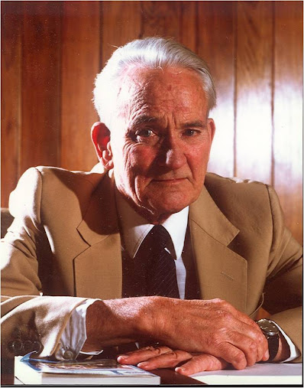
Robert Solow and Trevor Swan
Solow: https://en.wikipedia.org/wiki/Robert_Solow
Swan: https://en.wikipedia.org/wiki/Trevor_Swan

Slide 4
The Solow-Swan Model
This is a theory of macroeconomic dynamics
Using this theory,
you can predict where an economy will be tomorrow, the day after, and so on, if you know where it is today
you can predict the dynamic effects of changes in
the saving rate
and other factors

Slide 5
Two productive resources and one produced good
There are two productive resources:
Capital
Labor
These two productive resources are used to produce one
final good

Slide 6
Two productive resources and one produced good
There are two productive resources:
Capital; the amount employed in production is denoted K
Labor; the amount employed in production is denoted L
These two productive resources are used to produce one
final good; the amount produced is denoted Y

Slide 7
The Production Function (or, Technology)
The production function is an equation that tells us how much of the final good is produced with specified amounts of capital and labor
Y = F(K, L)
Example: Y = 5K^{0.3}L^{0.7}
Example in Textbook: Y = K^{0.5}L^{0.5}
If you plug numbers for capital (K) and labor (L) in the production function equation, you get the number for the resulting output of the final good (Y).
 | Y = 5K^{0.3}L^{0.7}
 |  | labor
 |  | 0 | 10 | 20 | 30
capital | 0 | 0 | 0 | 0 | 0
 | 1 | 0 | 25.06 | 40.71 | 54.07
 | 2 | 0 | 30.85 | 50.12 | 66.57
 | 3 | 0 | 34.84 | 56.60 | 75.18
 | 4 | 0 | 37.98 | 61.70 | 81.95

Slide 8
Constant returns to scale
 | Y = 5K^{0.3}L^{0.7}
 |  | labor
 |  | 0 | 10 | 20 | 30
capital | 0 | 0 | 0 | 0 | 0
 | 1 | 0 | 25.06 | 40.71 | 54.07
 | 2 | 0 | 30.85 | 50.12 | 66.57
 | 3 | 0 | 34.84 | 56.60 | 75.18
 | 4 | 0 | 37.98 | 61.70 | 81.95
Y = F(K, L) = 5K^{0.3}L^{0.7}
Note:
if you double both K and L, Y will also double
if you triple both K and L, Y will also triple
… and so on
This feature of the Y = 5K^{0.3}L^{0.7} production function is called constant returns to scale
The Solow-Swan model assumes that production functions obey constant returns to scale.
(Do you think this is a reasonable assumption?)
Please try Problem 1(a) in the Problems and Applications section of the textbook.

Slide 9
The Cobb-Douglas Production Function
Y = F(K, L) = 5K^{0.3}L^{0.7}
The above production function is an instance of a more general production function called …
The Cobb-Douglas Production Function:
Y = AK^{α}L^{1 − α} ,
where A is any positive number (A > 0) and
α is any positive fraction (1 > α > 0)
A represents the productivity of the technology
α represents the importance of capital relative to labor in production

Slide 10
From the total production function to the per-worker production function
Let us now switch from total capital (K) and total output (Y) to …
… per-worker capital (k) and per-worker output (y)
Define:
$k=\frac{K}{L}$
$y=\frac{Y}{L}$

Slide 11
From the total production function to the per-worker production function: Cobb-Douglas
$Y=F\left(K,L\right)$
$Y=A∙K^{α}∙L^{1−α}$.
$\frac{Y}{L}=\frac{A∙K^{α}∙L^{1−α}}{L}=\frac{A∙K^{α}∙L^{1−α}}{L^{α}∙L^{1−α}}=\frac{A∙K^{α}}{L^{α}}=A∙{\left(\frac{K}{L}\right)}^{α}$.
$y=A∙k^{α}$
$y=f\left(k\right)$
This is the per-worker production function
Note that we can switch from a total production function F(K, L) to a per-worker production function f(k).

Slide 12
From the total production function to the per-worker production function: Cobb-Douglas
k | y
0 | 0
1 | 5
2 | 6.156
3 | 6.952
4 | 7.579
5 | 8.103
6 | 8.559
7 | 8.964
8 | 9.330
9 | 9.666
10 | 9.976
11 | 10.266
12 | 10.537
13 | 10.793
14 | 11.036
15 | 11.267
16 | 11.487
17 | 11.698
18 | 11.900
19 | 12.095
20 | 12.282
Total production function:
$Y=F\left(K,L\right)$
$Y=5∙K^{0.3}∙L^{0.7}$.
$\frac{Y}{L}=\frac{5∙K^{0.3}∙L^{0.7}}{L}=\frac{5∙K^{0.3}∙L^{0.7}}{L^{0.3}∙L^{0.7}}=\frac{5∙K^{0.3}}{L^{0.3}}=5∙{\left(\frac{K}{L}\right)}^{0.3}$.
$y=5∙k^{0.3}$
$y=f\left(k\right)$
Per-worker production function
This is what a typical per worker production function looks like: concave

Slide 13
From the total production function to the per-worker production function: Cobb-Douglas
In Problem 1 of the Problems and Applications section of Chapter 8 of the textbook, you get Y = K^{1/3}L^{2/3}, which is the Cobb-Douglas production with A = 1 and α = 1/3. Try 1(a) and 1(b).
In Problem 3, you get Y = K^{0.4}L^{0.6}, which is the Cobb-Douglas production with A = 1 and α = 0.4. Try 3(a).

Slide 14
Per-worker production function: graph

Slide 15
Income, consumption, saving, investment
Output = income
Assumption: The Solow-Swan model assumes that each individual saves a constant fraction, s, of his or her income
Therefore, saving per worker = sy = sf(k)
This saving becomes investment
that is, unconsumed output gets added to the existing capital stock
Therefore, i = sy = sf(k) is investment per worker.
Consumption per worker is c = y – sy = (1 – s)y = (1 – s)f(k)
Please try Problem 1(d) of the textbook.

Slide 16
Income, consumption, saving, investment: graph

Slide 17
Depreciation
Part of the existing capital stock wears out
This is called depreciation
Assumption: The Solow-Swan model assumes that a constant fraction, δ, of the existing capital stock wears out in every period
That is, an individual who currently has k units of capital will lose δk units of capital though depreciation (or, wear and tear)
δk is called break-even investment per worker.

Slide 18
Depreciation
Although 0 < δ < 1 is the fraction of existing capital that wears out every period, in some cases depreciation is expressed as a percentage.
Problem 1(c) of the Problems and Applications section of the textbook says “20 percent of capital depreciates each year”.
This means δ = 20/100 = 0.20.
Problem 3(c) says “the depreciation rate is 15 percent per year”.
This means δ = 15/100 = 0.15.

Slide 19
Depreciation: graph

Slide 20
Dynamics

Slide 21
Dynamics: What time is it?
We’ll attach a subscript to each variable to denote what date we’re talking about
For example:
k_{t} denotes the per worker stock of capital on date t and
k_{t+1} denotes the per worker stock of capital on date t + 1
Assumption: For the time being we’ll assume that the population is constant. Each worker is immortal and does not create children. Nobody knows how the workers themselves were created.

Slide 22
How does per worker capital change?
Suppose a worker has k_{t} units of capital on date t
Assumption: All available resources are fully utilized in production
His/her output would be y_{t} = f(k_{t}).
He/she adds sy_{t} units of capital through saving …
… and loses δk_{t} units of capital through depreciation
So, each worker has k_{t} + sy_{t} − δk_{t} units of capital on date t + 1
That is, k_{t+1} = k_{t} + sy_{t} − δk_{t}.
In the Cobb-Douglas case, y_{t} = f(k_{t}) = Ak_{t}^{α}.
Therefore, k_{t+1} = k_{t} + sAk_{t}^{α} − δk_{t}.

Slide 23
Dynamics
k_{t+1} = k_{t} + sAk_{t}^{α} − δk_{t}
Now we are ready to do dynamics!
Assumption: The values of the parameters s, A, α, and δ are known
Table 8-2 of the textbook sets s = 0.3, A = 1, α = 0.5, and δ = 0.1
Assumption: The year-one capital per worker, k₁, is known
The exercise in Table 8-2 of the textbook sets k₁ = 4
Use the equation to calculate k₂, the year-two capital per worker
k₂ = k₁ + sAk₁^{α} − δk₁ = 4 + 0.3∙1 ∙ 4^{0.5} − 0.1 ∙ 4 = 4.2.

Slide 24
Dynamics
k_{t+1} = k_{t} + sAk_{t}^{α} − δk_{t}
Assumption: The values of the parameters s, A, α, and δ are known
Table 8-2 of the textbook sets s = 0.3, A = 1, α = 0.5, and δ = 0.1
Assumption: The year-one capital per worker, k₁, is known
We saw that k₂ = 4.2
Use the equation to calculate k₃, the year-three capital per worker
k₃ = k₂ + sAk₂^{α} − δk₂ = 4.2 + 0.3∙1 ∙ (4.2)^{0.5} − 0.1 ∙ 4.2 = 4.3948.
Keep going: Calculate k₄, k₅, etc., ad infinitum!

Slide 25
Dynamics: k_{t+1} = k_{t} + sAk_{t}^{α} − δk_{t}
Exogenous Variables |  |  | t | k_{t} | y_{t} | c_{t} = (1 - s)y_{t} | i_{t} = s_{t} = sy_{t} | δk_{t} | Δkt | Growth of y_{t}
A = | 1 |  | 1 | 4 | 2.0000 | 1.4000 | 0.6000 | 0.4000
α = | 0.5 |  | 2 | 4.2000 | 2.0494 | 1.4346 | 0.6148 | 0.4200 | 0.2000 | 2.4695
δ = | 0.1 |  | 3 | 4.3948 | 2.0964 | 1.4675 | 0.6289 | 0.4395 | 0.1948 | 2.2930
n = | 0 |  | 4 | 4.5842 | 2.1411 | 1.4988 | 0.6423 | 0.4584 | 0.1894 | 2.1324
s = | 0.3 |  | 5 | 4.7682 | 2.1836 | 1.5285 | 0.6551 | 0.4768 | 0.1839 | 1.9861
k₀ = | 4 |  | 6 | 4.9464 | 2.2241 | 1.5568 | 0.6672 | 0.4946 | 0.1783 | 1.8522
 |  |  | 7 | 5.1190 | 2.2625 | 1.5838 | 0.6788 | 0.5119 | 0.1726 | 1.7295
k* = | 9 |  | 8 | 5.2858 | 2.2991 | 1.6094 | 0.6897 | 0.5286 | 0.1669 | 1.6167
 |  |  | 9 | 5.4470 | 2.3339 | 1.6337 | 0.7002 | 0.5447 | 0.1611 | 1.5129
 |  |  | 10 | 5.6025 | 2.3670 | 1.6569 | 0.7101 | 0.5602 | 0.1555 | 1.4170
 |  |  | 11 | 5.7523 | 2.3984 | 1.6789 | 0.7195 | 0.5752 | 0.1498 | 1.3284
 |  |  | 12 | 5.8966 | 2.4283 | 1.6998 | 0.7285 | 0.5897 | 0.1443 | 1.2464
 |  |  | 13 | 6.0354 | 2.4567 | 1.7197 | 0.7370 | 0.6035 | 0.1388 | 1.1703
 |  |  | 14 | 6.1689 | 2.4837 | 1.7386 | 0.7451 | 0.6169 | 0.1335 | 1.0997
 |  |  | 15 | 6.2971 | 2.5094 | 1.7566 | 0.7528 | 0.6297 | 0.1282 | 1.0340
 |  |  | 16 | 6.4202 | 2.5338 | 1.7737 | 0.7601 | 0.6420 | 0.1231 | 0.9728
 |  |  | 17 | 6.5383 | 2.5570 | 1.7899 | 0.7671 | 0.6538 | 0.1181 | 0.9157
 |  |  | 18 | 6.6516 | 2.5791 | 1.8054 | 0.7737 | 0.6652 | 0.1133 | 0.8625
 |  |  | 19 | 6.7602 | 2.6000 | 1.8200 | 0.7800 | 0.6760 | 0.1086 | 0.8127
 |  |  | 20 | 6.8642 | 2.6200 | 1.8340 | 0.7860 | 0.6864 | 0.1040 | 0.7662
See my spreadsheet solow-swan-growth-model.xlsx. Change the parameters in the yellow cells to see how the economy responds.
Ignore the cells for k* for now.
Please try Problem 1(e) of the textbook.

Slide 26
Table 8.2, Approaching the Steady State: A Numerical Example, Page 196
Year | k | y | c | i | δk | Δk
1 | 4.000 | 2.000 | 1.400 | 0.600 | 0.400 | 0.200
2 | 4.200 | 2.049 | 1.435 | 0.615 | 0.420 | 0.195
3 | 4.395 | 2.096 | 1.467 | 0.629 | 0.440 | 0.189
4 | 4.584 | 2.141 | 1.499 | 0.642 | 0.458 | 0.184
5 | 4.768 | 2.184 | 1.529 | 0.655 | 0.477 | 0.178
.
.
.
10 | 5.602 | 2.367 | 1.657 | 0.710 | 0.560 | 0.150
.
.
.
25 | 7.321 | 2.706 | 1.894 | 0.812 | 0.732 | 0.080
.
.
.
100 | 8.962 | 2.994 | 2.096 | 0.898 | 0.896 | 0.002
.
.
.
∞ | 9.000 | 3.000 | 2.100 | 0.900 | 0.900 | 0.000

Slide 27
Dynamics: algebra to graphs
k_{t+1} = k_{t} + sAk_{t}^{α} − δk_{t}
Although the basic Solow-Swan dynamic equation is algebraic, a simple modification will help us analyze the theory graphically.
The increase in the per-worker stock of capital at t is denoted:
Δk_{t} ≡ k_{t+1} − k_{t} = sAk_{t}^{α} − δk_{t}
Investment (sAk_{t}^{α}) adds to the worker’s capital
Depreciation (δk_{t}) destroys the worker’s capital. Depreciation is also known as break-even investment.

Slide 28
Dynamics: algebra to graphs
Δk_{t} ≡ k_{t+1} − k_{t} = sAk_{t}^{α} − δk_{t}
The economy grows [Δk_{t} > 0] if and only if per worker saving and investment [sf(k_{t}) = sAk_{t}^{α}] exceeds break-even investment [δk_{t}].
The economy shrinks [Δk_{t} < 0] if and only if per worker saving and investment [sf(k_{t})] is less than break-even investment [δk_{t}].
The economy is at a steady state [Δk_{t} = 0] if and only if per worker saving and investment [sf(k_{t})] is equal to break-even investment [δk_{t}].

Slide 29
Dynamics: Δk_{t} = sAk_{t}^{α} − δk_{t}
Investment and break-even investment
2. The height of this curve gives the break-even investment per worker for the corresponding value of capital per worker.
δk_{t}
sf(k_{t})
1. The height of this curve gives the investment per worker for the corresponding value of capital per worker.
3. As implied by the Solow-Swan equation, the height of the investment-per-worker curve minus the height of the break-even-investment-per-worker curve equals the increase in capital per worker for the corresponding value of capital per worker.
Capital per worker, k

Slide 30
Dynamics: Δk_{t} = sAk_{t}^{α} − δk_{t}
Investment and break-even investment
2. The height of this curve gives the break-even investment per worker for the corresponding value of capital per worker.
δk_{t}
sf(k_{t})
1. The height of this curve gives the investment per worker for the corresponding value of capital per worker.
3. As implied by the Solow-Swan equation, the height of the investment-per-worker curve minus the height of the break-even-investment-per-worker curve equals the increase in capital per worker for the corresponding value of capital per worker.
k₁
Capital per worker, k

Slide 31
Dynamics: Δk_{t} = sAk_{t}^{α} − δk_{t}
Investment and break-even investment
δk_{t}
sf(k_{t})
1. We saw earlier that the economy is at a steady state [Δk_{t} = 0] if and only if per worker saving and investment [sf(k_{t})] is equal to break-even investment [δk_{t}].
2. Therefore, the amount of capital per worker at which the investment-per-worker curve intersects the break-even-investment-per-worker curve is called the steady state capital per worker and denoted as k*.
k*
Capital per worker, k
Steady state

Slide 32
All Roads Lead to the Steady State!
An important property of the Solow-Swan theory is that capital per worker always ends up at the steady-state amount (k*) no matter how much capital per worker the economy starts out with.

Slide 33
Dynamics: Δk_{t} = sAk_{t}^{α} − δk_{t}
Investment and break-even investment
δk_{t}
sf(k_{t})
investment
Δk₁
In this case, the initial capital per worker is k₁ < k*. Investment exceeds break-even investment. As a result, capital per worker increases as time passes and gradually approaches the steady state.
Break-even investment
k₁
k*
Capital per worker, k
Steady state

Slide 34
Dynamics: Δk_{t} = sAk_{t}^{α} − δk_{t}
Investment and break-even investment
δk_{t}
sf(k_{t})
Δk₁
In this case, the initial capital per worker is k₁ < k*. Investment exceeds break-even investment. As a result, capital per worker increases as time passes and gradually approaches the steady state.
Δk₁
k₁
k₂
k*
Capital per worker, k
Steady state

Slide 35
Dynamics: Δk_{t} = sAk_{t}^{α} − δk_{t}
Investment and break-even investment
δk_{t}
sf(k_{t})
Δk₂
investment
In this case, the initial capital per worker is k₁ < k*. Investment exceeds break-even investment. As a result, capital per worker increases as time passes and gradually approaches the steady state.
Break-even investment
k₁
k₂
k*
Capital per worker, k
Steady state

Slide 36
Dynamics: Δk_{t} = sAk_{t}^{α} − δk_{t}
Investment and break-even investment
δk_{t}
sf(k_{t})
Δk₂
In this case, the initial capital per worker is k₁ < k*. Investment exceeds break-even investment. As a result, capital per worker increases as time passes and gradually approaches the steady state.
Δk₁
Δk₂
k₁
k₂
k₃
k*
Capital per worker, k
Steady state

Slide 37
Dynamics: Δk_{t} = sAk_{t}^{α} − δk_{t}
Investment and break-even investment
δk_{t}
Break-even investment
Δk₁ < 0
sf(k_{t})
investment
In this case, the initial capital per worker is k₁ > k*. Investment is less than break-even investment. As a result, capital per worker decreases as time passes and gradually approaches the steady state.
k*
k₁
Capital per worker, k
Steady state

Slide 38
Dynamics: Δk_{t} = sAk_{t}^{α} − δk_{t}
Investment and break-even investment
δk_{t}
Δk₂ < 0
sf(k_{t})
In this case, the initial capital per worker is k₁ > k*. Investment is less than break-even investment. As a result, capital per worker decreases as time passes and gradually approaches the steady state.
Δk₁
k*
k₂
k₁
Capital per worker, k
Steady state

Slide 39
Dynamics: Δk_{t} = sAk_{t}^{α} − δk_{t}
Investment and break-even investment
δk_{t}
Δk₂ < 0
sf(k_{t})
In this case, the initial capital per worker is k₁ > k*. Investment is less than break-even investment. As a result, capital per worker decreases as time passes and gradually approaches the steady state.
Δk₂
k*
k₃
k₂
k₁
Capital per worker, k
Steady state

Slide 40
Figure 8.4, Page 194

Slide 41
Solow-Swan predictions for the steady state

Slide 42
There is no growth!
The Solow-Swan model predicts that
Every economy will end up at the steady-state; in the long run, the growth rate is zero!
That is, k = k* and y = f(k*) = y* in the long run
Growth is possible—temporarily!—only if the economy’s per worker stock of capital is less than the steady state per worker stock of capital (k < k*)
If k < k*, the smaller the value of k, the faster the growth of k and y

Slide 43
There is no growth!
So, in the long run:
Capital per worker, k = k*, is constant
Output per worker, y = f(k*) = y*, is constant
Saving (and investment) per worker, sy*, is constant
Consumption per worker, c* = y* – sy* = (1 – s)y*, is also constant.

Slide 44
The Steady State
In the long run, the economy ends up at the steady state
Output, investment and break-even investment
δk_{t}
f(k)
c*
sf(k)
f(k*)
sf(k*)
k
k*

Slide 45
Steady state: algebra
So far, we have described the steady state graphically. Now we will calculate it algebraically.

Slide 46
The Steady State: Algebra
We have seen that, at the steady state, capital added is equal to capital destroyed:
sf(k) = δk.
For the Cobb-Douglas case, this becomes: sAk^{α} = δk.
Therefore, $\frac{sA}{δ}=\frac{k}{k^{α}}$.
Therefore, $\frac{sA}{δ}=k^{1−α}$.
Therefore, $k={\left(\frac{sA}{δ}\right)}^{\frac{1}{1−α}}$ at the steady state.

Slide 47
The Steady State: Capital per Worker
We just saw that $k={\left(\frac{sA}{δ}\right)}^{\frac{1}{1−α}}$ at the steady state.
We’ll denote all steady state quantities with an asterisk (*).
So, $k^{∗}={\left(\frac{sA}{δ}\right)}^{\frac{1}{1−α}}$.
Note that this is a solution equation, because it expresses an endogenous variable (k*) entirely in terms of exogenous variables and parameters.

Slide 48
The Steady State: Output per Worker
We have seen that at the steady state per worker saving and investment is equal to break-even investment: sy* = δk*.
Therefore, $y^{∗}=\frac{δ}{s}∙k^{∗}=\frac{δ}{s}∙{\left(\frac{sA}{δ}\right)}^{\frac{1}{1−α}}$.
With a little algebra, we get $y^{∗}={\left(\frac{s}{δ}\right)}^{\frac{α}{1−α}}A^{\frac{1}{1−α}}$.

Slide 49
The Steady State: Investment per Worker
We have seen that at the steady state per worker investment (which equals per worker saving) is equal to per worker break-even investment: i* = sy* = δk*.
Therefore, $i^{∗}=δ∙k^{∗}=δ∙{\left(\frac{sA}{δ}\right)}^{\frac{1}{1−α}}$.
With a little algebra, we get $i^{∗}=δ^{−\frac{α}{1−α}}∙{\left(sA\right)}^{\frac{1}{1−α}}$.

Slide 50
The Steady State: Consumption per Worker
We have seen that c = (1 – s)y.
Therefore, at the steady state, consumption per worker is also constant: c* = (1 – s)y*.
Therefore, $c^{∗}=\left(1−s\right)∙{\left(\frac{s}{δ}\right)}^{\frac{α}{1−α}}A^{\frac{1}{1−α}}$.
Please try Problem 1(c), 3(b), and 3(c) of the textbook.

Slide 51
Solow-Swan predictions for changes to the steady state
What might be the long-run consequences of: The destruction of physical capital (perhaps by war or natural disaster) An increase in the saving rate

Slide 52
A sudden fall in capital per worker
A sudden decrease in k could be caused by:
Earthquake or war that destroys capital more than people
Immigration
What does the Solow-Swan model say will be the result of this?

Slide 53
A sudden fall in capital per worker
Investment and depreciation
δk_{t}
sf(k_{t})
Solow-Swan Predictions Grid
 | k_{t+1}, y_{t+1}, Δk_{t} | k*, y*, i* = sy* | c* = (1 – s)y*
k_{t} | ? | 0 | 0
2. A gradual return to the steady state
k₁
k*
Capital per worker, k
At this point, you should be able to do problem 2 of the textbook. Please give it a try.
1. A sudden decline

Slide 54
An increase in the saving rate
Investment, break-even investment
δk_{t}
s₂f(k)
1. An increase in the saving rate raises investment …
s₁f(k)
2. … causing k to grow (toward a new steady state)
3. This raises steady-state per worker output y* = f(k*) and saving sy*.
4. The growth rate begins at zero, becomes positive for a while, and eventually returns to zero.
k
k₁*
k₂*

Slide 55
Figure 8.5, Page 198

Slide 56
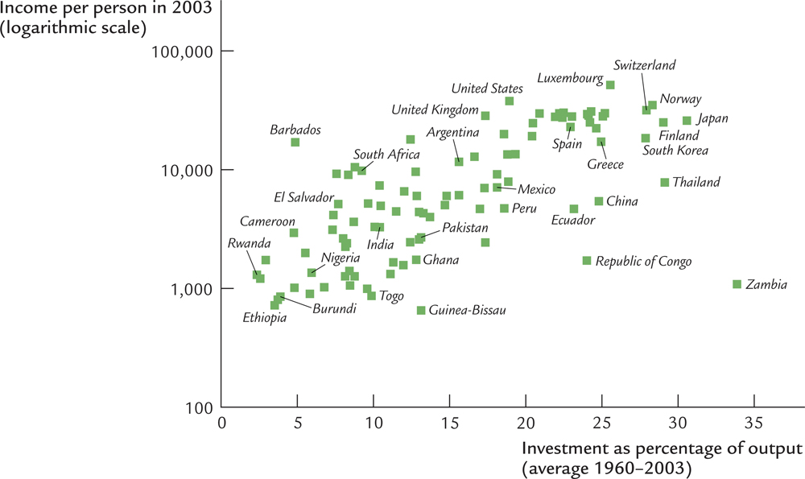
Effect of saving: evidence

Slide 57
How does an increase in the saving rate affect steady-state consumption per worker?
Investment, break-even investment
δk_{t}
s₂f(k)
s₁f(k)
An increase in the saving rate causes a temporary spurt in growth. The economy reaches a new steady state. At the new steady state, per worker capital, output, and saving are all higher. But per worker consumption is a bit trickier.
k
k₁*
k₂*

Slide 58
An increase in the saving rate
Investment, break-even investment
δk
f(k)
1. Recall that the saving rate, s, is a fraction between 0 and 1.
c*
sf(k)
2. What can we say about the steady state levels of k, y, and c when s = 0?
f(k*)
Q: Do you know the fable of the ant and the grasshopper by Aesop?
sf(k*)
3. And when s = 1?
4. So, how is consumption per worker, c, affected by changes in s?
k
k*
Steady State

Slide 59
Being the grasshopper is not good!
1. Recall that the saving rate is a fraction between 0 and 1.
2. What can we say about the steady state levels of k, y, and c when s = 0?
Investment and break-even investment
3. They are all zero!
δk_{t}
f(k)
sf(k) when s = 0
k
k*= 0

Slide 60
Being a miserly ant is not good either!
1. Recall that the saving rate is a fraction between 0 and 1.
2. What can we say about the steady state levels of k, y, and c when s = 1?
Investment and break-even investment
δk_{t}
f(k)
= sf(k)
c*= 0
sf(k*)
f(k*)
k
k*

Slide 61
What do we get for thrift?
In the long run, a higher rate of saving and investment gives us
A higher per worker income
But not a faster rate of growth
And consumption per worker, c* = (1 – s)y*, may increase or decrease or stay unchanged when s increases.
You should now be able to do Problem 4 of the textbook. Please try it.

Slide 62
Effect of saving on steady state consumption
For the Cobb-Douglas case, it can be shown that the Golden Rule saving rate is equal to capital’s share of all income, which, for the United States, is approximately 30% or 0.30.
Steady state consumption per worker, c* = (1 – s)f(k*)
The US saving rate is well below 0.30. So, according to the Solow-Swan model, if we save more we will, in the long run, consume more too!
Golden Rule consumption per worker
0
Golden Rule Saving rate
1
Saving rate, s

Slide 63
Figure 8.6, Page 200

Slide 64
Figure 8.7, Page 202

Slide 65
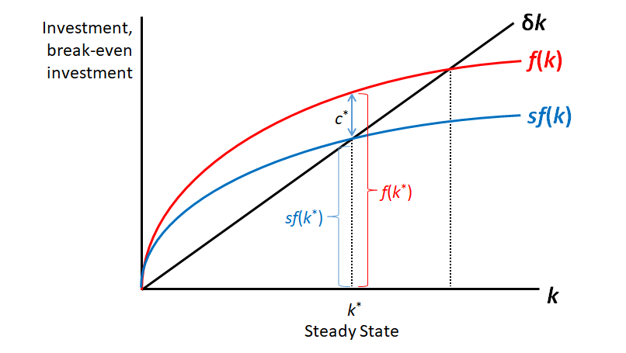
Whole lecture in one slide!
Solow-Swan Predictions Grid
 | k_{t+1}, y_{t+1}, Δk_{t} | k*, y*, i* = sy* | c* = (1 – s)y*
k_{t} | ? | 0 | 0
s | + | + | ?
A | + | + | +
δ | – | – | –
k_{t+1} = k_{t} + sAk_{t}^{α} − δk_{t}
y_{t} = Ak_{t}^{α}.
i_{t} = sy_{t} = sAk_{t}^{α}.
c_{t} = (1 – s)y_{t} = (1 – s)Ak_{t}^{α}.
$k^{∗}={\left(\frac{sA}{δ}\right)}^{\frac{1}{1−α}}$.
$y^{∗}={\left(\frac{s}{δ}\right)}^{\frac{α}{1−α}}A^{\frac{1}{1−α}}$.
$i^{∗}=δ^{−\frac{α}{1−α}}∙{\left(sA\right)}^{\frac{1}{1−α}}$.
$c^{∗}=\left(1−s\right)∙{\left(\frac{s}{δ}\right)}^{\frac{α}{1−α}}A^{\frac{1}{1−α}}$.

Slide 66
What’s Next?
The Solow-Swan model of this chapter says that an economy will grow if its per-worker income is less than the steady-state per-worker income.
But in the long run per-worker income cannot exceed the steady-state per-worker income. Our standards of living are limited in the long run.
We’ll next see if a modified Solow-Swan model can predict perpetual growth.
This chapter assumed zero population growth.
We’ll next see what happens when there is population growth.

Slide 67
Figure 8.8, Page 204

Slide 68
Figure 8.9, Page 205

Slide 69
Table 8.3, Finding the Golden Rule Steady State: A Numerical Example, Page 203
s | k* | y* | δk* | c* | MPK | MPK − δ
0.0 | 0.0 | 0.0 | 0.0 | 0.0 | ∞ | ∞
0.1 | 1.0 | 1.0 | 0.1 | 0.9 | 0.500 | 0.400
0.2 | 4.0 | 2.0 | 0.4 | 1.6 | 0.250 | 0.150
0.3 | 9.0 | 3.0 | 0.9 | 2.1 | 0.167 | 0.067
0.4 | 16.0 | 4.0 | 1.6 | 2.4 | 0.125 | 0.025
0.5 | 25.0 | 5.0 | 2.5 | 2.5 | 0.100 | 0.000
0.6 | 36.0 | 6.0 | 3.6 | 2.4 | 0.083 | −0.017
0.7 | 49.0 | 7.0 | 4.9 | 2.1 | 0.071 | −0.029
0.8 | 64.0 | 8.0 | 6.4 | 1.6 | 0.062 | −0.038
0.9 | 81.0 | 9.0 | 8.1 | 0.9 | 0.056 | −0.044
1.0 | 100.0 | 10.0 | 10.0 | 0.0 | 0.050 | −0.050

