Slide 1
Economic Growth II: Technology, Empirics, and Policy
Chapter 9 of Macroeconomics, 10th edition, by N. Gregory Mankiw
ECO62 Udayan Roy

Slide 2
Recap: Solow-Swan, Ch. 8
L and K are used to produce a final good Y = F(K, L)
k = K/L and y = Y/L = f(k) are per worker capital and output
L grows at the rate n every period.
A fraction s of Y is saved and added to capital every period.
A fraction δ of K depreciates (wears out) every period.

Slide 3
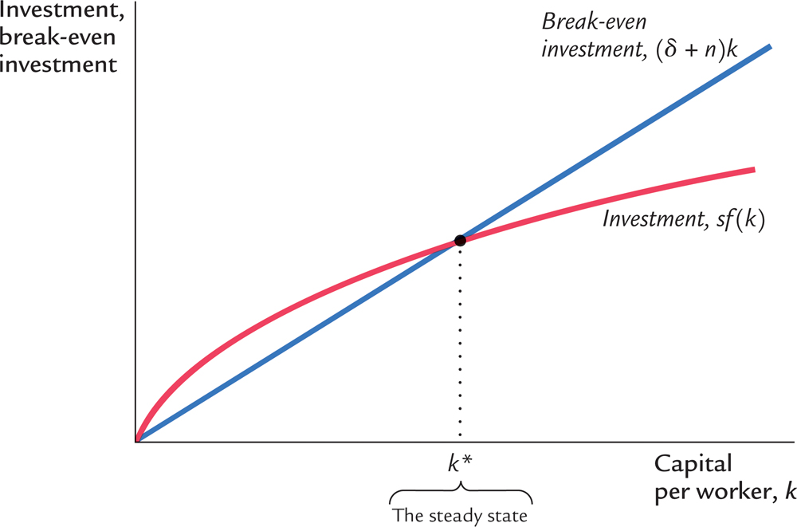
Recap: Solow-Swan, Ch. 8
In the long run, the economy reaches a steady state, with constant k and y

Slide 4
Recap: Solow-Swan, Ch. 8
In the long run, the economy reaches a steady state, with constant k and y
Total capital (K) and total output (Y) both increase at the rate n

Slide 5
Recap: Solow-Swan, Ch. 8
Variable | Symbol | Steady state behavior
Capital per worker | k | Constant
Income per worker | y = f(k) | Constant
Saving and investment per worker | sy | Constant
Consumption per worker | c = (1 – s)y | Constant
Labor | L | Grows at rate n
Capital | K | Grows at rate n
Income | Y = F(K, L) | Grows at rate n
Saving and investment | sY | Grows at rate n

Slide 6
The Sad Lesson of Solow-Swan
It is an undeniable fact that our standards of living increase over time
Yet, Solow-Swan cannot explain this!
Why?
Solow-Swan relies on capital accumulation as the only means of progress
We must introduce some means of progress other than capital accumulation

Slide 7
Technological Progress
Maybe Solow-Swan fails to show economic progress because there is no technological progress in it
We need to create a theory with technological progress in it
But how?

Slide 8
Technological Progress
Think of technological progress as each adult having n human children who eat and g non-human children who don’t eat
All children born at time t become adults at time t + 1, go to work, and have children of their own (n human and g non-human), and so on and on
This is a model or metaphor for technological progress.
It represents the idea that technological progress helps humans get more work done.

Slide 9
Technological Progress
Think of technological progress as each adult having n human children who eat and g non-human children who don’t eat
All children born at time t become adults at time t + 1, go to work, and have children of their own (n human and g non-human), and so on and on
So, labor (L) now grows at the rate n + g
The number of humans, who eat, grows at the rate n
The number of non-humans, who do not eat, grows at the rate g

Slide 10
Solow-Swan With Technological Progress
The analysis of the Solow-Swan model of Ch. 8 can now be repeated exactly as before but with just one change: n becomes n + g.

Slide 11
Dynamics: Ch. 8 and Ch. 9
Ch. 8 No technological change
Ch. 9 Technological Progress

Slide 12
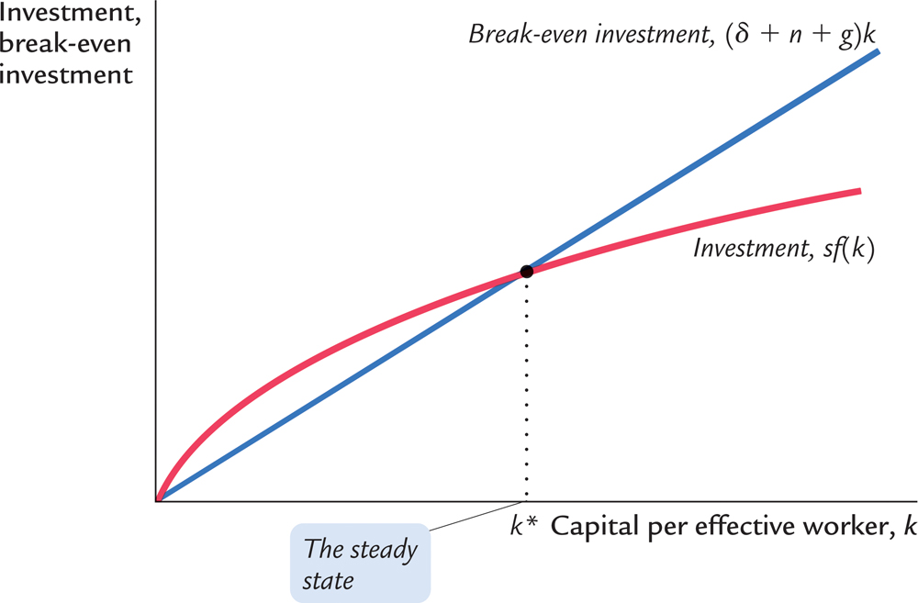
Dynamics: graph
As in Ch. 8, in the long run, k and y reach a steady state at k = k* and y = y* = f(k*)
$$k^{∗}={\left(\frac{s∙A}{δ+n+g}\right)}^{\frac{1}{1−α}}$$

Slide 13
Dynamics: Ch. 8 and Ch. 9
$$k^{∗}={\left(\frac{s∙A}{δ+n}\right)}^{\frac{1}{1−α}}$$
$$k^{∗}={\left(\frac{s∙A}{δ+n+g}\right)}^{\frac{1}{1−α}}$$

Slide 14
Solow-Swan With Technological Progress
Variable | Symbol | Steady state behavior
Capital per worker | k | Constant
Income per worker | y = f(k) | Constant
Saving and investment per worker | sy | Constant
Consumption per worker | c = (1 – s)y | Constant
Effective Labor | L | Grows at rate n + g
Capital | K | Grows at rate n + g
Income | Y = F(K, L) | Grows at rate n + g
Saving and investment | sY | Grows at rate n + g
Consumption | C = (1 – s)Y | Grows at rate n + g

Slide 15
Solow-Swan With Technological Progress
Recall that the (effective) labor force consists of humans, who eat, and non-humans, who do not eat
Output per human = total output / number of humans
Recall that if z = x/y then, then growth rates follow z_{g} = x_{g} – y_{g}.
Therefore, the growth rate of output per human = growth rate of total output – growth rate of the number of humans = n + g – n = g > 0.

Slide 16
Solow-Swan With Technological Progress
Similarly, consumption per human = total consumption / number of humans
As before, if z = x/y then, then z_{g} = x_{g} – y_{g}.
Therefore, the growth rate of consumption per human = growth rate of total consumption – growth rate of the number of humans = n + g – n = g > 0.

Slide 17
Progress, finally!
We have just seen that if we introduce technological progress in the Solow-Swan theory of long-run growth, then in the economy’s steady state
Per-human output and consumption both increase at the rate g, which is the rate of technological progress
This is a major triumph for the Solow-Swan theory

Slide 18
Technological Progress
So we see that a simple re-interpretation of the Solow-Swan economy gives us what we were looking for—steadily increasing income and consumption per human

Slide 20
Growth empirics

Slide 21
Growth empirics: Balanced growth
The Solow model’s steady state exhibits balanced growth: many variables grow at the same rate.
The Solow model predicts that Y/L and K/L grow at the same rate (g), so K/Y should be constant. This is true in the real world.
The Solow model predicts that real wage grows at the same rate as Y/L, while real rental price of capital is constant. Also true in the real world.

Slide 22
Growth empirics: Convergence, part 1
Solow model predicts that, other things equal, poorer countries (with lower Y/L and K/L) should grow faster than rich ones.
If true, then the income gap between rich and poor countries would shrink over time, causing living standards to converge.
In the real world, many poor countries do NOT grow faster than rich ones. Does this mean the Solow model fails?

Slide 23
Growth empirics: Convergence, part 2
No, the Solow model does not fail because it predicts that, other things equal, poor countries (with lower Y/L and K/L) should grow faster than rich ones.
In samples of countries with similar savings and population growth rates, income gaps shrink about 2% per year.
In larger samples, after controlling for differences in saving, population growth, and human capital, incomes converge by about 2% per year.

Slide 24
Growth empirics: Convergence, part 3
What the Solow model really predicts is conditional convergence: countries converge to their own steady states, which are determined by saving, population growth, and education.
This prediction comes true in the real world.

Slide 25
Growth Convergence: After 1990
“While unconditional convergence was singularly absent in the past, there has been unconditional convergence, beginning (weakly) around 1990 and emphatically for the last two decades.”
Everything You Know about Cross-Country Convergence Is (Now) Wrong, by Dev Patel (Harvard University), Justin Sandefur (Center for Global Development) and Arvind Subramanian(PIIE), October 15, 2018
Notes:
Article source: https://piie.com/blogs/realtime-economic-issues-watch/everything-you-know-about-cross-country-convergence-now-wrong and https://voxeu.org/content/everything-you-know-about-cross-country-convergence-now-wrong.

Slide 26
Growth empirics: Factor accumulation vs. production efficiency, part 1
Differences in income per capita among countries can be due to differences in:
capital—physical or human—per worker
the efficiency of production (the height of the production function)
Studies:
Both factors are important.
The two factors are correlated: countries with higher physical or human capital per worker also tend to have higher production efficiency.

Slide 27
Growth empirics: Factor accumulation vs. production efficiency, part 2
Possible explanations for the correlation between capital per worker and production efficiency:
Production efficiency encourages capital accumulation.
Capital accumulation has externalities that raise efficiency.
A third, unknown variable causes capital accumulation and efficiency to be higher in some countries than others.

Slide 28
Policy issues

Slide 29
Policy issues
Are we saving enough? Too much?
What policies might change the saving rate?
How should we allocate our investment between privately owned physical capital, public infrastructure, and human capital?
How do a country’s institutions affect production efficiency and capital accumulation?
What policies might encourage faster technological progress?

Slide 30
Policy issues: Evaluating the rate of saving, part 1
Use the Golden Rule to determine whether the U.S. saving rate and capital stock are too high, too low, or about right.
If (MPK − δ) > (n + g), the U.S. economy is below the Golden Rule steady state and should increase s.
If (MPK − δ) < (n + g), the U.S. economy is above the Golden Rule steady state and should reduce s.

Slide 31
Policy issues: Evaluating the rate of saving, part 2
To estimate (MPK − δ), use three facts about the U.S. economy:
k = 2.5 y The capital stock is about 2.5 times one year’s GDP.
δk = 0.1 y About 10% of GDP is used to replace depreciating capital.
MPK × k = 0.3 y Capital income is about 30% of GDP.

Slide 32
Policy issues: Evaluating the rate of saving, part 3
k = 2.5 y
δk = 0.1 y
MPK × k = 0.3 y
To determine δ, divide 2 by 1:

Slide 33
Policy issues: Evaluating the rate of saving, part 4
k = 2.5 y
δk = 0.1 y
MPK × k = 0.3 y
To determine MPK, divide 3 by 1:
Hence, MPK − δ = 0.12 − 0.04 = 0.08

Slide 34
Policy issues: Evaluating the rate of saving, part 5
From the last slide: MPK − δ = 0.08
U.S. real GDP grows an average of 3% per year, so n + g = 0.03
Thus,
MPK − δ = 0.08 > 0.03 = n + g
Conclusion:
The U.S. is below the Golden Rule steady state: Increasing the U.S. saving rate would increase consumption per capita in the long run.

Slide 35
Policy issues: How to increase the saving rate
Reduce the government budget deficit (or increase the budget surplus).
Increase incentives for private saving:
Reduce capital gains tax, corporate income tax, and estate tax, as they discourage saving.
Replace federal income tax with a consumption tax.
Expand tax incentives for IRAs (individual retirement accounts) and other retirement savings accounts.

Slide 36
Policy issues: Allocating the economy’s investment, part 1
In the Solow model, there’s one type of capital.
In the real world, there are many types, which we can divide into three categories:
private capital stock
public infrastructure
human capital: the knowledge and skills that workers acquire through education
How should we allocate investment among these types?

Slide 37
Policy issues: Allocating the economy’s investment, part 2
Two viewpoints:
Equalize tax treatment of all types of capital in all industries and let the market allocate investment to the type with the highest marginal product.
Industrial policy: Government should actively encourage investment in capital of certain types or in certain industries because it may have positive externalities that private investors don’t consider.

Slide 38
Possible problems with industrial policy
The government may not have the ability to “pick winners” (choose industries with the highest return to capital or biggest externalities).
Politics (e.g., campaign contributions) rather than economics may influence which industries get preferential treatment.

Slide 39
Policy issues: Establishing the right institutions
Creating the right institutions is important for ensuring that resources are allocated to their best use. Examples:
Legal institutions, to protect property rights.
Capital markets, to help financial capital flow to the best investment projects.
A corruption-free government, to promote competition, enforce contracts, etc.

Slide 40
Establishing the right institutions: North versus South Korea
After WW2, Korea split into:
North Korea with institutions based on authoritarian communism
South Korea with Western-style democratic capitalism
Today, GDP per capita is over 10 times higher in S. Korea than in N. Korea.

Slide 41
Policy issues: Encouraging technological progress
Patent laws: encourage innovation by granting temporary monopolies to inventors of new products
Tax incentives for research
Grants to fund basic research at universities
Industrial policy: encourages specific industries that are key for rapid technological progress (subject to the concerns discussed earlier).

Slide 42
CASE STUDY: Is free trade good for economic growth? Part 1
Since Adam Smith, economists have argued that free trade can increase production efficiency and living standards.
Research by Sachs and Warner
Average annual growth rates, 1970–89
 | Open | Closed
Developed nations | 2.3% | 0.7%
Developing nations | 4.5% | 0.7%

Slide 43
CASE STUDY: Is free trade good for economic growth? Part 2
To determine causation, Frankel and Romer exploit geographic differences among countries:
Some nations trade less because they are farther from other nations or landlocked.
Such geographic differences are correlated with trade but not with other determinants of income.
Hence, they can be used to isolate the impact of trade on income.
Findings: increasing trade/GDP by 2% causes GDP per capita to rise 1%, other things equal.

Slide 44
Endogenous growth theory

Slide 45
Endogenous growth theory
Solow model:
Sustained growth in living standards is due to technological progress.
The rate of technological progress is exogenous.
Endogenous growth theory:
In this set of models, the growth rate of productivity and living standards is endogenous.

Slide 46
The basic model, part 1
Production function: Y = A K where A is the amount of output for each unit of capital (A is exogenous and constant)
Key difference between this model and Solow: MPK is constant here, diminishes in Solow
Investment: sY
Depreciation: δK
Equation of motion for total capital:
ΔK = sY − δK

Slide 47
The basic model, part 2
ΔK = sY − δK
Divide through by K and use Y = A K to get:
If s A > δ, then income will grow forever, and investment is the “engine of growth.”
Here, the permanent growth rate depends on s. In Solow model, it does not.

Slide 48
Does capital have diminishing returns or not?
It depends on the definition of capital.
If capital is narrowly defined (only plant and equipment), then yes.
Advocates of endogenous growth theory argue that knowledge is a type of capital.
If so, then constant returns to capital is more plausible, and this model may be a good description of economic growth.

Slide 49
Does capital have diminishing returns or not?
It depends on the definition of capital.
If capital is narrowly defined (only plant and equipment), then yes.
Advocates of endogenous growth theory argue that knowledge is a type of capital.
If so, then constant returns to capital is more plausible, and this model may be a good description of economic growth.

Slide 50
A two-sector model, part 1
Two sectors:
manufacturing firms produce goods.
research universities produce knowledge that increases labor efficiency in manufacturing.
u = fraction of labor in research (u is exogenous)
Manufacturing production function:
Y = F [K, (1 − u )E L]
Research production function: ΔE = g (u)E
Capital accumulation: ΔK = s Y − δK

Slide 51
A two-sector model, part 2
In the steady state, manufacturing output per worker and the standard of living grow at rate ΔE / E = g (u).
Key variables:
s: affects the level of income but not its growth rate (same as in the Solow model)
u: affects level and growth rate of income

Slide 52
DISCUSSION QUESTION The merits of raising u
In what ways would raising u (that is, devoting more labor to research) benefit the economy?
What are the costs of raising u?

Slide 53
Facts about R&D
Much research is done by firms seeking profits.
Firms profit from research:
Patents create a stream of monopoly profits.
There is extra profit in being first on the market with a new product.
Innovation produces externalities that reduce the cost of subsequent innovation.
Much of the new endogenous growth theory attempts to incorporate these facts into models to better understand technological progress.

Slide 54
Is the private sector doing enough R&D?
The existence of positive externalities in the creation of knowledge suggests that the private sector is not doing enough research.
But there is also much duplication of research effort among competing firms.
Estimates: social return to research ≥ 40% per year
Thus, many believe the government should encourage research.

Slide 55
Economic growth as “creative destruction”
Schumpeter (1942) coined term “creative destruction” to describe displacements resulting from technological progress:
The introduction of a new product is good for consumers but often bad for incumbent producers, who may be forced out of the market.
Examples:
Luddites (1811–1812) destroyed machines that displaced skilled mill workers in England.
Walmart displaces many mom-and-pop stores.

Slide 56
Appendix: Accounting for the Sources of Economic Growth

Slide 57
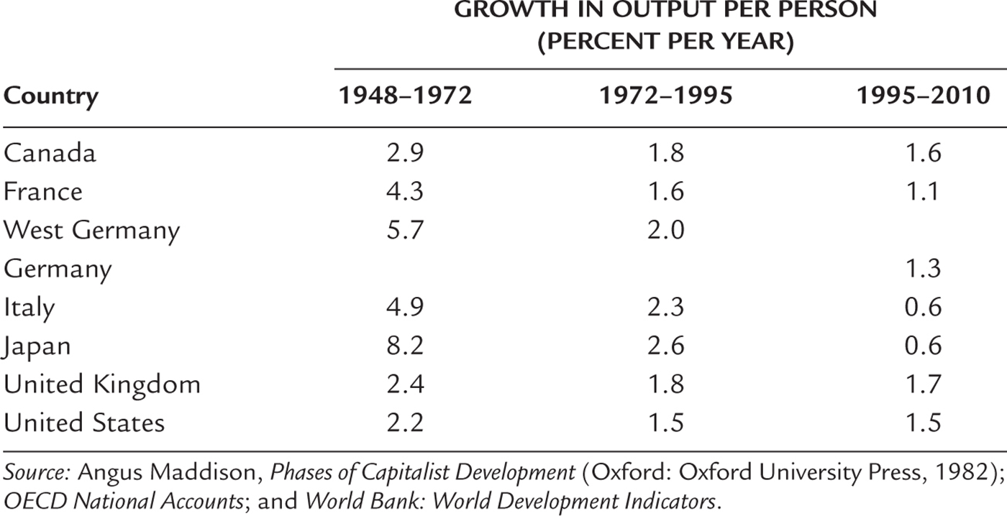
Productivity Slowdown
There was a worldwide slowdown in economic growth during 1972-1995. Why?
Notes:
Table 9.2 Growth Around the World

Slide 58
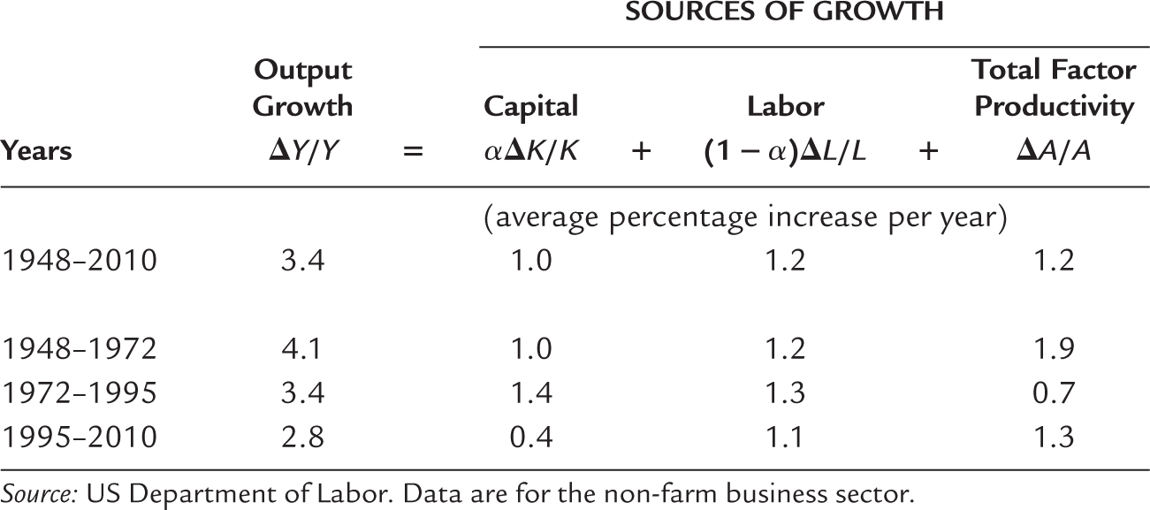
Growth Accounting
Table 9.3 Accounting for Economic Growth in the United States

