Slide 1
Ch. 9: Population Growth and Technological Progress
Part III Growth Theory: The Economy in the Very Long Run
Macroeconomics, 11th Edition, by N. Gregory Mankiw
ECO 62 Instructor: Udayan Roy

Slide 2
IN THIS CHAPTER, YOU WILL LEARN:
How the Solow-Swan economy is affected by:
population growth
exogenous technological progress
How an economy behaves when there are no diminishing returns to capital accumulation
How growth models can make technological progress depend on human choices

Slide 3
Population Growth in the Solow-Swan Model
Recall that in Chapter 8 we assumed a constant population. That’s about to change.

Slide 4
New Population Assumptions
Consider an economy that is exactly like the Solow-Swan economy of Chapter 8, but with one difference.
In Chapter 8, we assumed that:
every worker is immortal,
never has any kids, and
nobody knows how they were born.
Now we assume:
each worker has n kids every period.
Those kids become adult workers in the very next period and, like all other adult workers, have n kids of their own.

Slide 5
Dynamics: what time is it?
Recall from Ch. 8 that we attach a subscript to each variable to denote what date we’re talking about
For example:
k_{t} denotes the economy’s per worker stock of capital on date t and
k_{t+1} denotes the per worker stock of capital on date t + 1

Slide 6
How does per worker capital change?
A worker has k_{t} units of capital on date t
He/she produces y_{t} = f(k_{t}) = Ak_{t}^{α} units of output and …
… adds sy_{t} units of capital (to his/her capital stock) through saving …
… and loses δk_{t} units of capital through depreciation
So, each worker accumulates k_{t} + sy_{t} − δk_{t} units of capital on date t + 1
Does this mean k_{t+1} = k_{t} + sy_{t} − δk_{t} as in Ch. 8?
Not quite!

Slide 7
Population Growth
The Solow-Swan model with population growth assumes that each worker has n kids in each period
The kids become adult workers themselves in the period immediately after they are born
and, like every other worker, have n kids of their own
and so on

Slide 8
Population Growth
Let the growth rate of any variable x be denoted x_{g}. It is calculated as follows:
Therefore, the growth rate of the number of workers, L_{g}, is:
$L_{g}=\frac{\left(n+1\right)−1}{1}=n$
So, when each adult has n kids per period, the rate of population growth is also n.

Slide 9
How does per worker capital change?
Recall that, each individual has k_{t} units of capital on date t …
… and accumulates k_{t} + sy_{t} − δk_{t} units of capital on date t + 1
… which he/she shares equally with his/her n kids
(and the kids born at time t become adult workers at time t + 1).
Therefore, the per worker capital stock at time t + 1 is: $k_{t+1}=\frac{k_{t}+s∙y_{t}−δ∙k_{t}}{1+n}$

Slide 10
Dynamics: algebra
$k_{t+1}=\frac{k_{t}+s∙y_{t}−δ∙k_{t}}{1+n}$
Using this equation and other information about the production function, population growth and depreciation, we would be able to use information about the current level of k to predict the entire future of the economy!

Slide 11
Dynamics: algebra
$k_{t+1}=\frac{k_{t}+s∙y_{t}−δ∙k_{t}}{1+n}$
We also saw earlier that in the Cobb-Douglas case, y = f(k) = Ak^{α}.
Therefore, we get:
$k_{t+1}=\frac{k_{t}+s∙A∙k_{t}^{α}−δ∙k_{t}}{1+n}$
As in Ch. 8, if we know k₁, we can use the above equation to calculate k₂. We can then use the calculated value of k₂ to calculate k₃.
And so on and on, for ever and ever!

Slide 12
Dynamics: algebra to graphs
Although this is the basic Solow-Swan dynamic equation, a simple modification will help us analyze the theory graphically.
Now we are ready for graphical analysis.

Slide 13
Dynamics: graph
This graph is the same as the graph we saw in Ch. 8 except that break-even investment was δk in Ch. 8 but is (δ + n)k now.

Slide 14
Break-even investment
(δ + n)k = break-even investment, the amount of investment necessary to keep k constant
Break-even investment includes:
δ k to replace capital as it wears out
n k to equip new workers with capital
(Otherwise, k would fall as the existing capital stock is spread more thinly over a larger population of workers.)

Slide 15
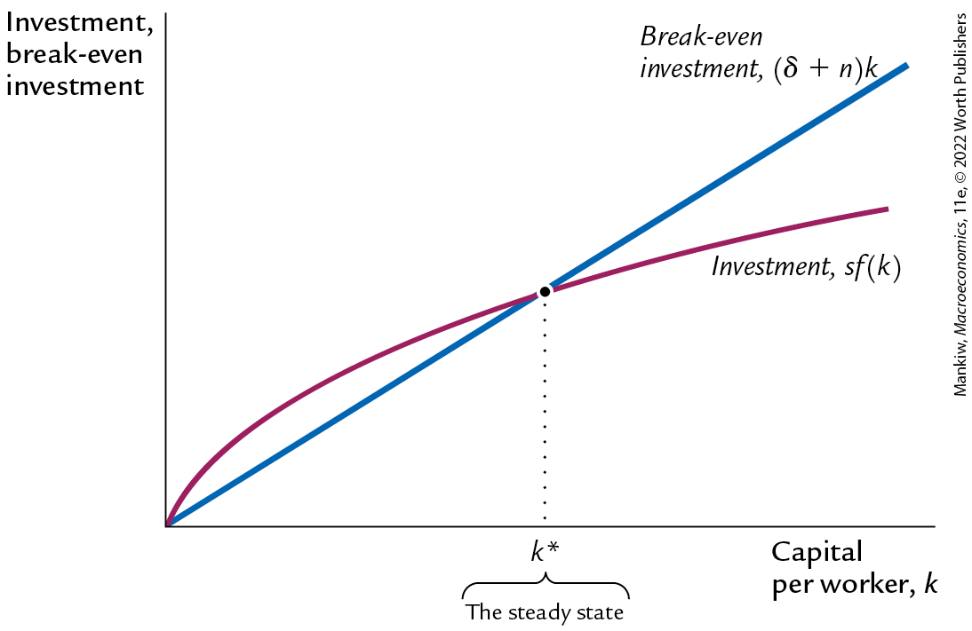
The Solow-Swan model diagram
So, we once again end up with the prediction that there will be no economic growth in the long run
Regardless of the initial level of capital per worker, the economy will end up at the steady-state capital per worker.
Very disappointing.

Slide 16
The impact of population growth
But one advantage of introducing population growth is that we can use the model to make a testable prediction of the effect of population growth on capital per worker.
An increase in n causes an increase in break-even investment, leading to a lower steady-state level of k.

Slide 17
Prediction
The Solow-Swan model predicts that countries with higher population growth rates will have lower levels of capital per worker in the long run.
This implies lower income per worker as well.
Q: Are the data consistent with this prediction?
A: Yes!
See next slide
Notes:
This and the preceding slide establish an implication of the model.

Slide 18
Faster population growth: evidence
This chart, though included in the 9th edition of the course’s textbook, has been dropped from the 10th and 11th editions.

Slide 19
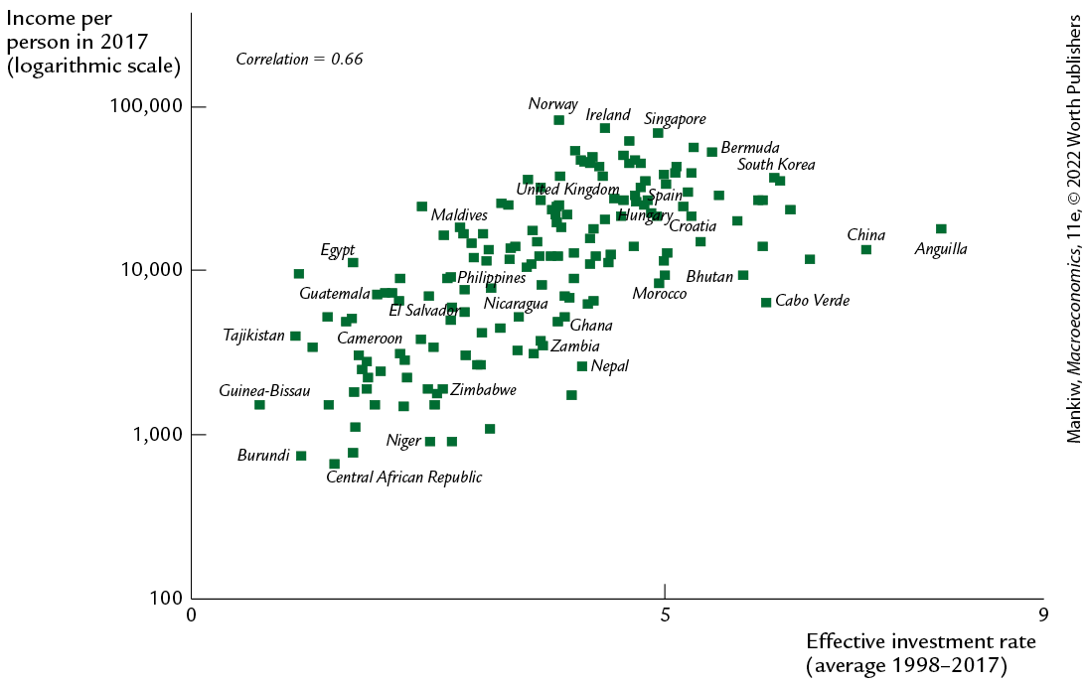
International evidence on effective investment rate and income per person
The effective investment rate on the horizontal axis is s/(δ + n), where s is the investment rate, δ is the depreciation rate and n is the population growth rate.
Slower population growth makes the effective investment rate higher.
The chart shows that higher effective investment rates are associated with higher income per person, as predicted by the Solow-Swan theory of this chapter.
Notes:
Note: This is looking at effective investment rate; not savings and population growth separately. In a few slides, the argument will be made that population growth causes economic growth.

Slide 20
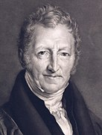
Alternative perspectives on population growth, part 1
Thomas Malthus (1798)
Predicted that population growth will outstrip the Earth’s ability to produce food, leading to the impoverishment of humanity.
Since the time of Malthus, world population has increased six fold, yet living standards are higher than ever.
Malthus neglected the effects of technological progress.

Slide 21
Alternative perspectives on population growth, part 2
Michael Kremer (1993)
Argues that population growth helps economic growth.
More people = more geniuses, scientists, and engineers = faster technological progress.
Evidence from very long historical periods shows that:
as world population growth rate increased, so did the rate of growth in living standards.
historically, regions with larger populations have enjoyed faster growth.
Notes:
Michael Kremer, “Population Growth and Technological Change: One Million B.S. to 1990,” Quarterly Journal of Economics 108 (August 1993): 681–716.
Charles Jones has a new paper on declining population: “The End of Economic Growth? Unintended Consequences of a Declining Population”

Slide 22
Alternative perspectives on population growth: Kremer

Slide 23
Bonus Section: Steady-State Algebra for Solow-Swan with Population Growth

Slide 24
The Steady State: Algebra
We have seen that, at the steady state, capital added is equal to capital destroyed:
sf(k) = (δ + n)k.
For the Cobb-Douglas case, this becomes: sAk^{α} = (δ + n)k.
Therefore, $\frac{sA}{δ+n}=\frac{k}{k^{α}}$.
Therefore, $\frac{sA}{δ+n}=k^{1−α}$.
Therefore, $k={\left(\frac{sA}{δ+n}\right)}^{\frac{1}{1−α}}$ at the steady state.
This is an exact repeat of the steady-state algebra of Ch. 8, except that δ + n replaces δ everywhere.

Slide 25
The Steady State: Capital per Worker
We’ll denote all steady state quantities with an asterisk (*).
So, $k^{∗}={\left(\frac{sA}{δ+n}\right)}^{\frac{1}{1−α}}$.
Recall that in Ch. 8, we had $k^{∗}={\left(\frac{sA}{δ}\right)}^{\frac{1}{1−α}}$.
This is an exact repeat of the steady-state algebra of Ch. 8, except that δ + n replaces δ everywhere.

Slide 26
The Steady State: Output per Worker
In Ch. 8, we got $y^{∗}={\left(\frac{s}{δ}\right)}^{\frac{α}{1−α}}A^{\frac{1}{1−α}}$.
Now, it is $y^{∗}={\left(\frac{s}{δ+n}\right)}^{\frac{α}{1−α}}A^{\frac{1}{1−α}}$.
This is an exact repeat of the steady-state algebra of Ch. 8, except that δ + n replaces δ everywhere.

Slide 27
The Steady State: Investment per Worker
In Ch. 8, we got, $i^{∗}=δ^{−\frac{α}{1−α}}∙{\left(sA\right)}^{\frac{1}{1−α}}$.
Now, it is $i^{∗}={\left(δ+n\right)}^{−\frac{α}{1−α}}∙{\left(sA\right)}^{\frac{1}{1−α}}$.
This is an exact repeat of the steady-state algebra of Ch. 8, except that δ + n replaces δ everywhere.

Slide 28
The Steady State: Consumption per Worker
In Ch. 8, we got, $c^{∗}=\left(1−s\right)∙{\left(\frac{s}{δ}\right)}^{\frac{α}{1−α}}A^{\frac{1}{1−α}}$.
Now, it is $c^{∗}=\left(1−s\right)∙{\left(\frac{s}{δ+n}\right)}^{\frac{α}{1−α}}A^{\frac{1}{1−α}}$.
This is an exact repeat of the steady-state algebra of Ch. 8, except that δ + n replaces δ everywhere.

Slide 29
Technological Progress in the Solow-Swan Model
This model shows that the Solow-Swan predicts perpetually rising living standards once technological progress is added to the model. However, this technological progress is exogenous (not explained by decisions made by the members of the society).

Slide 30
Adding technological progress into the Solow-Swan Model
In the Solow-Swan model of Chapter 8,
the production technology is assumed unchanging.
income per capita is predicted to be constant in the steady state.
Neither point is true in the real world:
1950–2019: U.S. real GDP per person grew by a factor of over 4.
Notes:
Source: Data used to construct Figure 1-1 and some simple calculations.

Slide 31
Recap: Solow-Swan with Population Growth
Variable | Symbol | Steady state behavior
Capital per worker | k | Constant
Income per worker | y = f(k) | Constant
Saving and investment per worker | sy | Constant
Consumption per worker | c = (1 – s)y | Constant
Labor | L | Grows at rate n
Capital | K | Grows at rate n
Income | Y = F(K, L) | Grows at rate n
Saving and investment | sY | Grows at rate n

Slide 32
The Sad Lesson of Solow-Swan
It is an undeniable fact that our standards of living increase over time
Yet, Solow-Swan cannot explain this!
Why?
Solow-Swan relies on capital accumulation as the only means of progress
We must introduce some means of progress other than capital accumulation

Slide 33
Technological Progress
Maybe Solow-Swan fails to show economic progress because there is no technological progress in it
We need to create a theory with technological progress in it
But how?

Slide 34
Technological Progress
Think of technological progress as each adult having n children who need to eat and g children who don’t eat
Very strange, but humor me
All children born at time t – whether eaters or non-eaters – become adults at time t + 1, go to work, and have children of their own (n eaters and g non-eaters), and so on and on
This is a model or metaphor for technological progress.
It represents the idea that technological progress helps humans get more work done.

Slide 35
Technological Progress
Think of technological progress as each adult having n children who need to eat and g children who don’t eat
Very strange, but humor me
All children born at time t – whether eaters or non-eaters – become adults at time t + 1, go to work, and have children of their own (n eaters and g non-eaters), and so on and on
Effective labor (eaters and non-eaters) grows at the rate n + g
The number of eaters grows at the rate n
The number of non- eaters grows at the rate g

Slide 36
Technological Progress
Think of technological progress as each adult having n children who need to eat and g children who don’t eat
Very strange, but humor me
All children born at time t – whether eaters or non-eaters – become adults at time t + 1, go to work, and have children of their own (n eaters and g non-eaters), and so on and on
The eaters consume their unsaved income (1 – s)y_{t}.
The non-eaters donate their unsaved income to the eaters (who consume the donations they receive).

Slide 37
Solow-Swan and exogenous tech progress
Investment and break-even investment
δk (capital destroyed)
The idea is to imagine a world where people give birth to creatures who are just like them except that they don’t eat. Every birth of a non-eater is just like a burst of technological progress for the eaters. And, as is shown in the diagram, as we keep having these bursts of technological progress, the steady state keeps increasing. In effect, there is no steady state any more. We get perpetual growth.
sA₄k^{α}
sA₃k^{α}
sA₂k^{α}
sA₁k^{α} (capital added)
k₁*
k₂*
k₃*
k₄*
Capital per worker, k
Steady state

Slide 38
Technological Progress
So, as far as the accumulation of capital is concerned there is no difference between eaters and non-eaters.
An effective worker – that is, eater or non-eater – has k_{t} units of capital on date t
He/she produces y_{t} = f(k_{t}) = Ak_{t}^{α} units of output and …
… adds sy_{t} units of capital (to his/her capital stock) through saving …
… and loses δk_{t} units of capital through depreciation
So, each effective worker accumulates k_{t} + sy_{t} − δk_{t} units of capital on date t + 1

Slide 39
Technological Progress
On date t + 1, each effective worker shares his/her k_{t} + sy_{t} − δk_{t} units of capital with the n + g kids he/she had at date t.
Therefore, we get $k_{t+1}=\frac{k_{t}+s∙A∙k_{t}^{α}−δ∙k_{t}}{1+n+g}$ as our new equation.
And, as before, for the purpose of graphical analysis, we can rewrite the above equation as:
$∆k_{t}≡k_{t+1}−k_{t}=\frac{s∙A∙k_{t}^{α}−\left(δ+n+g\right)k_{t}}{1+n+g}$.
Note that our dynamics equations are the same as the ones for the Solow-Swan model with population growth except that n has been replaced by n + g.

Slide 40
Solow-Swan With Technological Progress
The analysis of the Solow-Swan model with population growth earlier in this chapter can now be repeated exactly as before but with just one change: n becomes n + g.

Slide 41
Dynamics: Technological Progress
No technological change
Technological Progress
Simply replace the n we had earlier in this chapter with n + g. That’s it!

Slide 42
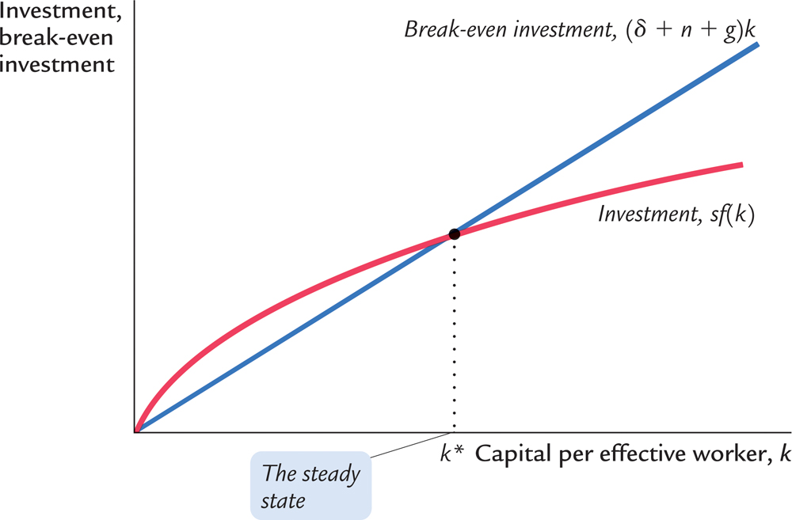
Dynamics: graph
In the long run, capital per effective worker and output per effective worker reach a steady state at k = k* and y = y* = f(k*)
$$k^{∗}={\left(\frac{s∙A}{δ+n+g}\right)}^{\frac{1}{1−α}}$$

Slide 43
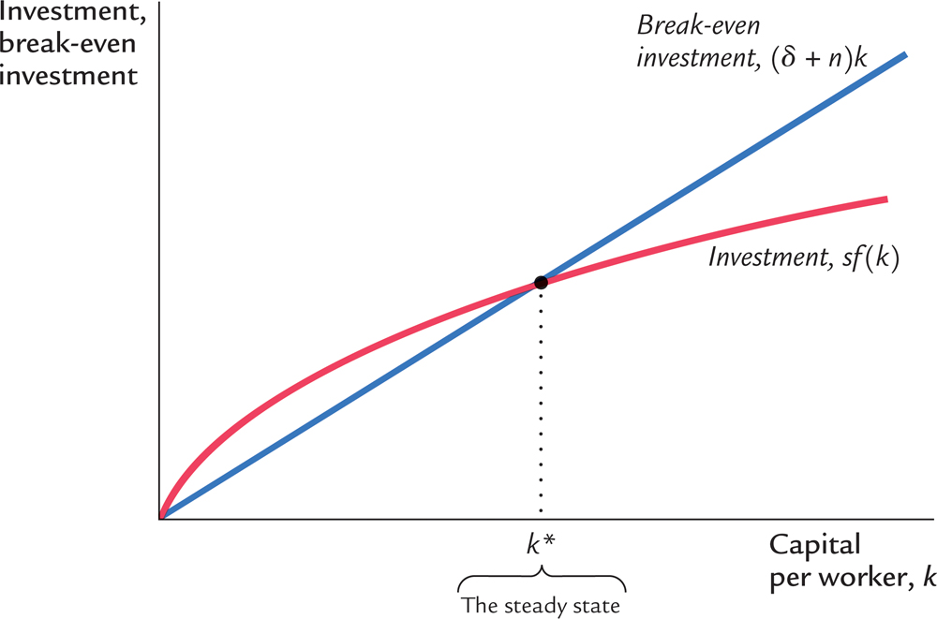
Dynamics: Technological Progress
$$k^{∗}={\left(\frac{s∙A}{δ+n}\right)}^{\frac{1}{1−α}}$$
$$k^{∗}={\left(\frac{s∙A}{δ+n+g}\right)}^{\frac{1}{1−α}}$$

Slide 44
Capital and effective labor in the long run
Now, total capital = capital per effective worker × number of effective workers
We have seen before that the growth rate of the product of two quantities is the sum of the growth rates of the two quantities
Therefore, the growth rate of total capital = growth rate of capital per effective worker + growth rate of the number of effective workers
We have just seen that in the long run growth rate of capital per effective worker is zero (steady state) …
… and the growth rate of the number of effective workers is n + g.
So, the growth rate of total capital = 0 + n + g = n + g.

Slide 45
Output, investment and consumption
Recall that:
Total output is given by the total production function: Y = F(K, L) and
This production function has constant returns to scale
Meaning that if both total capital and total effective labor (eaters and non-eaters) grow at the rate n + g, then Y would also grow at the rate n + g.
Therefore, in the long run, total output, Y, will grow at the rate n + g.
Therefore, total saving and investment, sY, will also grow at the rate n + g.
And similarly total consumption , (1 – s)Y, will also grow at the rate n + g.

Slide 46
Output, investment and consumption per eater
Now recall that each effective worker—eater or non-eater—in each period has n kids who eat.
So, the growth rate of the number of eaters is n.
Now, output per eater = total output/number of eaters
Recall that the growth rate of the ratio of two variables = growth rate of the numerator – the growth rate of the denominator
Therefore, the growth rate of per-eater output = the growth rate of total output – the growth rate of the number of eaters = n + g – n = g > 0.

Slide 47
Output, investment and consumption per eater
The growth rate of per-eater output = g > 0.
Therefore, per-eater saving and investment will also grow at the rate g.
And similarly per-eater consumption will also grow at the rate g.
Now, what I have been calling “eaters” here are really us, humans.
The “non-eaters” were put into the story to represent technological progress.

Slide 48
Rising living standards in the long run!
When we imagine that we have the ability to create entities who will work like us, save and invest like us, and reproduce like us, but donate their uninvested output to us humans, we are really talking about what economists call labor-augmenting technological progress.
As we have just proved that, in a Solow-Swan economy with labor-augmenting technological progress, consumption per eater grows at the rate g > 0, we have proved that this version of the Solow-Swan theory can explain rising living standards in the long run.

Slide 49
Solow-Swan With Technological Progress
Variable | Symbol | Steady state behavior
Capital per effective worker | k | Constant
Income per effective worker | y = f(k) | Constant
Saving and investment per effective worker | sy | Constant
Consumption per effective worker | c = (1 – s)y | Constant
Effective Labor | L | Grows at rate n + g
Capital | K | Grows at rate n + g
Income | Y = F(K, L) | Grows at rate n + g
Saving and investment | sY | Grows at rate n + g
Consumption | C = (1 – s)Y | Grows at rate n + g
Number of humans |  | Grows at rate n
Output per human |  | Grows at rate g
Saving and investment per human |  | Grows at rate g
Consumption per human |  | Grows at rate g

Slide 50
Progress, finally!
We have just seen that if we introduce technological progress in the Solow-Swan theory of long-run growth, then in the economy’s steady state
Per-human output and per-human consumption both increase at the rate g, which is the rate of technological progress
This is a major triumph for the Solow-Swan theory

Slide 51
Beyond the Solow-Swan Model: Endogenous Growth Theory: The Basic AK Model
We just saw a modified Solow-Swan model in which per-worker output grows at the rate of technological progress. But that rate is exogenous; that is, mysterious and inexplicable. We need to explain the rate of economic growth. First, a model with constant returns to capital. It’s called the AK model.

Slide 52
Endogenous growth theory
Solow-Swan model:
Sustained growth in living standards is g, the rate of technological progress.
The rate of technological progress, g, is exogenous.
Endogenous growth theory:
In this set of models, the growth rate of productivity and living standards is endogenous.
Notes:
In the Solow-Swan model, the long-run economic growth rate equals the rate of technological progress, which is exogenous in the model. Hence, the Solow-Swan model is basically saying, “all I can tell you is that growth in living standards depends on technological progress. I have no idea what drives technological progress.”
Endogenous growth theory tries to explain the behavior of the rates of technological progress and/or productivity growth rather than merely taking these rates as given.

Slide 53
The basic model
Capital per worker is k.
Per-worker production function: y = Ak
where A is the amount of output for each unit of capital
A is exogenous and constant
Per-worker Saving and Investment: sy
Depreciation: δk
Therefore, increase in per-worker capital: Δk = sy − δk
So, the growth rate of k is $\frac{∆k}{k}=sA−δ$.
Notes:
This is an extremely simple model yet has a powerful implication (to be developed below).

Slide 54
The basic model
And as y = Ak we get the growth rate of per-worker output: $\frac{∆y}{y}=\frac{∆k}{k}=sA−δ$
If sA > δ, then per-worker income will grow forever at the rate sA – δ
Investment is the “engine of growth.”
The long-run growth rate depends on s, the rate of investment.
Recall that in Solow-Swan model, s does not help growth.
Notes:
Y and K grow at the same rate because A is constant.
Discussion:
The return to capital is the incentive to invest. If capital exhibits diminishing returns, then the incentive to invest decreases as the economy grows. Hence, investment cannot be a source of sustained growth.
However, in this model, MPK does not fall as K rises, so the incentive to invest never declines; people will always find it worthwhile to save and invest over and above depreciation, so investment becomes an engine of growth.
The $64,000 question:
Does capital exhibit diminishing or constant marginal returns? The answer is critical, for it determines whether investment explains sustained (i.e. steady-state) growth in productivity and living standards. See the next slide for discussion.

Slide 55
The AK Model: Non-decreasing Returns to Capital and Endogenous Growth
Investment and break-even investment
sAk (capital added)
In the AK model, the “capital added” graph is a straight line because we have non-decreasing returns to capital. In the Solow-Swan model
By contrast the “capital added” graph is concave and curved.
For this reason, while the Solow-Swan model yields a steady state, the AK model has perpetual growth.
δk (capital lost)
Δk = (sA – δ)k₁ > 0
k₁
Capital per worker, k

Slide 56
Does capital have diminishing returns or not?
It depends on the definition of capital.
If capital is narrowly defined (only plant and equipment), then yes.
Advocates of endogenous growth theory argue that knowledge is a type of capital.
So, even labor is in a sense capital
If so, then constant return to capital is more plausible, and the model we have just discussed may be a good description of economic growth.

Slide 57
Beyond the Solow-Swan Model: Endogenous Growth Theory: A Two-Sector Model
We just saw a modified Solow-Swan model in which per-worker output grows at the rate of technological progress. But that rate is exogenous; that is, mysterious and inexplicable. We need to explain the rate of technological progress. We need to make the rate of technological progress endogenous.

Slide 58
Take Solow-Swan and add research
Let’s revisit the Solow-Swan model with technological progress that we saw earlier in this chapter
Recall that there were two types of (effective) workers: eaters and non-eaters.
In that model, consumption per person grew in the steady state at the exogenous rate g, which is the number of non-eater kids every effective worker—eater or non-eater—had in every period.
Now, let’s modify that model economy

Slide 59
Take Solow-Swan and add research
Assume that in each period, each effective worker needs to spend a fraction u of his/her time to produce g non-eater kids.
u is assumed exogenous
The number of non-eater kids each effective worker has in each period, g, is now assumed to increase in u. That is, g = g(u), an increasing function
The downside of spending more time making non-eater kids is less output of the final good
A worker with k_{t} units of capital produces (1 – u)f(k_{t}) units of the final good

Slide 60
Take Solow-Swan and add research
The saving and investment per effective worker is then s(1 – u)f(k_{t})
So, each effective worker ends up with k_{t} + s(1 – u)f(k_{t}) – δk_{t} of capital that he/she shares at time t + 1 with the n + g kids he/she had at time t.
Therefore, $k_{t+1}=\frac{k_{t}+\left(1−u\right)∙s∙A∙k_{t}^{α}−δ∙k_{t}}{1+n+g}$ is our new growth equation.
For graphing, this equation becomes $∆k_{t}≡k_{t+1}−k_{t}=\frac{\left(1−u\right)∙s∙A∙k_{t}^{α}−\left(δ+n+g\right)k_{t}}{1+n+g}$.

Slide 61
Take Solow-Swan and add research
Investment and break-even investment
(δ + n + g)k_{t}
(1 – u)sf(k_{t})
This is the only difference compared with the Solow-Swan model of exogenous technological progress that we saw earlier in this chapter.
k*
Capital per effective worker, k
$$∆k_{t}=\frac{\left(1−u\right)∙s∙A∙k_{t}^{α}−\left(δ+n+g\right)k_{t}}{1+n+g}$$
Steady state

Slide 62
Take Solow-Swan and add research
It should be straightforward to see that in this model we get the same result we saw in the Solow-Swan model with exogenous technological progress (earlier in this chapter): output per person and consumption per person grows at the rate g in the long run.
But there are two differences:
g is not exogenous anymore. Instead, g = g(u). So, the growth of consumption per person increases with the time spent producing non-eater kids, which can be interpreted as effort spent on technology research
The output of the final good decreases when more time is given to research

Slide 63
Take Solow-Swan and add research
Investment and break-even investment
(δ + n + g(u₂))k
(δ + n + g(u₁))k capital lost
Time spent on producing non-eater children, u, can be interpreted as time spent on technology research.
When u increases, the long-run growth of income per person g(u) increases.
However, steady-state capital per effective worker, k*, decreases and steady-state output per effective worker, (1 – u)∙f(k*), also decreases.
So, one upside and two downsides!
(1 – u₁)sf(k) capital added
(1 – u₂)sf(k)
$$∆k_{t}=\frac{\left(1−u\right)∙s∙A∙k_{t}^{α}−\left(δ+n+g\left(u\right)\right)k_{t}}{1+n+g\left(u\right)}$$
k₂*
k₁*
Capital per effective worker, k

Slide 64
Facts about R&D
Much research is done by firms seeking profits.
Firms profit from research:
Patents create a stream of monopoly profits.
There is extra profit in being first on the market with a new product.
Innovation produces externalities that reduce the cost of subsequent innovation.
Much of the new endogenous growth theory attempts to incorporate these facts into models to better understand technological progress.
Notes:
An excellent quote on p. 222 is relevant to fact #3: Isaac Newton once said, “If I have seen further, it is by standing on the shoulders of giants.”

Slide 65
Is the private sector doing enough R&D?
The existence of positive externalities in the creation of knowledge (“standing on the shoulders of giants”) suggests that the private sector is doing too little R&D.
The existence of negative externalities in the creation of knowledge (“stepping on others’ toes”) suggests that the private sector is doing too much R&D.
The positive externality is thought to be stronger.
Estimates suggest that the social return to R&D ≥ 40 percent per year
Much higher than the 6 percent per year return to physical capital
Thus, many believe the government should encourage R&D.

Slide 66
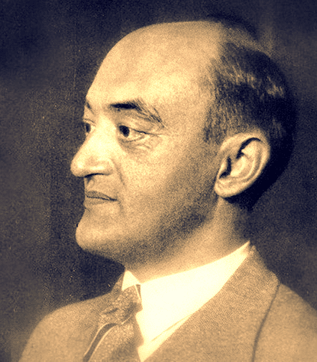
Economic growth as “creative destruction”
Joseph Schumpeter (1942) coined term “creative destruction” to describe displacements resulting from technological progress:
The introduction of a new product is good for consumers but often bad for incumbent producers, who may be forced out of the market.
Examples:
Luddites (1811–1812) destroyed machines that displaced skilled mill workers in England.
Walmart reduces prices for consumers and makes its owners rich but displaces many mom-and-pop stores.

Slide 67
Solow-Swan Model
Video: https://youtu.be/eVAS-t83Tx0 (Intro to the Solow Model of Economic Growth)
Video: https://youtu.be/SljsIacQDbc (Physical Capital and Diminishing Returns)
Video: https://youtu.be/LQR7rO-I96A (The Solow Model and the Steady State)
Video: https://youtu.be/SVWX4Xjl4Os (Human Capital & Conditional Convergence)

Slide 68
Growth and Ideas
Video: https://youtu.be/-yPDlowSL1w (The Solow Model and Ideas)
Video: https://youtu.be/1mXBg-BVrJ0 (The Economics of Ideas)
Video: https://youtu.be/Jz0VXPPZOiU (Patents, Prizes, and Subsidies)
Video: https://youtu.be/Ip2-Qa50uBI (Alex Tabarrok on how ideas trump crises)
Video: https://youtu.be/4zhPbYYaV5Y (The Idea Equation)

Slide 69
Solow-Swan (Going Deeper)
https://youtu.be/IqUuxEQUt4I (The Solow Model 1 - Introduction)
https://youtu.be/MmsSIoGtyh4 (The Solow Model 2: Comparative Statics)
https://youtu.be/lG4m_4uhZIA (The Solow Model 3 -- Taking the Model to Data)
https://youtu.be/S1xRi5JPDaM (The Solow Model 4 - Productivity)

